Slide 1
Male LUTS
GP training day
Mr Tamer El-Husseiny
Consultant Urological Surgeon
Imperial College Healthcare NHS Trust

Slide 2
Definitions
Benign prostate hyperplasia (BPH) - histological diagnosis
Benign prostate enlargement (BPE) - clinical diagnosis based on DRE.
Bladder outflow obstruction - clinical diagnosis
Lower urinary tract symptoms (LUTS) - constellation of symptoms which neither gender or organ specific

Slide 3
Overlapping area of Symptomatic BPH

Slide 4
BPH risk factors
Age
Androgens
Functional androgen receptors
Obesity ^{1,2}
Diabetes (& elevated fasting glucose)^{1,3,4}
Dyslipidaemia ^{5,6}
Genetic
Afro-Caribbean ???
1. Parsons et al J.Clin.End Met 2006
2. Kristal et al. J.Urol 2007
3. Gupta et al Urol 2006
4. Rhrmann et al Int J.Obes 2005
5. Parsons et al J.Urol 2007
6. Parsons et al BJU Int 2008

Slide 5
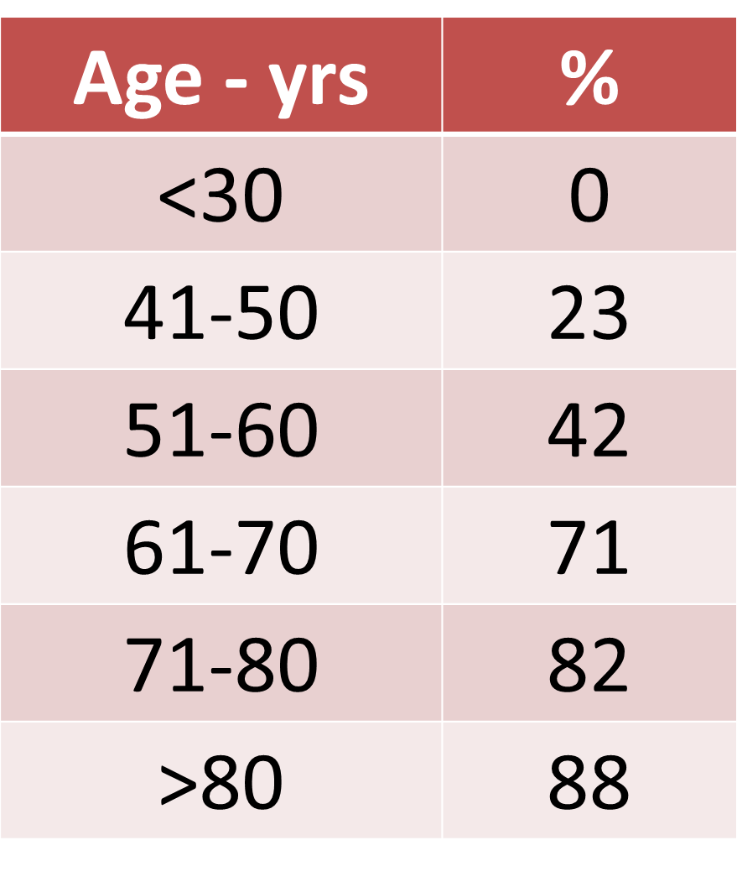
Prevalence
Histological prevalence rates of BPH at autopsy
Berry et al J Urol 1984:

Slide 6
Symptoms
Storage LUTS
Frequency
Urgency
Overflow incontinence
Voiding LUTS
Hesitancy
Poor steam
Straining
Incomplete emptying
Terminal dribbling
Double micturition

Slide 7
Primary care Assessment
History
LUTS - storage vs voiding
General medical history to identify other causes of LUTS
Review medications
IPSS and QoL score
0-7 mild; 8-19 moderate; 20-35 severe

Slide 8
IPSS
 | Not at all | Less than 1 time in 5 | Less than half the time | About half the time | More than half the time | Almost always | Your score
Incomplete emptying Over the past month, how often have you had a sensation of not emptying your bladder completely after you finish urinating? | 0 | 1 | 2 | 3 | 4 | 5
Frequency Over the past month, how often have you had to urinate again less than two hours after you finished urinating? | 0 | 1 | 2 | 3 | 4 | 5
Intermittency Over the past month, how often have you found you stopped and started again several times when you urinated? | 0 | 1 | 2 | 3 | 4 | 5
Urgency Over the last month, how difficult have you found it to postpone urination? | 0 | 1 | 2 | 3 | 4 | 5
Weak stream Over the past month, how often have you had a weak urinary stream? | 0 | 1 | 2 | 3 | 4 | 5
Straining Over the past month, how often have you had to push or strain to begin urination? | 0 | 1 | 2 | 3 | 4 | 5
Nocturia Over the past month, many times did you most typically get up to urinate from the time you went to bed until the time you got up in the morning? | 0 | 1 | 2 | 3 | 4 | 5
Quality of life due to urinary symptoms | Delighted | Pleased | Mostly satisfied | Mixed – about equally satisfied and dissatisfied | Mostly dissatisfied | Unhappy | Terrible
If you were to spend the rest of your life with your urinary condition the way it is now, how would you feel about that? | 0 | 1 | 2 | 3 | 4 | 5 | 6

Slide 9
IPSS is recommended for assessing symptom severity in LUTS
Cannot be used to establish BPH as patients with infection, tumour neurogenic bladder also have raised IPSS score.
Useful in gaining baseline symptoms and assessing progression and/or response to therapy

Slide 10
Examination

Slide 11
Abdomen - Palpable bladder
External genitalia - Meatal stenosis or palpable urethral mass
DRE - Prostate or rectal malignancy
Anal tone - Neurogenic causes

Slide 12
DRE
To establish approx. size of the gland
Size does not always correlate with symptom severity, degree of obstruction or treatment outcome.

Slide 13
Urine dip
Blood, glucose, protein, leuk and nitrites
Frequency volume chart
Patient with bothersome LUTS
Polyuria > 3L/day
Nocturnal polyuria > third of daily output during 8 hours of sleep

Slide 15
PSA
Prostate Ca can lead to LUTS
Prostate Ca commonly co-exists with BPH
Patient with a 10yr life expectancy the knowledge of prostate Ca may change the management of their BPH
Therefore should be performed in patients whom diagnosis of prostate Ca will alter clinical management.
Prostate feels abnormal
Offer to patients concerned about prostate Ca

Slide 16
Renal functions
Only if you suspect renal impairment
Palpable bladder
Enuresis
Recurrent UTIs
History of stones

Slide 17
Management in 1ry care
After initial assessment in non-bothersome LUTS
Reassurance, lifestyle changes and information
Review if symptoms deteriorate
Offer medical treatment

Slide 18
When to refer
Refer for specialist assessment if
Bothersome LUTS
Failure of conservative management
Failure of drug management
Complicated patients
Recurrent UTIs
Retention
Renal impairment
Suspected urological cancer

Slide 19
DoS

Slide 20
Male Lower Urinary Tract Symptoms – LUTS (Charing Cross Hospital) - Imperial College Healthcare
Clinic Type – Male Lower urinary tract symptoms (Male LUTS)
Clinical term searches are as follows;
Male Lower Urinary Tract Symptoms (Male LUTS)
BPH
Benign Prostate Hyperplasia
Overactive Bladder (OAB) symptoms in men
Retention
Bladder outflow obstruction
Urethral stricture
Currently on e-RS for our Male Lower Urinary Tract Symptoms – LUTS service.
Conditions Treated:
Male LUTS not responding to conservative management or drug treatment, in the absence of red flag symptoms of suspected cancer (haematuria and raised PSA) which should be referred according to the cancer network guidelines.
LUTS complicated by recurrent UTI’s, urinary retention or renal impairment

Slide 21
Procedures Performed:
TURP (Transurethral resection of the Prostate)
TURis/Bipolar TURP (Transurethral resection of the Prostate in Saline)
HoLEP (Holmium Laser Enucleation of the Prostate)
Urolift
Rezum
Prostate Artery Embolisation (PAE)
Suprapubic catheters
Long term catheters
Urethral stricture procedures
Urethral dilatation
Exclusions:
Women
Patients with suspected cancer should be referred according to the cancer network guidelines.
Patients under 16 years old.

Slide 22
Suggested Investigations:
As per NICE male LUTS guidelines:
Physical examination including DRE
Urine dipstick
Complete a urinary frequency volume chart
PSA testing if LUTS are suggestive of bladder outlet obstruction secondary to Benign prostatic enlargement, abnormal feeling prostate on DRE or to patients concerned about prostate cancer
Offer conservative treatment and lifestyle advice.
Offer trial of medical treatment/or combination as appropriate:
Alpha blockers: to men with moderate to severe LUTS.
Anticholinergics: to men to manage the symptoms of OAB
5-alpha reductase inhibitor: to men with LUTS who have prostates estimated to be larger than 30 g or a PSA level greater than 1.4 ng/ml, and who are considered to be at high risk of progression (for example, older men)
Consider completing an IPSS questionnaire

Slide 23
Management in 2ry care

Slide 24
2ry care assessment
Same as primary care
History
Examination
DRE
IPSS
Urine dip
Freq/vol chart
PSA
?renal function
Plus:
Flow rate & PVR
UDS/VUDS
Flexi cystoscopy

Slide 25
Uroflowmetry

Slide 26
Generally recommended as a specialist investigation before invasive treatment.
results are non specific for BOO. eg stricture, enlarged prostate, detrusor hypocontractility

Slide 27
Flow rate
Flow rate is inaccurate if voided volume <125-150mls
Single best non-invasive test. However no given ‘cut off’ value for the appropriateness of therapy
The peak flow rate (Qmax) is more specific for BPH than average flow rate (Qave)
Qmax decreases with age and decreasing voided volume
Qmax of >15mls/s have poorer treatment outcomes after prostatectomy than Qmax <15mls/s
Qmax <15mls/s does not differentiate between BOO and bladder decompensation
McConnell et al 1994

Slide 28
Postvoiding residual

Slide 29
78% normal men have a PVR <5mls
100% normal men have a PVR <12mls (diMare et al 1963)
PVR significant intra-individual variability
Does not correlate well with other signs or symptoms
The threshold of defining a poor PVR is uncertain
Unknown whether PVR can predict outcome of surgery
Unknown whether PVR can predict impending bladder or renal damage

Slide 30
Patients with significant PVR should be considered as a ‘safety parameter’
Patients with significant PVR should be monitored more closely if they select a nonsurgical option, especially if on antimuscarinicsred m

Slide 31
Cystoscopy
Indications:
Haematuria
Urethral stricture disease
Malignancy
Deciding on type of treatment to offer.
The relationship between the appearance of the urinary tract and treatment outcome is poor.
Not recommended to assess need for treatment.

Slide 32
Upper tract imaging
Imaging of the upper tracts is not recommended unless
Haematuria
UTI
Poor renal function
History of stones

Slide 33
Urodynamics
If initial evaluation, uroflowmetry and PVR are not suggestive of BOO urodynamics can be considered especially if surgery is being considered
Consider urodynamics if:
cannot void >150 mls
max flow rate >15mls/s
<50yrs or >80yrs
PVR >300
suspicious of neurogenic bladder dysfunction
bilat hydronephrosis
previous radical pelvic surgery
previous failed surgery

Slide 34
Urodynamics can distinguish those with low Qmax secondary to obstruction or detrusor hypocontractility
Therefore study should be performed when distinguishing between the two as it will affect therapy

Slide 35
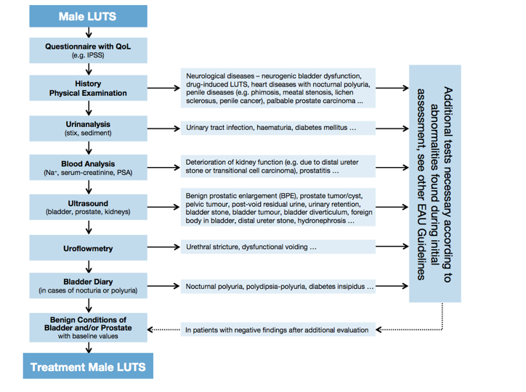

Slide 36
Medical Treatment

Slide 37
Offer when conservative measures have not worked or are not appropriate
Take into account co-morbidities and current treatments
Offer an alpha blocker to men with moderate to severe LUTS
Tamsulosin
Alfuzosin
Terazosin
Doxazosin
5 ARI for men with prostate > 30g or PSA >1.4 ng/ml and are at a high risk of progression (eg. older men)

Slide 38
Consider combination of alpha blocker and 5ARI for men with moderate to severe LUTS and prostates > 30g or PSA > 1.4ng/ml
No evidence to suggest 5ARI to reduce intra op bleeding at TURP
Consider an anti cholinergic for men with storage symptoms despite an alpha blocker
Prior to initiation of an anti cholinergic PVR should be assessed
Consider a late afternoon loop diuretic for men with nocturnal polyuria
Consider oral desmopressin for patients with nocturnal polyuria if other medical causes have been excluded and other treatments have failed

Slide 39
Treating Urinary Retention
Offer an alpha blocker to manage AUR before TWOC
Consider self- or carer-administered intermittent urethral catheterisation before offering indwelling catheterisation for men with chronic urinary retention.
Check serum creatinine and imaging of the upper urinary tract in men with chronic urinary retention
Consider offering intermittent or indwelling catheterisation before offering surgery in men with chronic urinary retention

Slide 40
Continue or start long-term catheterisation in men with chronic retention for whom surgery is unsuitable
Provide active surveillance (post void residual volume measurement, upper tract imaging and serum creatinine testing) to men with non-bothersome LUTS secondary to chronic retention who have not had their bladder drained.

Slide 41
Overactive Bladder

Slide 42
OAB
OAB is defined as urgency with or without urgency incontinence in the absence of any underlying pathology^{1,2}
Usually associated with increased daytime frequency and nocturia²
In Europe, approximately 17% of the adult population (aged ≥40 years) may experience OAB³
1. Abrams P. Urology 2003;62(Suppl 5B):28-37.
2. Abrams P et al. Neurourol Urodyn 2009;28(4):287.
3. Milsom I et al. BJU Int 2001;87(9):760-766.
Notes:
Prof Abrams from Bristol, ICS head

Slide 43
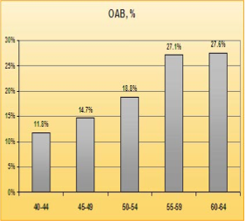
Worse with age?
Irwin D, et al. 2005 Impact of overactive bladder symptoms on employment, social interactions and emotional wellbeing in six European countries. British Journal of Urology International
Notes:
cross-sectional population-based survey of 11,521 individuals aged 40–64 years, conducted in France, Germany, Italy, Spain, Sweden, and the UK.

Slide 44
OAB treatment options
Conservative:
Life style modifications
Bladder retraining
PFMT
Biofeedback
Pharmacotherapy:
Anticholinergics
β3 agonists
Oestrogen
Surgical:
Botox
Neuromodulatiuon
Augmentation cystoplasty
Urinary diversion

Slide 45
OAB….When to refer
Failed medical treatment
Red flag signs: Haematuria, Recurrent UTI’s
Abnormal DRE +/- abnormal PSA
Previous surgery (hysterectomy, incontinence surgeries, etc..)
Difficulty emptying the bladder / high PVR
Symptomatic POP
Neurological conditions (spinal cord injury, stroke, MS, etc..)

Slide 46
Surgical treatment

Slide 47
Offer only if symptoms are severe or drug and conservative measure have failed or are inappropriate .
Discuss alternatives and outcomes from surgery.

Slide 48
BPH Surgery at Imperial Urology

Slide 49
What do we offer…
TURP - Monopolar/Bipolar
HoLEP
Urolift
Rezum
Prostatic stents
Prostate Artery Embolisation (PAE)

Slide 50
How do you decide…??
Prostate size/anatomy
Patient fitness
Patient preference

Slide 52
Monopolar TURP
Electrical current passes from the active electrode (connected to the resectoscope loop) to a grounding pad attached to the patient
Potential risks:
TUR syndrome (glycine).
skin burns
excessive heating of deep tissues
Inadvertent nerve stimulation (e.g. obturator reflex)
Cardiac pacemaker malfunction.
In an attempt to address some of these disadvantages, bipolar technology was proposed as an alternative treatment for BPH.

Slide 53
Monopolar TURP - the evidence
Meta-analysis of 20 contemporary RCTs with a maximum follow-up of five years
TURP: mean Qmax improvement (+162%), significant reduction in IPSS (-70%), QoL score (-69%) and PVR (-77%) 1.
Durable outcomes with a follow-up of 8-22 years. There are no similar data on durability for any other surgical treatment for BPO 2.
1. Ahyai, S.A., et al. Eur Urol, 2010.
2. Reich, O., et al. Eur Urol, 2006.

Slide 54
Bipolar TURP
The ground electrode is placed inside the sheath of a modified continuous-flow resectoscope, allowing the cutting current to pass directly between the wire loop and the sheath, or is built into the electrode itself.
This creates a high energy super-hot plasma arc that resects tissue.
Allows the use of physiological conductive solutions (NS) as an irrigating fluid.
No TURP syndrome

Slide 55
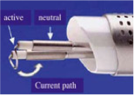
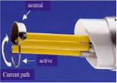
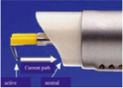
Bipolar loops
Gyrus with neutral electrode proximal to loop
Storz with neutral electrode opposite to loop
Olympus using the sheath as neutral electrode

Slide 56
Bipolar TURP - the evidence
B-TURP Vs M-TURP
RCT’s, Syst Rev & Cochrane Database Systs Rev
Results from > 40 RCTs.
No clinically relevant differences in long term f/u (up to 60 months) in efficacy (IPSS, QoL score and Qmax) .
B-TURP: Lower peri-operative morbidity (elimination of TUR-syndrome; lower clot retention/blood transfusion rates; shorter irrigation, catheterisation, and possibly hospitalisation times)
Mamoulakis, C., et al. Cochrane Database Syst Rev, 2014
Mamoulakis, C., et al. Eur Urol, 2009. 56: 798.

Slide 58
HoLEP

Slide 60
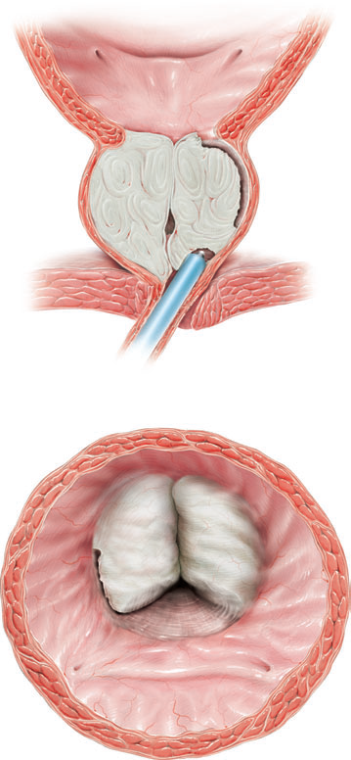
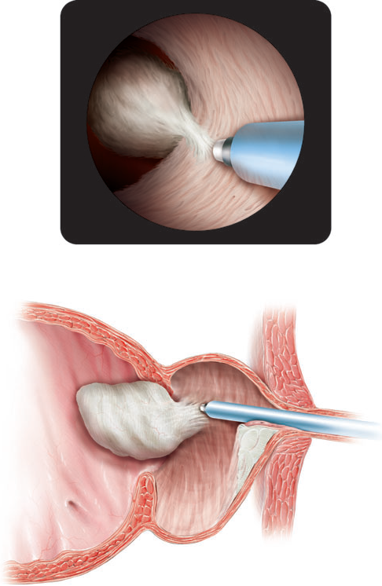

Slide 61
The holmium:yttrium-aluminium garnet (Ho:YAG) laser (wavelength 2140 nm) is a pulsed solid-state laser
Absorbed by water and water-containing tissues.
Tissue coagulation and necrosis are limited to 3-4 mm, which is enough to obtain adequate haemostasis.

Slide 62
HOLEP - the evidence
HOLEP Vs TURP
5 RCT (8 Publications)
Shorter hospital stay 1,2,4
Shorter catheterisation time 1,2,4,6,8
Reduced blood loss 6
Increased tissue resected 4
Less re-treatment rate 4.3% Vs 8.8%
Longer operation time 1,2,4,8
Equal: Efficacy (objective and subjective) 1,2,4,5,6,7,8 Impact on sexual function 3
1. Montorsi et al J.Urol 2004 2. Rigatti et al Urology 2006
3. Briganti et al J Urol 2006 4. Tan et al J.Urol 2003
5. Gilling et al Eur Urol 2006 6. Gupta et al BJUI 2006
7. Ahyai et al Eur Urol 2007 8. Mavuduru et al Urol Int 2009

Slide 63
HoLEP Vs Open prostatectomy
• 3 RCT (4 Publications)
– Shorter
• Hospital stay1,2
• Catheter duration1,2
• Blood loss1,2
– Equal
• Efficacy @ 2 years 1
• Efficacy @ 5 years 3
• Complication rate @ 5years 3
1. Naspro et al Eur Urol 2006
2. Kuntz et al J Endouol 2004
3. Kuntz et al Eur Urol 2008

Slide 65
If offering surgery for managing voiding LUTS presumed secondary to BPE, offer monopolar or bipolar transurethral resection of the prostate (TURP), monopolar transurethral vaporisation of the prostate (TUVP) or holmium laser enucleation of the prostate (HoLEP).
Perform HoLEP at a centre specialising in the technique, or with mentorship arrangements in place.
Less blood loss, shorter catheter time & hospital stay

Slide 67
HoLEP - our experience
NIPCOM approval - April 2016
60 cases to date
24 tertiary referrals
93% of cases discharged on day 1 post-operative.
100% catheter free at 3/12 f/u
Very satisfactory follow up results - comparable with published RCT’s
Complications -
1 Sepsis meningitis – ITU, treated with IV antibiotics
1 fluid overload – HF, treated with furosemide infusion
1 morcellator failure – managed with open cystotomy

Slide 68
HoLEP - summary
Safe procedure
Durable results
Mainly suitable for large prostates (alternative to open prostatectomy)
No TURP syndrome
Less bleeding
Shorter hospital stay
Shorter postoperative catheterisation period
Could be performed on anti coagulated patients
Reduced need for bladder irrigation
Ability to retrieve tissue for histological examination

Slide 69
Urolift (prostatic urethral lift)
Ambulatory minimally invasive, day-case treatment
Urolift is a short, <30-min procedure, performed under local anaesthetic or occasionally light sedation.
Creates an anterior channel in the prostatic urethra. Permanent intra-prostatic UroLift® implants are delivered to separate encroaching lateral prostate lobes and expand the urethral lumen.
Avoids the complications associated with tissue resection/enucleation/evaporation, and also avoids permanent side effects, such as sexual dysfunction.
No catheter post op

Slide 70
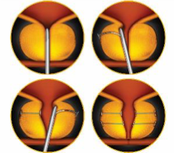
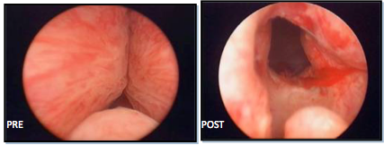

Slide 71
Prospective multicentre RCT
19 centers in North America and Australia, 206 subjects ≥ 50 years old with (IPSS ) > 12,(Qmax) ≤ 12 mL/s, and Pvol 30 cc-80 cc were randomised
Improvement in IPSS, QOL, and Qmax were durable through 5 years with improvements of 36%, 50%, and 44% respectively durable up to 5 years.
Surgical re-treatment was 13.6% over 5 years.
Adverse events were mild to moderate and transient.
Sexual function was stable over 5 years with no de novo, sustained erectile or ejaculatory dysfunction.
PUL offers a minimally invasive option in the treatment of LUTS due to BPH.

Slide 72
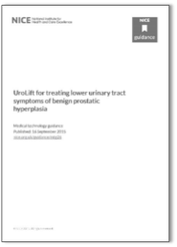
NICE guidance
The UroLift system may result in productivity savings for the NHS trusts from reduced length of stay in hospital and the associated inpatient & outpatients resource use since it can be done as a day case procedure compared to TURP.
The UroLift system relieves LUTS while avoiding the risk to sexual function associated with TURP and HoLEP.
Superior benefits in terms of minimal side effects, post-op complications and efficiency
UroLift should be considered for use in men with lower urinary tract symptoms of BPH who are aged 50 years and older and who have a prostate size of less than 100cm3.

Slide 73
Urolift - our experience
NIPCOM approval - October 2016
41 cases to date
All performed as day cases
No major complications
1 case needed a delayed middle lobe HoLEP.
1 post op retention - needed BNI
Last 23 cases under LA +/- sedation

Slide 74
Urolift - benefits to patients & hospital
Improved bed capacity (day case Vs 2 days hospital stay with TURP)
Improved theatre utilisation (<30min under LA)
April 2017: New Innovation and Technology tariff which has increased the Urolift tariff from £2100 to £2538 (compared to £1700 for TURP) . OPCS 4.8 code, effective from April 2017, identifies the procedure as M68.3 (endoscopic insertion of prosthesis to compress lobe of prostate). This code will map to HRG LB70
Rapid and sustained improvement in symptoms and flow
Durable benefits, with published data up to 5 years
Significantly reduced post-operative complications - more rapid return to daily activities

Slide 75
REZUM

Slide 77
Prospective, randomized, controlled, double-blinded study
197 patients
2:1 ratio allocation to treatment and control arms
Convective RF thermal therapy yielded IPSS improvements 160% when compared to control subjects at 3 months (p<0.0001).
surgical re-treatment rate was 4.4% over 3 years

Slide 78
CXH & Basingstoke joint data (BAUS 2018)
Ongoing prospective registry evaluation of the first 67 UK consecutive cases
All patients had moderate or severe symptoms. Prostate volumes ranged from 22-110mls; patients with an obstructing median lobe and those in retention were included.
36 of 67 procedures were performed under local anaesthetic with sedation. At 3 months, mean IPSS was significantly improved (-13.1 points) (p<0.001) as was IPSS-QOL (p<0.001).
Qmax improved by 6mL/s at 4-6 weeks, 8.4mL/s at 3 months, p<0.001 and 8.8ml/s at 6 months, p=0.002.. Prostate volume was reduced by 36% at 3 months, p=0.002.
After 1st TWOC, 56/67 (84%) were successful; at 3 months 65/67 (97%) were catheter free.
Two grade II complications (UTI requiring antibiotics), three grade 3b (two patients returned to theatre for clot retention 1 month post operatively, and one had transurethral resection of infected prostate tissue at 3 weeks).

Slide 79
Prostate Artery Embolisation (PAE)

Slide 80
 | Median improvement from baseline at 12 months n of subjects completing baseline and 12 months FU p value improvement from baseline
Measurement | PAE | TURP
IPSS | -10.0 n = 117 p = 0.000 | -15.0 n = 21 p = 0.000
IPSS QoL | -3.0 n = 126 p = 0.000 | -4.0 n = 26 p = 0.000
IIEF | 0.0 n = 94 p = 0.19 | 0.0 n = 15 p = 0.903
Qmax (ml/s) | + 3.0 n = 78 p = 0.000 | + 7.5 n = 10 p = 0.022
Prostate Volume (ml) | -25.0 (-27.8%) n = 165 p = 0.000 | N/A n = 0 p = N/A
Residual Volume (ml) | -15.0 n = 70 p = 0.071 | - 48.5 n = 12 p = 0.059

Slide 81
Prostatic stents

Slide 82
Future….
New LUTS pathway
CNS-led clinics
One stop clinics
More innovative minimally invasive, office-based treatments.
More procedures under LA as day cases
Better case selection - Patient/prostate tailored treatment….offer all suitable options

Slide 83
Questions?

