Slide 1
Falls & Postural Hypotension
Dr Colin Mitchell
Consultant Geriatrician, St Mary’s Hospital, Paddington

Slide 2
Falls Myths
UTIs cause falls
TIAs cause falls
“Patient denies loss of consciousness” is a diagnostically relevant sentence.
“Mechanical” falls are, like, a thing
You can differentiate falls from syncope
You can make a diagnosis from the history
Postural hypotension causes blackouts

Slide 3
Falls Myths
UTIs cause falls
TIAs cause falls
“Patient denies loss of consciousness” is a diagnostically relevant sentence.
“Mechanical falls” are, like, a thing
You can differentiate falls from syncope
You can make a diagnosis from the history
Postural hypotension causes blackouts

Slide 4
Falls Myths - Caveats
UTIs cause falls…
TIAs cause falls
“Patient denies loss of consciousness” is a diagnostically relevant sentence.“Mechanical falls” are, like, a thing…
You can differentiate falls from syncope
You can make a diagnosis from the history…
Postural hypotension causes blackouts…

Slide 5
Falls Myths – Well… ok
UTIs cause falls…
TIAs cause falls
“Patient denies loss of consciousness” is a diagnostically relevant sentence.
“Mechanical falls” are, like, a thing…
You can differentiate falls from syncope
You can make a diagnosis from the history…
Postural hypotension causes blackouts…

Slide 6
Diagnosing Falls vs Syncope

Slide 7
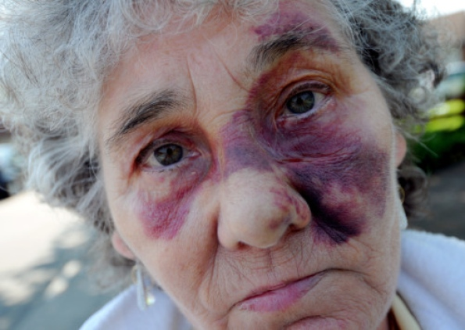
Mrs M: 88yo found on floor, denies LOC...
Notes:
So – we have an 88 year old lady who had a fall at home during the night
She’s not really sure how she fell, but doesn’t think she lost consciousness.
She sometimes feels unsteady when she stands up, and thinks she might have tripped, as her balance isn’t great.
She has a past medical history of hypertension, and mild Alzheimer’s. She also had a head and neck cancer, which was treated with surgery and radiotherapy 10 years ago. No alcohol.
She takes bendroflumethiazide and donepezil.
On examination, she has some bumps and bruises all over, especially her face, which you can see above. No fractures found and her hips are ok.
.

Slide 8
Everyone is a liar
So you need a collateral history…

Slide 9
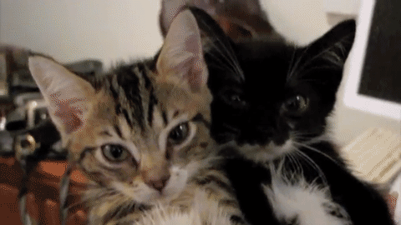
What is syncope?
Notes:
2 reasons to put this slide in:
cute!
The public perception is that this is fainting but its not because these cats don’t lose consciousness therefore witness accounts aren’t always reliable
Whereas Syncope essentially is a transient LOC due to failure of cerebral perfusion and oxygenation, which falls below threshold for consciousness.
history is important because it can provide some suggestive clues and patients may recall losing consciousness but in many cases episodes are associated with anmesia surround ing the event and so the presenting history is oftn not reliable

Slide 10
Everyone is a liar

Slide 11
What causes syncope? (ADULTS)
Notes:
Neurally-mediated 60%– vasovagal, carotid sinus hypersensitivity, situational
Orthostatic 15%– drug-induced, autonomic failure i.e. PD, DM
Cardiac arrhythmia 15% – bradycardic and tachycardic
Structural cardiac – valvular disease inc AS, HOCM, pulmonary HTN
This is representing adults generally – in older adults ALL of these things are more common, but orthostatic is proportionally a bit bigger.
(change blue)
So even though the bulk of investigation of syncope is based on excluding cardiac causes – it actually makes up only 15% of total syncope.

Slide 12
‘Serious’ Syncope
Most syncope is non life-threatening
Syncope during exercise is different
Syncope scores / rules pick out high risk cases typically based on:
ECG +/- cardiac markers*
Significant cardiac history
Low Hb
*Don’t routinely request troponin / BNP on unexplained falls

Slide 13
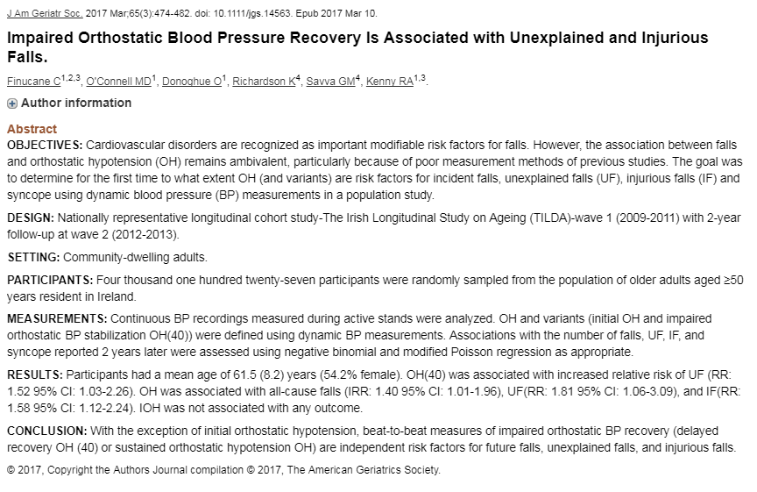
OH causes syncope YES OK, but…

Slide 14
Tests in Syncope / Unexplained falls
Everyone should have* (true / false):
24hr tape
L/S BP
Echocardiogram
24hr BP
Tilt test
Medication review
*Assuming ECG / cardiac exam / Hb normal

Slide 15
Tests in Syncope / Unexplained falls
Everyone should have* (true / false):
24hr tape
L/S BP
Echocardiogram
24hr BP
Tilt test
Medication review
*Assuming ECG / cardiac exam / Hb normal

Slide 16
JUST BY THE WAY
L/S BP should be performed on EVERY acute admission to hospital >65
How to do it:
Patient lies down quietly for 5 minutes, then check BP
Stand up, wait 40-60s, check BP
Err… that’s it!

Slide 17
How to think about falls & syncope

Slide 18
Geriatric Medicine
Complexity
Frailty
Functional / psychosocial
Non-specific presentations / syndromes
eg Falls, confusion…

Slide 19
mobility
As it relates to frailty

Slide 20
Before pathology, normality

Slide 21
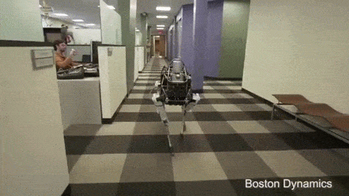
How to walk upright

Slide 22
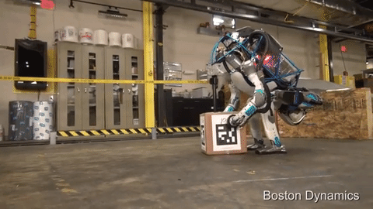
How to walk upright

Slide 23
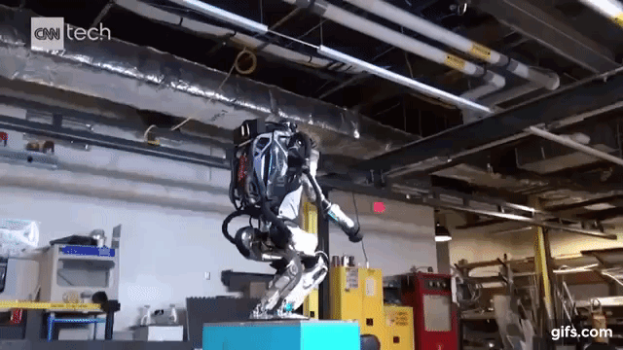
How to walk upright

Slide 24
I, for one, welcome our new robot overlords

Slide 25
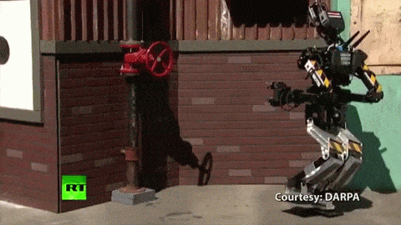
How not to walk upright

Slide 26
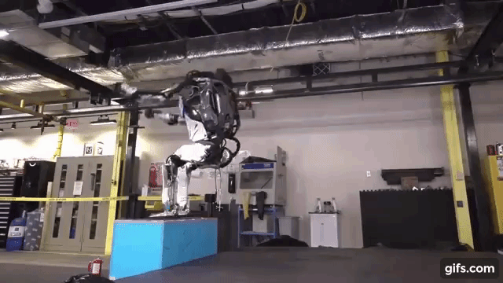
How not to walk upright

Slide 27
Balance : I/O
Inputs | Outputs
Vision | Skeletal Muscles
Vestibular (motion/rotation) | (Joints)
Joint position | Eye movements
Muscle stretch
Peripheral sensation (feet)

Slide 28
Balance : Processing
Inputs
Vision
Vestibular
Joint position
Muscle stretch
Peripheral sensation
Outputs
Skeletal Muscles
(Joints)
Eye movements

Slide 29
Balance : Processing
Inputs
Vision
Vestibular
Joint position
Muscle stretch
Peripheral sensation
Cerebellum
Outputs
Skeletal Muscles
(Joints)
Eye movements

Slide 30
Balance : Function
Inputs
Vision
Vestibular
Joint position
Muscle stretch
Peripheral sensation
Higher Brain Functions
Intentions & Plans
Concentration
Memory
Confidence / Fear
CNS
Outputs
Skeletal Muscles
(Joints)
Eye movements
Environment
Floor
Lighting
Obstacles
Distractions

Slide 31
Such confusion
Wow
So diagrams
???

Slide 32
Falls / Frailty: How to intervene

Slide 33
CGA: Comprehensive Geriatric Assessment
CGA works
Particularly
On inpatients in specialist units
To high-risk (pre-frail) outpatients (eg fallers)

Slide 34
What is CGA?
Needs based
Holistic
Multiprofessional
Time consuming!
Core elements:
Medical review
Medication review
Mobility
ADLs
Psychological / Cognitive

Slide 35
CGA: Not a list
A way of working / thinking

Slide 36
Mrs F

Slide 37
Background
Osteoarthritis, Hypertension, Type 2 Diabetes
Rx:
Paracetamol PRN, Ramipril, BFZ, Metformin, Amitryptilline
Lives alone, family live >1hr away
Best friend admitted to NH 6 months ago
Had a ‘mechanical’ fall in the street 3 months ago – minor injuries unit
Hasn’t had glasses checked for 3 years

Slide 38
Very exciting slide

Slide 39
Result of her fall

Slide 40
One does not simply
One does not simply
trip on a carpet

Slide 41
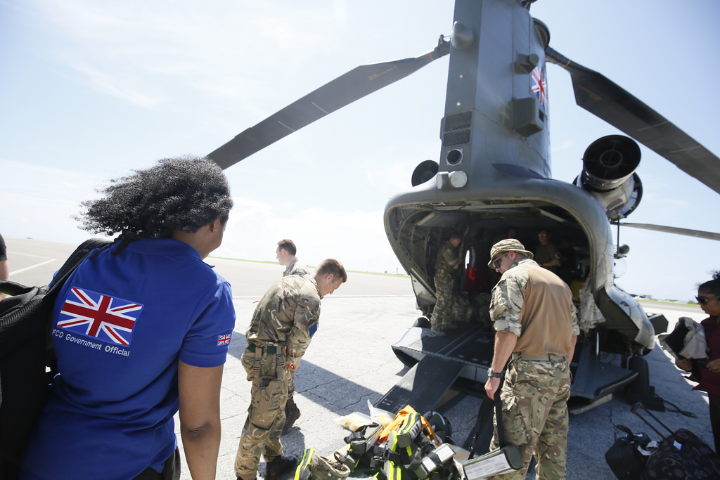
Let’s be engineers!

Slide 42
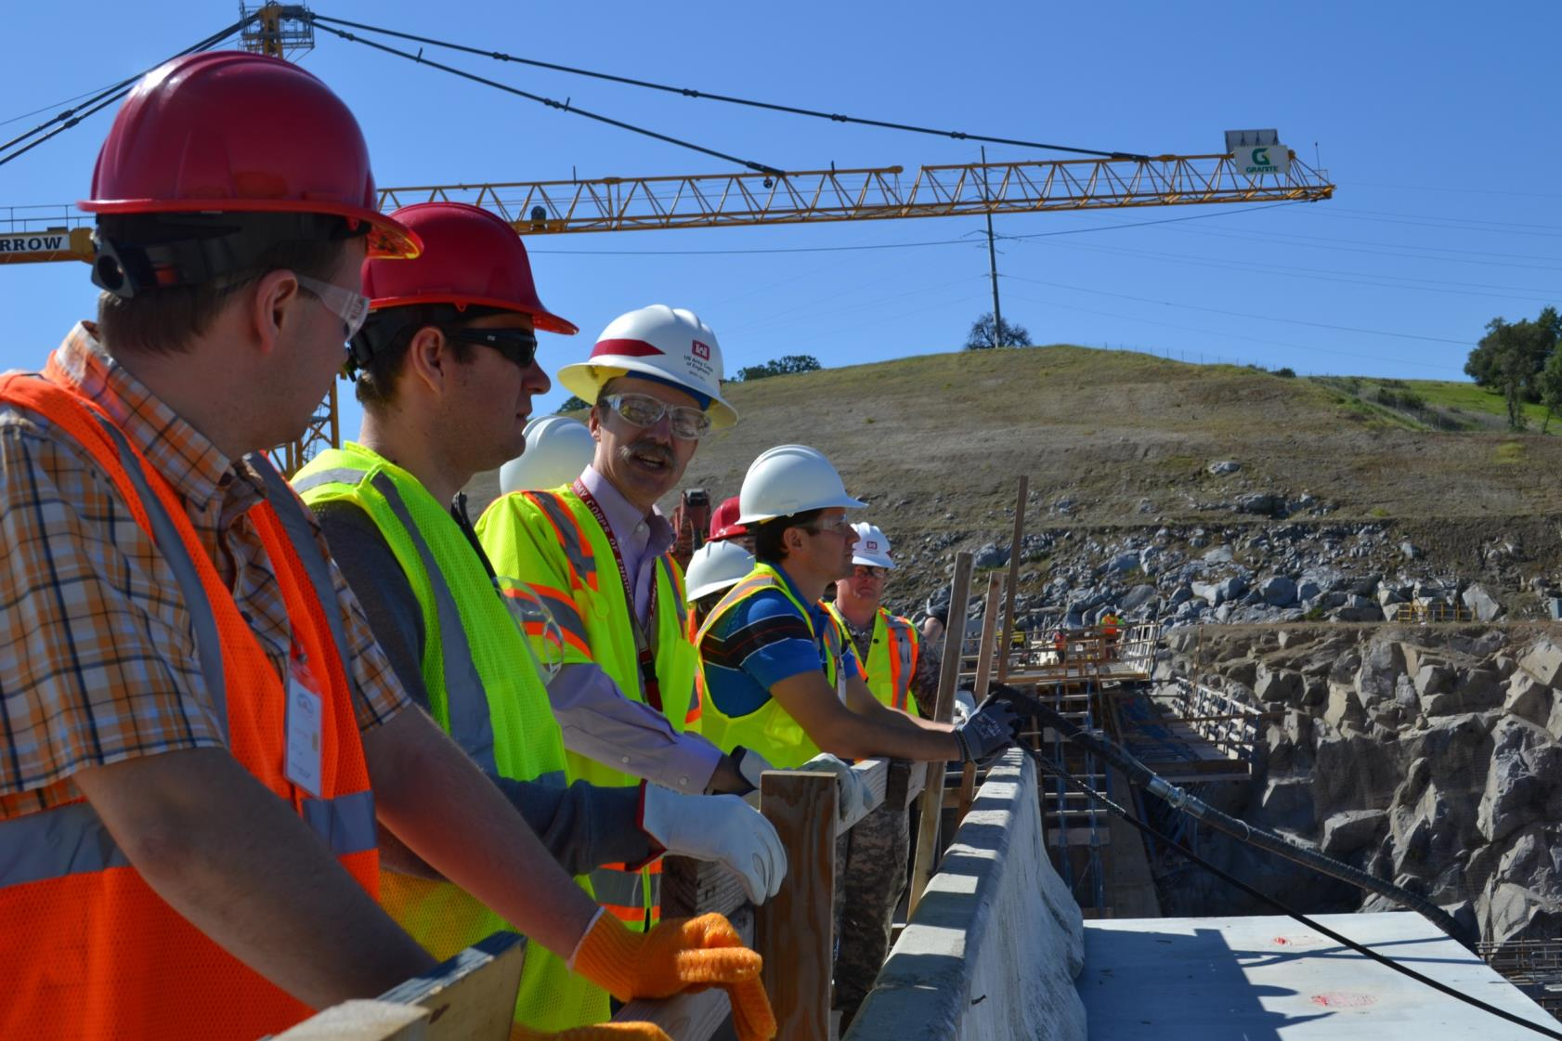
Let’s be engineers

Slide 43
Balance : Function
Inputs
Vision
Vestibular
Joint position
Muscle stretch
Peripheral sensation
Higher Brain Functions
Intentions & Plans
Concentration
Memory
Confidence / Fear
CNS
Outputs
Skeletal Muscles
(Joints)
Eye movements
Environment
Floor
Lighting
Obstacles
Distractions

Slide 44
Background
Osteoarthritis, Hypertension, Type 2 Diabetes
Stiff legs, fluctuating BP, numb feet
Rx:
Paracetamol PRN, Ramipril, BFZ, Metformin, Amitryptilline
Lives alone, family live >1hr away
Best friend admitted to NH 6 months ago
Had a fall in the street 3 months ago – minor injuries unit
Significantly reduced regular exercise
Lost confidence
Hasn’t had glasses checked for 3 years
Bifocals

Slide 45
Cause(s) of her fall
Environmental
Visual
Gait
Strength & fitness
Pain?
Peripheral sensory loss
Drops in blood pressure?
Medication?
Acute illness?

Slide 46
Balance : Function
Inputs
Vision
Vestibular
Joint position
Muscle stretch
Peripheral sensation
Higher Brain Functions
Intentions & Plans
Concentration
Memory
Confidence / Fear
CNS (and its perfusion)
Outputs
Skeletal Muscles
(Joints)
Eye movements
Environment
Floor
Lighting
Obstacles
Distractions

Slide 47
Could this fall have been prevented?
Decline was insidious
Multiple causes / risk factors – needs a holistic assessment
Fall in street may have been opportunity to recognise early frailty
Previous innocuous presentation but all RFs were already there
These were all called ‘mechanical’ falls
Presentations ≠ diagnoses!

Slide 48
In summary…
You probably already have most of the key knowledge about how to manage falls
You can make some diagnoses from the history but it has to be a REALLY GOOD history
That takes time, skill, and sometimes multiple sources (remember the kittens)
And you still need a L/S BP
Every faller needs some basic investigations: ECG, FBC, U&E
Every faller needs a multifactorial falls intervention
You can’t do this on your own, nor should you
But you can try to make a diagnosis & start a medication review

Slide 49
take home messages - General
Don’t say mechanical fall
Don’t say “patient denies loss of consciousness”
Don’t overdiagnose UTIs
Remember everyone is a liar (kittens)
Be comprehensive (work with a team)
Be an engineer and a problem-solver
Check L/S BPs
Review medications

Slide 50
Take Home Messages - Local
NICE say:
Everyone who has 1+ fall per year (on screening)
Any fall that results in a presentation to a healthcare service
…needs a multifactorial falls risk assessment
For most, this means a referral to the Community Falls Service (CLCH, therapy-led)
For the housebound, CIS (CNWL) may be more appropriate
And medical input (usually from GP) including medication review
For unexplained and complex cases, a referral to a Consultant-led Falls Clinic
Clear syncope, especially young / single-pathology patients, goes to Syncope Clinic (Cardio @ HH)

