Slide 1
Ambulatory Care
Dr Lucy Bingham
ED Consultant (Imperial)

Slide 2
Learning Objectives
Understand what AEC is
Understand what AEC does
Understand how to refer into AEC
Information about the pathways and conditions seen in AEC

Slide 3
The number one issue facing the NHS in England is reversing the ‘unsustainable’ rise in emergency hospital admissions" Nuffield Institute, 2010

Slide 4
How do I (we) see it…

Slide 5
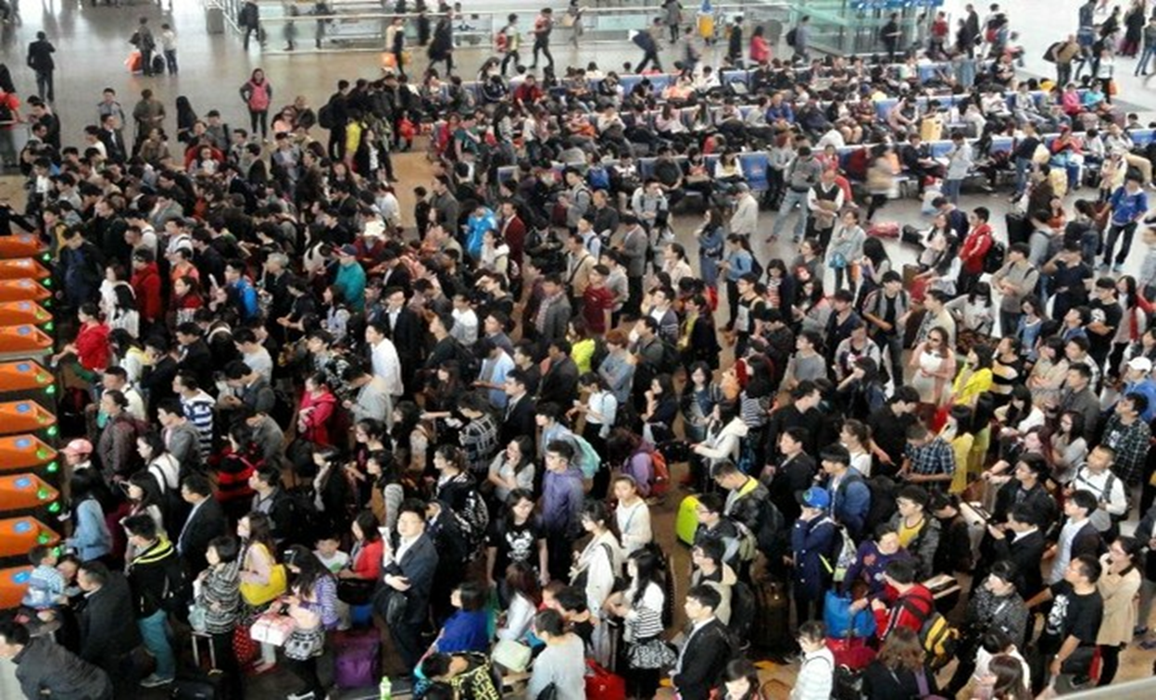
Just an average day in the ED

Slide 6
One Trust… Two Sites

Slide 7
Daily Staffing (Weekday)
Charing Cross
St Marys
Doctors:
9-19
13-22
Band 7: 9.30-22.00
Band 5/6: 8-20.30
HCA: 9.30-22.00
Admin
Doctors:
8-16
11-19
14-22
Band 6: 10-22.00
Band 5 x2: 8-20.30
HCA: 8-20.30
Admin

Slide 8
19,331
Cross Site

Slide 9
How do I refer?
PHONE!
Charing Cross – 020 3313 0734
St Mary’s – 020 3312 3196

Slide 10
It’s all just cellulitis, renal colic and DVTs?

Slide 11
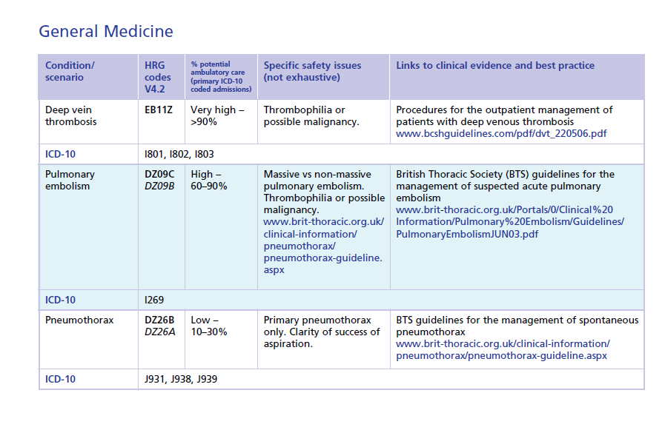
What would you send to AEC?

Slide 12
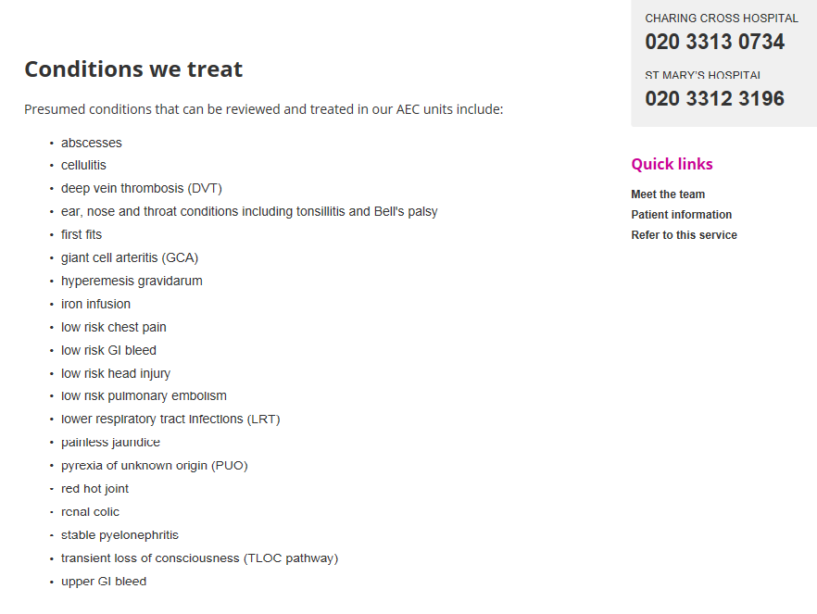

Slide 13
Suspected DVT
Signs or symptoms of uncomplicated below knee DVT.
Other causes excluded by history and examination.
Perform Wells score – if ≤1, DVT is unlikely and D-dimer can be performed. If D-dimer is negative, DVT is unlikely and another cause should be sought.
If Wells score is 2 or above, or D-dimer is positive, refer to AEC.
Consider giving NOAC or LMWH if AEC appointment is not the same day.

Slide 14
Suspected PE
Signs or symptoms PE, haemodynaically stable, saturations ≥ 96%OA (or normal for patient if they usually run low sats due to pre-existing pathology).
Other causes excluded by history and examination.
Consider giving NOAC or LMWH if AEC appointment is not the same day.

Slide 15
Cellulitis / pyelonephritis requiring antibiotics
Signs or symptoms of cellulitis, pyelonephritis or UTI.
Clinician deems that oral antibiotic treatment is likely to be inadequate.
Patient is haemodynamically stable.
Please note this service is only suitable if it is likely to be logistically possible for the patient to be assessed the same day in AEC.

Slide 16
Low risk chest pain
Chest pain in which ACS is thought to be unlikely but needs to be excluded.
Patient is haemodynamically stable.
Generally young people with no history of IHD and no significant risk factors.
These patients should be discussed with an AEC clinician at the time of referral to confirm suitability for assessment there.
Please note this service is only suitable if it is likely to be logistically possible for the patient to be assessed the same day in AEC.

Slide 17
Electrolyte abnormalities
Patients with hypo- or hypernatraemia, or hypo- or hypercalcaemia, who require assessment of the cause of the derangement, or IV correction of the abnormality.
Not suitable for those patients whose level of consciousness is impaired by the derangement, or who are likely to need admission due to the severity of electrolyte derangement.

Slide 18
Renal colic
Patients with symptoms and signs suggestive of acute renal colic.
Other causes excluded by history and examination.
If there is any haemodynamic instability, or any suspicion of ruptured or leaking AAA, these patients should be sent urgently to A&E.
Consider giving diclofenac 100mg PR at the time of referral if no contraindication.

Slide 19
Hyperemesis gravidarum
Symptoms and signs of hyperemesis gravidarum.
Other causes for symptoms excluded by history and examination.
Patient likely to need intravenous fluids and antiemetics (eg – signs of dehydration, not tolerating oral fluids or anti-emetics, continued nausea and vomiting associated with ketonuria or weight loss >5% body weight despite oral anti-emetics).
Patient is haemodynamically stable.

Slide 20
Temporal arteritis
Symptoms and signs suggestive of temporal arteritis.
Other causes excluded by history and examination.

Slide 21
Other services
Blood transfusion or IV iron replacement in patients with chronic iron deficiency anaemia who are unlikely to need admission for treatment (NB – not for investigation of IDA, or for those who may be having an acute GI bleed).
Investigation of other symptom complexes which might need relatively urgent investigation in otherwise well patients – please discuss with AEC clinician.

Slide 22
The Priorities?
Ask a patient…

Slide 24
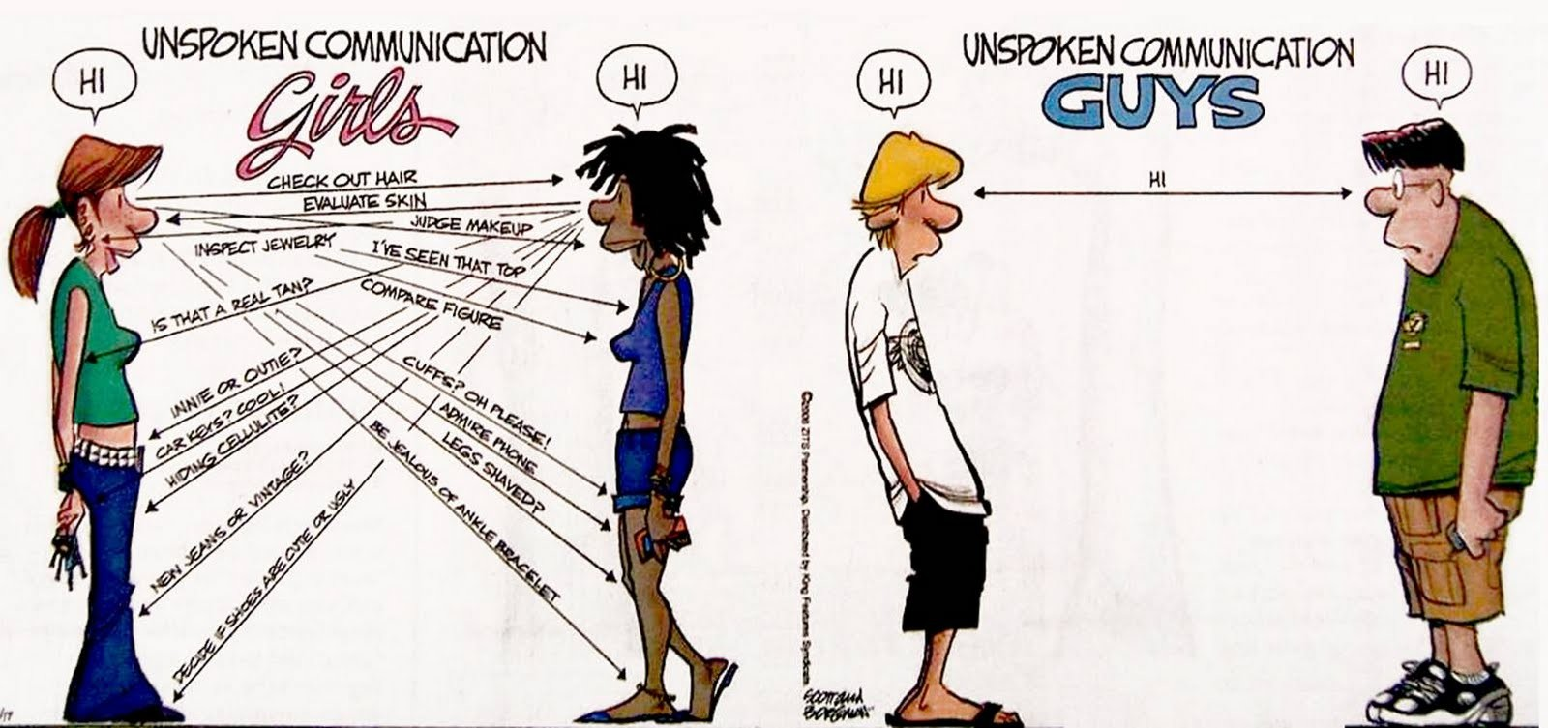
A little bit of Communication…

Slide 25
The Priorities?
Ask me…

Slide 26
The Patient Pathway
111 – GP – UCC – ED - AEC - Admission

Slide 29
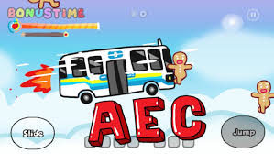
What’s in a name?

