Slide 1
The role of physiotherapy in the management of men’s lower urinary tract symptoms (LUTS)
Sarah Wolujewicz
Clinical Lead
Women’s & Men’s Health Physiotherapy
sarah.wolujewicz@nhs.net

Slide 2
Learning objectives
Physiotherapy assessment of male LUTS
Physiotherapy treatment - including pelvic floor muscle rehabilitation
Useful resources

Slide 3
Subjective Assessment
History
Bladder & bowel function
Sexual function
PMH
Medications
Social history

Slide 4
Common symptoms post-TURP
Urinary incontinence
  65% at 6 weeks post-op
  (MAPS trial, Glazener et al, 2010)
  55% at 3 months post-op
  (Emberton et al, 1996)
  *11% of these needed pads*
Erectile dysfunction
  17% (Donovan et al, 1997)
Notes:
Emberton et al audit – 3000 men

Slide 5
Common symptoms post-radical prostatectomy
Urinary incontinence
  80-90% initially; 5-60% at 3 months post-op (Hunskaar et al, 2002)
  89% at 6 weeks post-op (MAPS trial, Glazener et al, 2010)
Erectile dysfunction
  10-90% (Kirby et al, 1998)
Notes:
Emberton et al audit – 3000 men
Nocturia 63%
Frequency 56%
Hesitancy 47%
Urgency 34%
Incomplete emptying 30%
Dysuria 22%
Urge incontinence 17%
Stress incontinence 9%
Voiding symptoms
Hesitation
Straining
Weak Stream
Intermittent Stream
Incomplete Emptying
Terminal dribble

Slide 6
Common symptoms post-surgery
Stress urinary incontinence = is the complaint of involuntary leakage on effort or exertion, or on sneezing or coughing (International Continence Society, 2018)
  May leak on sit → stand
Urgency urinary incontinence
Notes:
Emberton et al audit – 3000 men

Slide 7
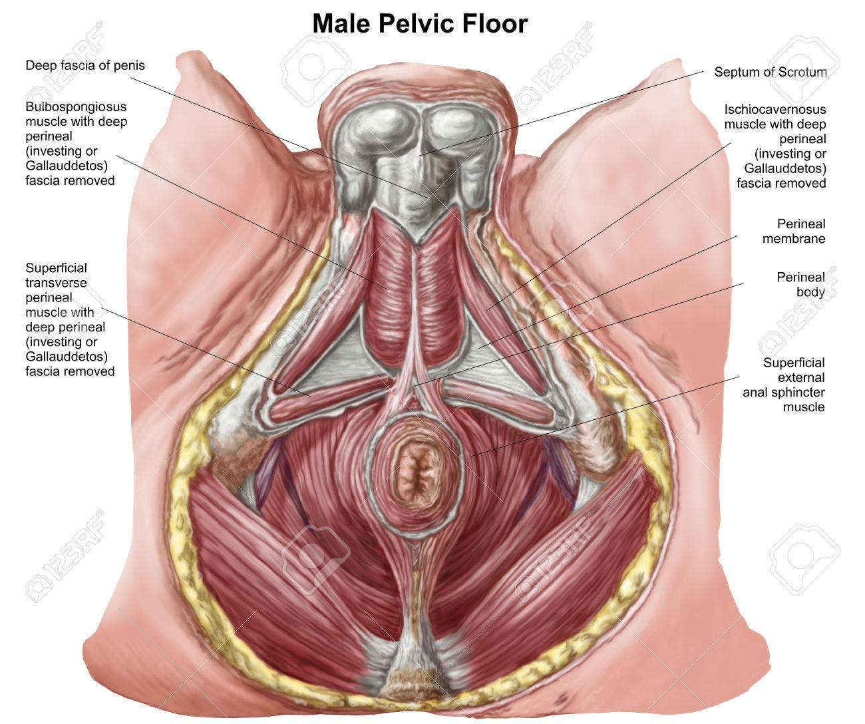
Objective Assessment: Pelvic floor assessment
LISTEN
LOOK
FEEL
Notes:
Deep PFM –
Superficial PFM – penile rigidity, pumps ejaculate, prevents PMD.
Look – skin, perineal lift, penile retraction and scrotal lift, cough – any UI?, cough with PFM contraction
Feel – ARE – power, endurance, reps, fast, coordination

Slide 8
Physiotherapy Treatment
Education
Pelvic floor muscle (PFM) rehabilitation
  Strengthening
  Downtraining?
The ‘knack’
PFM contraction post-void
Fluid advice
Bladder retraining
Voiding techniques
Address other problems – constipation
Notes:
PFMT – progressions, positions,
Knack v important

Slide 9

Physiotherapy: is it effective?
Post op
MAPS trial (Glazener et al, 2011) – similar improvements
Pre op
RCTS – PFME
Significant improvement
Notes:
Post-op – most men usually better within 1 year – but aim to improve asap, cost of pads, QOL, etc.
Men After Prostate Surgery trial – large multi centre trial (34 centres), 205 men radicals, 220 men TURPs.
Controls – knew about PFME, some were doing as part of standard care, at 1 year post-op, 50% radical controls and 20% TURP controls were doing PFMEs
Pre op – radicals - 62% dry vs controls 38% dry (Centemaro et al, 2009)

Slide 10

Useful resources
POGP https://pogp.csp.org.uk/

Slide 11
Thank you
Any questions?

Slide 12
References
Emberton, M. et al, (1996) The effect of prostatectomy on symptom severity and quality of life. British J. of Urology. 77 (2); p233-247
Glazener, C. et al (2011) Conservative treatment for urinary incontinence in Men After Prostate Surgery (MAPS): two parallel randomised controlled trials. Health Technology Assessment; 15 (24).

