Slide 1
Role of CNS in Imperial
Roisin Warden
Urology

Slide 2

Urology and Andrology CNS
Clinical nurse specialists
Benign LUTS – 2 nurses
GRS - 1
Stone – 1
Andrology -2
Uro -oncology - 8 specialising in renal, bladder and prostate

Slide 3
Benign CNS
There are currently 2 CNS in post
3N in CXH is a dedicated urology OPD
The clinic staff specialise in Urology
SMH OPD is a general clinic
Services we provide are diagnostic and treatment

Slide 4
Flow rates and PVR
Usually completed by the OP
To measure maximum urinary flow rate
This involves urine being passed into a special device which measures electronically how fast the urine is expelled
A graph is produced to facilitate assessment
Post void residual is measured using a bladder scanner.

Slide 5
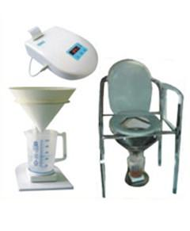
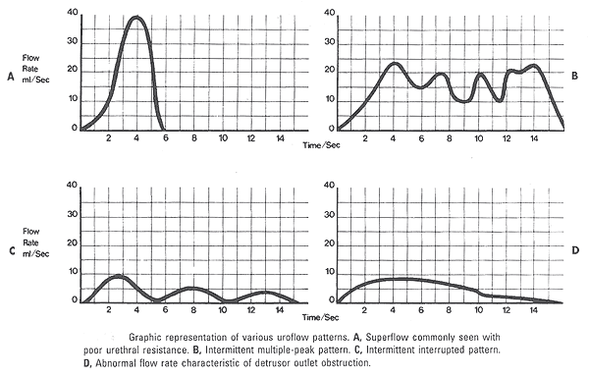
Flow rates and PVR

Slide 6
TWOC
Trial without catheter
Usually preformed by the OPD nurses
Complicated cases are preformed by the CNS
TWOC the patient is admitted in the morning and the catheter is removed
They are provided with drinks
They are given a jug and each void is recorded
A bladder scan is carried out
CNS are available for advice

Slide 7
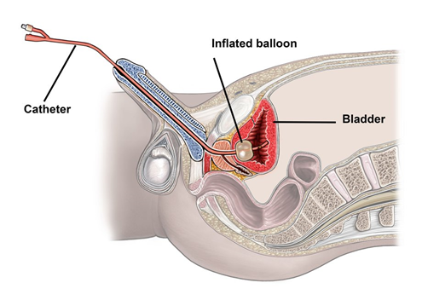
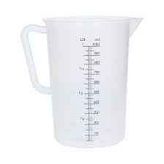
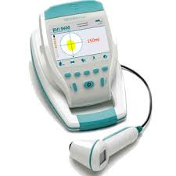
TWOC

Slide 8
TWOC
Successful – OPA or no action
Failed -Re-catheterise
-ISC
- Medication
- Clinic appointment
- Further tests i.e. flexible cystoscopy, UDS

Slide 9
Sheaths / Retracted penile pouches
Sometimes we recommend sheaths for men who are dribbling incontinent but are emptying their bladder and do not wish to ware pads
Sheaths are suitable for independent men as well as those in wheelchairs and with a more sedentary lifestyle.
They don’t work well if you have a short or retracted penis a retracted penile pouch is more suitable for these men
Must be measured to ensure the correct size and length

Slide 10
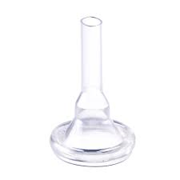
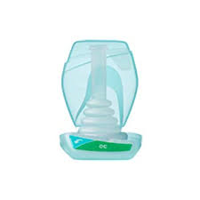
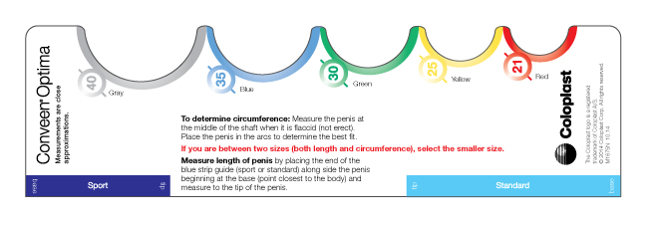
Product Advice

Slide 11
UDS
Any incontinence observed may be categorised as urodynamic SUI, detrusor over activity (DO) incontinence, a mixture of SUI/DO incontinence, or, rarely, urethral relaxation incontinence. Intravesical and intra-abdominal pressures while reproducing a patient’s symptoms.
Catheters are inserted into the bladder and rectum, the bladder is filled with a saline, the sensations are recorded on a graph.
This is reported and discussed at our MDT

Slide 12
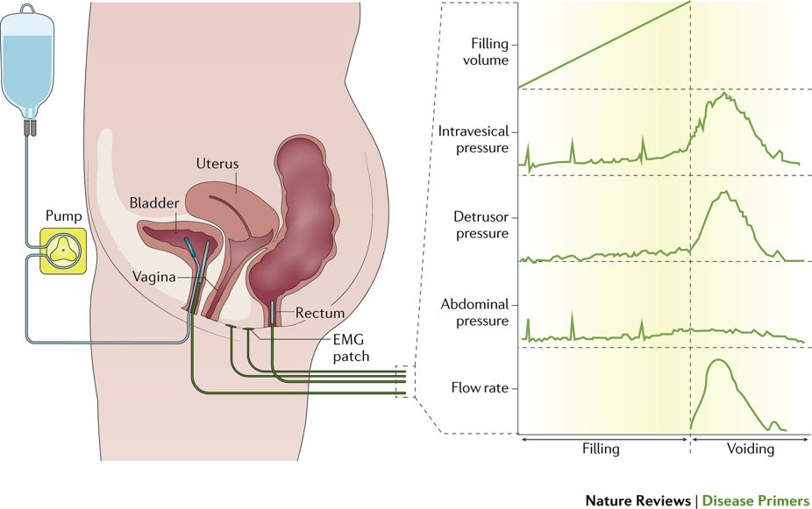
UDS

Slide 13
VUDS
The difference between UDS and VUDS
This is preformed in X-ray
The solution the bladder is filled with is a radio-opaque dye instead of saline
X-rays are carried out during the test and a video of the voiding phase

Slide 14
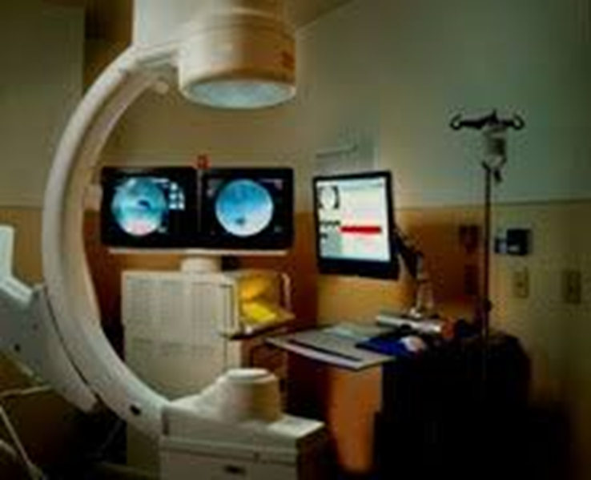
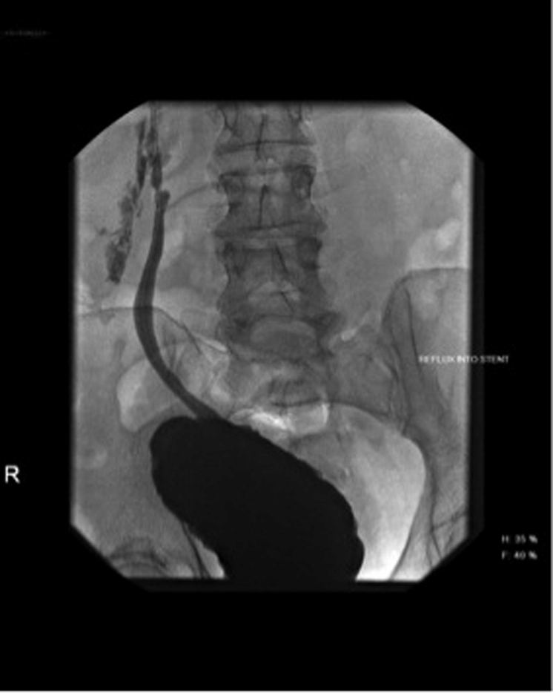
VUDS

Slide 15
UPP with clinical scientist
Urethral pressure profile
Urology A dataset used to determine the functional length, resting pressure, and maximal pressure of the urethral sphincter mechanisms
A catheter is inserted and slowly removed by a machine and the pressure is recorded
The test is repeated 2-3 times for a constant reading

Slide 16
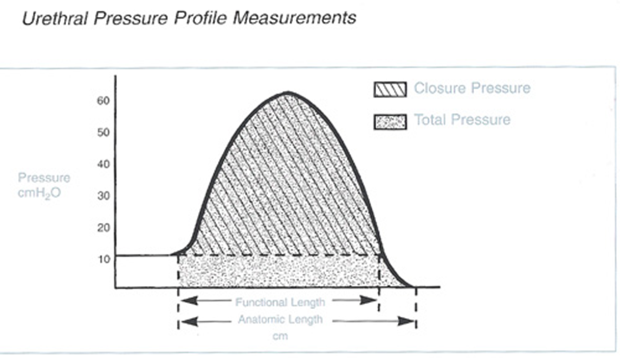
UPP

Slide 17
ISC – intermittent self catheterisation
Passing a thin hollow plastic tube (catheter) usually through the urethra into their bladder to drain urine with the catheter then being removed immediately
Usually taught by the OPD nurses
Complicated cases are taught by the CNS
Who is taught ISC
People with voiding or storage issues, resulting in retention of urine
Neurogenic i.e. MS, spinal cord injury
Non-neurogenic i.e. retention, incomplete bladder emptying
Requiring bladder washout i.e. after clamcystoplasy
Frequency can range from 1 a day to 5 a day

Slide 18
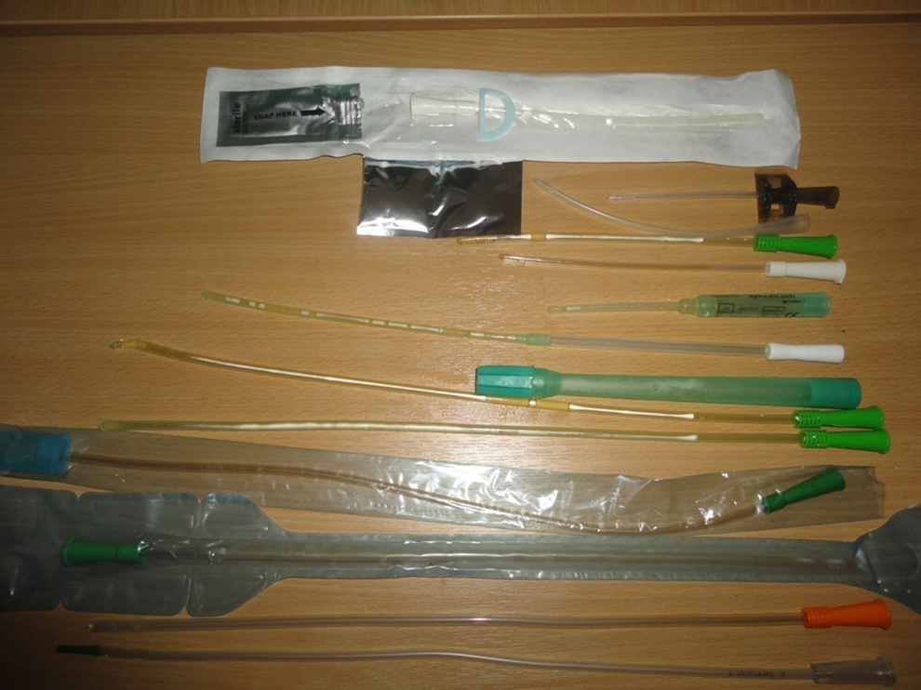

Slide 19
ISD – intermittent self dilatation and Meatal dilatation
It is ISC but with a larger catheter typically Ch16
It is used to prevent a urethral stricture re-occurring
Frequency can range from daily to weekly
Meatal dilatation – shorted dilators are used to dilate the meatus

Slide 20
Catheter changes
Catheter changes are usually preformed in the community however there are some cases they are referred from the community.
Typically difficult cases or those who are mobile.
Usually carried out by the OPD nurses
Complicated cases are taught by the CNS

Slide 21
Bladder Instillations
Instillation of medication for recurrent UTI’s and for Painful Bladder Syndrome
The catheter is inserted and the bladder emptied, the medication is instilled and the catheter removed. The patient is to hold the medication in the bladder for up to 2 hours.
6 Weekly instillations and monthly top ups, the duration of the top ups can vary from patient to patient.
Some patients who are competent in ISC have opted to self -administer them at home since they have become available on FP10

Slide 22
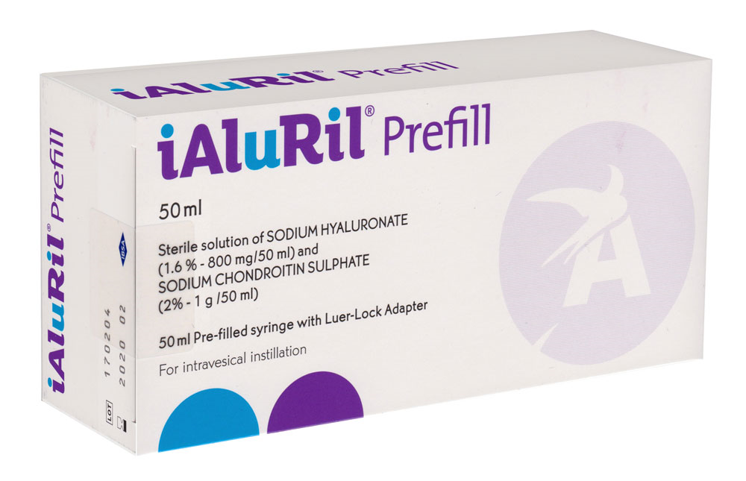
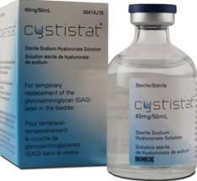
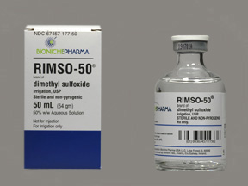
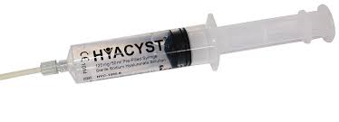
Bladder Instillations

Slide 23
PTNS (percutaneous tibial nerve stimulation)
It is used mainly for OAB but can be used for faecal incontinence also
A device is attached to the needle and delivers mild electrical impulses which travel up the nerves in the leg to the nerves that control the bladder
30-minute weekly sessions for 12 weeks.
Can only miss one treatment

Slide 24
PTNS (percutaneous tibial nerve stimulation)

Slide 25
Clinic in conjunction with Consultants
One stop clinic
General clinics
Assessing patients
Referring for tests
Discuss with the consultant

Slide 26
Nurse led clinic
LUTS
Post operative assessment
Assess if oral treatment has been successful
Post Botox to assess PVR and advise if ISC is needed
Activation of AUS

Slide 27
AUS – Artificial Urinary Sphincter
A fluid-filled cuff that fits around the urethra
A balloon in front of the bladder
A pump in male is in the scrotum or in the labia fro women
The cuff presses the urethra closed, so continence is achieved
To open or activate the AUS, the button is to be squeezed a couple of time and the water goes into the balloon enabling the cuff to be emptied therefore allowing the urine to drain out of the bladder
Up 2 minutes to empty your bladder

Slide 28
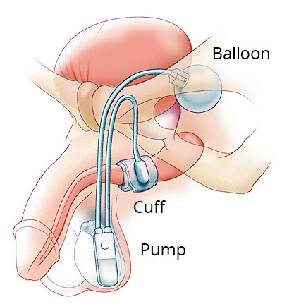
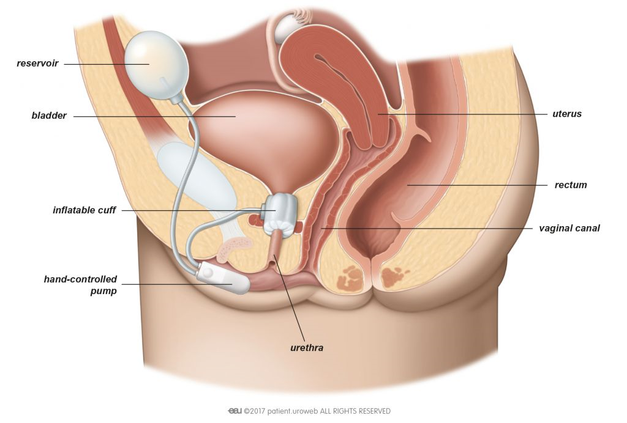
AUS – Artificial Urinary Sphincter

Slide 29
SNS – with Clinical Scientist
Nerve paths split off and go in different directions from the scaral area, some to the pelvic area. The muscles in the pelvic area, such as the pelvic floor, urethral sphincters, bladder and anal sphincter muscles are controlled by the brain through nerves that run from the sacral area. Our sensations, such as fullness in the bladder or rectum, are also relayed to the brain via these nerve routes.
SNS is also indicated for the treatment of overactive bladder, and funded by the NHS. It can be used to treat both bladder and bowel problems in conjunction.
Sacral Neurostimulation is performed in two stages, the first is an evaluation/test phase and the next is the implant phase. The evaluation phase allows your doctor to assess whether or not your symptoms will be significantly reduced by Sacral Neurostimulation

Slide 30
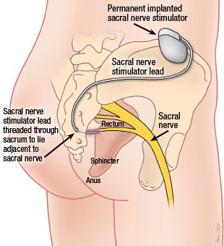
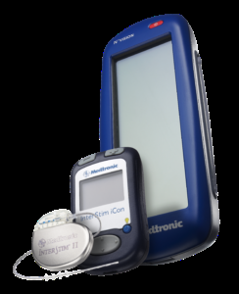
SNS – with clinical scientist

Slide 31
Training
Catheterisation training

Slide 32
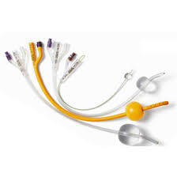
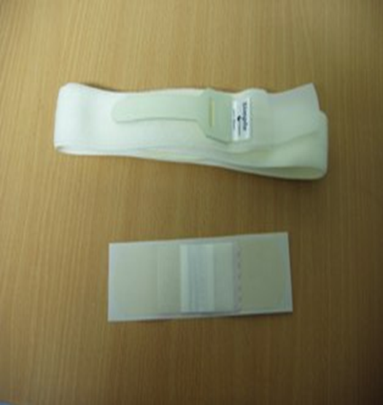
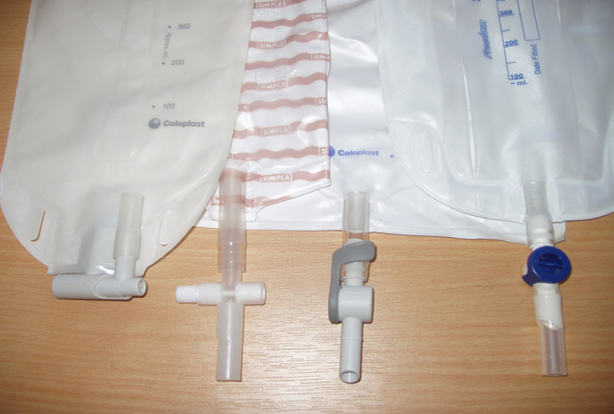
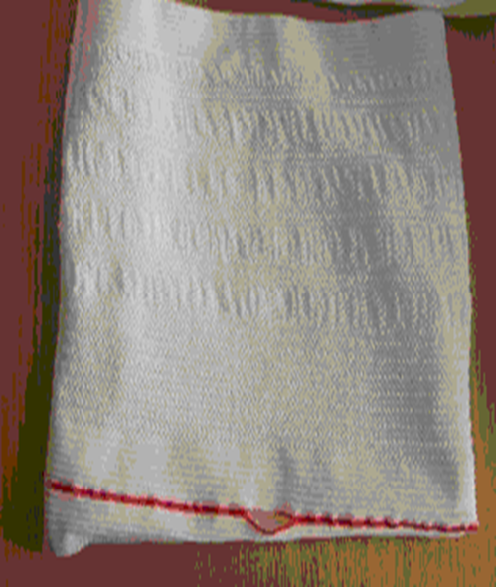
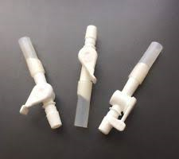
Advice on product selection

