Slide 1
Community Midwifery and Continuity of Care
Louise Frost
Interim Lead Midwife Community and Birth Centres

Slide 2

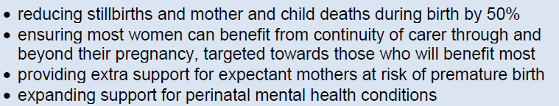
National Targets
Safer Maternity Care Report 2017
Reduce by 50% stillbirths, neonatal and maternal deaths and brain injuries that occur during or soon after birth by 2025 (20% by 2020)
Reduce the national rate of preterm births from 8% to 6% by 2025
NHS long term plan 2019

Slide 3
Better Births report
National Maternity review published February 2016
Recommendations support Secretary of State ambition to halve stillbirths, neonatal and maternal deaths and brain injuries:
Personalised care
Continuity of carer
Safer care
Better postnatal and perinatal mental health care
Multi-professional working
Working across boundaries
A payment system
Maternity Transformation Programme will achieve the vision of Better Births bringing together organisations
44 Local Maternity Systems (LMS)
North West London LMS – 4 Trusts, 6 maternity units

Slide 4
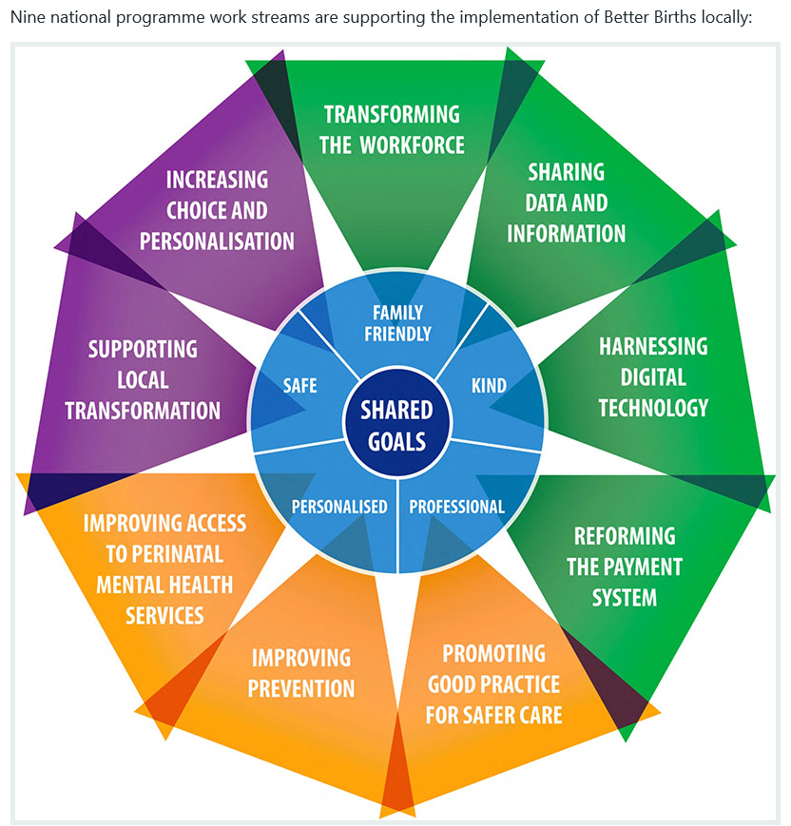
National work streams

Slide 5
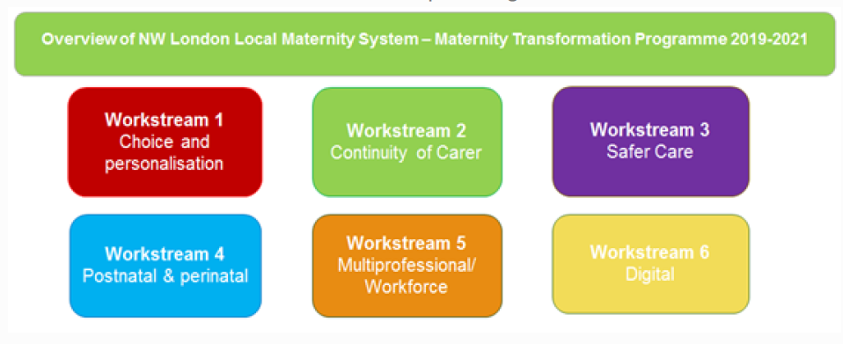
Local Maternity System work streams
Choice of birth location – home, birth centre, labour ward
Improve midwifery led births – 21.5% March 2020
Homebirth project midwife
Perinatal Mental Health Team

Slide 6
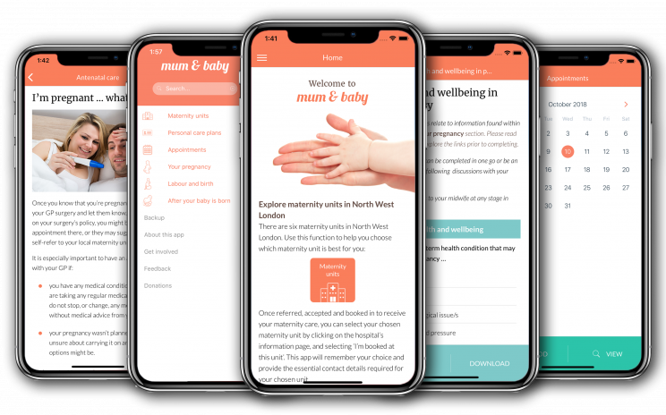
Service improvements & transformation
Maternity Transformation Programme Project Manager
Community Champions/ Maternity Champions
Community services & networking improvements
Maternity Voices Partnership
Mum and Baby app
Hospital information
Pregnancy, labour, postnatal information
Personalised care plans
QI Big Room projects
Maternal & Neonatal Safety Improvement Programme – Reducing smoking in pregnancy

Slide 7
Community Midwifery and Continuity of Care
Group Practice teams

Slide 8
Group Practice Teams
Community matron – Shreejana Koirala
St Mary’s Hospital
East – Ory Bolooki
North – Margarita Lopezliesa
Queen Charlotte’s & Chelsea Hospital
Central – Natasha Rose
South – Jacqui Bleach
West – Jennifer Badoe
Each team - team leader, midwives, preceptor midwife, student midwife, maternity support workers
Named midwife/ buddy midwife
Rotational midwives working on labour ward/ birth centre
Parent education, breast feeding drop-in clinics, breastfeeding workshops
2nd on call for homebirths

Slide 9
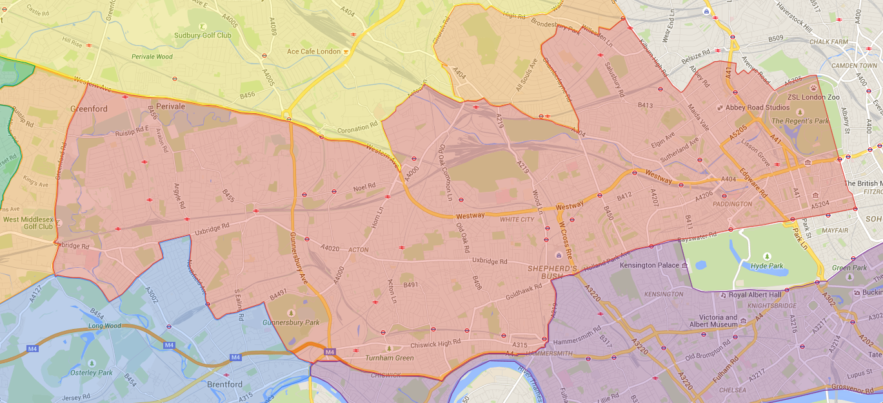
Imperial catchment area
St Mary’s Hospital
East – W2, W10, W11, W1
North – W9, NW1, NW2, NW8, NW6, NW10
Shared area – Brent & Ealing (LNWHT)
Queen Charlotte’s & Chelsea Hospital
Central – W3, W4
South – W6, W12, W10
West – W5, W6, W13, UB1, UB2, UB6 (Ealing hub)

Slide 10
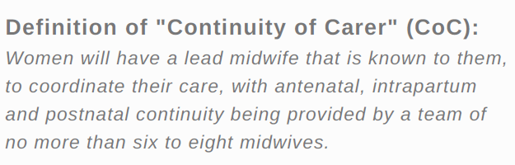
Community Midwifery and Continuity of Care
Continuity of Care

Slide 11
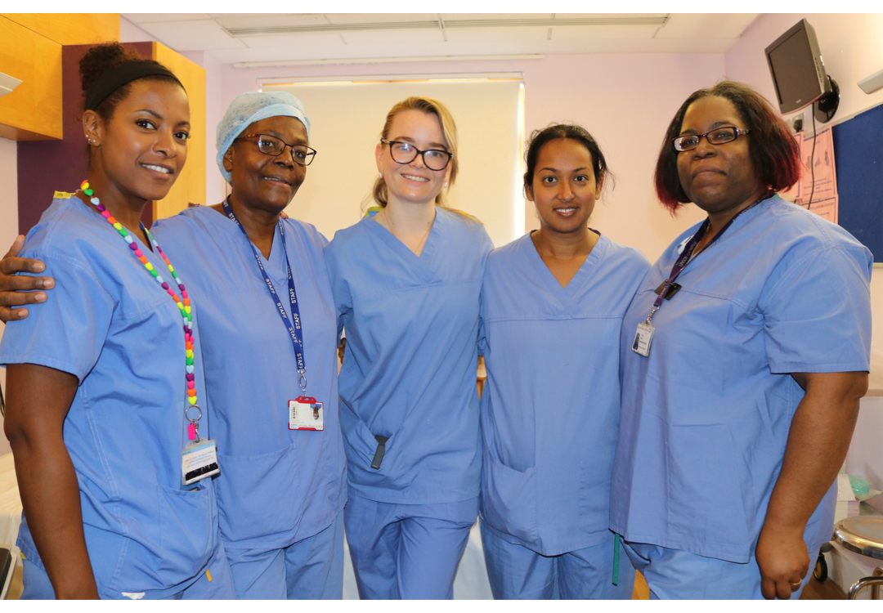
Midwifery Continuity of care teams
2017 – early adopters project – 2 caseload teams for vulnerable women 1:32 ratio including homebirth
January 2019 - Birth centre low risk teams
2019 - St Mary’s Hospital antenatal clinic
Green – maternal medicine
Orange – fetal medicine & multiple pregnancy
Gold – recurrent miscarriage, IVF
Lilac – low risk
Queen Charlotte’s and Chelsea Hospital
Diabetes
Multiple pregnancy
Bereavement

Slide 12
Multi-disciplinary continuity of care
MDT collaboration (obstetricians, neonatal team, diabetes, dietician, sonographers, anesthetists, HIV specialists, hepatologist, endocrinologist)
MDT meetings
Scan appointments
Fetal Medicine Unit
Gynaecological service
Parent education

Slide 13

Continuity of care expectations
Aim no more than 3 midwives – build relationships, consistent information, woman centred care
Research
improves safety & outcomes
Less likely SB, preterm birth
More likely vaginal birth
Achieved 26.9% March 2019 - target 20%
Birth centre booked 500 women since January 2019 implementation
Target 35% March 2020
New self referral form
BAME CoC 75% 2024
Areas of deprivation

Slide 14
GP continuity of care team
Direct referral to midwife early in pregnancy
Linked with a named obstetrician
Named midwife/ buddy midwife
Team booklet including GP’s (antenatal & neonatal)
Antenatal clinic for booking and follow-up appointments
Postnatal clinic
Collaborative close working relationship to improve experience and outcomes for women and their families

Slide 15
Community Midwifery and Continuity of Care
CQC

Slide 16
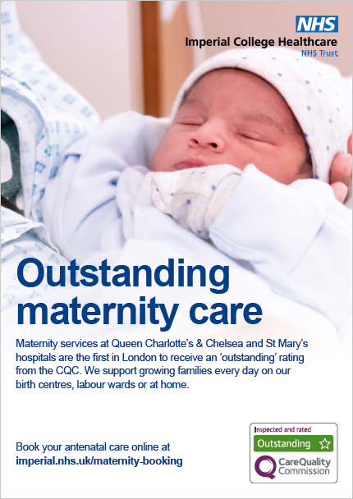

Slide 17
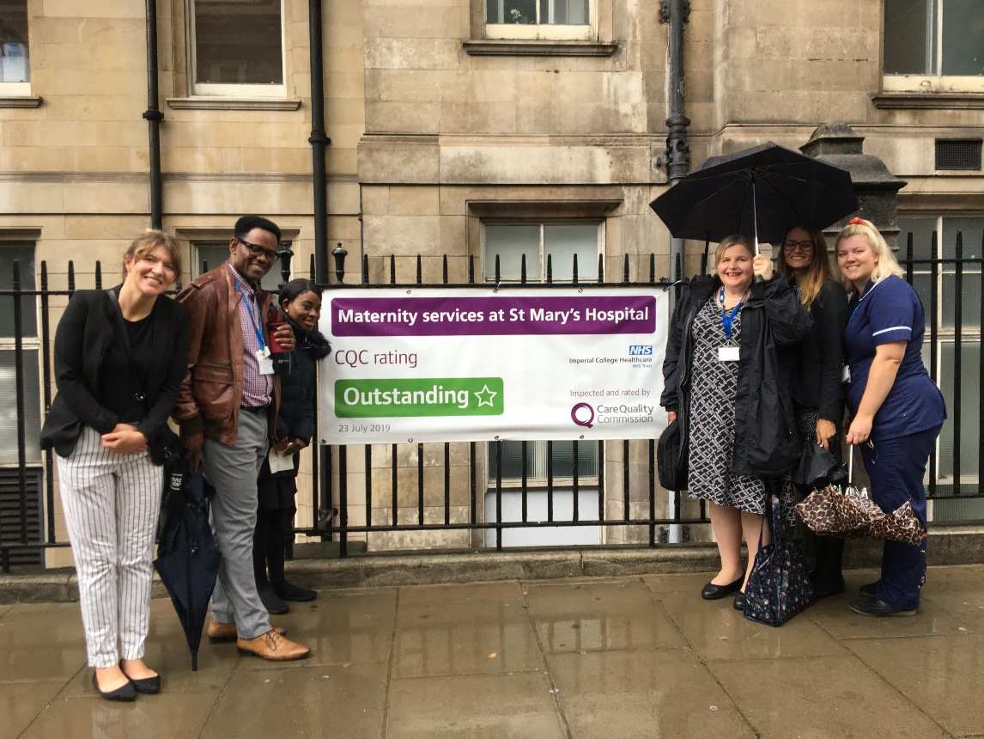
NMC Senior Midwifery Advisor visit
“Delighted to have the opportunity to meet midwives and women using Imperial maternity services. Women told me they felt safe and well informed about their care. Nothing was too much trouble for staff who had evidently pride in their service.”
Donna Ockenden
Senior Midwifery Advisor

Slide 18
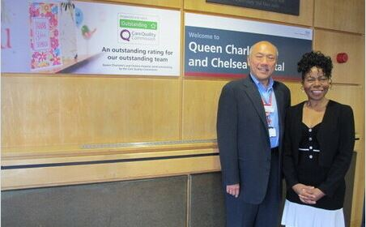
Chief Midwifery Officer visit
“It’s an absolute privilege to visit Imperial College Healthcare NHS Trust and to hear the great progress that has been made to improve women’s experiences and outcomes. I am absolutely delighted that maternity services have achieved a CQC outstanding – well done!”
Professor Jacqueline Dunkley-Bent
Chief Midwifery Officer

Slide 19
Thank you

