Slide 1
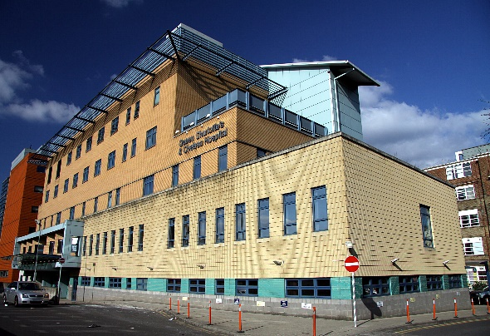
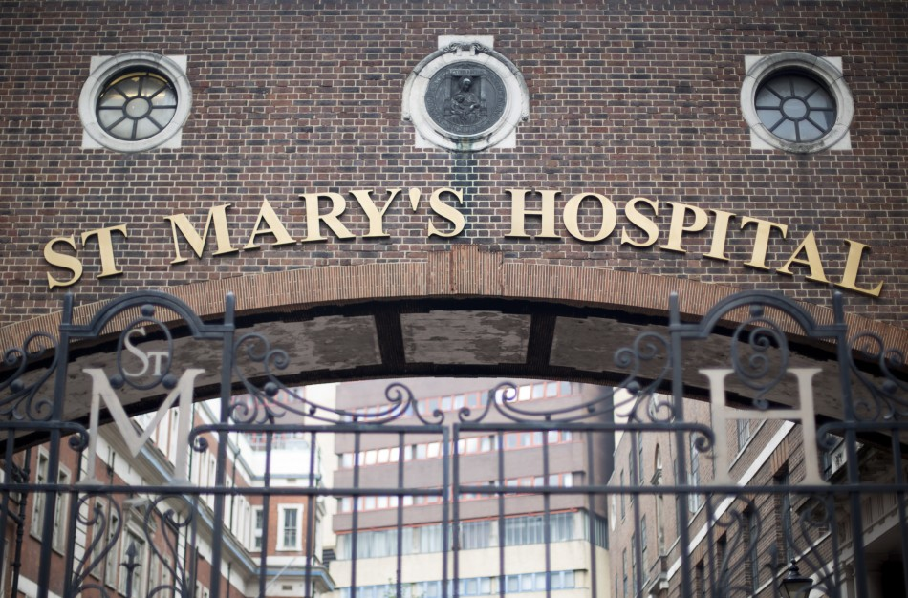
GP Event
Introduction to Maternity Services
Muna Noori
Head of Specialty at QCCH
Jayne Terry
Head of Specialty at St Mary’s

Slide 2
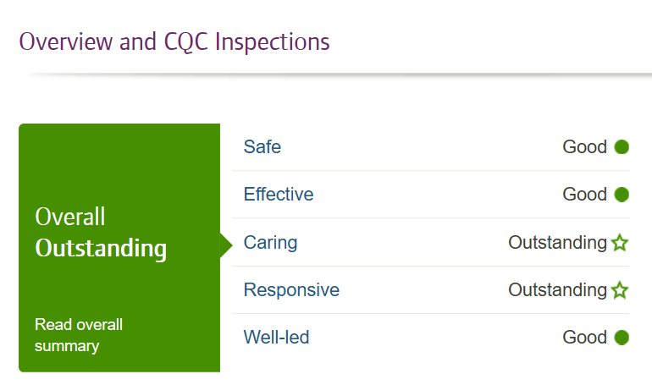
CQC Inspection
Imperial Maternity (QCCH, SMH and Lindo Wing)

Slide 3
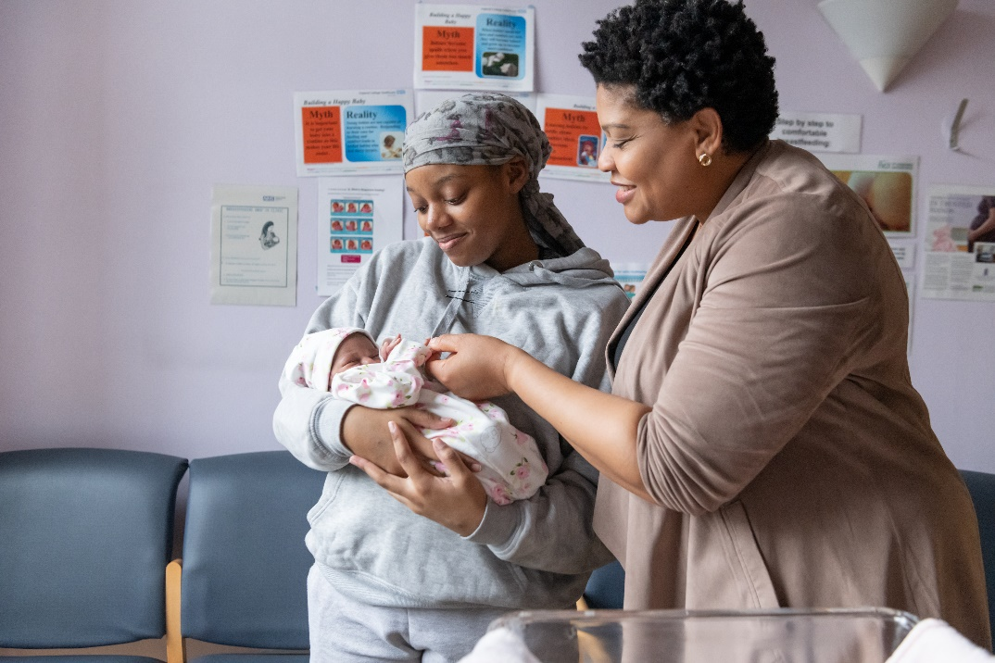
Our Services
Antenatal, intrapartum and postnatal care
Midwifery-led services (including community care)
Birth Centres at QCCH and SMH
Labour wards with birthing pool
Breastfeeding support
Bereavement services
Obstetric-led services
Specialist services
High Dependency Unit
Pre-pregnancy counselling
Neonatal (level 2 & 3) services
Sunflower (FGM) clinics
Private maternity care
Notes:
ST JOHNS WOOD MEDICAL PRACTICE 100

Slide 4
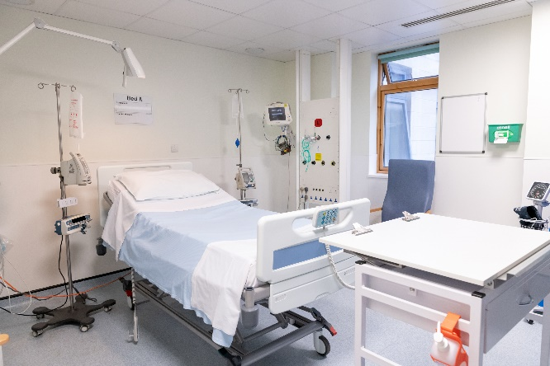
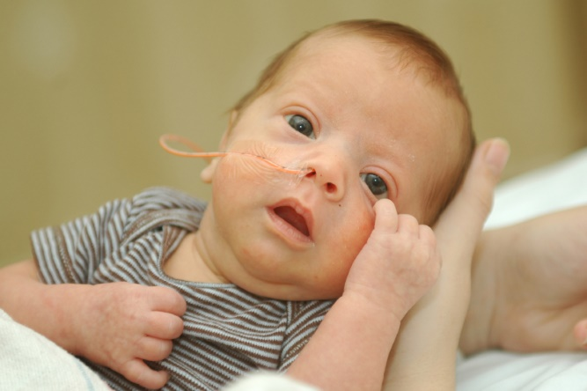
Our Activity
2018
Number of maternities 8361
(QCCH 5349; SMH 3012)
Acuity – 50% intermediate or intensive pathways
HDU (level 2 and 3)
Transitional care
Tertiary neonatal care at QCCH
Level 2 neonatal care at SMH
Notes:
ST JOHNS WOOD MEDICAL PRACTICE 100

Slide 5
Referral Sources
Notes:
ST JOHNS WOOD MEDICAL PRACTICE 100

Slide 6
GP Referrals by Practice
GP Practice | Referrals Jan-Nov 2019
LONSDALE MEDICAL CENTRE | 189
THE LAW MEDICAL GROUP PRACTICE | 181
THE WILLESDEN MEDICAL CENTRE | 177
NEWTON MEDICAL CENTRE | 174
FLUXMAN HARROW ROAD HEALTH CENTRE | 171
BARLBY ROAD SURGERY | 156
THE FLORENCE ROAD SURGERY | 148
BRONDESBURY MEDICAL CENTRE | 142
BURNLEY PRACTICE | 126
THE RANDOLPH SURGERY | 122
THE CORFTON ROAD SURGERY | 118
CLOISTER ROAD SURGERY | 109
ACTON LANE SURGERY | 107
GORDON HOUSE SURGERY | 105
DR DANDAPAT & PARTNERS | 105
PADDINGTON GREEN HEALTH CENTRE | 104
THE PEMBRIDGE VILLAS SURGERY | 103
ST JOHNS WOOD MEDICAL PRACTICE | 100
THE BUSH DOCTORS | 90

Slide 7
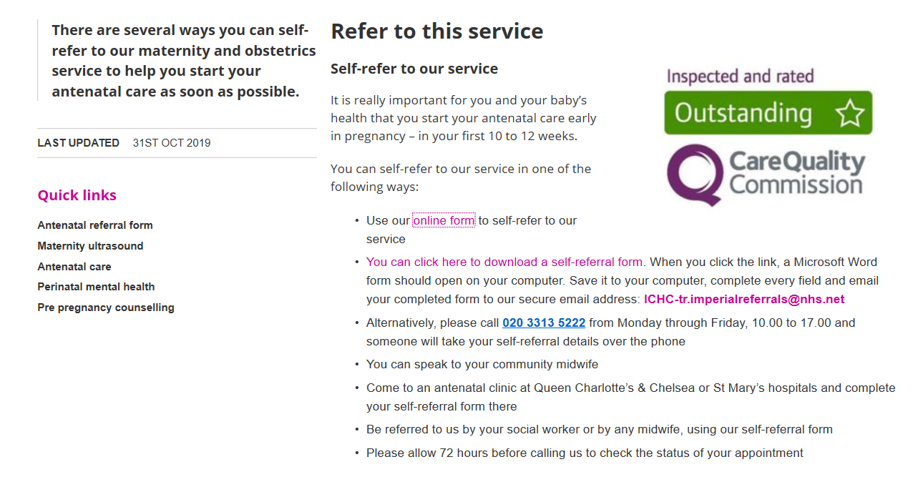
Referring to our Services
https://www.imperial.nhs.uk/our-services/maternity-and-obstetrics/refer-to-this-service
Notes:
ST JOHNS WOOD MEDICAL PRACTICE 100

Slide 8
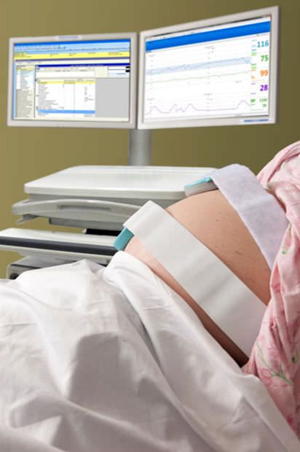
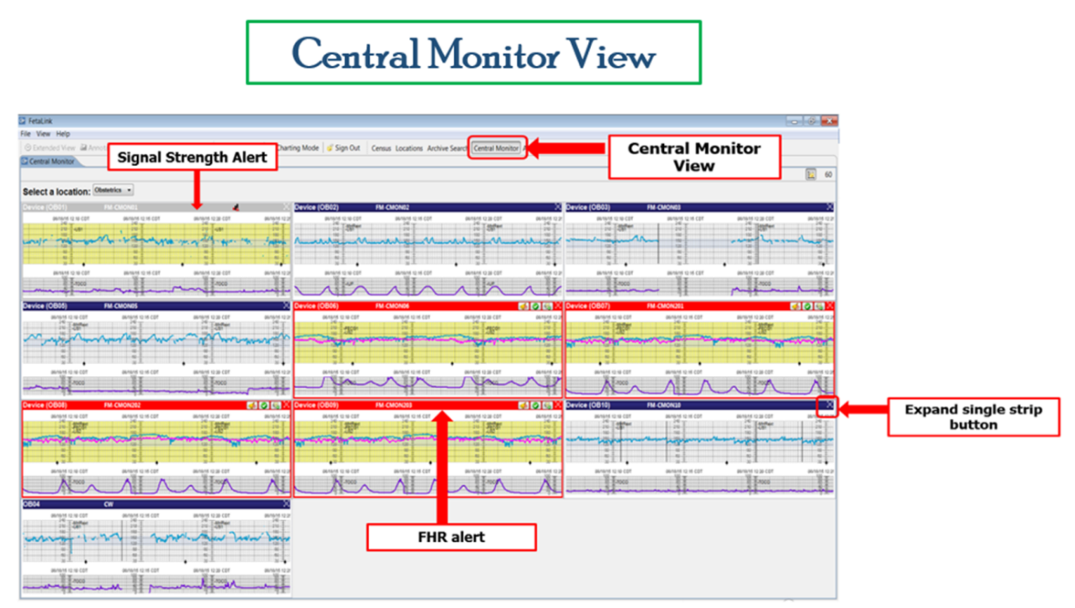
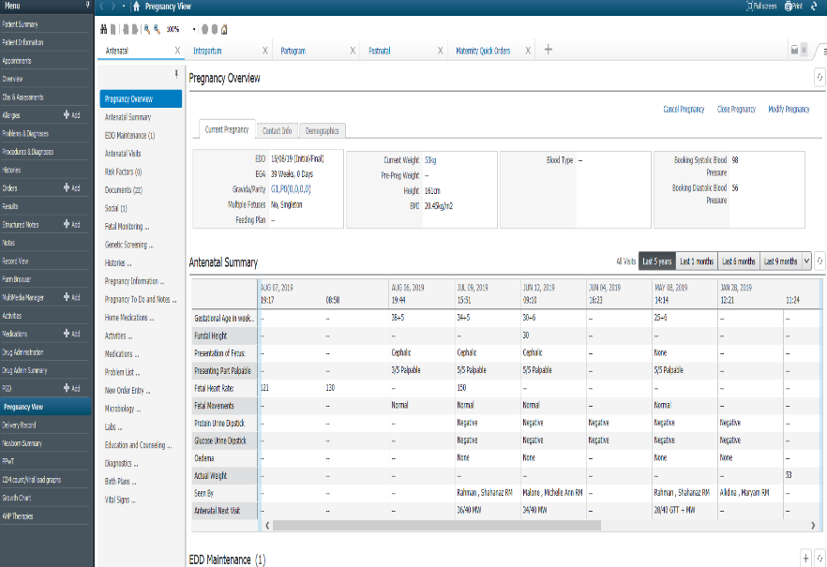
Digital Strategy
Paper-light
Electronic fetal monitoring
Electronic prescribing
Patient portal
Clinical document library
Mediview

