Slide 1
Welfare benefits and additional support people may be entitled to.
Jeremy Holloway
Specialist Social Worker – Haemoglobinopathies and Haemophilia

Slide 2
Learning Objectives
Personal Independence Payment – The process of a claim and what is being assessed.
Other welfare benefits.
Overview of some support services within the community.
Prescriptions – What support people may be entitled to towards the cost of prescriptions.

Slide 3
What is Personal Independence Payment (PIP)?
Personal Independence Payment gradually replacing Disability Living Allowance (DLA).
DLA remains for children up to age 16; and DLA recipients aged 65.
PIP helps towards costs arising from health condition or disability.
PIP based on how person’s condition affects them, not condition itself.
Can receive PIP whether in or out of work.
Not means tested or taxed.
PIP is not back dated.

Slide 4
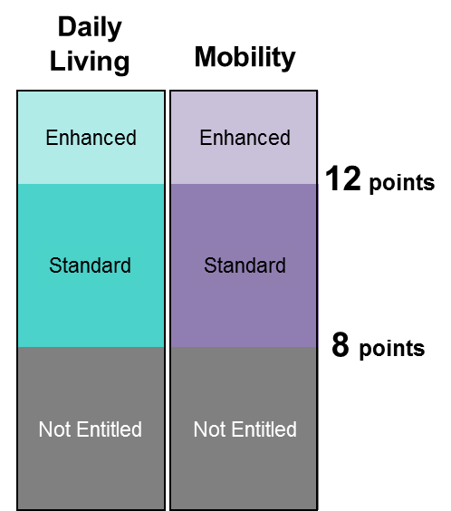
Components and Eligibility
PIP is made up of two components – daily living and mobility.
Each can be paid at standard rate, or enhanced rate for those with the greatest needs.
The PIP assessment criteria will consider the individuals’ ability to carry out a range of everyday activities.
Individuals will receive a point score for each activity, depending on how well they are able to carry them out and the help they may need to do them.
The total scores for each component determine whether a component is payable, and if so, whether at the standard or enhanced rate.
Daily living: Standard rate £57.30
Enhanced rate £85.60
Mobility: Standard rate: £22.65
Enhanced rate: £59.75

Slide 5
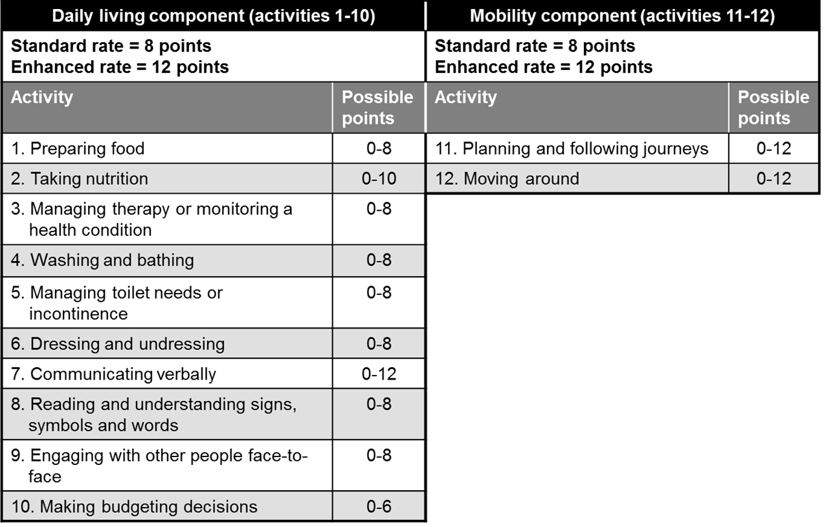
Assessment Criteria

Slide 6
The claimant journey - five key stages to claiming
1
Thinking about claiming
Information about PIP is available from a range of sources, including online, via leaflets and through support organisations.
Existing DLA claimants will be contacted individually to ask if they want to claim PIP.
2
Making a claim
Claimants phone DWP to make a claim to PIP.
DWP will send claimants a form where they can explain how their disability affects them.
3
How your disability affects you
Claimant completes the ‘How your disability affects you’ form to explain how their condition affects their daily life, both on good and bad days and over a range of activities.
Supporting evidence can be sent with this form, which they return to DWP by post.
4
Assessment
Claim details, form and supporting evidence are passed to the health professional.
Most people are asked to attend a face to face consultation. The health professional reviews the claim against a set of clear descriptors to assess the challenges faced by the individual.
5
Decision
A DWP Decision Maker will use all the information in the claim form, from the health professional and anything else that has been provided. They will make a reasoned decision on entitlement, including the level and length of award.

Slide 7
How is Personal Independence Payment Assessed?
Assessed as individuals - focus on the impact of condition on daily lives and over a range of different activities.
“How your disability affects you” - ability to complete everyday tasks and any support they need/require.
Face-to-face consultation - take somebody along, such as a friend or family member.
Home visits are available when necessary.
The health professional will send a report to the DWP following the assessment, for the DWP Decision Maker to make a decision.

Slide 8
Appeals
- Most common reasons for appeal are:
• Claimant was not awarded PIP.
• Claimant was awarded a lower level of PIP than they expected.
• Claimant believes that their PIP award should last for longer.
- Mandatory Reconsideration - over the telephone or in writing - complete within one month of receiving decision letter.
- Appeal to a tribunal – appeal to an independent panel, called a tribunal. The tribunal looks at the evidence from both sides, then makes a final decision. The tribunal is part of the court system - it’s not part of the DWP. Appeals must be lodged directly with Her Majesty’s Courts and Tribunals Service (HMCTS).

Slide 9
Supporting Information
Department of Work and Pension may request Factual Report when assessment provider believes that further evidence will help inform their advice to the department.
Advised that claimant provide up to date medical evidence already in possession – e.g. consultation letter / discharge summary.
May benefit from up to date support letter from medical professional (GP/Consultant) if not already in possession. Should not delay application.
May wish to include:
List of health conditions / impairments - dates conditions first presented
How these may affect current functional ability.
Symptoms and variability
Treatment: current, planned, response and diagnosis
Effects of the disabling condition(s) on day-to-day life if known

Slide 10
Other welfare benefits
- Job Seekers Allowance
- Employment and Support Allowance
- Attendance Allowance
- Income support
- Child Benefit
- Working tax credits / child tax credits
- Housing Benefit
- Carers Allowance
- Universal Credit

Slide 11
Community support services
Citizens Advice Bureau
Shelter - Housing
Home Start – Family Support
Carers UK
Local Law Centre
Social Services
Age UK
Turn2us

Slide 12
Prescriptions
- NHS prescription charge is currently £8.80 for each prescribed item
- Certain groups are entitled to free NHS prescriptions
- Some prescribed items are always free
- Regularly pay prescription charges - Prescription prepayment certificate (PPC) in place could save them money
- Medical Exemption Certificate
- Low income
- Check support eligibility online

Slide 13
Prescription prepayment certificates (PPCs)
- Prescription prepayment certificates allow for mulitple NHS Prescriptions as needed for set price.
A PPC costs:
• £29.10 for 3 months
• £104 for 12 months
Can be bought:
Online
Pharmacy (registered to sell PPCs online)
Over the telephone
Can be paid for by:
Direct Debit (online or by telephone)
Card payment (online or by telephone)
In full at a pharmacy.
- Can check prescription prepayment certificate status online. If someone already has a prescription prepayment certificate, they can check online to see if their certificate is still valid or will expire soon.
- Paper certificates rather than plastic cards

Slide 14
Entitlement to free prescriptions
Individuals can get free NHS prescriptions if, at the time the prescription is dispensed, they:
• are 60 or over
• are under 16
• are 16 to 18 and in full-time education
• are pregnant or have had a baby in the previous 12 months and have a valid maternity exemption certificate (MatEx)
• have a specified medical condition and have a valid medical exemption certificate (MedEx)
• have a continuing physical disability that prevents you going out without help from another person and have a valid MedEx
• hold a valid war pension exemption certificate and the prescription is for your accepted disability
• are an NHS inpatient

Slide 15
Medical Exemption Certificate (Med Ex)
People with certain medical conditions can get free NHS prescriptions if:
• they have one of the following conditions, and
• they hold a valid medical exemption certificate
Patients can apply for a medical exemption certificate if they have one of the following medical conditions:
• a permanent fistula (for example, a caecostomy, colostomy, laryngostomy or ileostomy) requiring continuous surgical dressing or requiring an appliance
• a form of hypoadrenalism (for example, Addison's disease) for which specific substitution therapy is essential
• diabetes insipidus or other forms of hypopituitarism
• diabetes mellitus, except where treatment is by diet alone
• hypoparathyroidism
• myasthenia gravis
• myxoedema (hypothyroidism requiring thyroid hormone replacement)
• epilepsy requiring continuous anticonvulsive therapy
• a continuing physical disability that means the person can't go out without the help of another person – temporary disabilities don't count, even if they last for several months
They are also issued for people undergoing treatment for cancer:
• including the effects of cancer, or
• the effects of current or previous cancer treatment

Slide 16
Applying for Medical Exemption Certificate
- Ask doctor for FP92A form
- GP, hospital or service doctor will sign the form to confirm statement is correct.
- Certificate valid from 1 month before date application form received.
- The MedEx lasts for 5 years and then needs to be renewed.
- Reminder that certificate needs to be renewed.

Slide 17
Claiming Refund
- Request refund form (FP57) from pharmacist, hospital or doctor when paying for prescription. Take - FP57 refund receipt community pharmacy, with evidence that were entitled to free NHS prescriptions paid.
- Must be done within three months of date that paid – will be refunded by pharmacy.
- If paid for a prescription prepayment certificate (PPC) and become exempt from paying for prescriptions - may be able to get refund from PPC.

Slide 18
In receipt of welfare benefits
- Certain benefits entitle people to help with NHS costs.
- Patients entitled to free prescriptions if they, or their partner, receive (or they are under the age of 20 and the dependant of someone receiving):
• Income Support
• Income-based Jobseeker's Allowance
• Income-related Employment and Support Allowance
• Pension Credit Guarantee Credit
• Universal credit and meet the criteria.
-If claimant receives:
• contribution-based Jobseeker’s Allowance
• contribution-based Employment and Support Allowance
not automatically entitled to free NHS prescriptions.
- Those not meeting following eligibility - may be able eligible for support through Low Income Scheme (HC2 or HC3 certificate).

Slide 19
Low income – Help with NHS charges
- People on low income may be eligible to receive financial help through the NHS Low Income Scheme.
- Apply - complete HC1 form. Available from Jobcentre Plus offices, most NHS hospitals, doctor, dentist or optician. Can also be requested to be sent to them by calling 0300 123 0849.
- Can apply for a refund at the same time that apply.
Can apply as long as do not have:
• £16,000 in savings, investments or property (not including the place where you live)
• £23,250 in savings, investments or property if live permanently in a care home
- Help entitled to depends on household income and outgoings.
- Qualifying based on comparison between weekly income and assessed requirements.
- May then qualify for:
• Full help towards health costs (receive HC2 certificate)
• Limited help towards health costs (receive a HC3 certificate) will indicate how much they have to pay towards.
- Help entitled to is also available to their partner.
- Certificates usually valid for periods between 6 months and 5 years.
- If have a partner, their income will also be taken into account as part of assessment, and other people living with.

Slide 20
Useful information
PIP enquiry line - Telephone: 0800 121 4433
Citizen’s Advice – https://www.citizensadvice.org.uk/, Telephone: 0344 411 1444
Shelter (Housing advice) - Telephone: 0300 330 1234
Home Start (Family Support) - https://www.home-start.org.uk/
Turn2us - https://www.turn2us.org.uk/
NHS Business Services Authority (prescription support) - https://www.nhsbsa.nhs.uk/contact-us, Telephone: 0300 330 1341

