Slide 1
Dealing With Persistent Pain in
Sickle Cell Disease
Dr. Jeremy Anderson
Clinical Haematology

Slide 2
What is pain?

Slide 3
IASP definition of pain:
“An unpleasant sensory and emotional experience associated with actual or potential tissue damage, or described in terms of such damage.”

Slide 4
Key Points:
It’s a sensation, and it has a valence to it—comes with distress
Not just about damage—can be no damage—more about ‘danger’
Pain is inherently a matter of one’s subjective experience (pain is something your brain does)

Slide 5
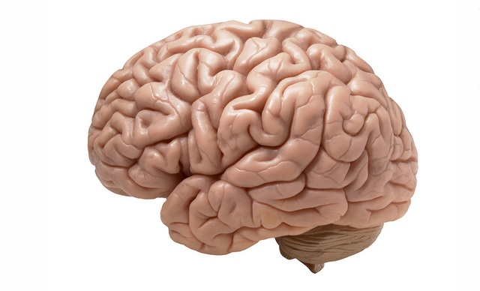
Brain
Spinal cord
Inhibitory
descending
pathway
Ascending pathways
Fast Aβ fibres
Injury
Pain signal
Pain gate
Slow
C fibres
Inhibitory spinal neuron
Aβ
fibres
Touch
Touch

Slide 9
ALL PAIN
IS PSYCHOLOGICAL

Slide 10
Acute vs. Chronic/Persistent Pain
Duration
Signal
Acute
< 3 months
Very useful
Persistent
> 3 months
Not useful
Expectation of Relief
High
Low

Slide 11
Sources of Pain in Sickle Cell
Acute
Vaso-occlusive crisis
Persistent
Bone/joint damage, e.g., AVN
Neuropathic Changes
Bone infarcts
Swelling
Medical procedures, e.g., surgery, RCE
Ulcers

Slide 12
Stimulus
Pain
Relief
Opioids
Tolerance
Learning
Response
Reinforcement

Slide 13
More Pain
Relief
Opioids
Tolerance

Slide 14
More Pain
Relief
More Opioids
Tolerance
Dependence

Slide 17
The US Opioid Epidemic
In 2016:
130+ died every day from opioid overdose
47,600 total dead, 28,466 dead from Rx
886,000 used street heroin, 81,000 for first time
2.1m had opioid use disorder
2m misused Rx for first time

Slide 18
Starts with Rx oxycontin
When access cut back, people turn to street heroin
Heroin cut with fentanyl, → overdoses
Fentanyl deaths up 29% in UK
UK opioid Rx doubled last 10 years
UK opioid Rx common for chronic pain
Quarter of patients Rx higher than guidelines warrant (Ashaye, et al., 2018, BMJ)

Slide 19
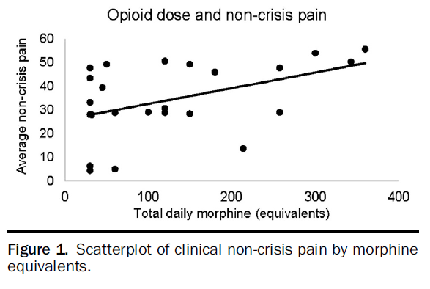
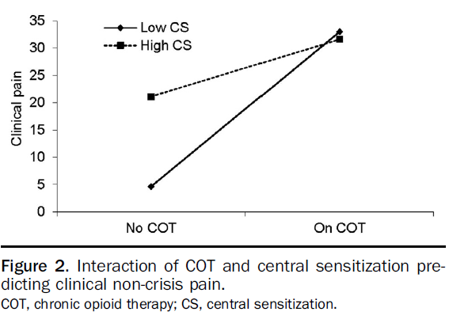
Carroll et al., 2016

Slide 20
We need a framework to identify a maladaptive coping pattern and intervene early

Slide 21
Situation:
Trigger
Pain
Response
PDU / RHTU
Inpatient Admission
Home Rx

Slide 22
What should this look like?

Slide 23
Self-management
Day service
Inpatient admission

Slide 24
How to decide if there is a problem?

Slide 25
Decision Rules: High or Low?
Home Rx
PDU / RHTU
>3x /month
Inpatient Admission
>60mg /day
Frequency x Duration = Total

Slide 27
High rating on one or more of these factors is a sign of maladaptive coping

Slide 28
A strategy is maladaptive when it seems to help initially, but leads to greater harm later

Slide 29
2 x 2 x 2 = 8 Profiles (7 really):
Profile 0: Low IP, Low OP, Low Home Rx
Profile 1: High IP, Low OP, Low Home Rx
Maladaptive pattern often starts with lengthy inpatient stay(s)
Not in much pain, not our focus here

Slide 30
2013

Slide 31
2014

Slide 32
2 x 2 x 2 = 8 Profiles (7 really):
Profile 0: Low IP, Low OP, Low Home Rx
Profile 1: High IP, Low OP, Low Home Rx
Maladaptive pattern often starts with lengthy inpatient stay(s)
Profile 2: Low IP, Low OP, High Home Rx
Response: Manage pain at home with opioids (easily unnoticed)
Profile 3: Low IP, High OP, Low Home Rx
Will almost never see this
Response: Increase outpatient visits

Slide 33
2014

Slide 34
2015

Slide 35
Building tolerance

Slide 36
2 x 2 x 2 = 8 Profiles (7 really):
Profile 4: Low IP, High OP, High Home Rx
Cut back on Home Rx, pain flares, increased IP
Profile 6: High IP, Low OP, High Home Rx
Cut back on OP visits, pain flares, increased IP
Profile 7: High IP, High OP, High Home Rx
Worst of all worlds
Pain getting worse. Starting to notice a problem
Profile 5: High IP, High OP, Low Home Rx

Slide 37
2015

Slide 38
2016

Slide 39
2017

Slide 40
Assess and identify profile:
Intervene early
Can get a sense of how far along the path patient is
Flagged patients can be referred to specialised pain service, specialist providers
In most cases, patient has developed chronic or persistent pain, needs a more comprehensive approach to pain mgmt

Slide 41
Comprehensive Pain Management Programme
Starting Now

Slide 42
Programme in Development:
Physiotherapist for outpatient and inpatient support.

Slide 43
Input from consultants with expertise in complex pain management and reducing reliance on pain medication.

Slide 44
Pain Management Group
Pain Workshops
1 to 1 Psychology/ Physiotherapy
Exercise Group
Joint Haematology/ Specialist Virtual Clinic
Social Work Referral
One-off sessions open to patients, friends, family, staff
Practical help to reduce burden and worry that contribute to your pain experience
Core of service.
~8 sessions, beginning
April 24, refer now
Highly specialised medical advice in conjunction with your core medical team
Safe activities led by the Physiotherapist, to prevent or eliminate pain coming from inactivity

Slide 45
Explore broader life goals

Slide 46
Examine activity cycles and pain, practice pacing, exercise, and stretching

Slide 47
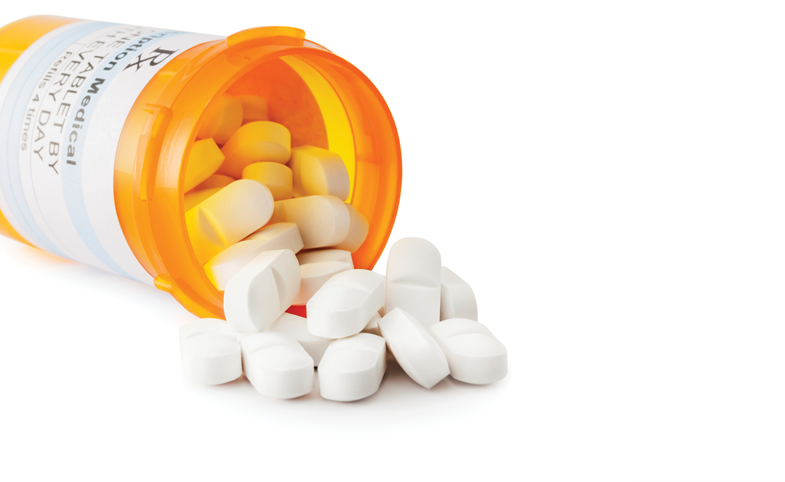
Reducing Reliance on Opioids
From short-acting to long-acting
Very gradual
Help with withdrawal

Slide 48
Look at thoughts & emotions

Slide 49
Discuss communication & relationships

Slide 50
Plan for dealing with pain flare-ups

Slide 51
Learn about different pain mechanisms
Brain
Spinal cord
Inhibitory
descending
pathway
Ascending pathways
Fast Aβ fibres
Injury
Pain signal
Pain gate
Slow
C fibres
Inhibitory spinal neuron
Aβ
fibres
Touch
Touch

Slide 52
Stress Management

Slide 53
Improving Sleep

Slide 54
Goal is improve patients’ overall quality of life

Slide 55
Change won’t happen if patients,
or providers,
do the same old thing

Slide 56
Must refuse to enable continued harmful behaviour, while giving patients new, helpful options

Slide 57
Thank you for listening
Dr. Jeremy Anderson
0203 313 8119
jeremy.anderson1@nhs.net

