Slide 1
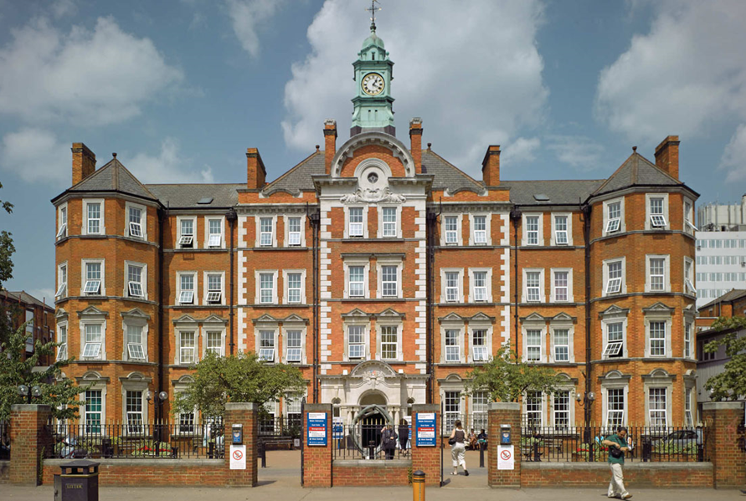
Management of Haemoglobinopathies in Primary Care
Dr Asad Luqmani

Slide 2
Epidemiology
Estimated 275,000 newborns every year
  Two-thirds in sub-Saharan Africa
  Almost all newborns in well resourced countries survive to adulthood
  Median survival for SCD improved dramatically

Slide 3
Epidemiology
Sickle cell disorders
  Prevalence 12000-15000
  Approx 70% live in Greater London
  Approx 350 new births per annum
National Haemoglobinopathy Registry (NHR)
Approx 370 patients at HH

Slide 4
Sickle cell disease (SCD)
  HbSS (“sickle cell anaemia”)
  HbSC
  HbS βthal
  HbS other

Slide 5
National Haemoblobinopathy Registry (NHR)
Means of monitoring the number of affected adults in a clinical centre, for adverse event recording and for demonstrating compliance with key standards of clinical care.

Slide 6
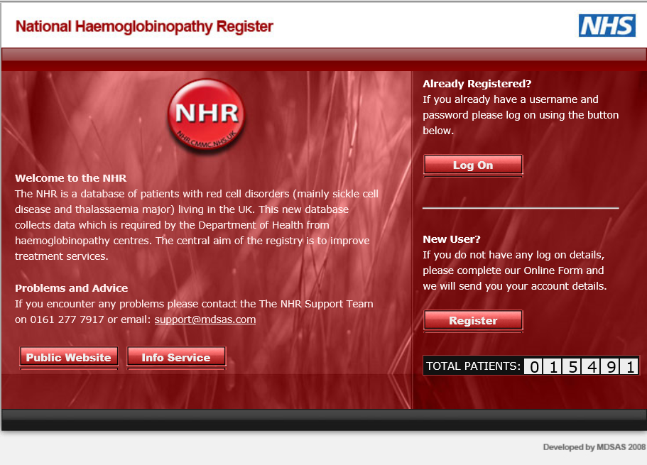

Slide 7
Organisation of Services
Specialist Haemoglobinopathy Trusts
Accredited local Haemoglobinopathy Trusts
Local Teams / linked hospitals
Specialist commissioning via NHS England

Slide 8
New Service Provision and Commissioning Model
10 National Haemoglobinopathy Coordinating Centres (HCCs)
National Haemoglobinopathy Panel
Specialist Haemoglobinopathy Trusts (SHTs)
Local Haemoglobinopathy Trusts (LHTs)

Slide 9

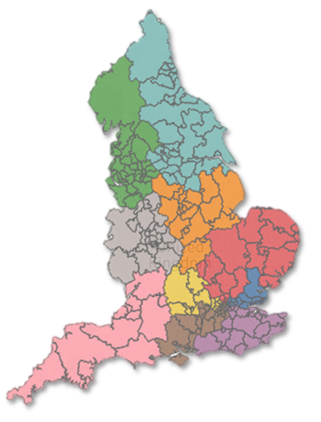

Slide 11
Clinical Haematology Structure: Consultants
Chief of Service
Prof Jane Apperley
Administrative Leads
Nina Salooja (Education)
Ed Kanfer (Audit)
Dragana Milojkovic (Clinical Trials)
MALIGNANT HAEMATOLOGY
‘White Cell’
CML
Jane Apperley
Dragana Milojkovic
Lymphoma
Ed Kanfer
Donald MacDonald
Sasha Marks
Anastasios Karadimitris
Aristeidis Chaidos
Lucy Cook
Acute leukaemia
Eduardo Olavarria
Jiri Pavlu
Renuka Palanaciwander
Myeloma
Aris Chaidos
Holger Auner
Maria Atta (locum)
RED CELL
Clinical Lead
Mark Layton
Asad Luqmani
Mamta Sohal
Simona Deplano
Nichola Cooper
Lambros Bourantas (Locum)
HAEMOSTASIS
Clinical Lead
Mike Laffan
Carolyn Millar
Nina Salooja
Abdul Shlebak
Deepa Arachhillage
TRANSFUSION
Clinical Lead
Fiona Regan NHS
Fateha Chowdhury
NON-MALIGNANT HAEMATOLOGY
‘Red Cell’

Slide 12
Patient population
Phenotype No.
βThal 38
HbSβThal 26
HbSC 56
HbSOther 6
HbSS 233
Total 359
Currently 300 paediatric patients under care of SMH 70 expected to transition by 2016

Slide 13
Patient population
Most resident in Hammersmith & Fulham, Kensington & Chelsea or Westminster
LHTs Chelsea&Westminster, W Middlesex and Ealing/Hillingdon

Slide 14
Red Cell Multidisciplinary Team
Core members
Mark Layton, Consultant (Clinical Lead)
Asad Luqmani, Consultant
Nichola Cooper, Consultant
Simona Deplano, Consultant
Mamta Sohal, Consultant
Lambros Bourantas, Locum Consultant
Di Hagger, Associate Specialist
Jasmine Joseph, CNS
Jeremy Anderson, Clinical Psychologist
Jeremy Holloway, Social Worker
Frances Sarkari, DCU/OPD
Evelyn Gomez, Fraser Gamble Ward
Sinju Thomas, Lead Nurse Apheresis
Red Cell SpR and SHO
Ralph Brown, Quality Manager
Weekly MDT meeting
Quarterly quality meeting

Slide 15
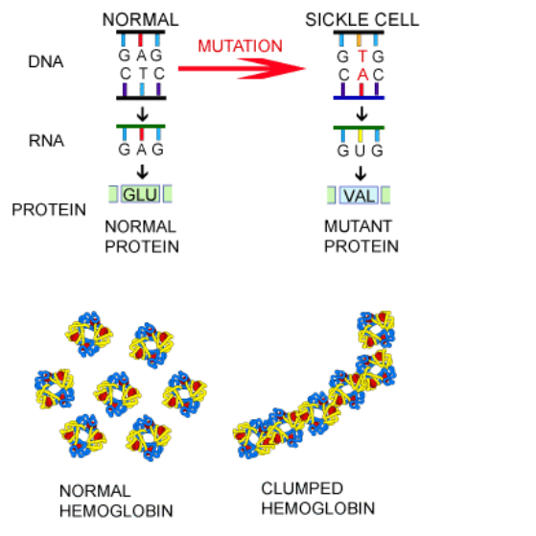
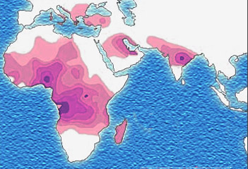

Slide 16
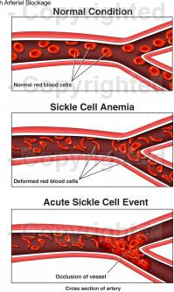
“Sickling”
Red cells deform under
conditions of reduced oxygenation
  Polymerisation of Hb
  Distorts red cell shape “sickle”
  Rigid cells
Do not flow well through small vessels
Increased adherence to vascular endothelium
  Vascular Occlusion
  Crises

Slide 17
Acute complications
Dactylitis
Sequestration
Aplastic crisis
Acute pain crisis
Acute chest syndrome
Increased risk of infections
Priapism
Strokes and subarachnoid haemorrhage

Slide 18
Chronic complications
Fatigue and anaemia
Nephropathy
Pulmonary hypertension
Chronic sickle lung disease
Gallstones
Avascular necrosis (AVN)
Leg ulcers
Retinopathy
Iron overload
Osteopenia
Growth, puberty and fertility problems

Slide 19
NCEPOD report 2008 “A Sickle Crisis?”
Principal recommendations
In our multi-racial society, it is essential that all doctors should have a basic understanding of the implications of thalassaemia and sickle cell trait. (General Medical Council)
As a minimum, the Department of Health guidance regarding vaccination and prophylactic antibiotics should be followed in order to prevent sepsis form hyposplenism. (Primary Care Trusts)
A mutidisciplinary and multi-agency approach is needed in the ongoing pain management of patients with sickle cell disease – essentially this takes place outside hospital for the majority of patients. (Primary and Secondary Care Trusts)

Slide 20
NCEPOD report 2008 “A Sickle Crisis?”
Principal recommendations
Patients with sickle cell disease or beta thalassaemia major should be managed by, or have access to, clinicians with experience of haemoglobinopathy management. (Primary and Secondary Care Trusts).
Healthcare centres responsible for the management of patients with haemoglobinopathies should have access to protocols/guidelines from their regional specialist centre. (Primary and Secondary Care Trusts)
A national database of patients with haemoglobinopathies should be developed and maintained, to include standardised information on death, for regular audit purposes. (Department of Health)

Slide 21
Standards for the Clinical Care of Adults with Sickle Cell Disease in the UK
2nd Edition, 2018

Slide 22
All adults with SCD should be registered with a GP
Primary Care teams should maintain good communication with the specialist and local haemoglobinopathy teams, enabling 2 way exchange of expertise
Each SCD patient should be offered routine primary heath services at their GP surgery
Specialist haemoglobinopathy teams should develop locally agreed shared care protocols with GPs defining the roles and responsibilities of each.

Slide 23
Primary Care - strengths
Direct involvement with patients and their home support network and environment
Greater awareness of social, economic, family and psychological factors

Slide 24
Primary Care
Genetic screening
Reproductive and health advice
Routine screening
Management of other comorbidities

Slide 25
Specific Responsibilities of the Primary Care Team
Early treatment of infections to prevent sepsis
Prescription of antibiotic prophylaxis
Ensuring vaccinations are up to date
Early referral of pregnant women
Reproductive advice including contraceptive advice, pre-conceptual testing and partner testing
Referral for psychological support and counselling
Encourage treatment compliance
Patient education and self-management of mild painful episodes
Support during transition and move to further education

Slide 26
Family planning / contraception
Injectable contraceptives e.g. Depo-Provera popular

Slide 27
If a child is diagnosed with SCD
Specialist nurse informs GP and Health Visitor
Child referred to local hospital haematologist / paediatrician
Parents receive appropriate education
GP should:
  Prescribe prophylactic penicillin to start by 3 months of age
  Prescribe folic acid
  Ensure the child receives full childhood immunisations in accordance with national schedule

Slide 28
Infections in SCD
Invasive pneumococcal disease (IPD)
Salmonella
Gram negative urinary tract infections
Complications following influenza

Slide 29
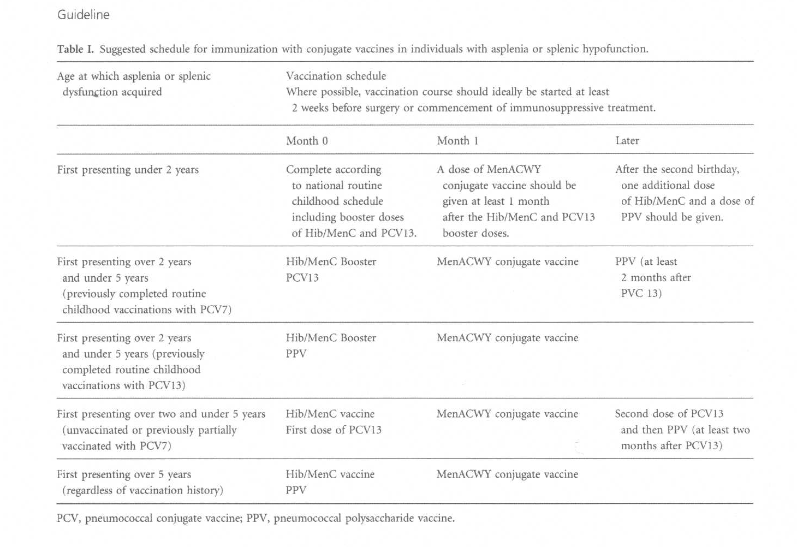
Vaccination guidelines

Slide 30
Vaccinations (Green Book, Public Health England, 2014)
All routine UK schedule vaccinations including Prevenar 13 (conjugate pneumococcal vaccine), Hib /Men C, meningococcal B vaccine
Men ACWY
Pneumovax II (23 valent polysaccharide pneumococcal vaccine) to all children with SCD at 2 years then repeated 5 yearly thereafter throughout adult life
Hepatitis B from age of 1 year – especially if receiving blood transfusions
Annual seasonal Flu vaccine

Slide 31
Vaccinations in Adults
Single dose of PCV 13 if not already given (Public Health England, 2017)
Meningococcal B vaccine (2 doses)
Single dose of Men ACWY
Single dose of Hib/Men C
Annual influenza vaccine
Hepatitis B vaccine (booster if Hep B surface Ab titre <100 mIU/ml)
Salmonella vaccine?

Slide 32
Antibiotic Prophylaxis
Highest risk of pneumococcal infection is in <5 year and >50 year age groups
Current opinion on long term oral penicillin prophylaxis is divided

Slide 33
Travelling
  Malaria prophylaxis
    Check G6PD status
Appropriate travel vaccinations

Slide 34
Blood Pressure Monitoring
Target
  <140/90 in absence of proteinuria
  <130/80 if proteinuria present
First line treatment – calcium channel blocker
Avoid diuretic as first-line treatment

Slide 35
Folic Acid
Usually recommend 5mg OD long term but lack of evidence
Some patients may take it intermittently
Important during periods of illness
Check level (along with B12) in patients with worsening macrocytosis or anaemia
Pregnancy – start 5mg OD

Slide 36
Vitamin D Deficiency
Associated with osteomalacia, fracture risk, musculoskeletal pains, chronic fatigue, cardiovascular disease, asthma, nephropathy
Rate substantially higher in African American population than Caucasians
Studies have shown improvements in pain symptoms, bone density markers and quality of life in SCD patients treated with high dose vitamin D supplements
Check levels at least annually
Check BMD if suspicion of osteoporosis

Slide 37
Vaccination guidelines

Slide 38
Chronic sickle lung disease and pulmonary hypertension
GPs can:
  Enquire about symptoms such as chest pain or shortness of breath on exertion
  Regularly check O₂ saturations on air
  Arrange for a CXR
  Inform the Haemoglobinopathy team as required

Slide 39
Renal problems (including haematuria and proteinuria)
GPs can:
  Avoid NSAIDs and other nephrotoxic drugs
  Control BP (<140/90 or <130/80 if proteinuria)
  Treat all UTIs promptly (check G6PD status)
  Urine dipstick at least annually +/- 24 hour urine protein / PCR
  Check U+E
  Review iron chelation and stop deferasirox (Exjade) if any evidence of renal failure
  Refer to Haemoglobinopathy team

Slide 40
Iron overload and iron chelation
  Desferioxamine - Subcutaneous infusion
    Side effects: abnormal bone growth, high tone sensori-neural hearing loss, Yersinia infection
  Deferiprone - oral
    Side effects: agranulocytosis, GI upset, zinc deficiency, arthropathy
  Deferasirox (Exjade) – oral
    Side effects: transient GI upset, deranged renal function, deranged LFTs

Slide 41
Hydroxycarbamide (Hydroxyurea)
Reduces frequency of painful crisis, acute chest syndrome and transfusion requirement, length of hospital stay and mortality
Promotes fetal Hb synthesis, improves red cell hydration, modifies red cell-endothelial cell interactions, acts as nitric oxide donor

Slide 42
Hydroxycarbamide
Side effects:
  Teratogenicity unknown
  Fertility
  (Leukaemia or other malignancy)
  Bone marrow suppression resulting in neutropenia or thrombocytopenia

Slide 43
Hydroxycarbamide
  STOP HYDROXYCARBAMIDE IF:
  Neutrophils <1.5 x 10⁹/L
  Platelets <80 x 10⁹/L
  Hb <55 g/L or drops by more than 20% from baseline
  Fever / infection (stop for a few days and restart on recovery after checking FBC)
  Leg ulcers
  ADMIT TO HOSPITAL IF NEUTROPENIC SEPSIS i.e. neutrophils <1.0 with fever

Slide 44
Sickle emergencies requiring urgent hospital admission
  Severe bone pain requiring opioid analgesia
    - Bone crisis / osteomyelitis / septic arthritis
Increased pallor, breathlessness, exhaustion
  Anaemia / parvovirus infection / sequestration
Marked pyrexia (>38ºC), tachycardia, tachypnoea, hypotension, low O₂ saturation or other worrying vital signs
  Sepsis / acute chest syndrome

Slide 45
Sickle emergencies requiring urgent hospital admission
Desaturation (pulse oximetry <95% on air)
  Pneumonia / acute chest syndrome / thromboembolic disease
Severe chest, thoracic, back pain; signs of lung consolidation / crackles
  Pneumonia / acute chest syndrome
Severe abdominal pain or distension, diarrhoea or vomiting
  Girdle syndrome / hepatic or splenic sequestration / GI infections inc. Yersinia

Slide 46
Sickle emergencies requiring urgent hospital admission
Diarrhoea in a patient on iron chelation therapy (deferrioxamine, deferasirox or deferiprone)
  Yersinia infection
Significant headache, fitting, drowsiness, CVA, TIA or any other abnormal CNS signs
  Stroke / other CNS complications
Fulminant priapism lasting >3-4 hours
  Management by GP: prompt analgesics, empty bladder, refer to A+E immediately if persists >3 hours

Slide 47
General Management for Acute Sickle Cell Crisis
Appropriate analgesia and other pain management measures (ideally within 15-30 mins of presentation)
Hydration
Oxygenation / warmth
Identify and treat any infection
Re-evaluation (esp chest / spine / abdominal pain)

Slide 48
Acute Chest Syndrome (ACS)
Leading cause of death in sickle cell disease
Signs / symptoms:
  Chest / abdo / thoracic spine pain developing during a painful vaso-occlusive limb crisis
  Dyspnoea
  Cough
  High fever >38.5ºC
  Tachycardia
  Bronchial breathing
  Changes on CXR (preceded by physical signs)
  Lung consolidation

Slide 49
Acute Chest Syndrome (ACS)
Any patient with suspected ACS should be referred urgently to the hospital or assessment

Slide 50
Signs and symptoms of stroke
Speech disturbance
Loss of consciousness
Seizures
Focal neurological deficit
Painless limp
Visual field disturbance
Behavioural changes

Slide 51
Multidisciplinary team
Hospital Specialists and team
GPs / Primary care team
Psychologist
Social worker
Dietician
Chronic pain services
Physiotherapist

Slide 52
Other roles of the GP
Transition
Hospital non-attenders
Complex psycho-social needs
Repeat prescriptions

Slide 53
Conclusions
Chronic multisystem diseases which are sometimes life-threatening and require lifelong medical and psychosocial care.
Important public health issue for NHS.
Good care improves life expectancy and quality of life.
Good care reduces disease complications including stroke and hospital admissions.
Importance of both Primary Care and Hospital-based care and two-way liaison between the teams.

Slide 54

Thank you
Questions

