Slide 1

Physical activity for people with MSK conditions
Benjamin Ellis
Rheumatology Consultant
24 July 2019

Slide 2
Physical activity for MSK health
Learning objectives
By the end of this talk, participants will be able to:
Discuss the benefits of physical activity for people with musculoskeletal conditions
Use a framework to incorporate discussions about physical activity in clinical consultations
Describe a public health framework for providing physical activity for people with musculoskeletal conditions

Slide 3
Physical activity for MSK health
Rising need and impact
Growing, ageing population:
  5.9m more by 2033/4
  ≥65y growing 3x faster than <65y
  (4.4m more ≥65y, 1.5m <65y
Increasing obesity prevalence
Multimorbidity and frailty are the new norm
In 2016/17, 242,629 joint replacements – 21,000 more than 2015/16
Rising biologics spend: >£803m in 2015/16
Office for National Statistics (ONS), "Quarterly Labour Force Survey, July - September, 2017," UK Data Service, 2017.

Slide 4
Physical activity for MSK health
Different approach needed
In five years’ time 38% of public spending will be on the NHS, up from 29% in 2010, 23% in 2000
Johnson P et al. Securing the future: funding health and social care to the 2030s.
The IFS. May 2018.

Slide 5
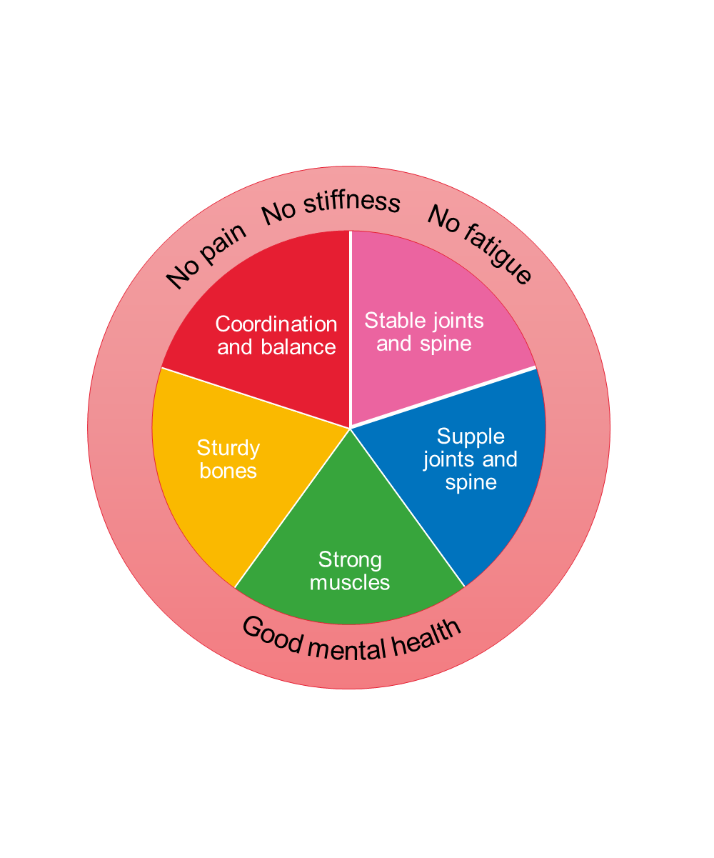
Physical activity for MSK health
A public health approach
Shift focus from
end stages of musculoskeletal disease to promotion
of lifelong musculoskeletal health.
Everyone, at every age can do something to improve and maintain the health of their muscles, bones and joints.
Particularly promote physical activity and a healthy weight
https://www.versusarthritis.org/policy/policy-reports/musculoskeletal-health/

Slide 6
Physical activity for MSK health
What do we know, what do we say?
Physical activity improves symptoms & co-morbidities
50% adults attending rheumatology clinics reported that physical activity had never been discussed with them^{1,2}
Lack of confidence, knowledge
(safety concerns) & resources^{3,4}
Role for HCPs
1. Manning VL et al Rheumatology.2011;50:iii34
2. Hurkmans EJ et al Clin Rheumatol 2011;30:16039.
3. Fontaine KR et al Arthritis Rheum 2005;53: 27983.
4. Lillie et al . Musculoskeletal Care 2013;11:938.

Slide 7
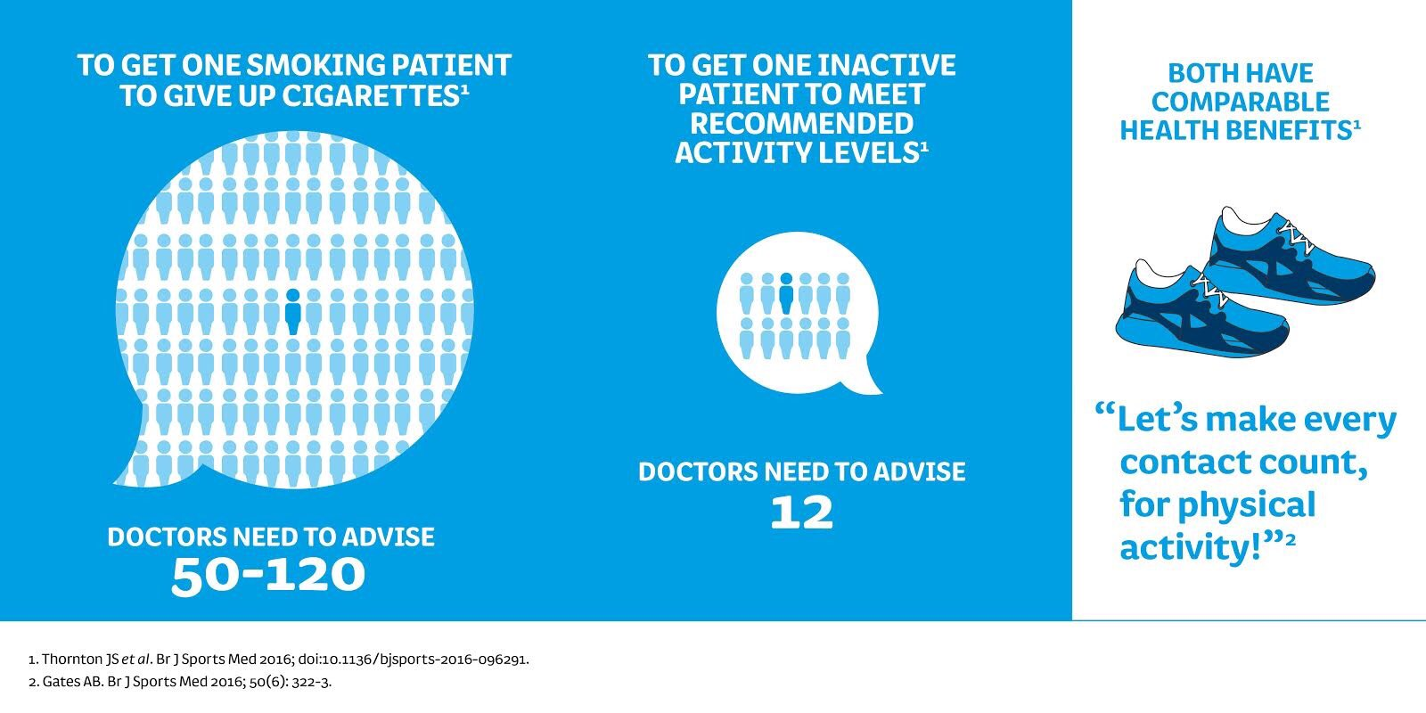
Physical activity for MSK health
It’s worth a mention

Slide 8



Physical activity for MSK health
Structuring the conversation
PA history
Discuss benefits & mechanism
Explore barriers & motivators
Address fear & safety concerns
PA prescription & signposting
https://movingmedicine.ac.uk/disease/msk/

Slide 9
Physical activity for MSK health
Benefits in rheumatoid arthritis
Outcomes with definite positive effect | Outcomes uncertain effect | Outcomes with no effect | Outcomes with definite negative effect
Physical function/ Disability Quality of life Strength Mood/psychological wellbeing Pain (CVS exercise) | Fatigue Pain (resistance exercise) Disease activity | Radiological changes | Absence of adverse events vs controls
https://movingmedicine.ac.uk/disease/msk/

Slide 10
Physical activity for MSK health
Benefits for common MSK conditions
OA hip/knee; Back pain
Reduces pain
Reduces stiffness
Improves physical function
Chronic MSK pain
Reduces pain
Improves fatigue
Improves physical function
Reduces tenderness
Improves self-efficacy
Improves general wellbeing
Improves fitness
Talk about ‘wear and repair’ and not ‘wear and tear’ when giving the diagnosis of OA. Explain that, although we commonly refer to OA as wear and tear, OA is a metabolically active condition and not the simple mechanical wearing out of a joint, and so is about wear and repair.
Porcheret M et al. Osteoarthritis: a modern approach to diagnosis and management. Arthritis Research UK Hands On Series 6, Issue 10, Autumn 2011

Slide 11
Physical activity for MSK health
Structuring the conversation
PA history
Discuss benefits & mechanism
Explore barriers & motivators
Address fear & safety concerns
PA prescription & signposting
https://movingmedicine.ac.uk/disease/msk/

Slide 12
Physical activity for MSK health
Exercise influencers in chronic MSK pain
Motivators
Anticipated positive effects/symptom management Pain relief Well-being Return to previous functioning Group exercise/peer support Exercise on prescription Fun/enjoyment
Barriers
Symptoms Pain Fatigue Reduced function/mobility Fear/kinesiophobia Lack of education/belief pain is bad and irreversible Lack of support/ personalisation of programme Co-morbidities Lack of time/motivation Cost/expense

Slide 13
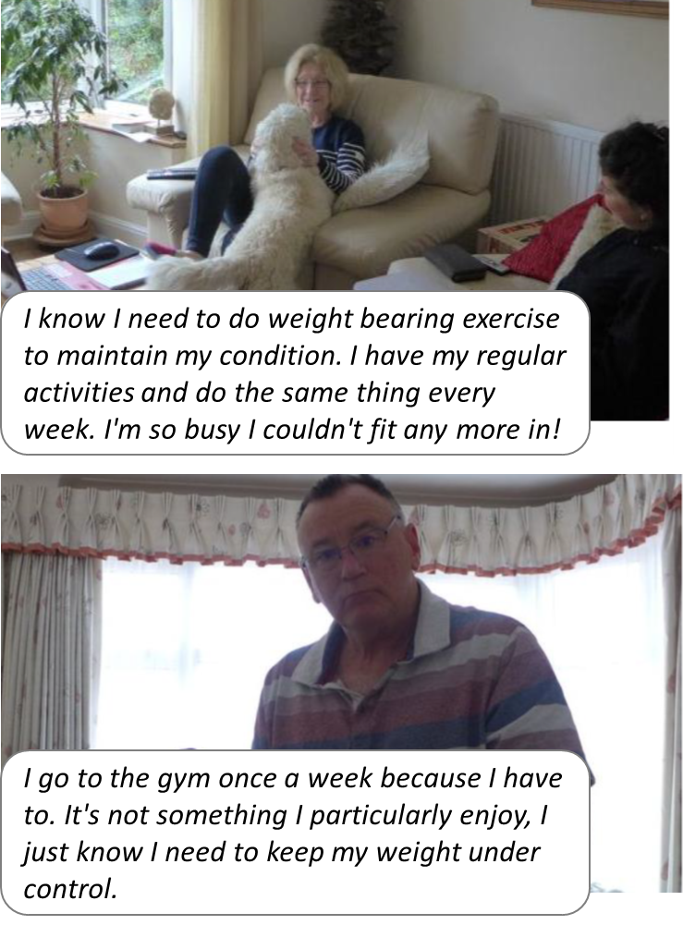
Physical activity for MSK health
Motivating factors for the ‘managing’
Exercise: Most
universally acceptable word.
Physical activity: People found the term a bit harsh and vigorous.

Slide 14

Physical activity for MSK health
Competing narratives about pain
Aggravating
Zapping
Damaging
Improving
Energising
Protecting
If I was more active,
I may have more knee pain and my knees might go.
Nicky, living with OA
Exercise can prevent flare ups if I keep it up as a routine. I do these regular stretches to prevent flare ups and manage the pain level.
Kylie, living with OA and fibromyalgia

Slide 15
Physical activity for MSK health
Structuring the conversation
PA history
Discuss benefits & mechanism
Explore barriers & motivators
Address fear & safety concerns
PA prescription & signposting
https://movingmedicine.ac.uk/disease/msk/

Slide 16
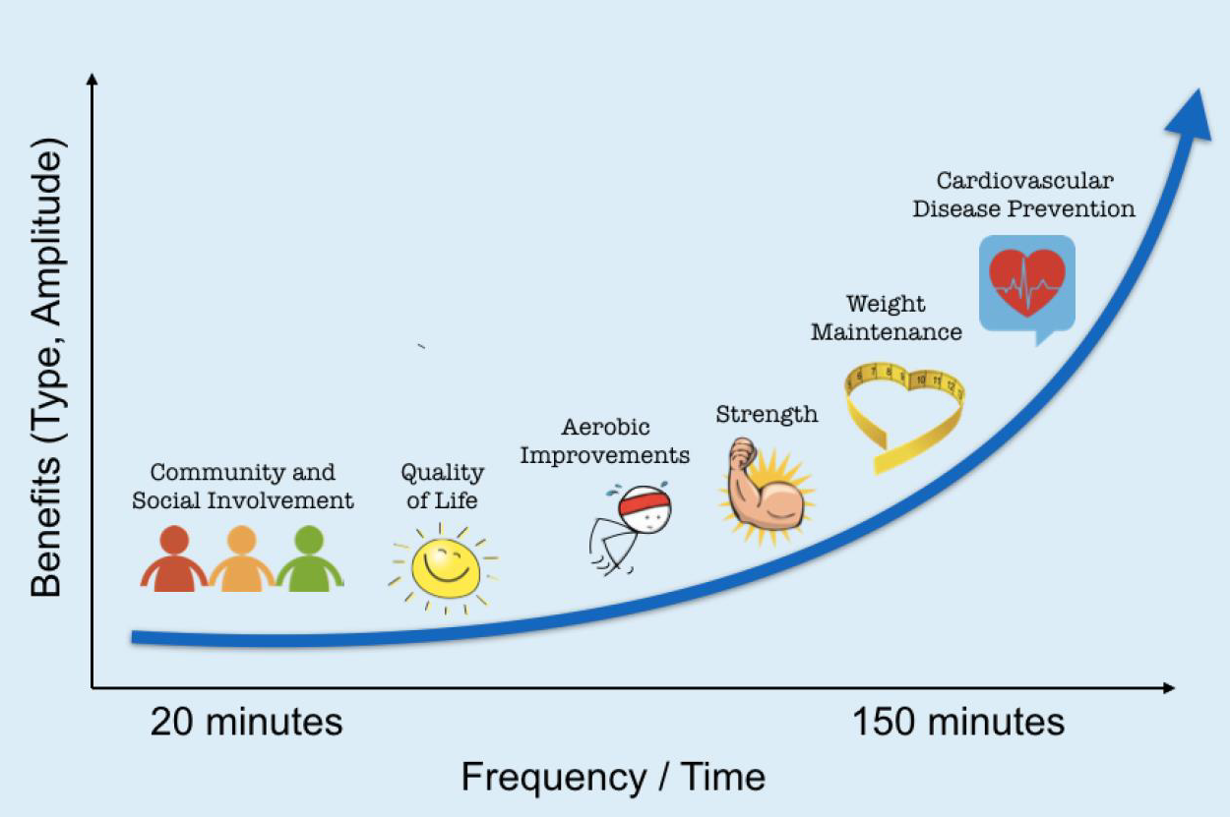
Physical activity for MSK health
Talking about the benefits
…an emphasis on the dose response relationship of physical activity and benefits to health could produce wider public health benefits and have greater impact than just one touch point – that is, 150 minutes per week
Physical activity for general health benefits in disabled adults: Summary of a rapid evidence review for the UK Chief Medical Officers’ update of the physical activity guidelines

Slide 17
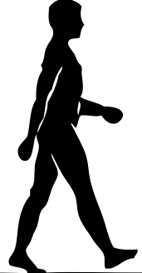


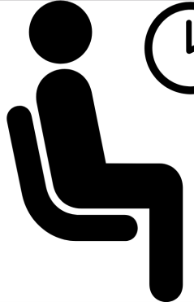

Physical activity for MSK health
How much is enough
Light
intensity
Moderate
intensity
Vigorous
intensity
Sleep
Sedentary
Moderate:
“talk, not sing”
Tremblay et al. (2010) Appl Physiol Nutr Metab

Slide 18
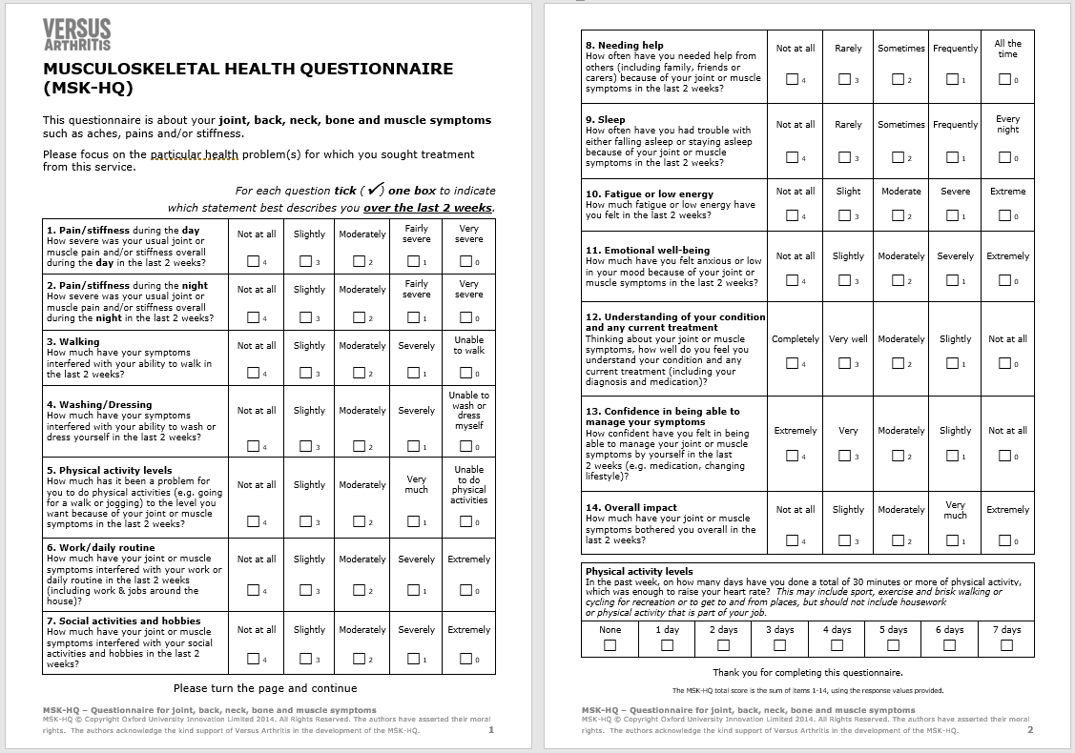


Physical activity for MSK health
Measuring what matters

Slide 19
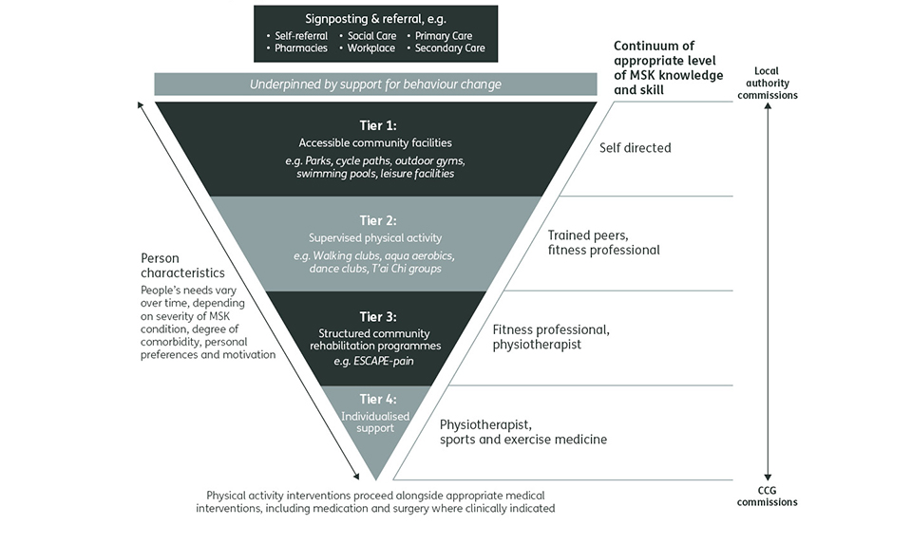
Physical activity for MSK health
Matching need to services
Appropriate physical activity improves MSK health
Muscle weakness worsens pain… so build joint strength and stability first
Pain is a barrier to physical activity participation
We can’t provide hands on treatment for all but luckily
not everyone
needs it…!
https://www.versusarthritis.org/policy/policy-reports/providing-physical-activity/

Slide 20



Physical activity for MSK health
Structured programmes, example 1
Enabling Self-management and Coping with Arthritic Pain using exercise
http://www.escape-pain.org/
Group chronic hip/knee pain programme:
✓ Patient information
Tailored advice on condition, self- management, pain coping strategies, weight control;
✓ Personalised Exercise regimen
  Individualised, progressive, challenging
  10 -12 sessions
  Supervised by physiotherapist, fitness instructor
  Clinically and cost-effective
  Needs large room, simple equipment
ESCAPE-pain:
Reduces pain
Improves function
Improves wellbeing
Reduces healthcare costs (estimated annual saving of £1,417 per person)
Benefits sustained for up to 30 months

Slide 21

Physical activity for MSK health
Structured programmes, example 2
Self-care group chronic low back pain programme:
✓ Physical activity (beginner-friendly)
Strengthening, Stretching, Mobility, Posture
✓ Education and behaviour change
Pain-relief, Spinal health education, Positive mental outlook, Home practice
✓ Holistic approach
Breathing, Mindfulness, Relaxation
www.yogaforbacks.co.uk
When studied, YHLB led to:
30% improvement in daily functioning
70% reduction in work absenteeism over 12 months (average 3.8 days off sick compared to 12.3 for control)
Most maintained exercises 9 months after course
Cost effective from NHS, societal perspective
  Delivering the programme
  Course of 12 classes x75 mins, max. 12 people
  Taught by qualified yoga teachers with additional specialised training
  Educational resources: Manual (book), Relaxation CD, Practice Sheets
  Cost £300 per person attending
Tilbrook HE et al. Ann Intern Med. 2011 Nov 1;155(9):569-78.
Chuang LH et al. Spine (Phila Pa 1976). 2012 Aug 15;37(18):1593-601.

Slide 22






Physical activity for MSK health
Health promotion systems
https://youtu.be/OVbpHFyUmR4
Set up ‘Managing Your Joint Pain’ clinics
Focus on physical activity and self-management
Signpost to local partners
Referral routes
Hip, knee and back pain
4 appointments over 6 months
Collect clinical outcome data
Free service for people living with persistent pain.
Chronic pain health trainers based in GP practices, community and leisure buildings.
5-7 one-hour sessions of 1-1 support
Encourage people to identify, and achieve health and wellbeing goals.
Harris J et al. Using health trainers to promote self-management of chronic pain: can it work?
Br J Pain. 2014 Feb;8(1):27-33.

Slide 23
Physical activity for MSK health
Learning objectives
By the end of this talk, participants will be able to:
Discuss the benefits of physical activity for people with musculoskeletal conditions
Use a framework to incorporate discussions about physical activity in clinical consultations
Describe a public health framework for providing physical activity for people with musculoskeletal conditions

