Slide 1

Gout - Treat to Target
Colin Tench
Consultant Rheumatologist
Imperial College Healthcare

Slide 2
Objectives
Treatment
  Acute gout
  Chronic gout
  Prophylactic treatment
Treat to target
New drugs
Pseudo gout
Joint Injections

Slide 3
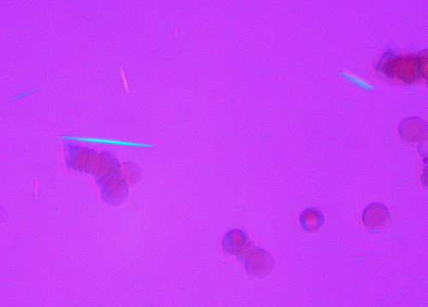
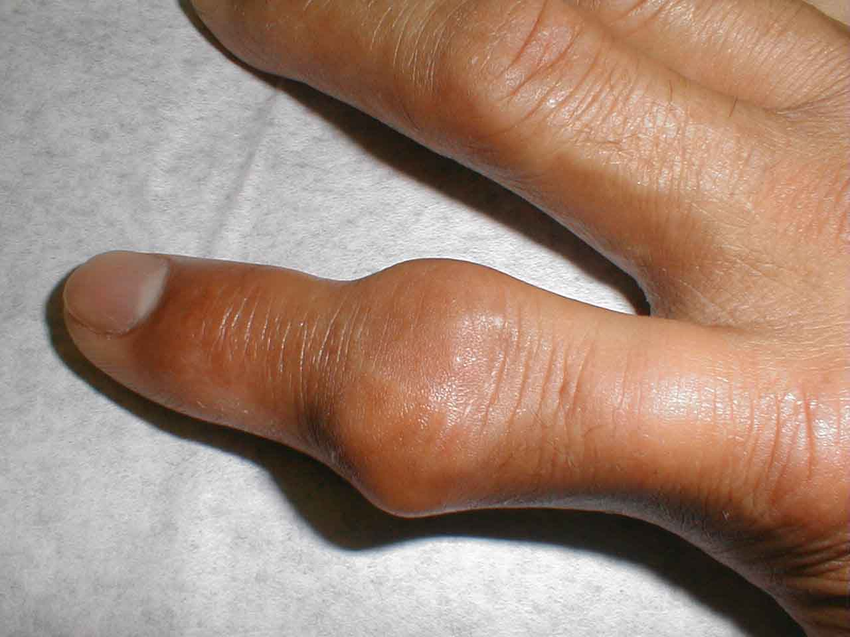
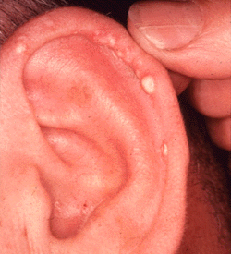
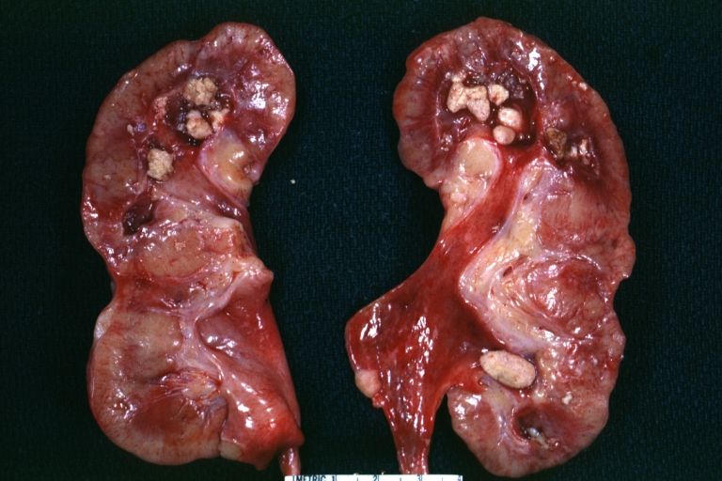
Gout

Slide 4
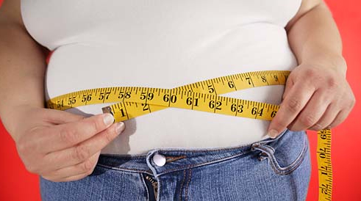
Gout
Common
  Hypertension
  Obesity
  Metabolic syndrome
  Chronic kidney disease
  Thiazide and loop diuretics
  Between 1965 and 2005 no new drugs for gout

Slide 5
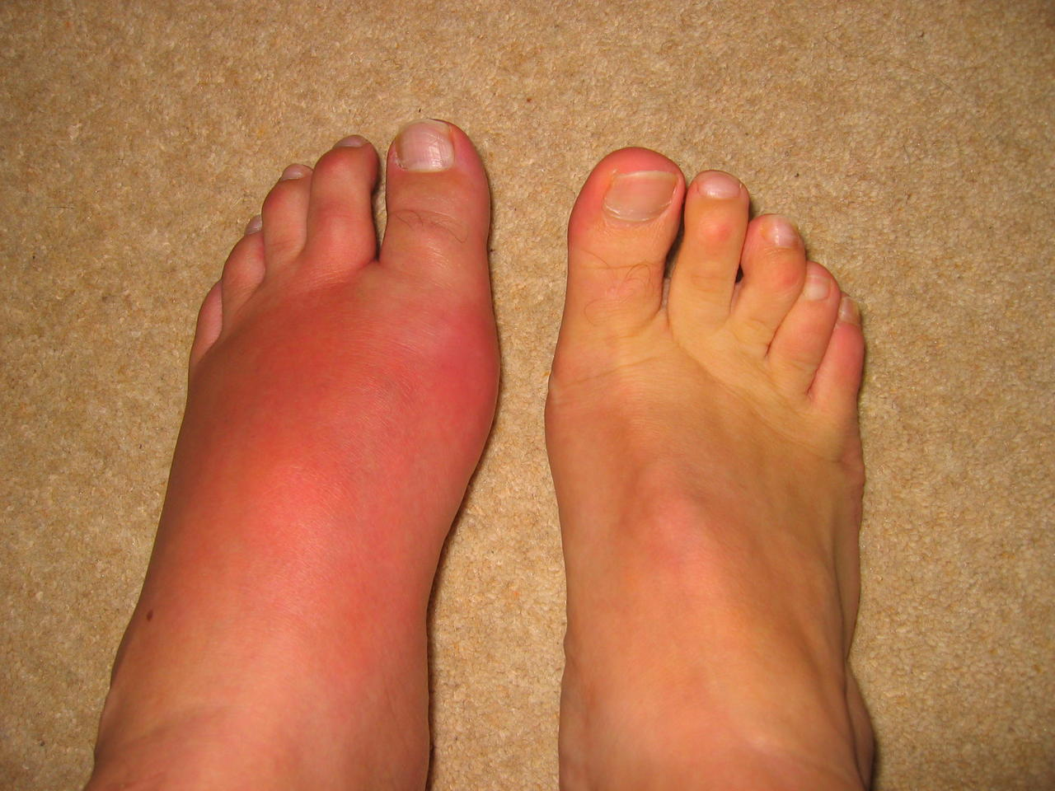
Diagnosis
Episodic arthritis
Severity peaks 12-24hrs
80% lower limb
Synovial fluid analysis
Blood tests
Normal to low urate levels in 12-43% acute flares

Slide 6
Guidelines
British Society for Rheumatology guideline for the management of gout. Rheumatology. Vol 56 Issue 7, 1st July 2017, Pages e1-e20
Richette P, Doherty M, Pascual E et al 2016 Updated EULAR evidence-based recommendations for the management of gout
Annals of the Rheumatic Diseases 2017;76:29-42
2012 American College of Rheumatology Guidelines for Management of Gout.
Part 1: Systematic Nonpharmacologic and Pharmacologic Therapeutic Approaches to Hyperuricemia. Arthritis Care & ResearchVol. 64, No. 10, October 2012, pp 1431–1446
Part 2: Therapy and Antiinflammatory Prophylaxis of Acute Gouty Arthritis. Arthritis Care & Research Vol. 64, No. 10, October 2012, pp 1447–1461

Slide 7
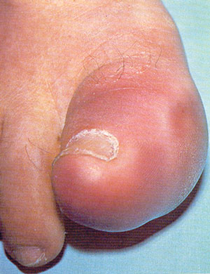
Acute gout
Treat early
Continue established urate lowering treatment
NSAID
Colchicine
Severe attacks
  combination therapy

Slide 8
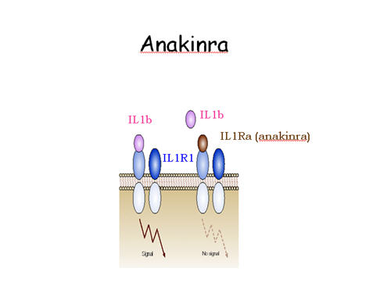
New treatments- off label
  IL-1β- key cytokine
  IL-1 inhibitors in treatment resistant gout
  Anakinra
    IL-1 receptor antagonist
  Rilonacept
    IL-1 Trap
  Canakinumab
    monoclonal anti IL-1β antibody

Slide 9
IL-1 inhibition
Canakinumab
  Monoclonal antibody blocks IL-1β signalling
  150 mg s/c v 40mg triamcinolone acetonide
  2 randomized trials 456 patients.
  Canakinumab resulted in a significantly greater reduction in a mean 72-hour pain score using a 100 mm visual analog scale (decrease of 35.7 versus 25 mm).
  Four patients receiving canakinumab, required hospitalization for treatment of infections (one abscess of the jaw, one abscess of the forearm, pneumonia, and gastroenteritis)
  Schlesinger N, Ann Rheum Dis.2012;71(11):1839.

Slide 10
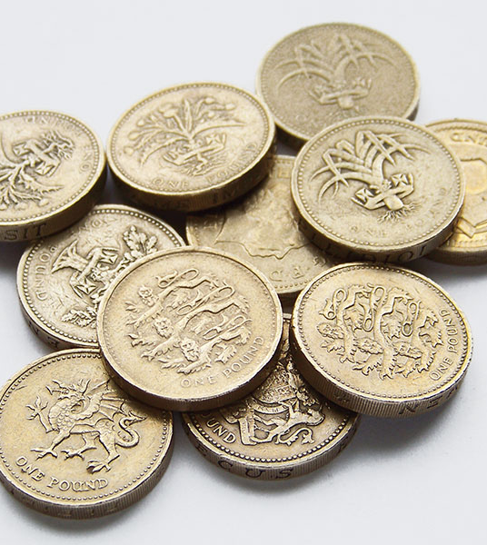
Cost
Colchicine 36p/tablet
Naproxen 6.5p/tablet
Anakinra £26/syringe
Canakinumab
  £9927

Slide 11
Chronic gout
General health, diet and lifestyle measures
Avoid
  Offal
  Soft and energy drinks
  Alcohol overuse
Limit
  Purine rich meat and seafood
  alcohol
Encourage
  Vegetables
  Low fat dairy products

Slide 12
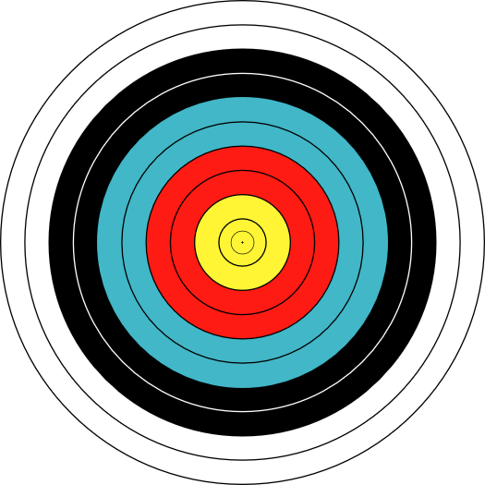
Treat to target- a potential for cure
MSU saturation threshold 408 μmol/L
Target <360 or 300 μmol/L
Dissolves crystals
No new crystals

Slide 13
Urate lowering therapy- 1st line
Allopurinol
Starting dose 100mg/day
Up to 800mg/day
Acute gout prophylaxsis

Slide 14

Reduction in flares when using
colchicine for prophylaxis
Colchicine prophylaxis during initiation of ULT for chronic hyperuricaemia with urate deposits:
  Reduces the frequency and severity of acute flares
  Reduces the likelihood of recurrent flares
  Evidence supports the use of low dose colchicine for up to 6 months following initiation of urate-lowering therapy
3.5
Colchicine (n=21)
3.0
Placebo (n=22)
2.91
2.5
Mean number of gout flares in patients treated with allopurinol
1.91
1.05
2.0
1.5
1.0
0.57
0.52
0.5
0.0
0
0-3 months
3-6 months
Overall
Borstad GC, et al. J Rheumatol 2004; 31(12): 2429-32.
Notes:
In a randomised, prospective double-blind trial, 43 patients starting allopurinol treatment for chronic gouty arthritis were randomised to receive colchicine 0.6 mg po bid or placebo. These patients were followed for evidence of acute gout flares and remained on colchicine for 3 months beyond attaining a serum urate concentration of less than 6.5 mg/dl. Subjects treated with colchicine experienced fewer total flares (p=0.008), fewer flares from 0 to 3 months (p=0.022), fewer flares between 3-6 months (p=0.033), and less severe flares as reported on a visual analogue scale (p=0.018), and fewer recurrent gout flares (p=0.001). Thus, treating patients with colchicine for 6 months during initiation of allopurinol therapy reduces the frequency and severity of acute flares, and reduces the likelihood of recurrent flares. [1]
1. Borstad GC, et al. J Rheumatol 2004; 31:2429-2432.

Slide 15
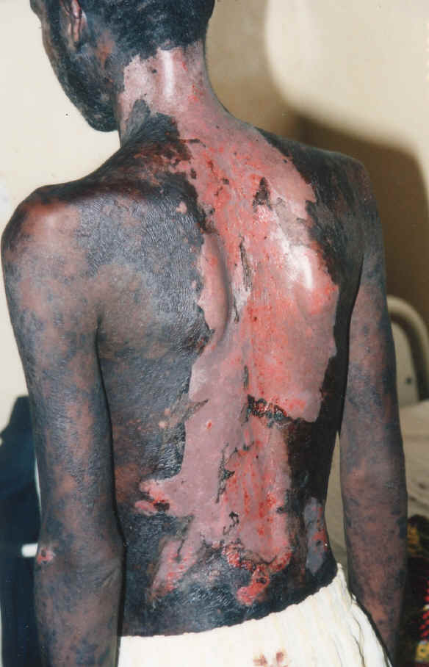
Adverse effects
Minor hypersensitivity reactions
  2%
Stevens Johnsons
Allopurinol hypersensitivity syndrome
  Rare
  20% mortality

Slide 16
HLA-B*5801
Korean descent &CKD (allelle frequency 12%)
Han Chinese or Thai (allelle frequency 6-8%)
Hazard ratios of several hundred
Worth testing in high risk populations before starting allopurinol. Avoid if positive.
Hershfield MS, Clin Pharmacol Ther. 2013;93(2):153.

Slide 17
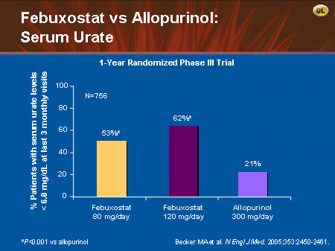
Febuxostat
Oral 80mg or 120 mg
inhibits xanthine oxidase

Slide 18
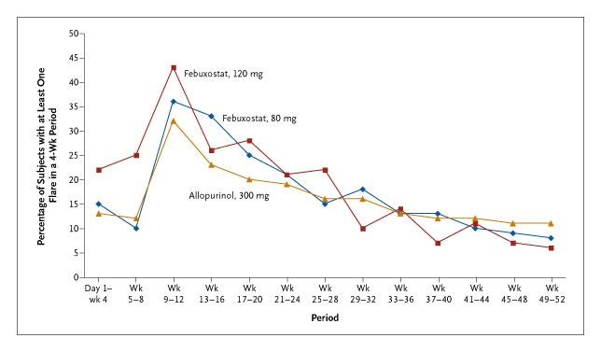

Subjects Requiring Treatment for Gout Flares.
Becker MA et al. N Engl J Med 2005;353:2450-2461.
Notes:
Figure 2. Subjects Requiring Treatment for Gout Flares. The percentage of subjects in each interval is calculated by dividing the number of subjects with at least one gout flare in that interval by the number of subjects exposed to at least one dose of drug in that interval. Subjects may be counted in more than one interval. The subjects received prophylaxis during the period from day 1 to week 8. The results for the 80-mg febuxostat group are shown in blue, those for the 120-mg febuxostat group in pink, and those for the allopurinol group in yellow.

Slide 19
Efficacy in patients with renal impairment
APEX study (6 months):
proportion of renal impaired (>1.5–≤2 serum creatinine [>133–≤177 μmol/l])
subjects with last 3 sUA levels <6.0 mg/dl (<0.36 mmol/l)
50
*
*
44%
46%
*p≤0.05 all febuxostat doses vs allopurinol and placebo
40
% of patients
30
20
10
0%
0%
0
Placebo
Febuxostat 80 mg
Febuxostat 120 mg
Allopurinol 100 mg
(n=5)
(n=9)
(n=11)
(n=10)
ITT population: subjects with serum urate level ≥8.mg/dl on day -2
Schumacher HR, et al. Arthritis Rheum 2008; 59: 1540-8.
Notes:
19
The APEX trial included patients with normal renal function (serum creatinine ≤1.5 mg/dl) and those with impaired renal function (serum creatinine level >1.5 mg/dl and ≤2.0 mg/dl). The proportions of subjects with impaired renal function attaining the primary efficacy end-point of last 3 monthly serum urate levels <6.0 mg/dl were 44% in the febuxostat 80 mg group and 46% in the 120 mg group. None of the subjects with renal impairment receiving allopurinol (at a 100 mg dose according to the study protocol) or placebo achieved last 3 monthly serum urate levels <6.0 mg/dl. [1]
Thus, febuxostat more effectively lowered and maintained serum urate levels <6.0 mg/dl than did allopurinol or placebo in subjects with hyperuricaemia and gout and mild to moderate impairment of renal function. [1]
1. Schumacher HR, et al. Arthritis Rheum 2008; 59:1540-1548.

Slide 20
Febuxostat
NICE approved in patients
    can't take allopurinol for medical reasons or
    the side effects of allopurinol are so bad that the person either has to stop taking it or can't be given the most effective dose.
£318 year
Not recommended for people with IHD or CCF

Slide 21
Uricosuric therapy
Increase uric acid secretion
Probenicid and sulphinpyrazone
  Avoid in renal impairment
  Avoid urolithiasis
  Measure urine uric acid
Benzbromarone
Losartan and fenofibrate

Slide 22
Lesinurad
Urate transporter inhibitor- URAT1
  FDA & EMA approved
Used in combination with xanthine oxidase inhibitor
2 RCTs show more patients achieve target uric acid (54% v 27%)
But average allopurinol dose 310mg and no evidence reduction in flares, tophi or mortality

Slide 23
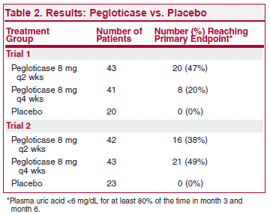
Peglioticase
Uricase enzyme converts urate to allantoin
absent in humans
Porcine uricase
2 phase 3 trials 225 patients with treatment resistant gout
Sundy JS, JAMA. 2011;306(7):711.

Slide 24
Peglioticase
Peglioticase antibodies developed in nearly 90% patients receiving the active drug
High titres were associated with loss of urate lowering effect
5 patients had severe infusion reactions

Slide 25
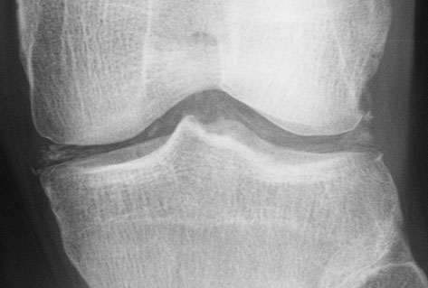
Pseudogout
Calcium pyrophosphate dihydrate (CPPD)
Asymptomatic
Pseudogout

Slide 26
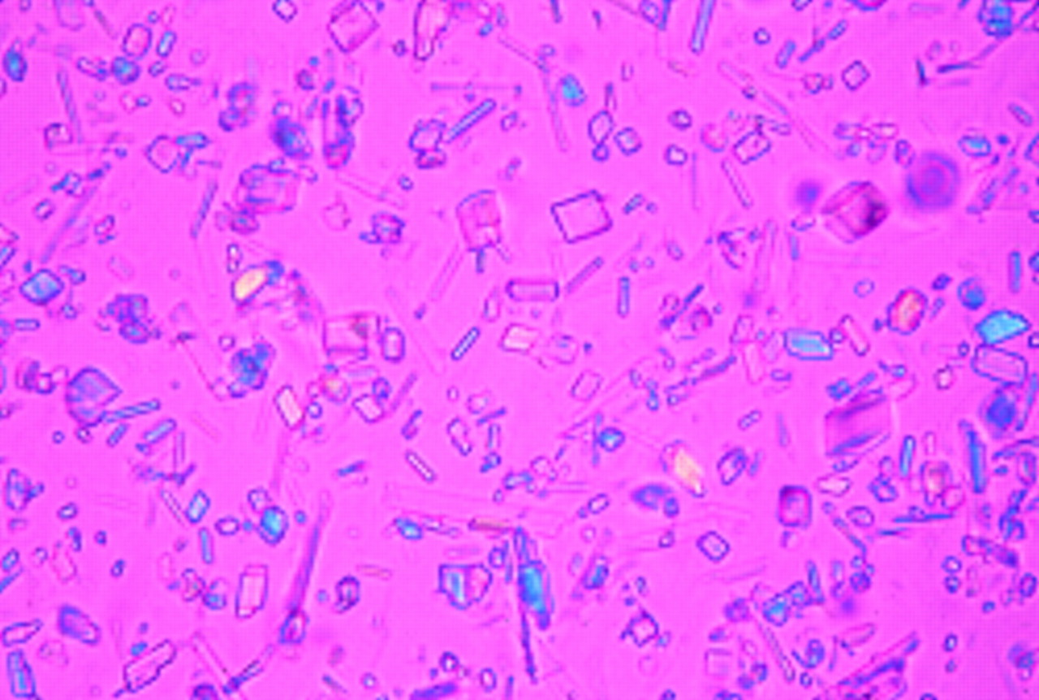

Slide 27
Treatment
Acute
NSAID
Colchicine
Intra- articular steroid
Prednisolone
Prophylactic
Colchicine

Slide 28
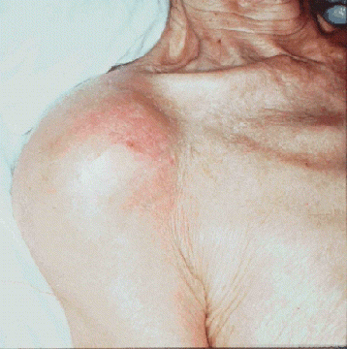
Joint and soft tissue injections
Diagnostic
Therapeutic

Slide 29
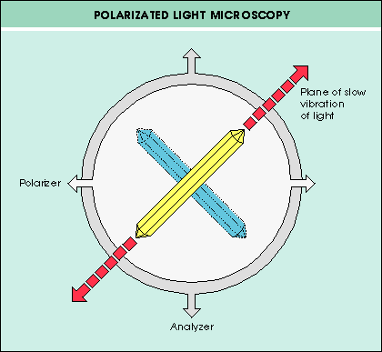

Slide 30
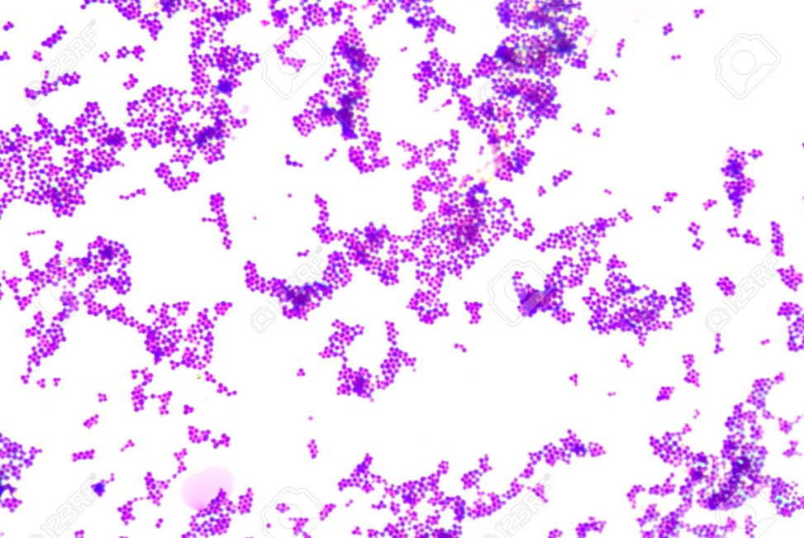

Slide 31
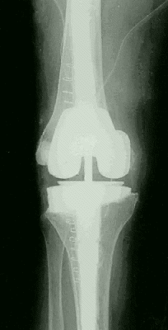
Who not to inject
Prosthetic joint
Infected joint
Overlying cellulitis
Bleeding disorder

Slide 32
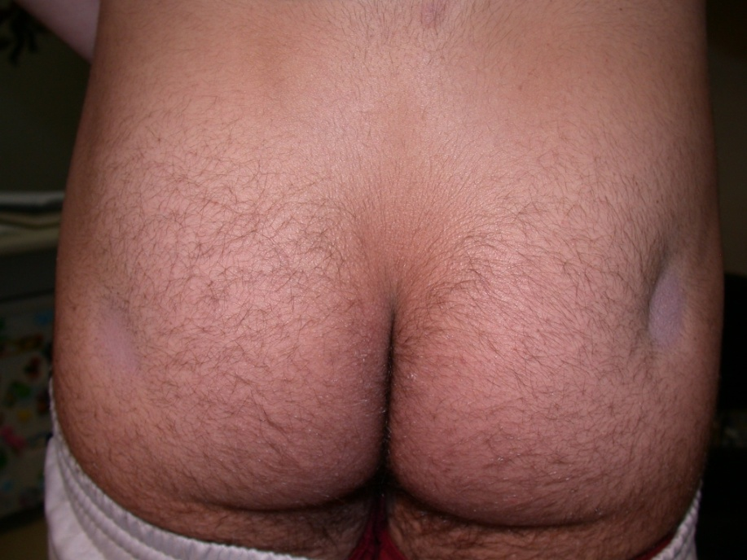
Complications
Infection
Tendon rupture
Facial flushing
Post injection flare
Skin atrophy
Skin hypopigmentation

Slide 33
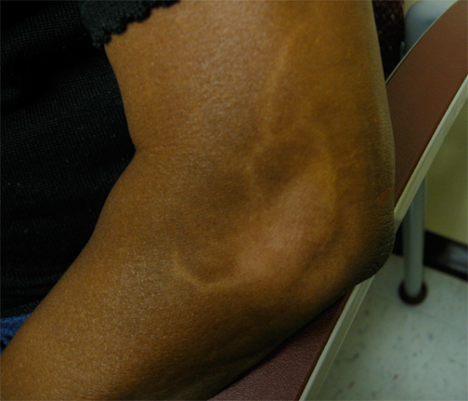
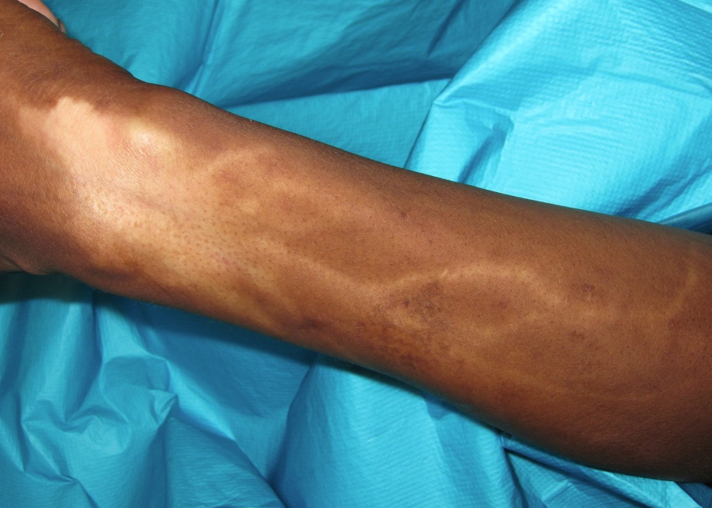

Slide 34
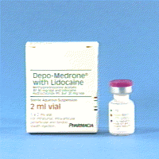
What to inject?
Hydrocortisone
Methylprednisolone acetate
Triamcinolone hexacetonide

Slide 35
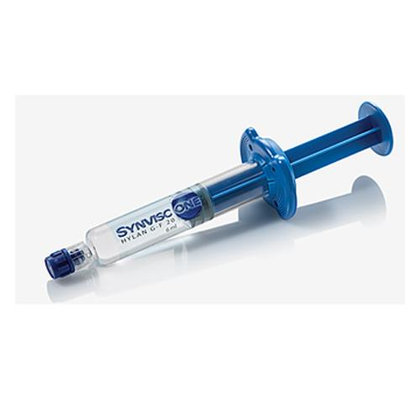
Hyaluronic acid
Knee osteoarthritis
Small and clinically irrelevant benefit compared to placebo
High cost
Acute flares

Slide 36
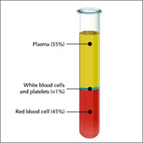
Platelet rich plasma
Contains “growth factors” stimulate tissue repair
Tendinopathies, plantar fasciitis, OA
Quality evidence low
At best unproven

Slide 37
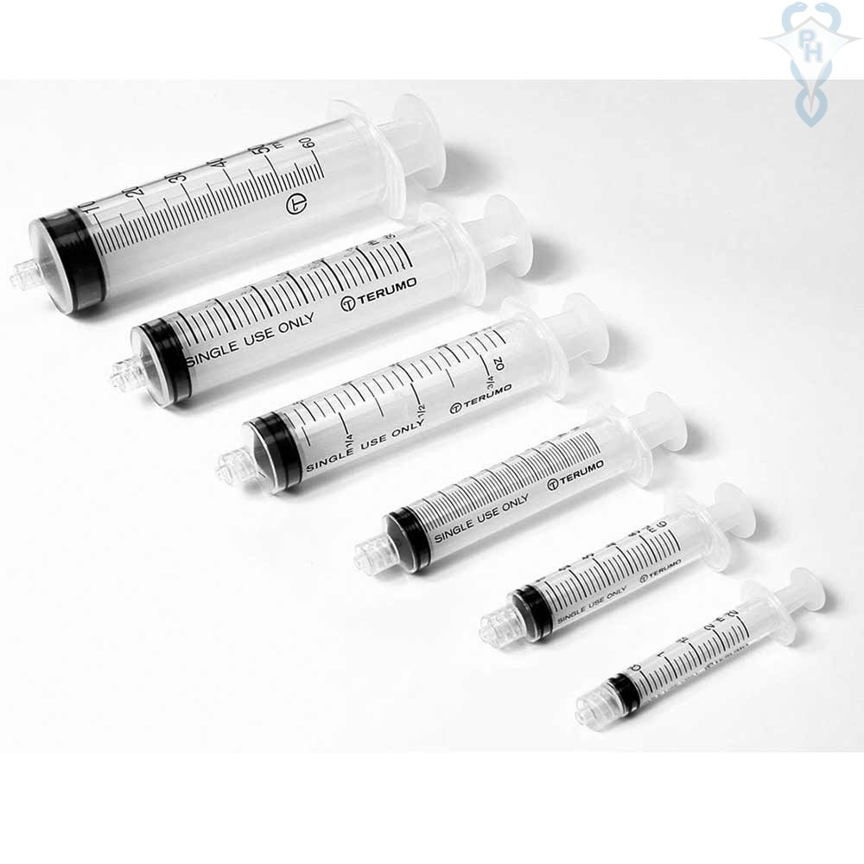
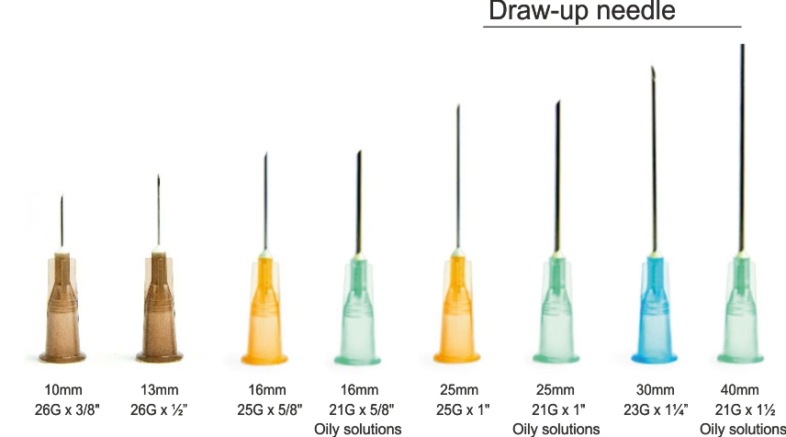

Slide 38
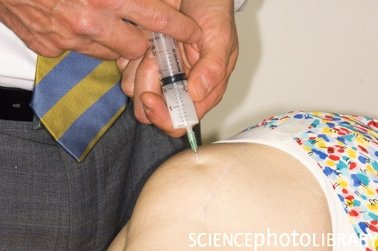
What to do at the time of the injection?
Chair or couch
Fully explain procedure
No touch technique
Local anaesthet

Slide 39
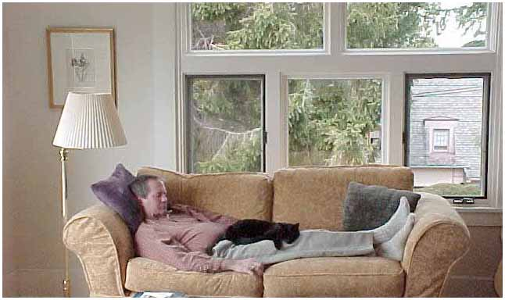
Aftercare
Rest for 24hours

Slide 40
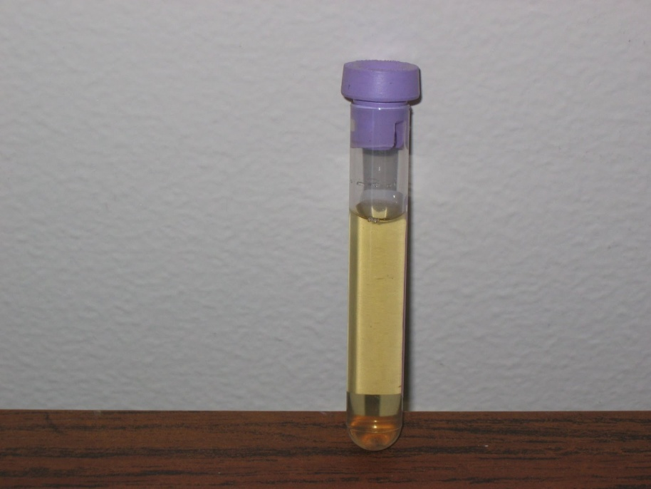
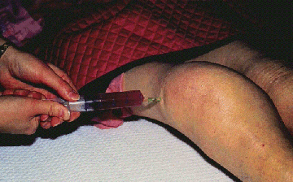

Slide 41
Summary
Conventional treatment for acute and chronic gout
Treat to target
New drugs
Pseudo gout
Joint injections

