Slide 1

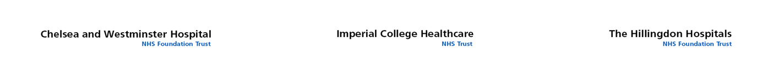
NWL Pathology GP Study Afternoon
Saghar Missaghian-Cully - Managing Director

Slide 2
Points of Discussion
Overview of North West London Pathology
Transition Plan
Update on Accreditation
Overview of Quality Framework
Test Assurances
Escalation Processes for GPs
Questions, comments, feedback

Slide 3
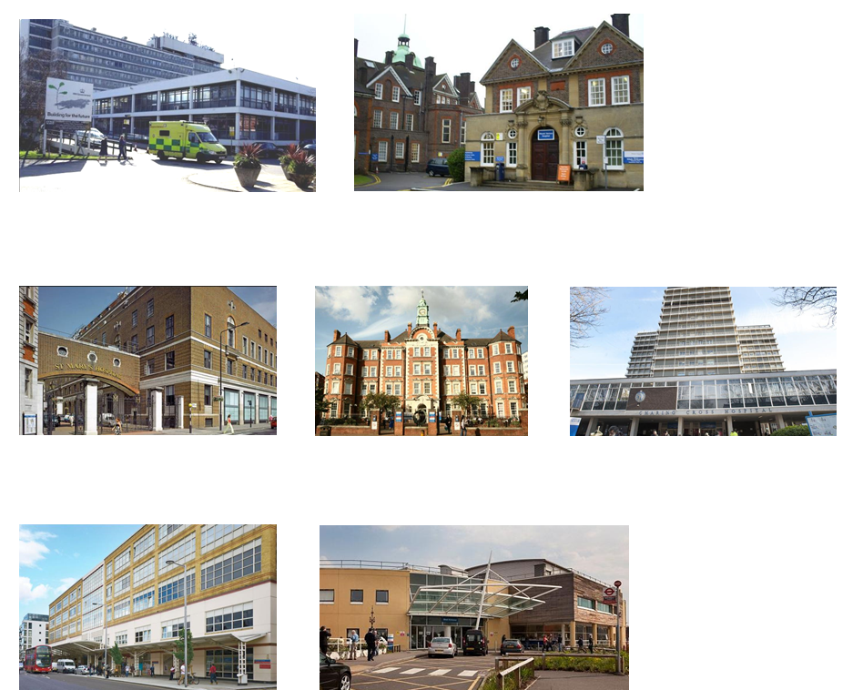
The Hillingdon Hospitals
Imperial College Healthcare NHS Trust
Chelsea and Westminster NHS Foundation Trust

Slide 4
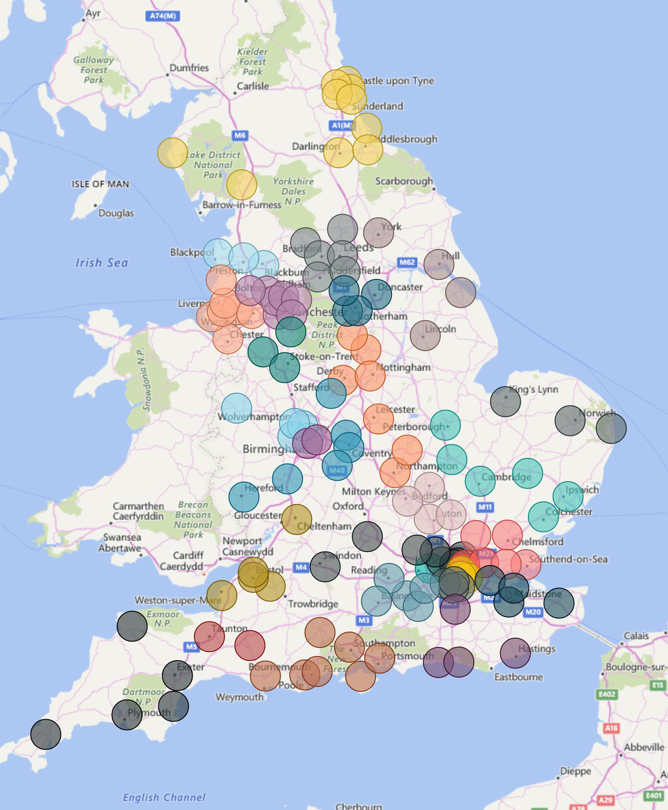
Changes to pathology across the UK
Pathology under pressure to deliver more with less
Analysis and modelling
Patient flow
Population size
STP boundaries
Cost of delivery £2.2 billion

Slide 5


Slide 6
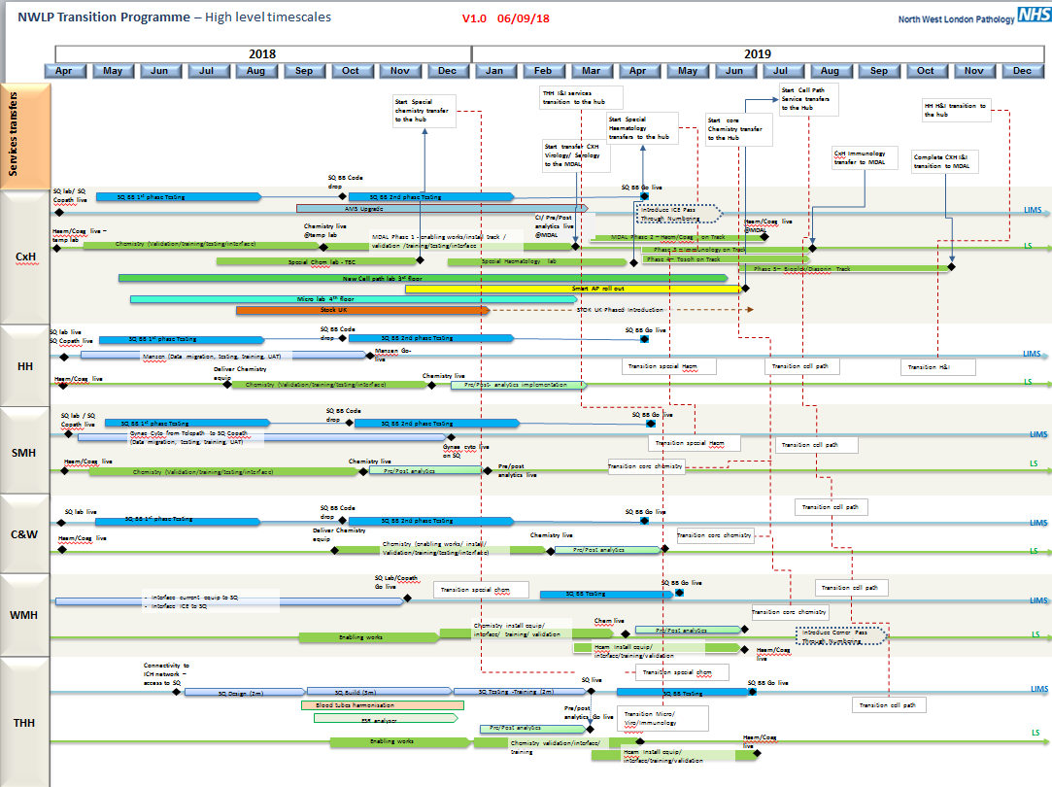

Slide 7
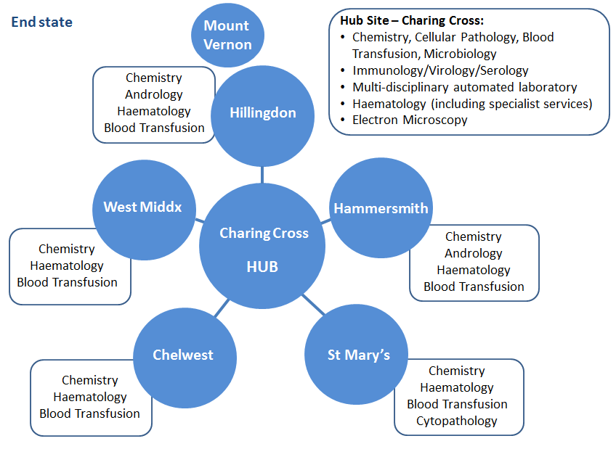
Hub and Spoke Model

Slide 8
Transition Plan
Our modernisation programme has now embarked on the transition phase. This phase will deliver the services to the hub and spoke model in accordance with the approved consolidated business case (April 2016).
The formal transition programme governance has now been established and has 6 programme work streams:
Pathology Services Transition
IT
Workforce
Logistics
Estates
Communications
Intensive operational planning is underway to develop the detailed plans for the service transfers across our network to achieve the end state for the hub and spoke model.

Slide 9
Transition Plan
The implementation of the new SunQuest Laboratory Information Management System (LIMS) is in progress and the following sites went live in April 2018:
Charing Cross Hospital, Hammersmith Hospital, St Mary’s Hospital, Chelsea and Westminster
The laboratory services project that covers the implementation of new analytical platforms across NWLP is well underway.
The new Haematology/ Coagulation Analysers went live in April 2018 at the following sites:
Charing Cross Hospital, Hammersmith Hospital, St Mary’s Hospital, Chelsea and Westminster
Extensive estates works is currently taking place at the hub for the new Cellular Pathology laboratory. The implementation of the new Multi Disciplinary Analytical Laboratory (MDAL) will be next.

Slide 10
Transition Plan
Changes which are likely to have an impact on GPs
Tests will change to new reference ranges which reflect the change in methodology with the new analysers.
Change of blood collection tubes (Sarstedt to BD Vacutainer)
This is due to change in Haematology analysers.
This will go live on 2 December
Training sessions currently being organised with GP practices
ESR reporting
This is due to change in Haematology analysers
Change to reference ranges
This is due to go live in December
We are using the CCG as our main channel to communication these changes to GPs – via their newsletters or bulletins and emails.

Slide 11
Update on Accreditation
Microbiology
Imperial sites - surveillance visit March 2018
Next visit Feb/March 2019
Infection & Immunity
Imperial sites - surveillance visit May 2018
Next visit Feb/March 2019 with Microbiology
Cellular Pathology
Imperial sites - successfully obtained accreditation
Next surveillance visit due January 2019
Haematology & Blood Transfusion
Imperial and Chelsea and Westminster hospital sites - surveillance visit March 2018
Waiting for UKAS to grant us accreditation and add these tests to the laboratory schedule of accreditation - Next visit Feb/March 2019
Clinical Biochemistry
  Imperial and Chelsea and Westminster hospital sites - surveillance visit Sept 2018 - Next surveillance visit September 2019.

Slide 12
Overview of Quality Framework
Key
Host Trust
Owner Trust
Customer Trust
NWL Pathology Meeting
NWL Pathology Departmental meeting

Slide 13

Test Assurances
Validation and Verification
Training
Competence
Documented Procedures
Internal Quality Control (IQC)
External Quality Assurance (EQA)
Inter Laboratory Comparison
Delta Checking
Registered Scientists
Telephoning Critical Results

Slide 14
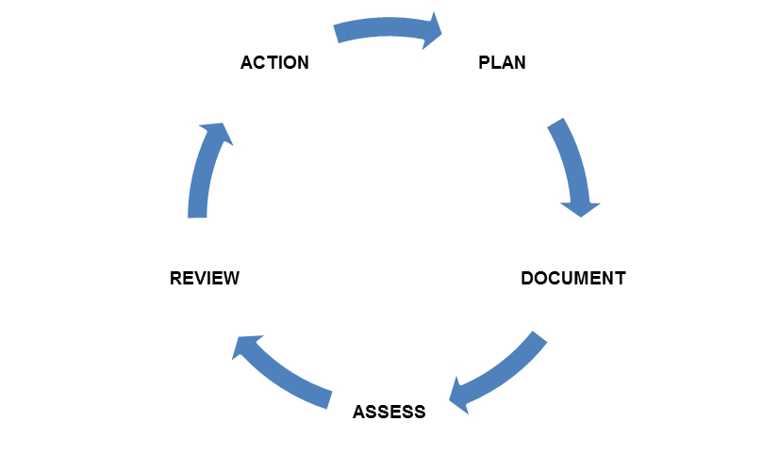
Quality Assurance
Internal audit of QMS and examination procedures
Quality improvements

Slide 15
Escalation Process for GPs
If you have any concerns in regards of your results then there are a
number of points of contact:
Imperial Call Centre: Tel: 020 331 35353
Email: ICHC-tr.ImperialPathologyResults@nhs.net
For any general enquiries or complaints please email: ICHC-tr.pathologyqueries@nhs.net
For any ICE IT enquiries please email: imperial.pathologyit@nhs.net
Out of hours:
Chemical Pathology Spr or Chemical Pathology Consultant via
Imperial College Healthcare NHS Trust switchboard 020 3311 3311
Hillingdon Results Line: 01895 279285 Email: thh-tr.thhpathology@nhs.net
Clinical Scientist at Hillingdon (Tues and Thurs): Lab number 01895 279 228 - ask for Laura
Tooth or Lab Manager on 01895 279 225 or ICHC-tr.biochemistryadvice@nhs.net
Pathology IT enquiries: thh-tr.pathologyit@nhs.net
For useful information on pathology go to the website: www.nwlpathology.nhs.uk

Slide 16
Any questions, feedback or comments?

