Slide 1


Vitamin D: clinical relevance and laboratory measurement
Ed Wilkes PhD
Senior Clinical Scientist

Slide 2

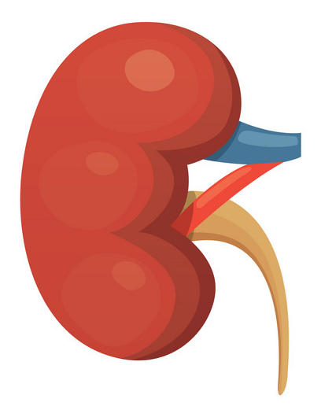
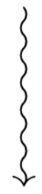

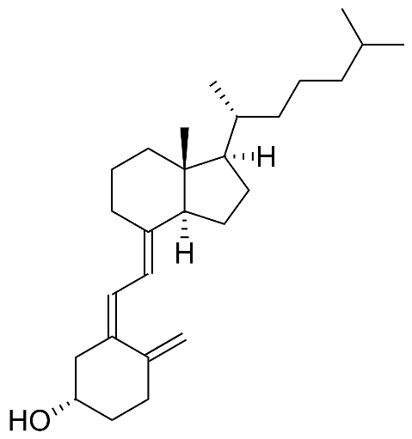

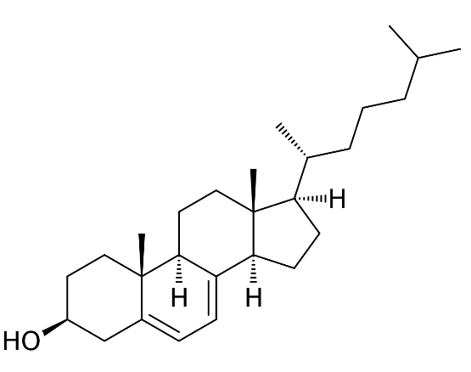
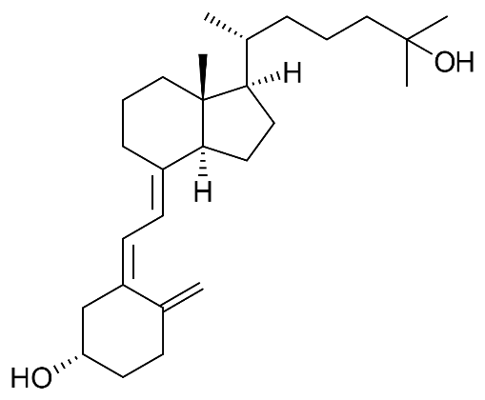
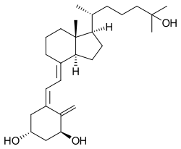
Formation of endogenous vitamin D
7-dehydrocholesterol
Vitamin D₃
25-hydroxyvitamin D₃
1,25-dihydroxyvitamin D₃

Slide 3
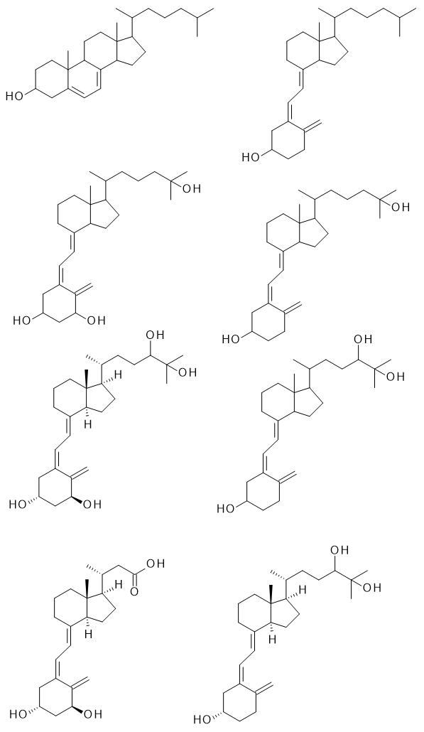
Metabolism of vitamin D
25-hydroxyvitamin D
1,25-dihydroxyvitamin D
Inactivation
Biliary excretion
24,25-dihydroxyvitamin D
1,24,25-trihydroxyvitamin D
Calcitroic acid

Slide 4
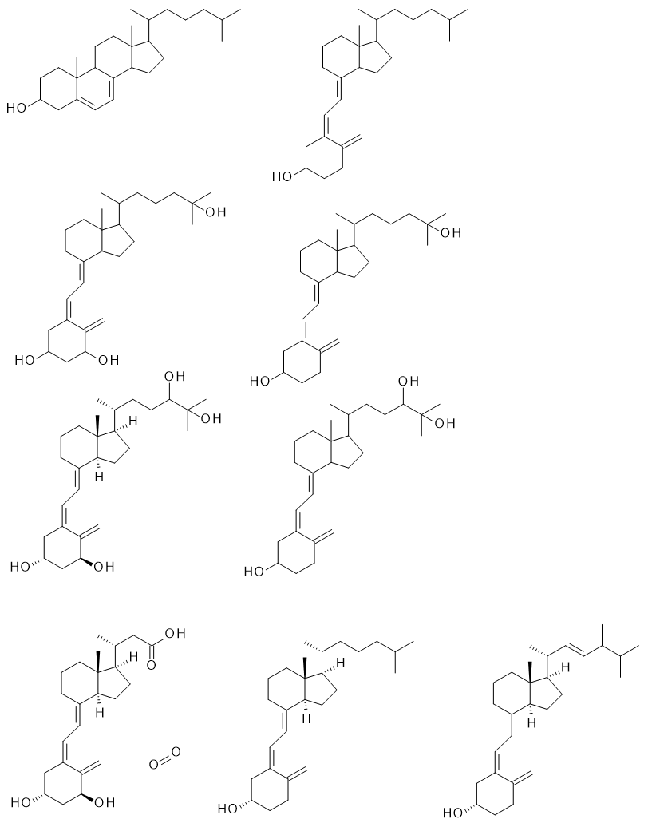
Forms of vitamin D
Vitamin D₃
Cholecalciferol
Endogenous form
Longer half-life
Vitamin D₂
Ergocalciferol
Exogenous form
Shorter half-life

Slide 5
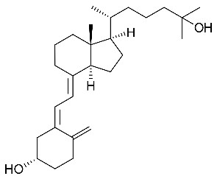

Vitamin D in circulation
25-hydroxyvitamin D is the main circulating form
25-hydroxyvitamin D circulates bound to vitamin D binding protein (VDBP)
Evidence suggests that different genetic variants of VDBP have different affinities for vitamin D
This may have an impact on total vitamin D circulating levels and their clinical interpretation (cf free/bioavailable testosterone – Powe et al. NEJM 2013)
+
VDBP
VDBP

Slide 6
Functions of vitamin D
1,25-dihydroxyvitamin D is the active form
Its primary effects are on calcium homeostasis and include:
    Increasing gut absorption of calcium and phosphate
    Stimulating bone resorption
Non-musculoskeletal effects include:
    Regulation of PTH secretion
    Blood pressure regulation via renin
    Pancreatic insulin secretion
    Immunomodulation
    Regulation of apoptosis

Slide 7
Vitamin D deficiency
Vitamin D deficiency can have several aetiologies
  Inadequate exposure to UV light
    reduced vitamin D formation
  Hepatic disease
    → reduced 25-hydroxylation of vitamin D
  Renal disease
  → reduced 1-hydroxylation of vitamin D
  Inadequate intake / malabsorption
    reduced vitamin D available for hydroxylation
Deficiency classically results in bone loss, muscle weakness, fractures
More clinically relevant in those with low calcium diets (e.g., veganism)
Some evidence to suggest link to cardiomyopathy in infants (Maiya et al. Heart 2008)

Slide 8
Vitamin D deficiency – typical biochemistry
Typical bone profile in early vitamin D deficiency in an adult:
Typical bone profile in severe vitamin D deficiency in an adult:
Analyte | Result | Reference range | Interpretation
Corrected calcium | 2.3 | 2.2 – 2.6 | Normal
Phosphate | 0.7 | 0.8 – 1.5 | Low
ALP | 223 | 30 – 130 | High
PTH | 14.5 | 1.1 – 6.8 | High
25-hydroxyvit D | 31 | 70 – 150 | Low
Analyte | Result | Reference range | Interpretation
Corrected calcium | 1.7 | 2.2 – 2.6 | Low
Phosphate | 0.5 | 0.8 – 1.5 | Low
ALP | 343 | 30 – 130 | High
PTH | 32.8 | 1.1 – 6.8 | High
25-hydroxyvit D | 17 | 70 – 150 | Low

Slide 9
Measurement of vitamin D in the laboratory
25-hydroxyvitamin D is the most commonly measured form in the lab
We can measure this metabolite with one of two methods:
  Immunoassay
  Liquid chromatography-tandem mass spectrometry (LC-MS/MS)
What about the other forms?
  Unhydroxylated vitamin D is hard to measure
  1,25-dihydroxyvitamin D is unstable and is rarely of clinical use

Slide 10
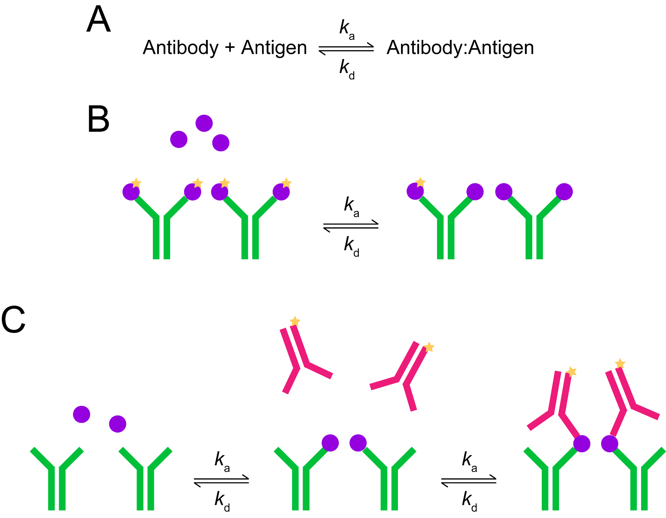
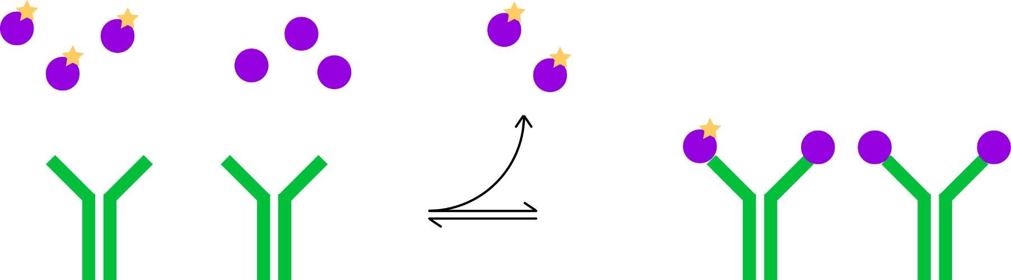
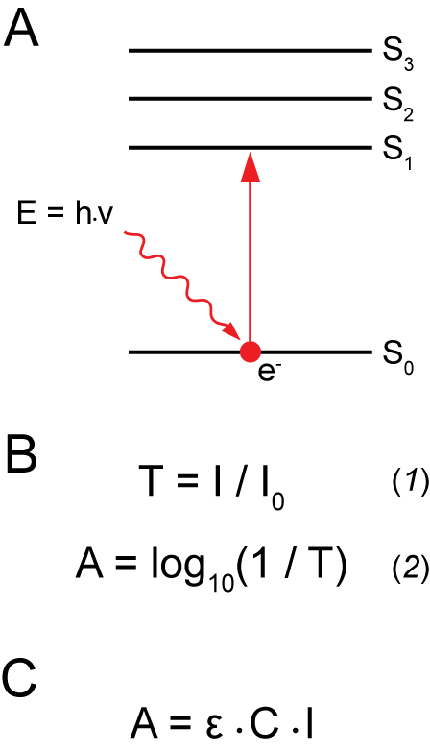
Immunoassay measurement of 25(OH)-vit D

Slide 11
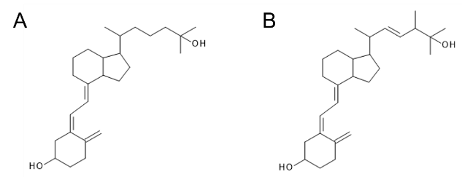
The scale of the problem…

Slide 12
Immunoassay – pros and cons
+ Fully automated (available 24/7)
+ Work well in the majority of clinical settings
+ Analytically sensitive
Cannot distinguish between 25-hydroxyvitamin D3 and D2
  The cross-reactivity for D2 is not perfect and often underestimates its levels
Assays are poorly standardised
Often cross-reacts with 24-hydroxylated and other vitamin D forms

Slide 13
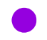
LC-MS/MS
Mass spectrometers measure the mass-to-charge ratio (m/z) of ions
We can target the analysis for ions of a specific mass-to-charge
Very selective and specific!
Sample mixture
Q1
Q2
Q3
Mass analysis of precursor ion
Fragmentation
Mass analysis of fragment ions
384.6
Relative intensity
Relative intensity
m/z
m/z

Slide 14
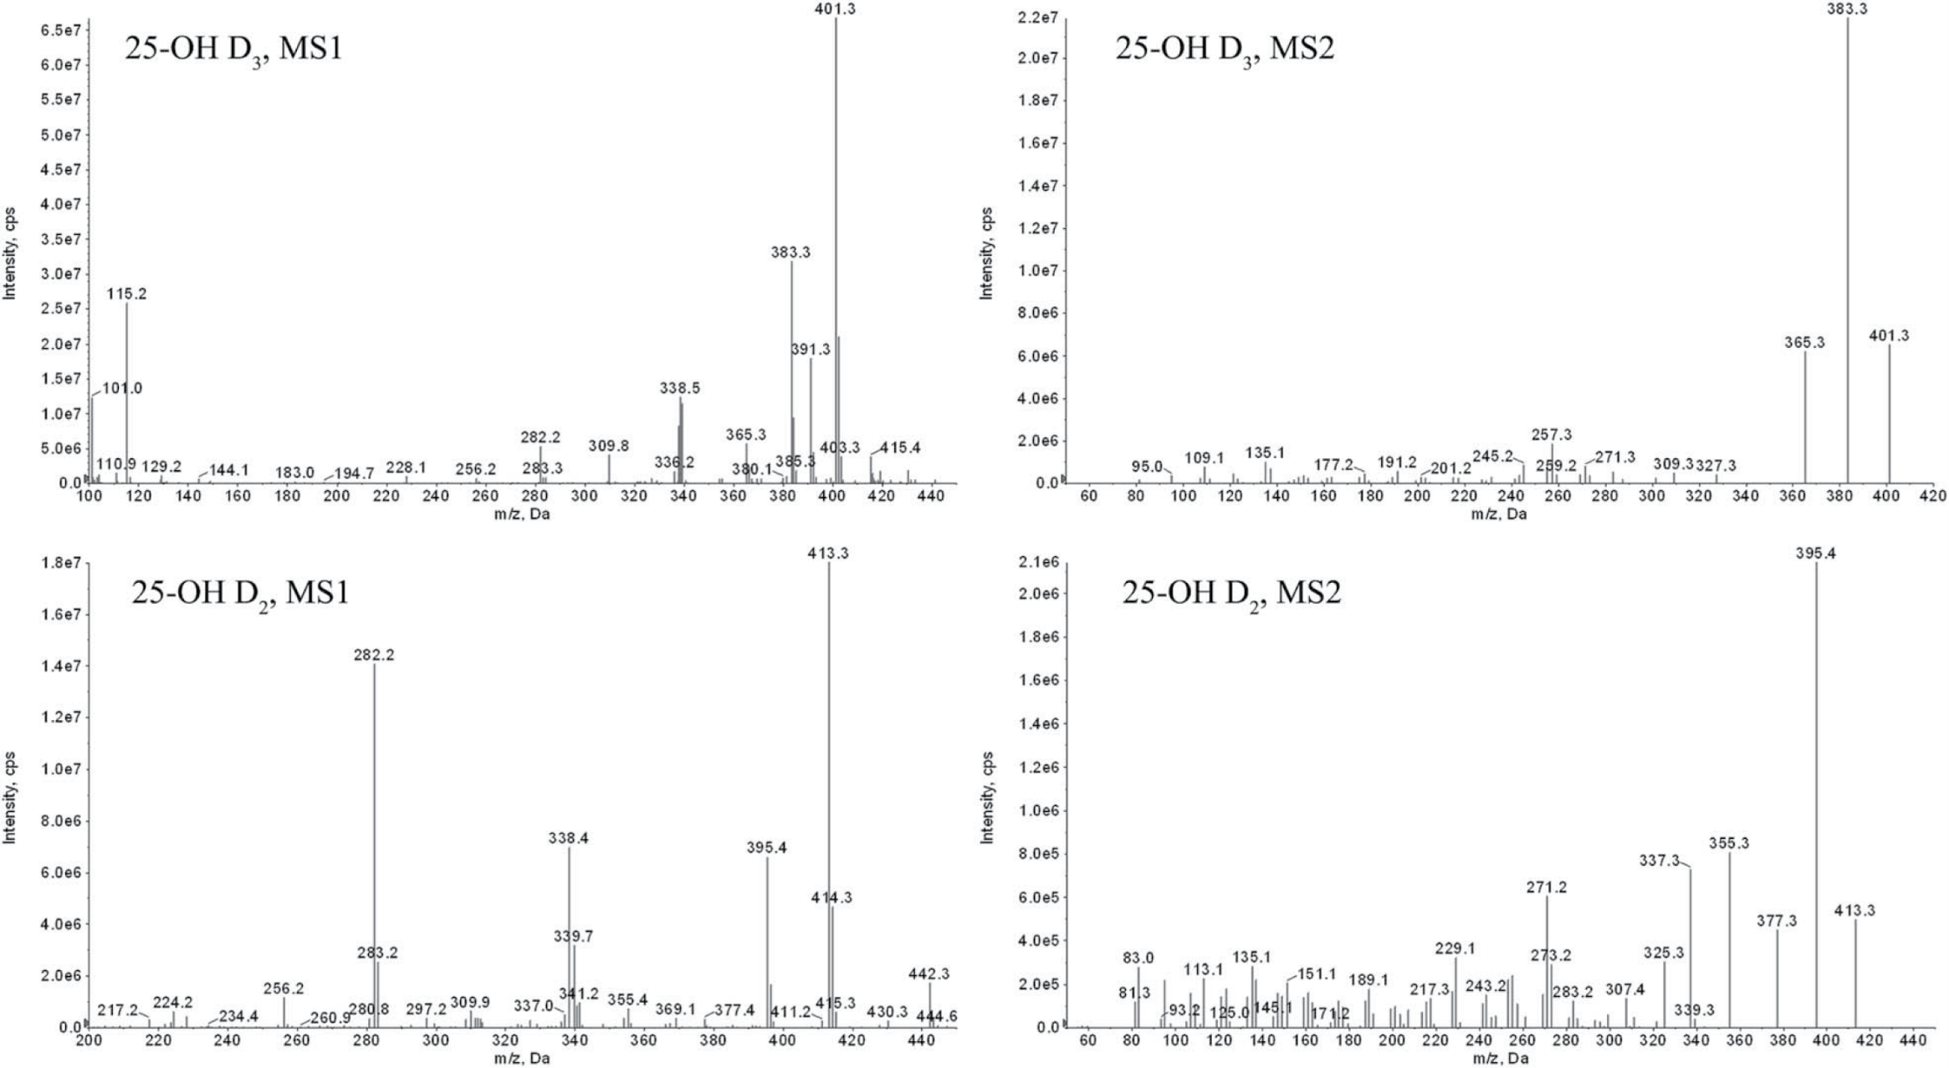
LC-MS/MS

Slide 15
LC-MS/MS – pros and cons
+ Very analytically specific
+ Can distinguish between D₃ and D₂
+ Analytically sensitive
Assays are relatively poorly standardised
Not available 24/7
Slower assay
Unnecessary in most instances

Slide 16
Local assays at NWLP
Immunoassay (total 25-hydroxyvitamin D)
  Appropriate for vast majority of requests where patients are:
    At risk and ?deficient
    Supplemented with vitamin D₃
LC-MS/MS
  Appropriate when patients are being supplemented with vitamin D₂ (± D₃)
  Appropriate when patients are on vitamin D but you are not sure which type

Slide 17
Who to test?
Patients at risk of vitamin D deficiency
  Ageing
  Certain drugs (e.g., phenytoin, rifampicin, glucocorticoids, anti-retrovirals)
  Pigmented skin
  Sunshine avoidance
  Obesity
  Low calcium (and high fibre) diets (e.g., vegan)
  Liver disease
Patients with an indicative bone profile
  Hypocalcaemia
  Hypophosphataemia
  Appropriately raised PTH

Slide 18
Who not to test?
Patients with no risk factors
Patients with renal disease
  25-hydroxyvitamin D may be normal

Slide 19
Interpretation of results
Interpretation is based on total 25-hydroxyvitamin D (D₂ + D₃)
70 – 150 nmol/L
  Replete → does not need replacement/continue with current regimen
40 – 70 nmol/L
  Insufficient → prescribe maintenance dose if required
  Consider referral to secondary care if on aforementioned drugs, patient is osteopaenic/osteoporotic, hypocalcaemic, CKD3/4, or if evidence of secondary hyperparathyroidism
< 40 nmol/L
  Deficient → prescribe loading dose
Important to note that > 150 nmol/L may be indicative of vitamin D intoxication → check calcium!
Adult and paediatric treatment guidelines are available on the Trust website

Slide 20
When to re-test?
RCPath guidelines state the following:
  No clinical signs and symptoms → do not retest
  Chole-/ergocaliferol therapy for whatever clinical indication, where baseline vitamin D was adequate → do not retest
  Chole-/ergocalciferol therapy for whatever clinical indication, where baseline vitamin D was low and where disease that might impact negatively on absorption is present → repeat after 3-6 months on recommended replacement dose
    It can take ~6 months to reach a steady-state on treatment
  Calcitriol or alphacalcidol therapy → do not measure vitamin D

Slide 21
Acknowledgements
The Endocrinology/LC-MS/MS team:
  Dr Emma Walker – Consultant Clinical Scientist/Lead Healthcare Scientist
  Matthew Whitlock – Principal Clinical Scientist
  Dr Sarah Darch – Senior Clinical Scientist
  Dr Cassie Porchetta – Senior Clinical Scientist
  Amal Bashir – Senior Biomedical Scientist
  Priya Pattni – Biomedical Scientist
  Thelma Omeire – Biomedical Scientist
  Sherrine Alleyne – Biomedical Scientist
  Somia Janjua – Biomedical Scientist

