Slide 1


Rapid diagnosis of gastrointestinal pathogens
Dr Giovanni Satta
Consultant in Infectious Diseases and Medical Microbiology
Imperial College Healthcare

Slide 2
Learning Objectives:
To be aware of the new bacterial enteric PCR that is being implemented imminently, EntericBio; the principles and limitations of the test
2. To know how to order the test on the electronic ordering system
3. How to interpret the results, the follow up tests, and the importance of including relevant clinical details on the request

Slide 3
Introduction
1.8M people (mostly children) die from diarrheal diseases/year
Unsafe water, inadequate sanitation and hygiene, contaminated food
In UK over 70,000 reported cases of bacterial gastroenteritis per year
  Outbreaks, hospitalisations, deaths

Slide 4


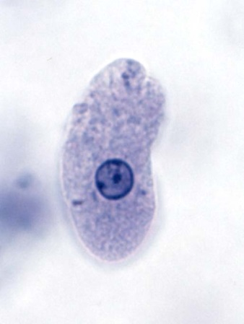
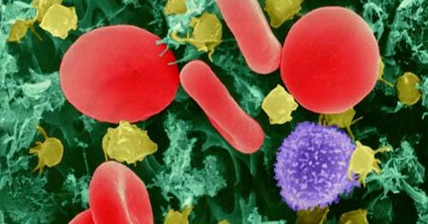
Causative Agents
Bacteria
Viruses
Parasites

Slide 5
Causative Agents
Bacteria
  Salmonella, Shigella, Campylobacter, E. coli toxigenic/0157
  Others: Bacillus cereus, Clostridium, Staphylococcus aureus
Viruses
  Norovirus, Sapovirus, Rotavirus
Parasites
  Giardia lamblia, Cryptosporidium sp, Entamoeba
  histolytica,

Slide 6



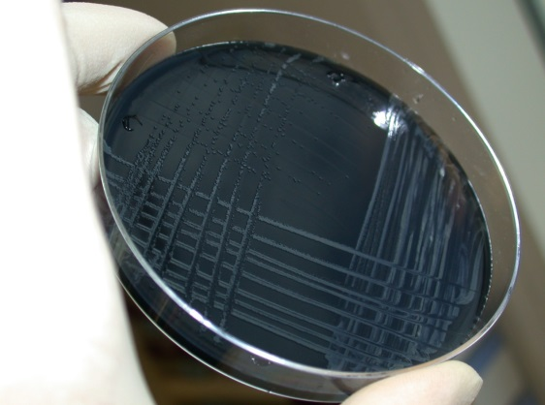
Traditional culture methods
Multiple culture media required
Time consuming; takes 48 hours for a negative, 72 for a positive
Labour intensive, subjective, insensitive

Slide 7

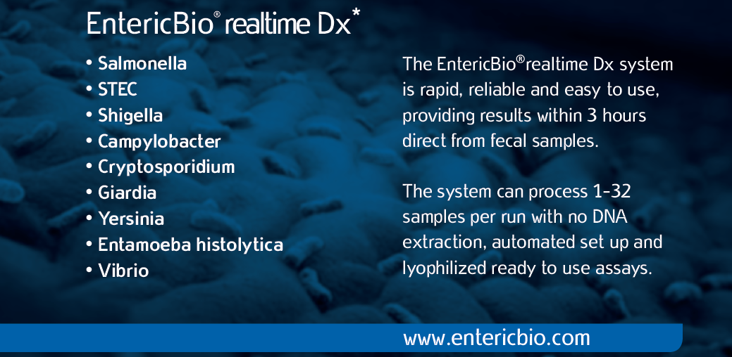
Title

Slide 9
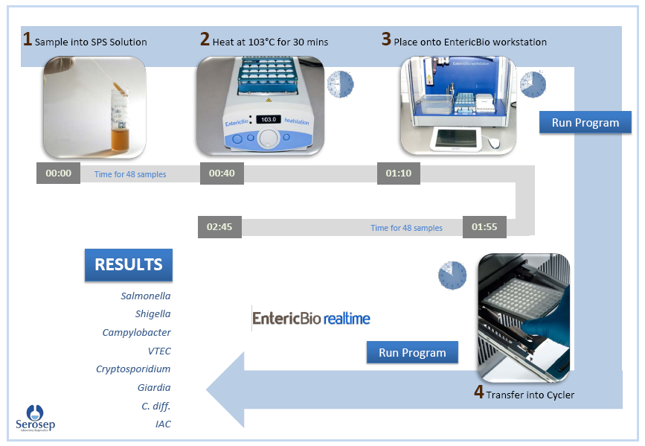
Support
Worker
Tasks

Slide 10
Scientist Task

Slide 11

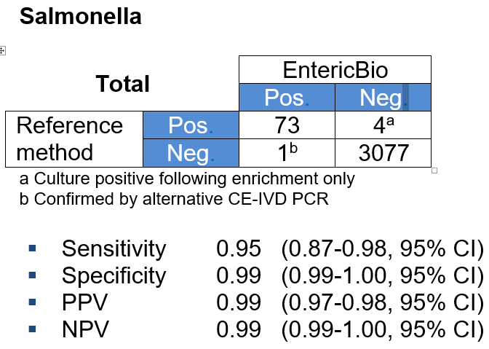
Target Performance

Slide 12
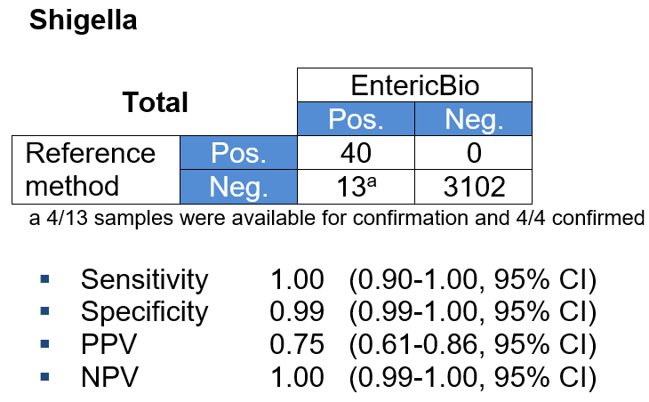
Target Performance

Slide 13
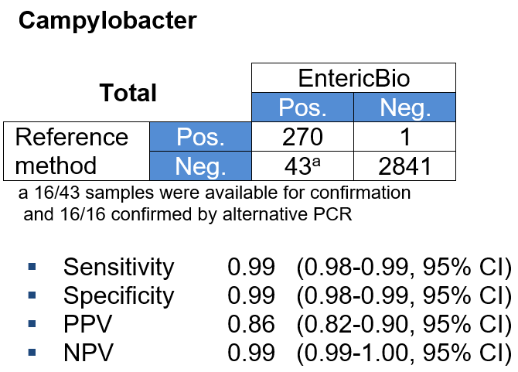
Target Performance

Slide 14
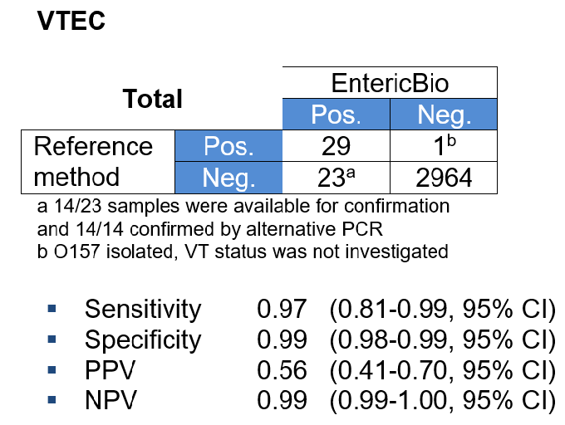
Target Performance

Slide 15
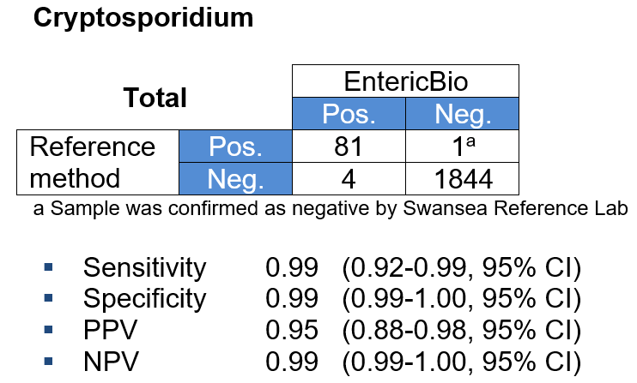

Target Performance

Slide 16
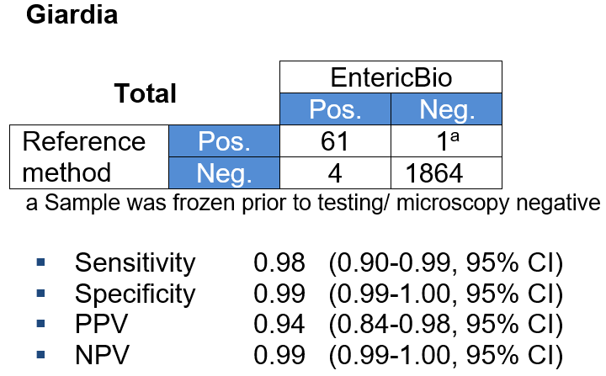
Target Performance

Slide 17
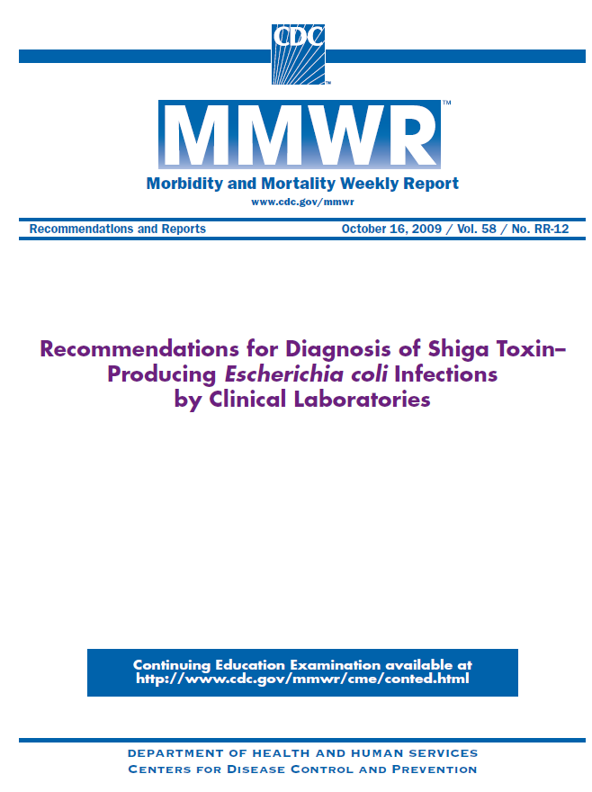
Why Molecular for VTEC?
DAEC
EAggEC
Atypical
EPEC
Typical
EPEC
EHEC
VTEC
0157
ETEC
EIEC

Slide 18
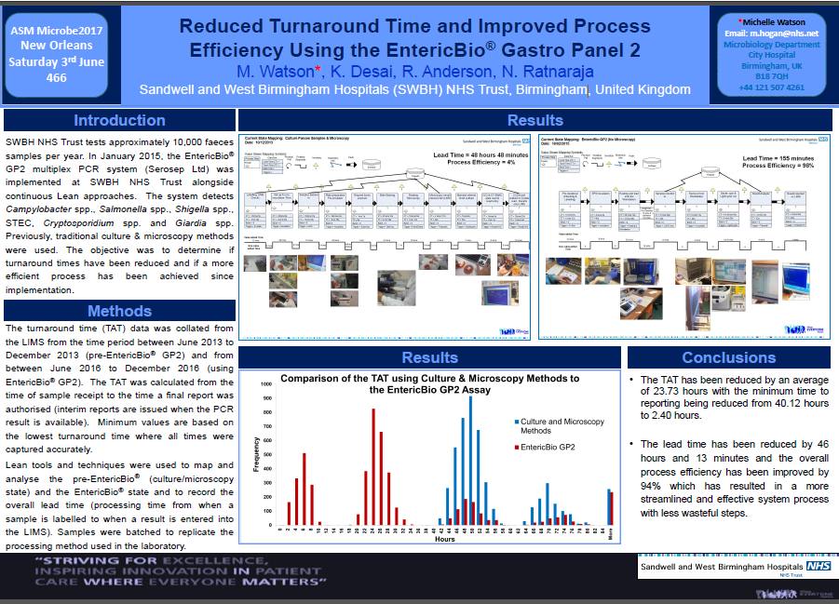

Slide 19
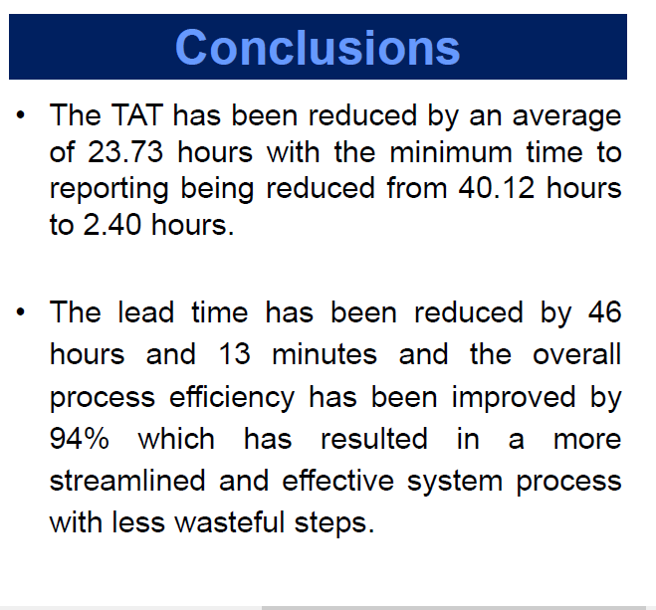

Slide 20
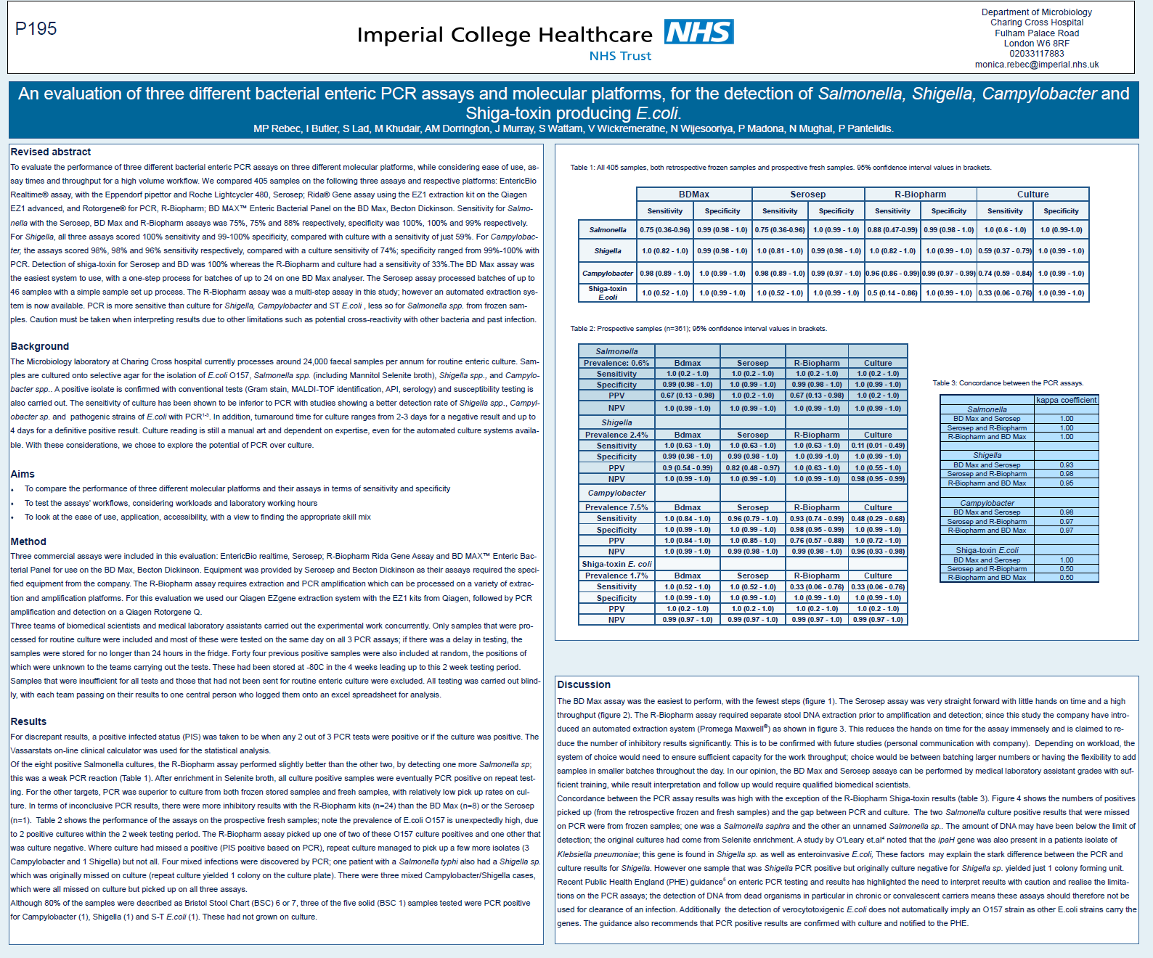
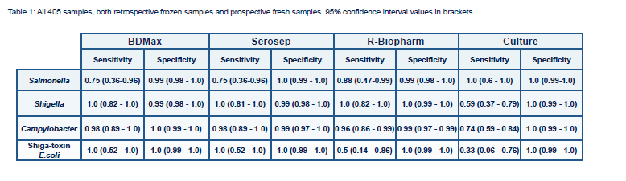

Slide 21
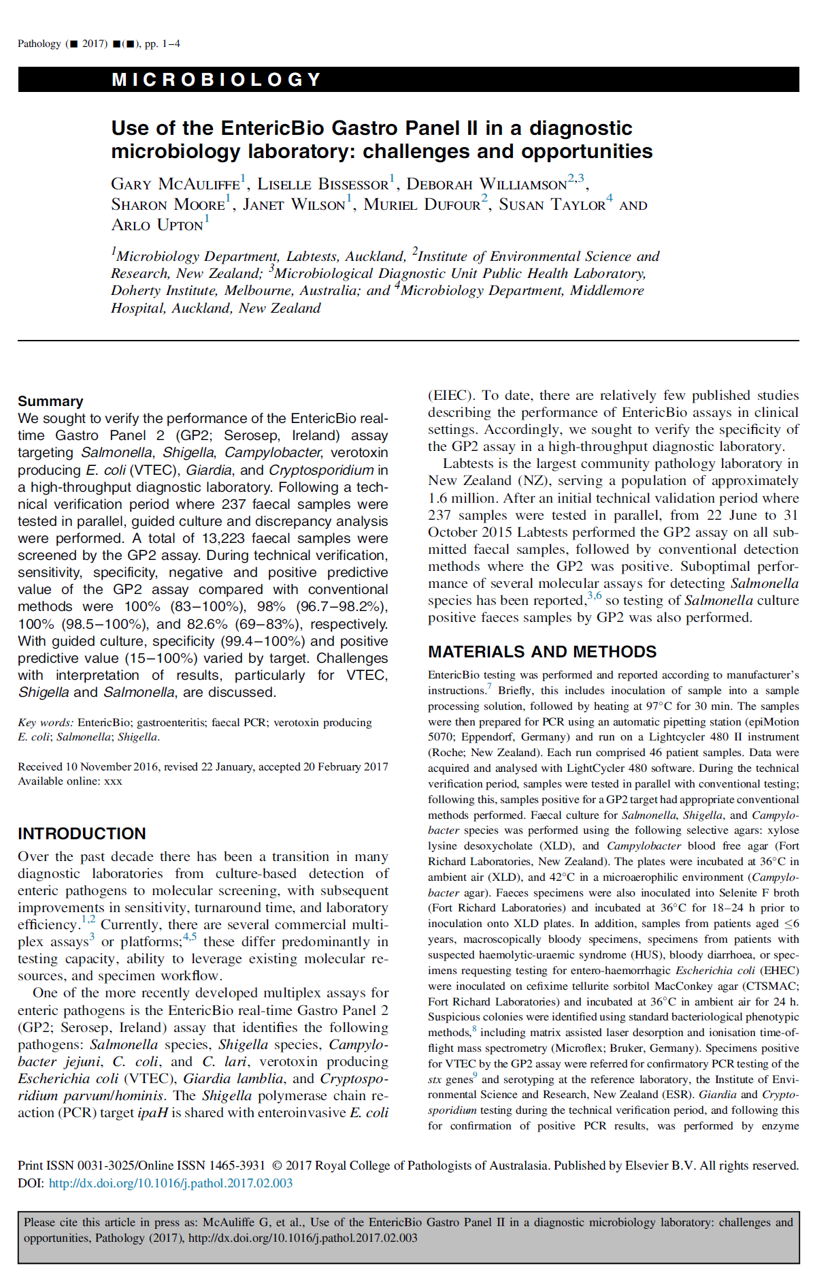

Slide 22
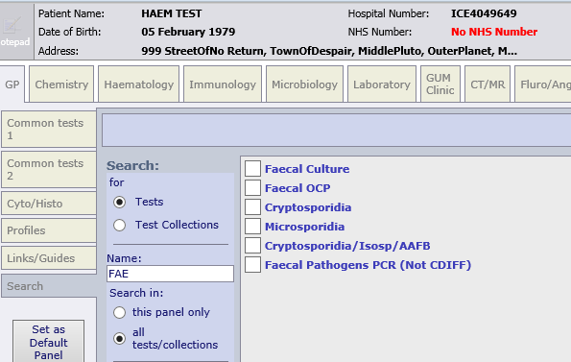
Ordering on ICE
When using FAE in the search bar, the following will appear: we will replace the Faecal culture on this screen and make it non-orderable

Slide 23
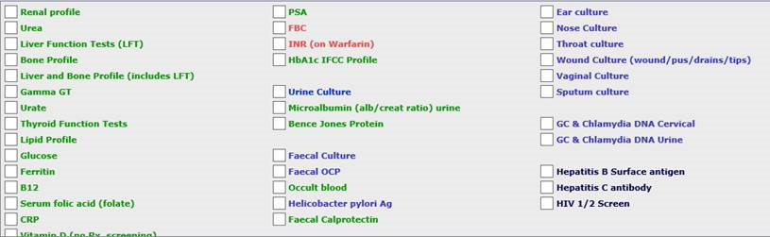
Ordering on ICE
At go live, we will replace the “Faecal culture” on this screen with “Faecal Pathogens PCR (not CDIFF)”
Faecal Pathogens PCR (Not CDIFF)

Slide 24
What the results mean - Salmonella
A positive result for Salmonella indicates the presence of the gene target specific for Salmonella enterica spp. in the sample.
If PCR Negative, report as ‘NEGATIVE’
If PCR Positive for salmonella, report as ‘PCR Positive, culture results to follow’
If Culture Positive, report as:
‘Salmonella sp. isolated’, perform sensitivities, serology and sent to the Reference Lab.
If culture Negative, report as:
‘Salmonella sp. not isolated’
‘PCR positive/ culture negative pattern may be due to different sensitivity of these tests’

Slide 25
What the results mean - Shigella
A positive result for Shigella indicates the presence of the nucleic acid target for the Invasion Plasmid Antigen H (ipaH) gene. This virulence factor can be carried by Shigella sp. and Enteroinvasive E. coli (EIEC).
If PCR Negative, report as ‘NEGATIVE ‘
If PCR Positive for Shigella sp., report as ‘PCR positive, culture results to follow’
If Culture Positive, report as ‘Shigella sp. isolated’
If Culture Negative, report as:
‘Shigella sp. not isolated’
‘PCR positive/ culture negative pattern may be due to different sensitivity of these tests’

Slide 26
What the results mean - Campylobacter
A positive result for Campylobacter indicates the presence of the gene target specific for Campylobacter jejuni, Campylobacter coli or Campylobacter lari (not differentiated) in the sample.
If PCR Negative report as ‘NEGATIVE’
If PCR Positive report as:
‘PCR Positive’
‘Campylobacter culture is no longer performed routinely’

Slide 27
What the results mean – STEC / VTEC
A positive result for STEC/ VTEC indicates the presence of the stx1 and/or stx2 gene target in the sample (not differentiated).
If PCR Negative report as ‘NEGATIVE’
If PCR Positive report as ‘PCR Positive, culture report to follow’
If Culture Positive; send the original stool to the Reference Lab to confirm the presence of any Verotoxin E.coli other than EC-0157.
Set up sensitivities and send to the Ref Lab for EC-0157confirmation.
If Culture Negative: Send original stool sample to the Ref Lab

Slide 28
What the results mean – Cryptosporidium and Giardia
Cryptosporidium
A positive result for Cryptosporidium indicates the presence of the gene target specific for C. parvum and/ or C. hominis (not differentiated) in the sample.
If PCR positive, report as ‘PCR positive’
If PCR Negative, report as ‘NEGATIVE’
Giardia
A positive result for Giardia indicates the presence of the gene target specific for G. lamblia in the sample.
If PCR positive, report as ‘PCR positive’
If PCR Negative, report as ‘NEGATIVE’

Slide 29
Any questions?
Giovanni.satta@nhs.net

