Slide 1







GP Study Afternoon: Viral Hepatitis
Cockburn Lecture Theatre, St Marys Hospital
Wednesday 22nd May
Prof Ashley Brown
Imperial Healthcare NHS Trust
Notes:
1

Slide 2
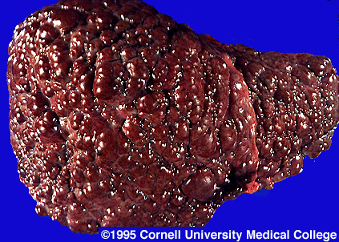
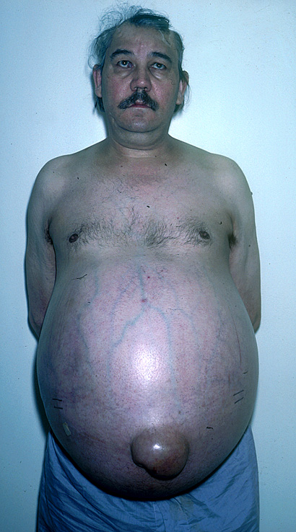


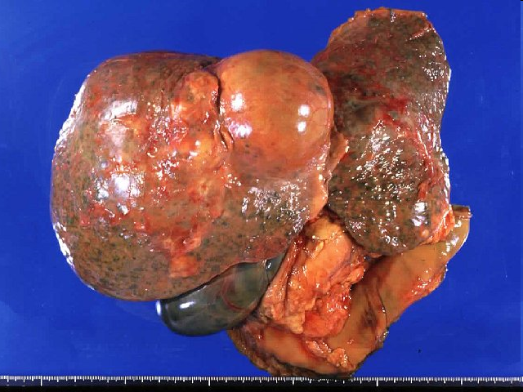
The cost of NOT treating Viral Hepatitis

Slide 3
HBV

Slide 4
Everything you ever need to know about HBV serology
HBsAg POSITIVE = REFER
HBsAg NEGATIVE = DON’T REFER
There’s no such thing as a healthy carrier – all HBsAg patients should be referred for long-term monitoring

Slide 5
Global Prevalence of Chronic HBV
Chronic HBV prevalence (% of population)
Chronic HBV in the UK
97% of people living with chronic HBV in the UK were born outside the UK
< 2% - Low
2-7% - Intermediate
(HPA statistics)
> 8% - High
Margolis et al, 1991
99% of chronic HBV is VERTICALLY TRANSMITTED
It has nothing to do with sex and drugs (or rock ‘n’ roll!!)
Notes:
There are around 350 million chronic carriers of HBV worldwide, accounting for more than five percent of the world’s population.
Though widely distributed, hepatitis B prevalence varies from a highly endemic disease in China, Southeast Asia, and Africa to a disease of low endemicity in North America, Western Europe and Australia.
In most developed countries, the prevalence of chronic HBV infection is <2 percent. Within these areas reside ethnic groups with HBV infection rates that are significantly higher than those of the general population e.g. Eskimo populations in Alaska and Canada and the New Zealand Maoris.
About 44 percent of the global population live in areas with a high prevalence of chronic infection, 43 percent in areas with intermediate prevalence and 13 per cent in areas with a low prevalence. In areas of high endemicity, the majority of the infections occur during early childhood.
In many countries, vaccination against hepatitis B will reduce the incidence of disease worldwide, although effective treatment of hepatitis B remains a priority for many millions of chronic carriers of HBV.
Margolis HS, Alter MJ and Hadler SC. Hepatitis B; evolving epidemiology and implications for control. Semin Liver Dis 1991;11:84-92

Slide 6
Why monitor HBV?
In the majority of patients, the immune system will keep the virus under control
LOW VIRAL LOAD
NORMAL LIVER ENZYMES
In 2-3 % of patients each year, the vrus will escape immune control
HIGH VIRAL LOAD
RAISED LIVER
ENZYMES
The transition is unpredictable and asymptomatic

Slide 7
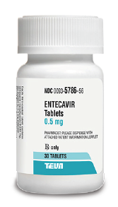
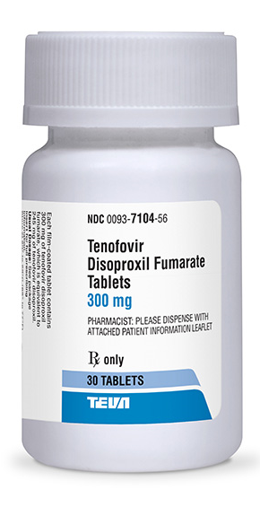
Treatment of HBV
Entecavir and Tenofovir are red-listed drugs and should not be stopped abruptly
Patients should be monitored every six months for viral load and renal function.
Screen regularly for metabolic bone disease

Slide 8
Antenatal Viral Hepatitis Clinic
Clinic every 2-4 weeks at both SMH and QCCH
Run jointly with BBV specialist midwife
Review of ALL women with viral hepatitis
GP referral not required
Discussion of birth plan and transmission reduction
Testing of partner and other children
Discussion of vaccination schedule
ICHNT achieved KPI’s year-on-year

Slide 9
HBV Neonatal Vaccination Schedule
BIR | 1 Mo | 2 Mo | 3 Mo | 4 Mo | 5 Mo |  |  |  |  |  | 12 Mo
Babies born to HBsAg +ve mothers prior to Aug 2017
Universal vaccination for all babies born from Aug 2017
Babies born to HBsAg +ve mothers prior to Aug 2017
HBV monovalent vaccine
HBV monovalent vaccine + HBIg
New hexavalent vaccine (inc HBV)

Slide 10
Family Hepatitis Clinic
Once a month clinic at SMH run jointly with paediatric ID
Post vaccination testing of all children born to HBV/HCV positive mothers
Screening of other family members
Management of infected children
Transition/adolescent clinic
Happy to accept referrals for other children with liver disease

Slide 11
HBV Vaccination
Always test for HBsAg BEFORE vaccinating
ALL household contacts of an HBV positive patient should be offered vaccination
ALL sexual partners of HBV positive patients should be offered vaccination
THESE VACCINATIONS MUST BE FREE OF CHARGE

Slide 12
HCV

Slide 13
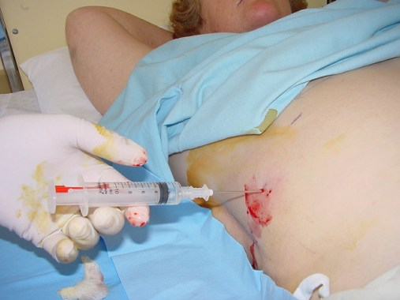
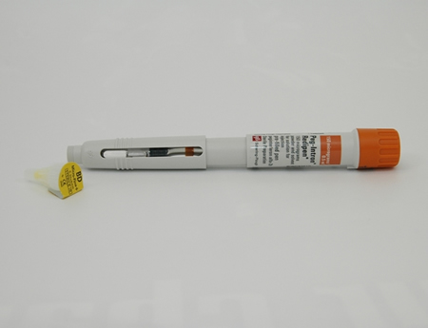
What everybody knows about HCV
LIVER BIOPSY
INTERFERON
WE DO NOT DO LIVER BIOPSIES ANYMORE
WE DO NOT USE INTERFERON ANYMORE

Slide 14
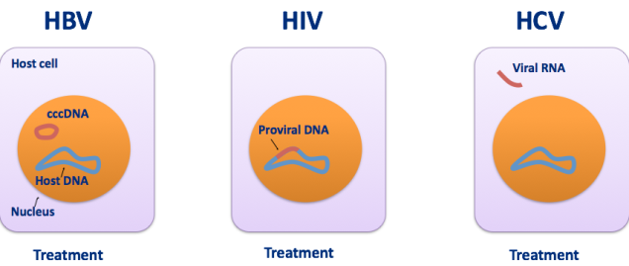
HCV is the only chronic blood-borne virus that can be CURED
Unlike HIV and HBV it is not a disease for life
Sustained virological response (SVR) = CURE
SVR: reduced morbidity and mortality
Pawlotsky JM. J Hepatol 2006;44:S10–3;
Siliciano JD, et al. J Antimicrob Chemother 2004;54:6–9;
Lucas GM. J Antimicrob Chemother 2005;55:413–6
cccDNA: covalently closed circular DNA

Slide 15

The Directly Acting Antiviral Drugs
HCV NS5B polymerase inhibitor
HCV NS5A inhibitor
8-12 weeks
Once daily dosing
Minimal side-effects
>95% cure rate
Harvoni
Sofosbuvir
Ledipasvir
HCV NS3/4A protease inhibitor
HCV NS5A inhibitor
Zepatier
Grazoprevir
Elbasvir
HCV NS5B polymerase inhibitor
HCV NS5A inhibitor
Epclusa
Sofosbuvir
Velpatasvir
HCV NS3/4A protease inhibitor
HCV NS5A inhibitor
Maviret
Glecaprevir
Pibrentasvir

Slide 16

From Virus Discovery to Plans for Elimination in 30 Years
Pan-genotypic era
1989: Identification of HCV
2016: The WHO Global Health Sector established the goal of HCV elimination as a major public health target by 2030
“DAA revolution”
Early era of DAAs
1986
1989
1998
2001
2011
2013
2014
2015
2016
2018…
“Non-A, non-B” hepatitis
The IFN era
NHS England have set the target of elimination in England by 2025
Pawlotsky JM, et al. J Hepatol 2015; 62:S87–99; Manns MP, et al. Nat Rev Dis Primers 2017; 3:1–19;
WHO. Global Health Sector Strategy on Viral Hepatitis 2016–2021. Available at: http://www.who.int/hepatitis/strategy2016-2021/ghss-hep/en/ (accessed March 2019).
Notes:
Choo QL, et al. Science 1989; 244:359–362.
WHO, Combating Hepatitis B And C to reach elimination by 2030, May 2016. Available online at: http://apps.who.int/iris/bitstream/handle/10665/206453/WHO_HIV_2016.04_eng.pdf?sequence=1 (accessed April 2018).

Slide 17
WHO HCV Elimination Targets: Progress
2030 TARGET
90% infected
diagnosed
70 million infected
13 million diagnosed (19%)
1.5 million treated in 2016 (2%)
2030 TARGET
80% diagnosed
treated
WHO 2018: Progress report on access to hepatitis C treatment (WHO/CDS/HIV/18.4).

Slide 18
What do we need to achieve elimination
Potent antiviral drugs ✓
Short duration therapy ✓
Simplification of therapy ✓
Universal access to therapy ✓
Up-to-date knowledge of HCV treatment for both general public and HCPs✗
Expanded treater pool ✗
Adequate case findings programmes ✗

Slide 19
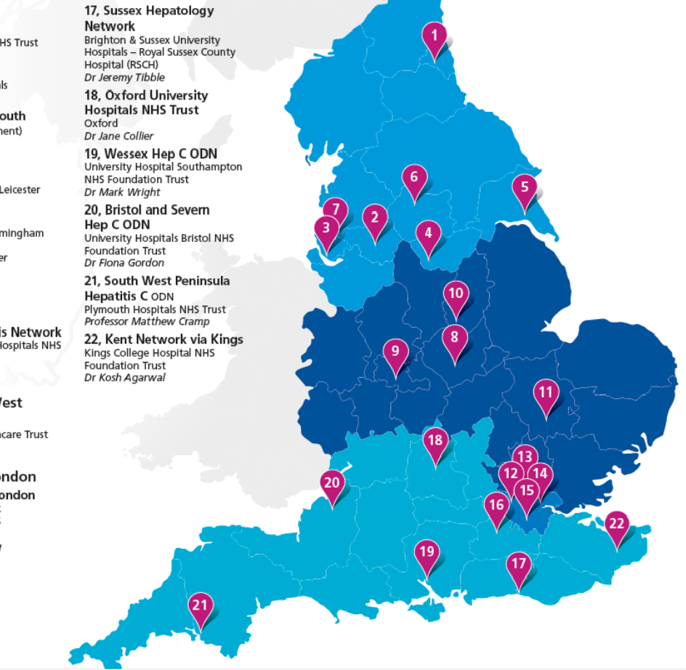
The English HCV ODN system
The ODNs are seen by the government as a way of ensuring equity of access and the responsible use of an expensive resource
Each ODN has a lead who heads an MDT (composed of hepatologists and/or ID physicians, CNS and pharmacists)
Each case is presented to the panel to ensure eligibility and to determine the appropriate treatment regimen
Treatment can occur at any site within the ODN, but prescribers assume financial responsibility
The ODN is responsible for policing the system, collecting and reporting data back to NHSE

Slide 20
The duality of HCV
HCV AS
A
LIVER
DISEASE
HCV AS A
PUBLIC
HEALTH
ISSUE
Prevention of cirrhosis, HCC and premature death
Alleviation of extra-hepatic symptoms
Prevention of onward transmission
Achievement of elimination as a public health issue
BENEFIT TO INDIVIDUAL
BENEFIT TO SOCIETY

Slide 21
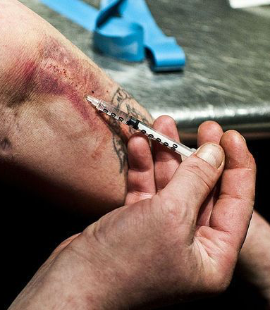


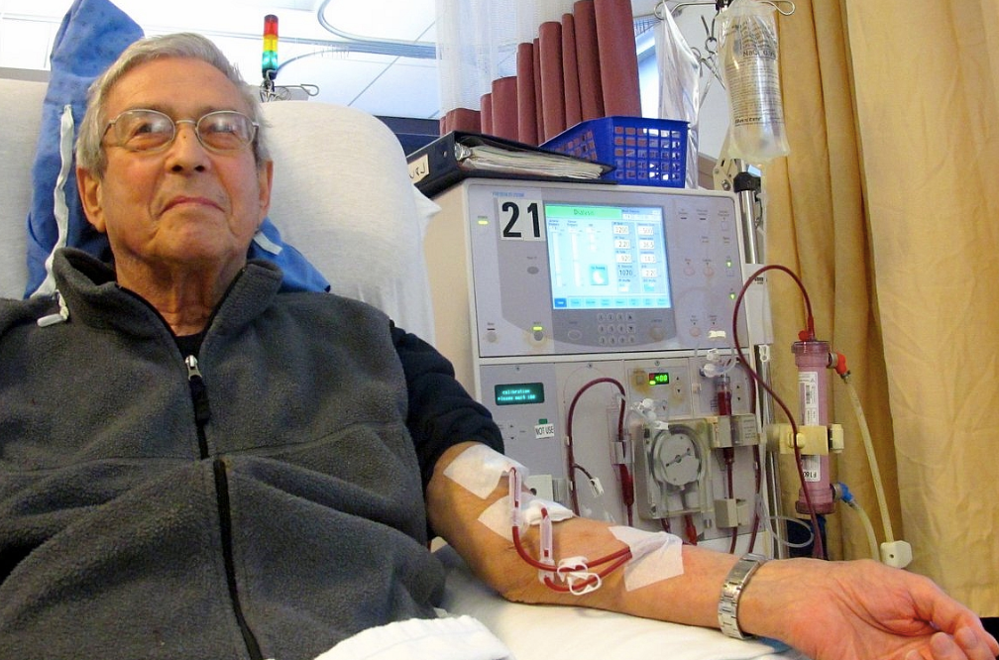

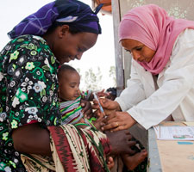
Who are the people living with HCV?
People who use Drugs
Prisoners
Men who have sex with Men
Haemodialysis Patients
Women of Child Bearing Age
MICROELIMINATION IN SPECIFIC COMMUNITIES
Iatrogenic
pre-1989
Immigrant Communities
Former PWID’s

Slide 22
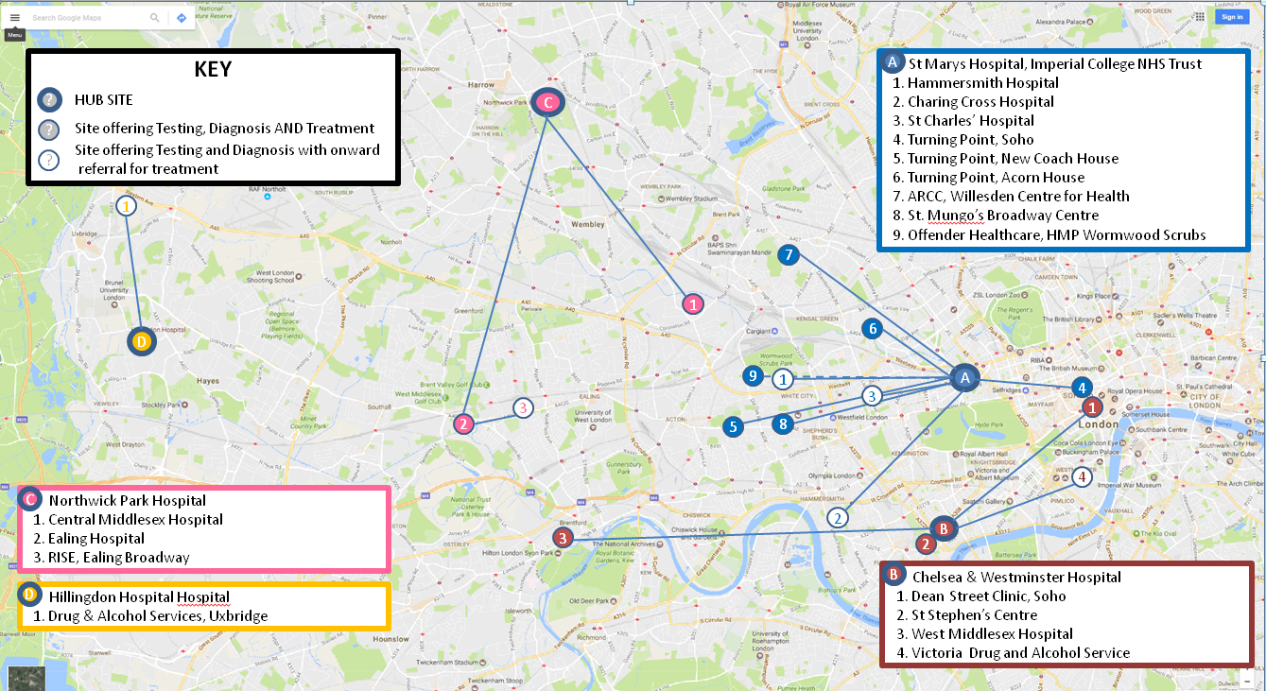
Testing and treatment now available in over
30 sites across NW London sector

Slide 23
Testing and treatment now available in over
30 sites across NW London sector
Hospital Clinics (10)
St Marys, Hammersmith, St Charles, Charing Cross, Chelsea & Westminster, West Middlesex, Ealing, Central Middlesex, Northwick Park, Hillingdon
Drug & Alcohol Services (9)
Turning Point Soho, Acorn Hall North Kensington, ARC Willesden, New Coach House Shepherds Bush, Ealing RISE
WDP Harrow, CGL Victoria, ARCH Uxbridge, ARC, Hounslow
Homeless Hostels (7)
Hope Gardens, The Old Theatre, Broadway Centre Shepherds Bush,
St Mungos 209 Harrow Rd, King George Hostel, Pound Lane Hostel, St Mungos Edith Road
GP Practices (2)
Dr Hickey Practice, Great Chapel Street
Sexual Health Clinics (4)
Dean Street, Wharfside Clinic, Kobler Centre, Hammersmith Broadway
Prisons (1)
HMP Wormwood Scrubs
Comnunity Pharmacy (1)
Portmans Pharmacy

Slide 24
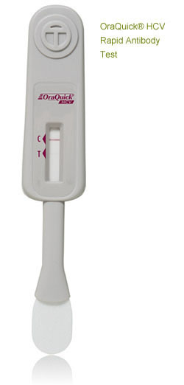
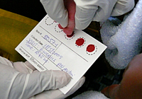
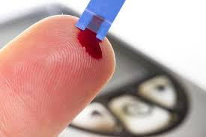
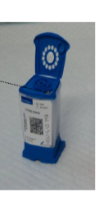

Advances in Diagnostics and Point-of-Care Testing
Saliva tests
Dried blood spot
Point-of-care
HCV RNA testing
Minimal expertise required
Suitable for mass screening
Results take 2-3 days
Can give viral load
Can test for other BBV
Minimal expertise required
HCV-RNA result in one hour
Limited capacity
Ideal for instant linkage to care
Results within minutes
No expertise or laboratory required
Can be self administered
Antibody result only
Fourati S, et al. J Int AIDS Soc 2018; 21:e25058.

Slide 25
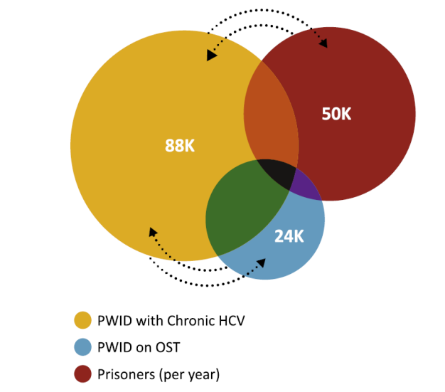

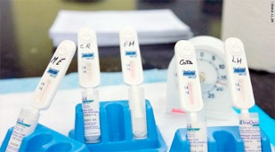

Simplification of the Treatment Pathway in Prisons
2 weeks for secondary medical review
“TRADITIONAL MODEL”
22–26 weeks
1 week for DBS result
1 week for doctor review
1 week for FibroScan®
4 weeks for genotype
1 week for MDT
12–16 weeks for treatment
The considerable movements between PWID on OST in the community and in the prison settings provides a unique opportunity to capitalize on these settings as HCV treatment access points¹
Reducing HCV prevalence in prisons will result in reduced HCV in the community¹
High turnover and short sentencing require specific pathways¹
20 mins for Orasure swab
1 hour for Cepheid HCV-RNA
8 weeks for pan-genotypic treatment
“CONIBEERE MODEL”
8–9 weeks
Data in Venn diagram taken from Australian figures.
DBS, dried blood spot testing; MDT, multidisciplinary team;
OST, opioid substitution therapy; PWID, people who inject drugs.
1. Grebely J and Dore GJ. Antiviral Res 2014; 104:62–72.

Slide 26
So where are the ‘Missing Millions?
‘THE MISSING MILLIONS’
People who use Drugs
Prisoners
Men who have sex with Men
Haemodialysis Patients
Women of Child Bearing Age
Iatrogenic
pre-1989
Immigrant Communities
Former PWID’s

Slide 27
2763 Untreated Positive HCVAb in West London Primary Care released by PHE

Slide 28
Of 2771 HCVAb results, 738 (27%) have no records in West London. Of the remaining 2033…
Known to service but
not yet treated 5.6%
Dead 0.1%
Known to have
been treated
16.2%
No HCV-RNA result
found
30.5%
Evidence of NEG HCV-RNA
and never positive
‘Spontaneous Clearance”
35.4%
*Speakers own unpublished data

Slide 29
PHE HCV recall
Please review the names on the list
Arrange HCV-RNA on those who are HCVAb positive
Refer in those who are HCV-RNA positive
Any problems, please discuss

Slide 30
Identifying those at risk
Anyone on OST or long term opioids
Anyone with a past history of drug-use
Anyone with a history of incarceration
Anyone born or raised abroad
Anyone who received blood transfusion before 1990
Anyone with non-specific symptoms of fatigue or cognitive impairment
Anyone with raised ALT/AST
ANYONE WHO ASKS!

Slide 31
Positive HCVAb
HCV-RNA NEG
Spontaneously Cleared
HCVAb Positive
Previously Treated
HCV-RNA POS
Actively Viraemic

Slide 32
Fast-Track HCV Clinic
Direct access for new HCV-RNA positive referrals
Usually seen within 2 weeks
Joint consultant/nurse assessment as one-stop-shop
Medical assessment, Fibroscan, genotyping and treatment discussion
Patient given provisional treatment start date
Considerable shortening of patient pathway
Reduces unnecessary OPD appts
Reduces anxiety
Advances the elimination programme

Slide 33
When your patient is on treatment…
Encourage adherence to treatment and follow-up appointments
Do not start any new drugs without checking for DDIs
Do not stop the treatment without discussing with HCV team
Remember that HCVAb persists indefinitely

Slide 34
WORKING TOGETHER WEST LONDON CAN BE THE FIRST ODN TO ACHIEVE HCV ELIMINATION
Imperial.hcv@nhs.net
07767 671954

