Slide 1
Egg Freezing & IVF “add ons”
Everything you need to know!
Rehan Salim MD MRCOG
Consultant Gynaecologist & Subspecialist in Reproductive Medicine
Hammersmith & St Mary’s Hospital
Imperial College Healthcare NHS Trust

Slide 2
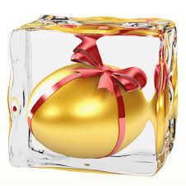


Egg freezing

Slide 3
Egg freezing
Collection and storage of eggs from a woman for use at a later date
Provides an “insurance” for when natural fertility declines
Means egg donation will not be needed
Allows women to concentrate on priorities other than getting pregnant without compromise

Slide 4
Can we predict declining fertility?
Ovarian reserve assessment
  “empowerment”?
FSH levels
AMH levels

Slide 5
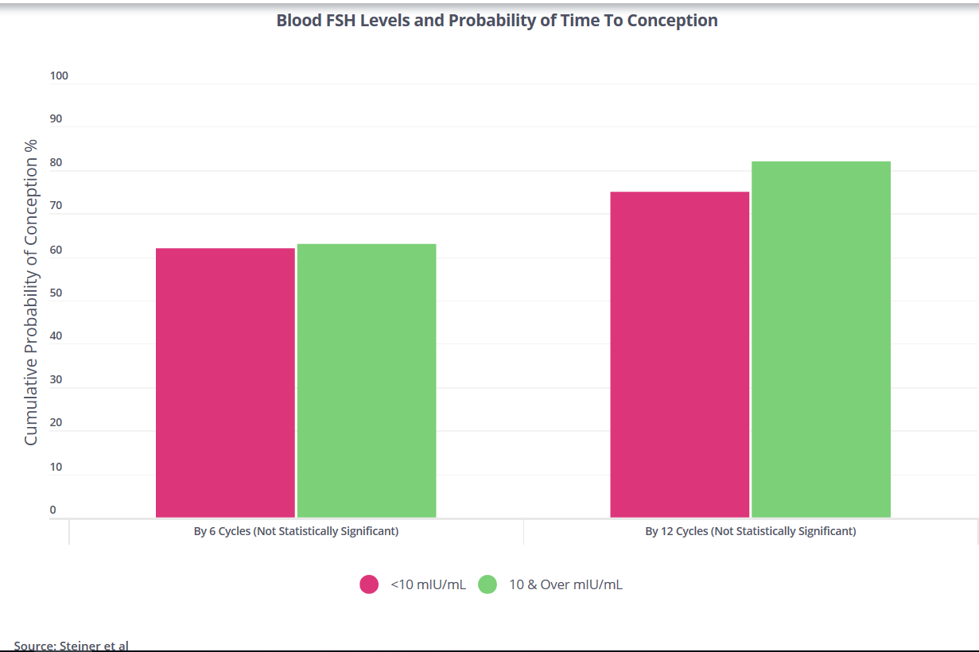

Slide 6
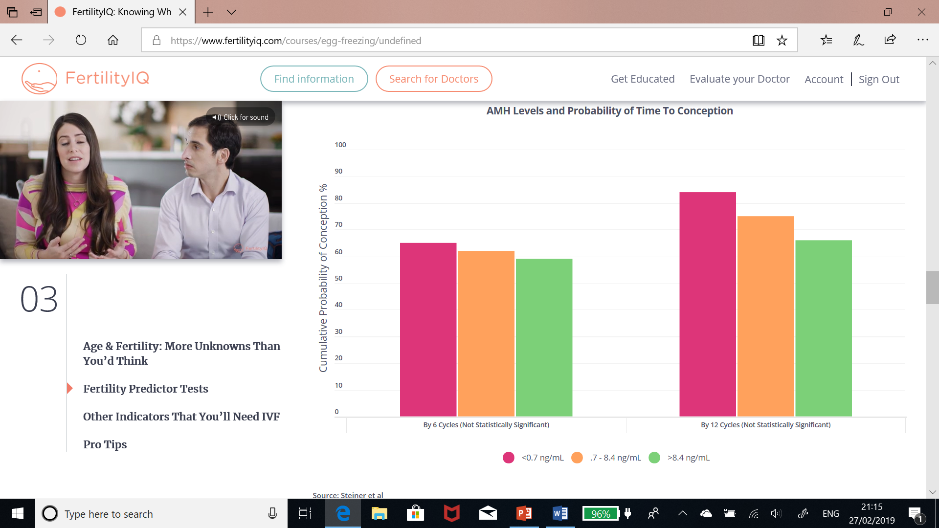

Slide 7
Egg freezing
Aim to freeze as many eggs as can safely be collected
HFEA data = approx 12 eggs for best chance of pregnancy from infertile couples

Slide 8
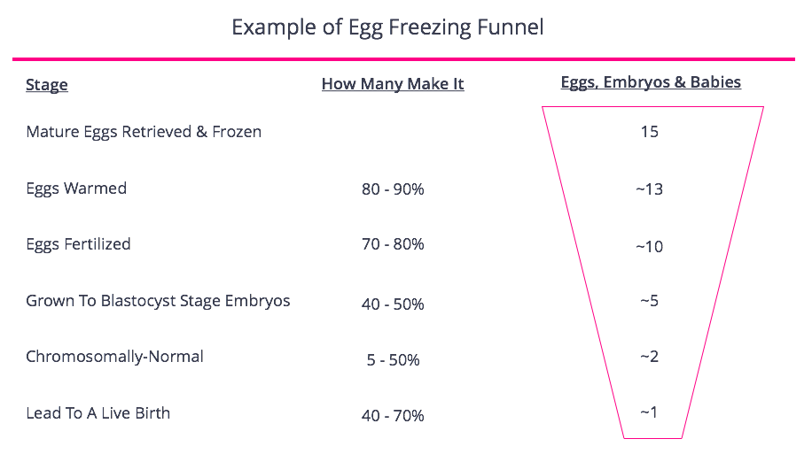

Slide 9
Egg freezing
Essentially an IVF cycle without the embryo transfer
Day 1 of period
Approx 10-12 days stimulation and then egg collection
Start FSH injections daily
From Day 5/6 start GnRH antagonist
Eggs collected under sedation
Frozen by vitrification same day

Slide 10
Vitrification vs Slow Freeze
Vitrification
  High level of cryoprotectants
  Extremely fast rate of cooling (>20,000C/min)
  No ice crystal formation (straight to glass like state)
  No special equipment needed
Slow freezing
  Low level of cryoprotectants
  Slow controlled rates of cooling (0.1-0.3C/min)
  Slow dehydration to minimise ice crystal formation
  Requires special equipment

Slide 11
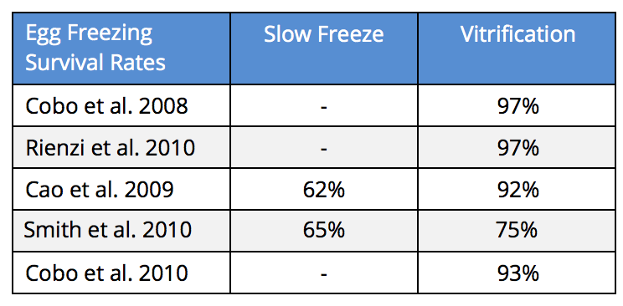
Vitrification vs Slow Freeze

Slide 12
Vitrification
ASRM (American Society for Reproductive Medicine) lifts label of “experimental technique” from egg vitrification in 2012
  expert committee formed their view based on 80 peer reviewed articles concerning the effectiveness of freezing eggs, and 32 concerning safety

Slide 13
Vitrification
ASRM Expert committee (2012)
  There were only 4 randomized controlled trials which found that success rates using fresh or frozen eggs in IVF were similar.
  All 4 of these trials were conducted on healthy YOUNG women under the age of 30
  Only two studies were referenced looking into the short term risks to babies born from frozen eggs. 1100 babies were included in these studies combined

Slide 14
Vitrification
ASRM Expert committee (2012)
  The ASRM also noted that the randomized controlled trials were only published by the best and most successful fertility clinics, and hence the results should not necessarily be generalized across ALL clinics.
  This recommendation was repeated when the ASRM looked at the actual success rate statistics from fertility clinics in the US as opposed to specific clinical trial results.

Slide 15
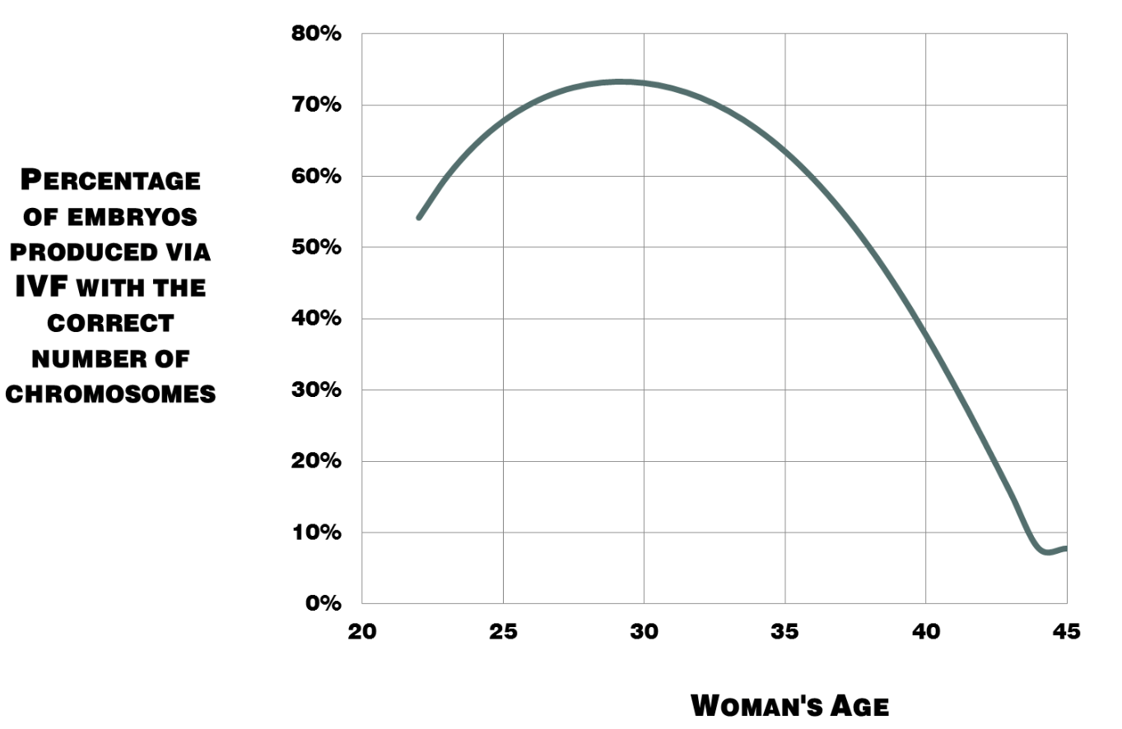
Egg Freezing

Slide 16
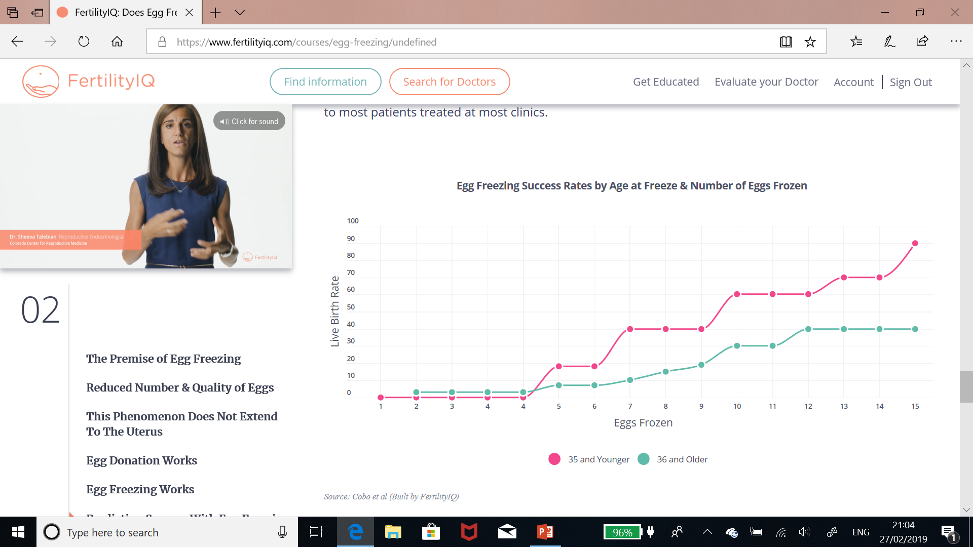

Slide 17
Number of Oocytes Obtained By Age For Cryopreservation at One Clinic 2007 - 2014
Source: NYU
Age | Average # of Mature Eggs | Most Per Patient | Least Per Patient
30 | 14.75 | 26 | 6
31 | 16.2 | 41 | 5
32 | 13.7 | 27 | 4
33 | 13.2 | 32 | 2
34 | 13.1 | 50 | 0
35 | 13.0 | 39 | 1
36 | 12.3 | 47 | 1
37 | 10.3 | 44 | 0
38 | 10.1 | 37 | 0
39 | 9.6 | 37 | 0
40 | 8.5 | 35 | 0
41 | 8.6 | 35 | 1
42 | 7.9 | 33 | 1
43 | 9.3 | 20 | 0
44 | 6.3 | 14 | 1
45 | 3.9 | 9 | 1

Slide 18
Predicted Egg Freezing Success Rates By Retrieval Age and Volume
Source: Goldman, Fox et al
# of Eggs | 30 | 35 | 37 | 40 | 42
1 | 11% | 11% | 7% | 4% | 2%
5 | 44% | 44 | 29% | 16% | 11%
10 | 69% | 69 | 50% | 30% | 20%
20 | 90% | 90 | 75% | 51% | 37%
40 | 99% | 99% | 94% | 76% | 60%

Slide 19
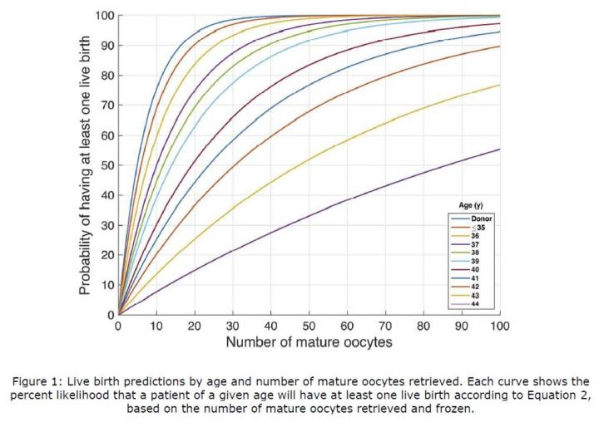
Egg freezing success rates

Slide 20
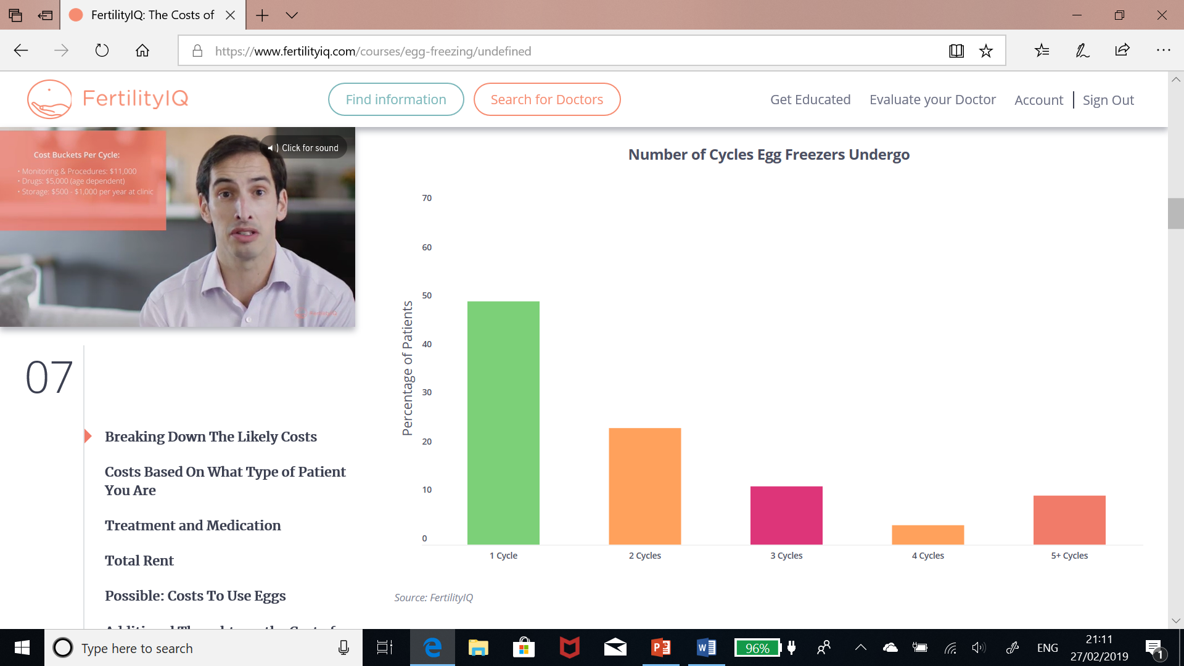

Slide 21
Egg Freezing costs – 1 cycle
Cost of Egg Freeze cycle + medications
  £4500
Cost of Storage each year
  £350
Cost of Thaw + ICSI
  £2000- £3000
+/- donor sperm
  £500
Total
  4500+ (350 x 5) + 2500 + 500 = £9250

Slide 22
Egg freezing
Is it “fertility insurance”?
Does it all women to “take control”
Gives a chance with own eggs when there may be no chance
Is an option to be considered
Beware hidden costs!

Slide 23

IVF Add Ons

Slide 24
IVF Add ons
Additional techniques
Aim to improve pregnancy rate
Commercially available
HFEA view
  Traffic light system
  Red, amber, green
  www.hfea.gov.uk

Slide 25
IVF Add ons
Problem
  Inflate cost of IVF cycle
  No good evidence they work
  “why not just try it”
  “it might work”
  Regret

Slide 26
IVF Add Ons
Solution
  Do not charge for experimental techniques
Add ons
  Assisted Hatching
  Time lapse incubator
  Embryoglue
  Acupuncture
  Nutritional support
  “Holistic therapies”

Slide 27
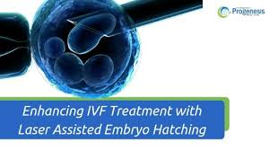
Assisted Hatching
Laser used to break shell around embryos
Some embryos may have thicker shell
  Older women
  Recurrent IVF failures
Theoretically helps embryo implant

Slide 28
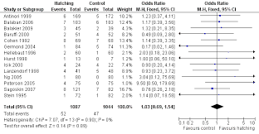
Assisted Hatching
Cochrane review

Slide 29
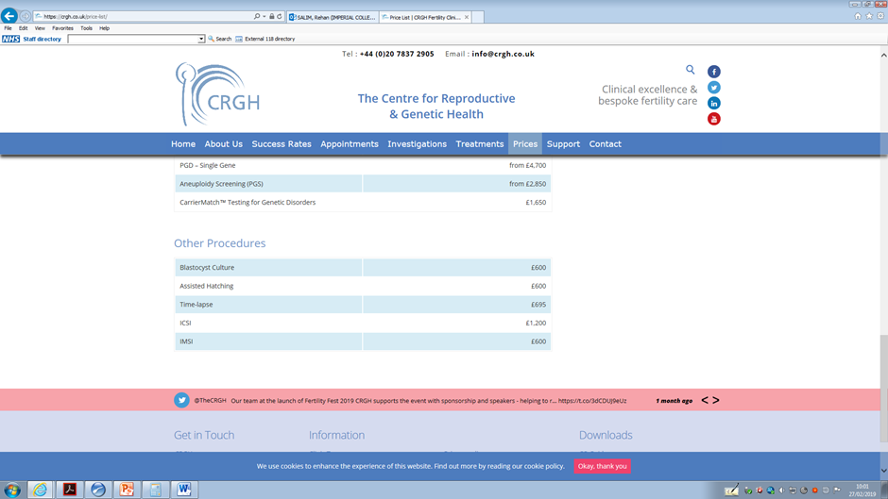

Assisted hatching

Slide 30
Time lapse incubator
Studies Comparing Outcomes With and Without Time Lapse
Study | Year | Sample Size | Statistically Significant Improvement
Kahraman | 2013 | 64 | No
Rubio | 2014 | 204 | Yes
Matyas | 2015 | 49 | No
Goodman | 2016 | 180 | No
Kaser | 2017 | 2015 | No

Slide 31
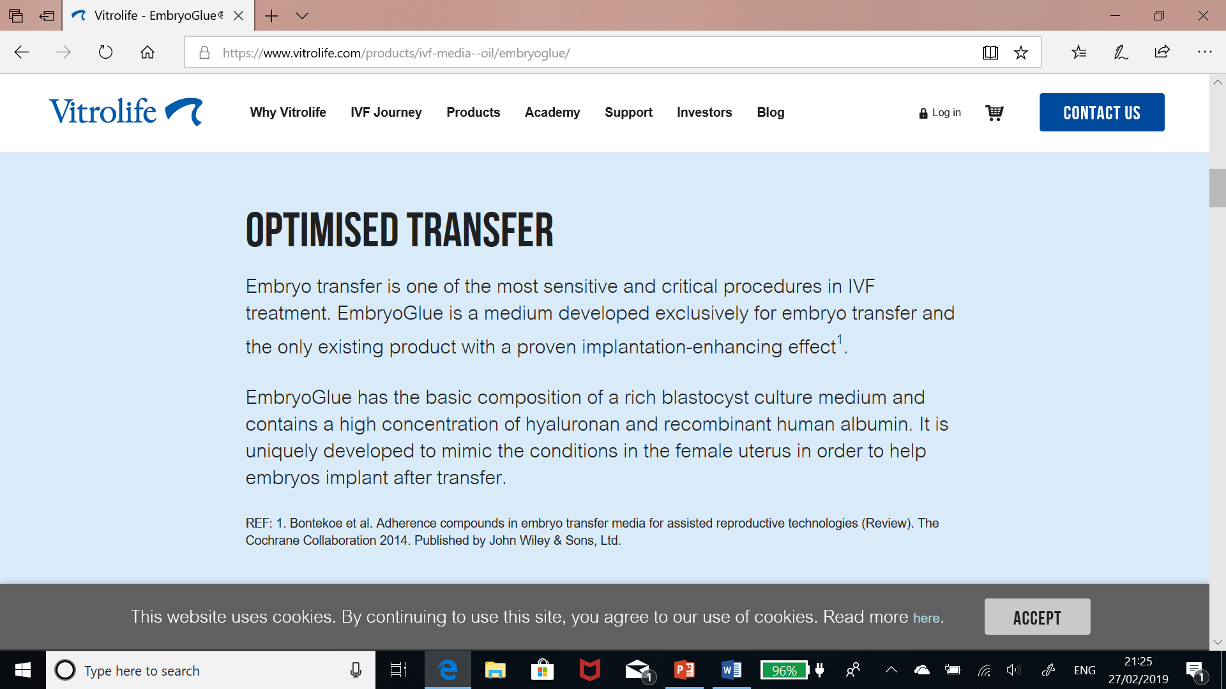
Embryoglue

Slide 32
Embryoglue
What’s the evidence for embryo glue?
Research from the Cochrane review shows that embryo glue containing hyaluronan increases pregnancy and live birth rates by around 10%. There is one high quality study in this review which shows that the use of embryo glue improves pregnancy and live birth rates, other studies in the review were of moderate quality. Further high quality studies are needed before doctors can be confident of the benefits of embryo glue.

Slide 33
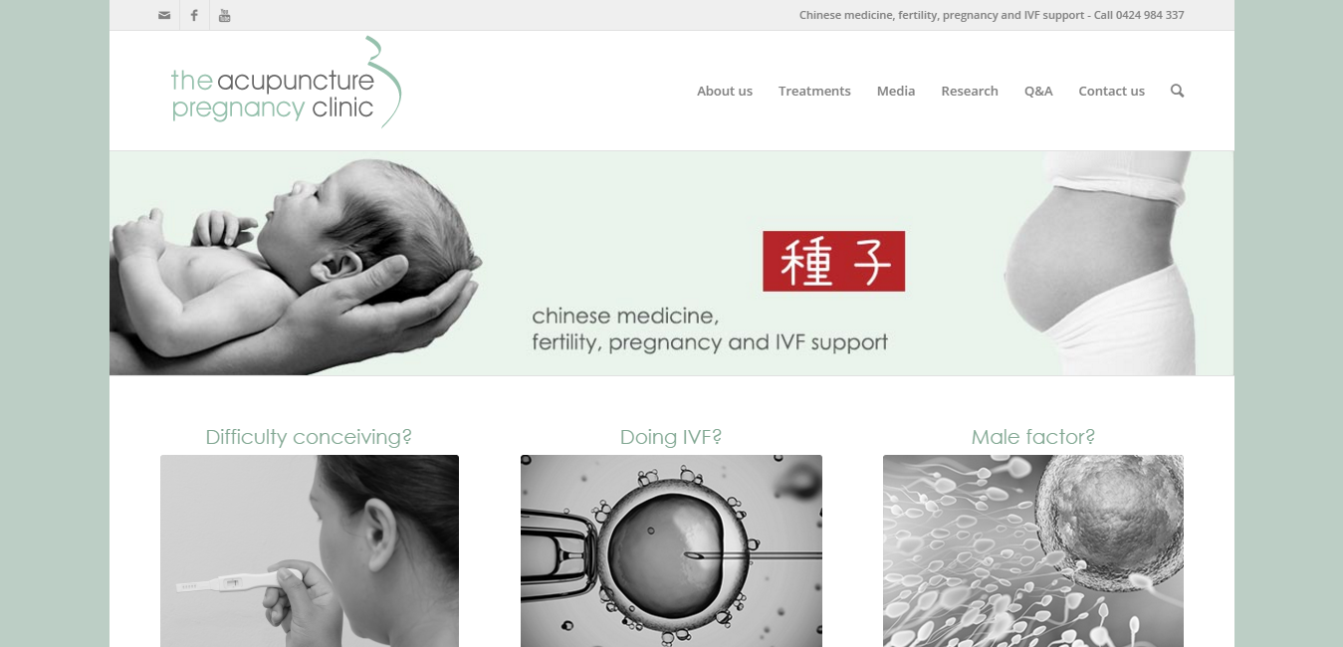
Acupuncture

Slide 34
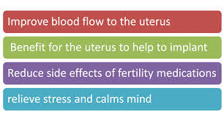
Acupuncture

Slide 35
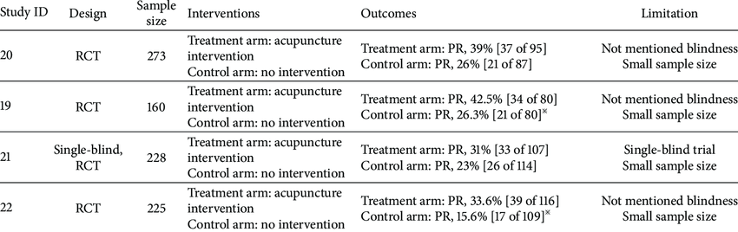
Acupuncture

Slide 36
Add ons
No evidence most work
Add considerable cost to an IVF cycle
If offered – should only be part of a research trial at present
  patients should not pay to take part in research

