Slide 1
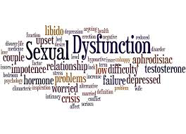
Physiotherapy management of female sexual dysfunction (FSD)
Holly Davies
Highly specialist pelvic health physiotherapist
Feb 2019
Notes:
Work for Imperial NHS trust and as part of that cover H&F and West London community gynaecology service
And today I am going to talk to you about FSD

Slide 2
Learning objectives
To be aware of the most common female sexual dysfunctions (FSD)
To understand the role of physiotherapy in the management of FSD, specifically genito-pelvic pain/penetration disorders
To understand the importance of a biopyschosocial approach to treatment

Slide 3
What is sexual health?
“…a state of physical, emotional, mental and social well-being in relation to sexuality;
it is not merely the absence of disease, dysfunction or infirmity.
Sexual health requires a positive and respectful approach to sexuality and sexual relationships,
as well as the possibility of having pleasurable and safe sexual experiences, free of coercion, discrimination and violence.
For sexual health to be attained and maintained, the sexual rights of all persons must be respected, protected and fulfilled.”
(WHO, 2006a)
Notes:
World health organisation in 2006
Infirmity
Coercion

Slide 4
What is normal in the UK?
NATSAL 3 (National Survey of Sexual Attitudes and Lifestyles UK)
Population study UK -2013
15,000 people
Ages 16-74
Average frequency of sex = x3 per month
70-80% of women will not orgasm with penetration
Reduced sexual function associated with depression, increasing age, poor health and unemployment
Notes:
What is normal in the UK when it comes to sex?
NATSAL – the National Survey of Sexual Attitudes and Lifestyles in the UK, did a population study in 2013 of 15, 000 people aged between 16-74
Often people have high expectations when it comes to sex, but in reality the average frequency of sex is 3 times per month. 70-80% women reported they did not orgasm during penetration alone.
The study also demonstrated that reduced sexual function is associated with depression, increasing age, poor health and unemployment

Slide 5
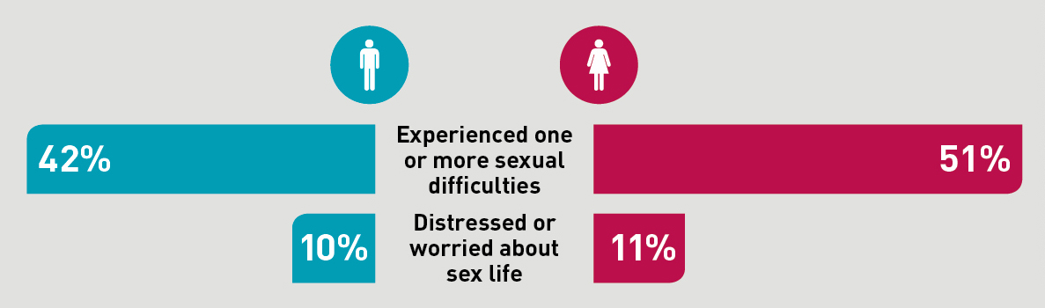
‘Any specific difficulties in the last year lasting 3 months or more?
Women
35% lacked interest in sex for at least 3 months in past year (only 10% distressed by this)
12% lacked enjoyment in sex
16% difficulty in reaching climax
7.5% felt physical pain as a result of sex
13% uncomfortable dry vagina
Notes:
One of the questions asked on the survey …
They found within women …
51% experienced one or more sexual difficulties – so over half the women in the survey (7,500) . With 11% - 825 people were distressed by this.

Slide 6
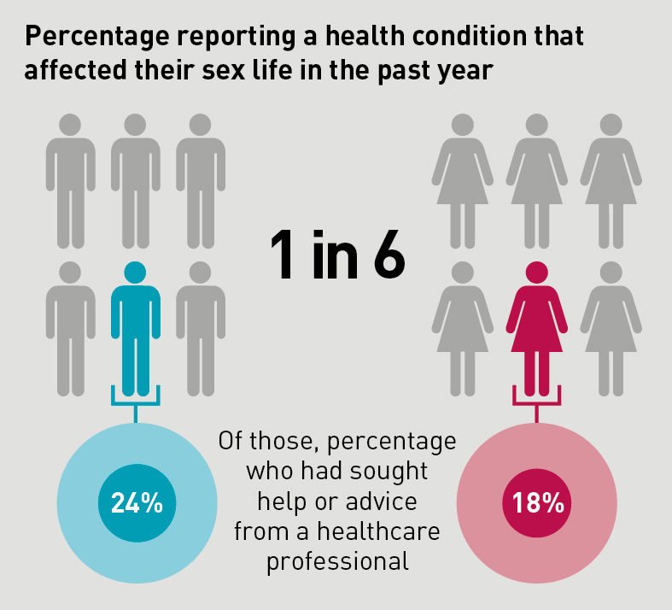
How good are we at talking about sex?
The PATIENT
The CLINICIAN/GP
Study 2009:
GPs ask patients <25% of the time
Secondary care – asked only 50% of the time
?this may be better now
?due to lack of time and training
Anybody presenting with period problems, pelvic pain, other gynaecology conditions should be asked about sex routinely. Using a relaxed open question ‘how's sex?’
Notes:
First of all the patient – with 1:1 reporting a health condition that affected their sex life in the past year. Only 18% sought help or advice from a healthcare professional.
Why is that – embarrassment, it still being a taboo subject, unsure who they should seek help from?

Slide 7
Definitions of FSD
Diagnostic and Statistical Manual of Mental Disorders (DSM) criteria (American Psychiatric Association)
DSM-5 (May 2013):
Female sexual interest/ arousal disorder
Female orgasmic disorder
Genito-pelvic pain/ penetration disorder (merged dyspareunia and vaginismus)
Previously DSM 4 (1994):
Dyspareunia – pain during penetration/ intercourse, which could be superficial or deep
Vaginismus – involuntary vaginal muscle spasms, which were strong enough to interfere with or prevent intercourse/ penetration
Notes:
The DSM 5 suggests 3 FSD diagnosis …
Merged the previously separate diagnosis of dyspareunia and vaginismus
Because in clinical practice these conditions often exist together or are very difficult to differentiate.
So merging them together should improve diagnostic accuracy

Slide 8
Genito-pelvic pain/ penetration disorder (GPPPD)
Defined by DSM-5 as at least 6 months persistent or recurrent difficulties in the following criteria:
Vaginal penetration during intercourse
Marked vulvo-vaginal or pelvic pain during vaginal intercourse or penetration attempts
Marked fear and anxiety about vulvo-vaginal or pelvic pain in anticipation of, during or as a result of vaginal penetration
Marked tensing and tightening of the pelvic floor muscles during attempted vaginal penetration
Diagnosis of exclusion

Slide 9
Vulvodynia
Definition: ‘ Vulvar discomfort, most often described as burning pain, occurring in the absence of relevant visible findings or a specific, clinical identifiable, neurological disorder’ (ISSVD, 2003)
Sub-types:
Generalised
a. Provoked – sexual, non sexual, both
b. Unprovoked
c. Mixed
2. Localised (includes vestibulodynia, clitorodynia and hemivulvodynia)
a. Provoked – sexual, non sexual (tampon), both
b. Unprovoked
c. Mixed
Diagnosis of exclusion
(2015 Consensus Terminology of Persistent Vulvar Pain and Vulvodynia)
Notes:
Then we have the term vulvodynia, which is a closely related and overlapping term used to describe chronic pain in the vulvar region of at least 3 months duration.
Generalised – more diffuse vulval pain, often described as a burning sensation
Provoked - the area is being touched. Sexual, none sexual (tampon, pelvic exam) or both
Unprovoked – occurs spontaneously without any trigger
Localised – specific location.
Most common localised provoked vulvodynia/ vestibulodynia
Again, as with GPPPD, vulvodynia is also a diagnosis of exclusion. If the vulval pain has an identifiable cause this is called persistent vulvar pain.

Slide 10
Pain related to specific conditions
Superficial/ vulvar
Infectious – candida, herpes simplex virus
Inflammatory/dermatologic – lichens planus, lichens sclerosus, vulvar dermatitis
Hormonal – vulvo-vaginal atrophy
Trauma - post operative delivery, perineal trauma, radiotherapy, FGM
Structural – septum, congenital
Neurological - neuropathic pain, neurological disease
Malignancy (vaginal or vulval neoplasia)
Deep
Non-gynaecological (IBS, inflammatory bowel disease, UTI)
Pelvic congestion syndrome
Endometriosis
Adnexal or pelvic pathology (cysts, fibroids, pelvic malignancies)
Infectious - PID
Iatrogenic - vaginal shortening or narrowing, post radiotherapy changes
Chronic pelvic pain
Pelvic floor dysfunction (mechanical, anatomical factors, retroversion, prolapse
Notes:
Specific disorders that need to be ruled out before a diagnosis of GPPPD or vulvodynia can be given.
Pelvic congestion syndrome - accumulation of blood in veins of the pelvis

Slide 11
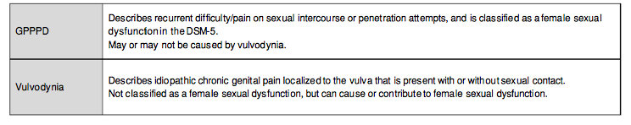
Correct terminology of sexual/genital conditions:
Conforti, Celine. (2017). Genito-Pelvic Pain/Penetration Disorder (GPPPD): An Overview of Current Terminology, Etiology, and Treatment. University of Ottawa Journal of Medicine. 7. 48. 10.18192
Notes:
Conforti, Celine. (2017). Genito-Pelvic Pain/Penetration Disorder (GPPPD): An Overview of Current Terminology, Etiology, and Treatment. University of Ottawa Journal of Medicine. 7. 48. 10.18192/uojm.v7i2.2198.

Slide 12
Vulvodynia and GPPPD: contributing factors …
Often complex and multifactorial
Biological:
Infections
Lack of lubrication – vaginal dryness/atrophy
Chemical irritation – soaps, douches, allergy
Recurrent vulvo-vaginal candida
Repeated local anti-fungal treatments
Local treatment for HPV
Immunological
Genetic link to develop chronic inflammatory conditions
Hormonal influence – combined oral contraceptive pill
Genital surgery – eg: episiotomy, perineal tear
Psychosocial:
Anxiety/ fear/ behavioural avoidance
Depression/ OCD
Lack of arousal/desire
Negative expectations
Partner’s support and understanding/ relationship
Cultural background
Past relationships, sexual education and knowledge of anatomy
Previous physical +/- sexual abuse
Previous trauma (eg: traumatising gynae procedure, early sexual experiences)
Notes:
No definite aetology for vaginismus in literature
Biological, psychological and relational factors interact to perpetuate and maintain a women’s pain response
Biological drivers –
Infections, lack of lubrication, chemical irriants, recurrent candida and its treatments, local Rx for PPV can all cause mechanical trauma or muscosal damage
Prolonged tissue damage can lead to mast cell hyperactivation, eventually causing an increase in nerve endings resulting in hyperalgesia and allodynia, which are characteristics of neuropathic pain.
Oral contraceptive – some evidence demonstrates altered pains sensitivity of the vesibular mucosa and a decreased mechanical pain threshold.
Hypersensitivity from scar tissue

Slide 13
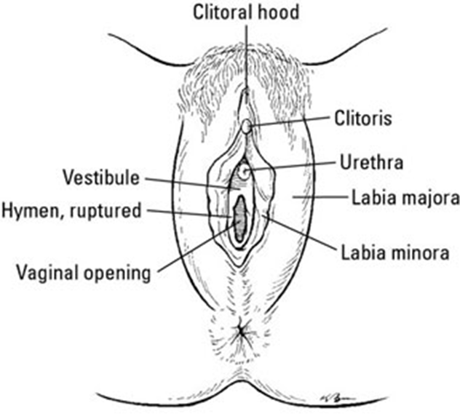
Physiotherapy Assessment:
Subjective assessment using open questions:
History of present condition
Pain – where, when, agg’s, eases, VAS
Sexual function – partners current and previous, first sexual experience, any previous trauma, self play, arousal/desire, vaginal dryness
Bladder and bowel function
Gynae history – any UTI’s, vaginal infections, thrush, STI’s, smear results, menstrual cycle, contraception
Obstetric history – type of delivery, baby weight’s
Objective assessment:
LISTEN
LOOK
FEEL
Notes:
Has anybody done anything you did not want them to do?
Vaginal examination - LOOK
• breathing pattern – apical or diaphragm breaths
• hiatus length
• pelvic floor muscle contraction - perineal lift
& drop - contraction & full relaxation
Skin changes – ?atrophy, skin conditions
Vaginal examination - FEEL - function? pain?
• External palpation - superficial pelvic floor
muscles
• Internal palpation - deep pelvic floor muscles
• Lumbar spine / hip / sacroiliac joint / coccyx /
abdominal examination (previous coccyx injury)

Slide 14
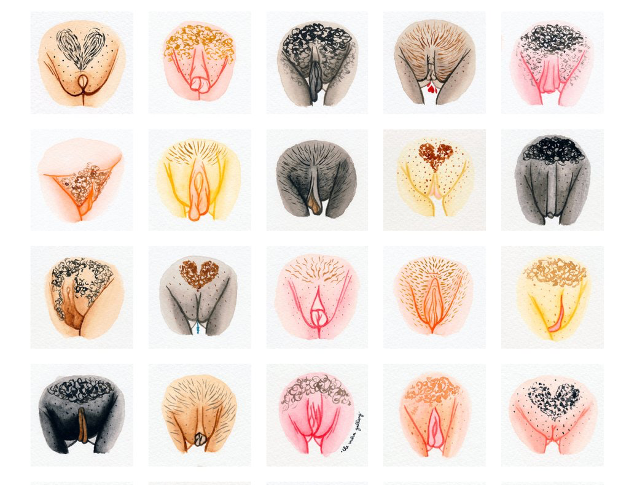

Physiotherapy treatment
Education – anatomy, pain, sex function
Vulvar care advice
Self exploration/ desensitisation with fingers or dilators – reducing fear and pain
Pelvic floor muscle release/ manual therapy/ pelvic floor awareness – reducing tension and tone
Pelvic stretches
Breathing techniques
Relaxation/ mindfulness
Graded exposure/ vaginal trainers/ wands
Acupuncture/ dry needling
Notes:
Vulvar care advice – avoid soaps. Could do dermol or cetraben as washes, Sudocream or Cavilon as barrier creams or hydromol as moisturiser

Slide 15
Research:
Bergeron et al 2002
A retrospective study evaluated the effectiveness of physical therapy in relieving painful intercourse and improving sexual function in women diagnosed with vulvar vestibulitis (PVD)
35 women with PVD took part in a physical therapy program for an average of 7 sessions
Results: 51.4% of women with PVD had complete or great improvement and 20% moderate improvement to pain at follow up
Average coital pain rating decreased from 8.2 to 3.9 after treatment
Notes:
Study was done in 2002 looking at the effectiveness of physical therapy in relieving painful intercourse and improving sexual function in women with provoked vulvodynia
35 women with provoked vulvodynia attended 7 sessions of physiotherapy
51.4% had complete or great improvement to symptoms and 20% had moderate improvement to symptoms at follow up
And the average sexual pain decreased from 8.2 to 3.9 on the vas scale after treatment

Slide 16


MDT - biopsychosocial approach
CBT – explore women’s thoughts, emotions, behaviours and relationship dynamics associated with the experiences of sexual pain
Psychosexual counselling/ sex therapy– ideally involving partner. Sensate focus programmes.
Medication –
  antidepressants (amitriptyline)
  anticonvulsants (gabapentin, pregablin)
  topical (lidocaine) – one study demonstrated only 20% improvement to pain
  topical oestrogen – lack of evidence
  Botox – several small studies demonstrate efficacy, no RCT’s to confirm
Surgery – vulvar vestibulectomy
Notes:
Jeferriss Wing SMH
Vulval vestibulectomy – complete removal of vestibule – invasive approach to treatment. However a meta-anaylsis of 33 studies demonstrated partial relief of sexual pain in 88% of patients and significant relief in 78.5% of patients.

Slide 17

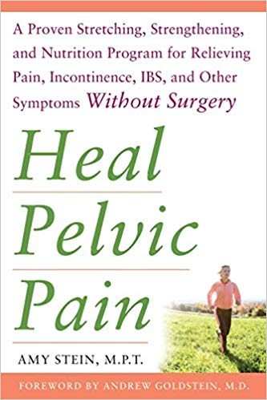

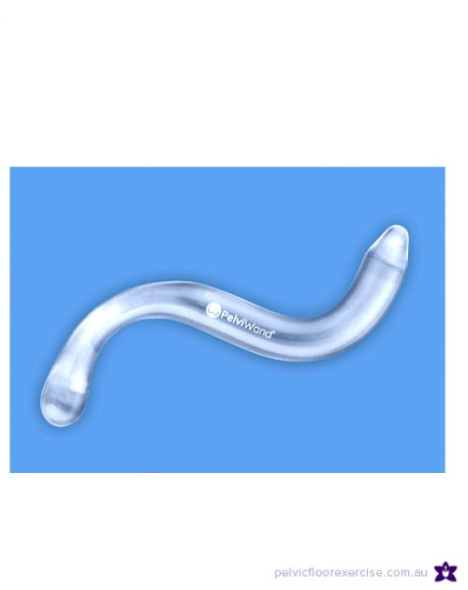

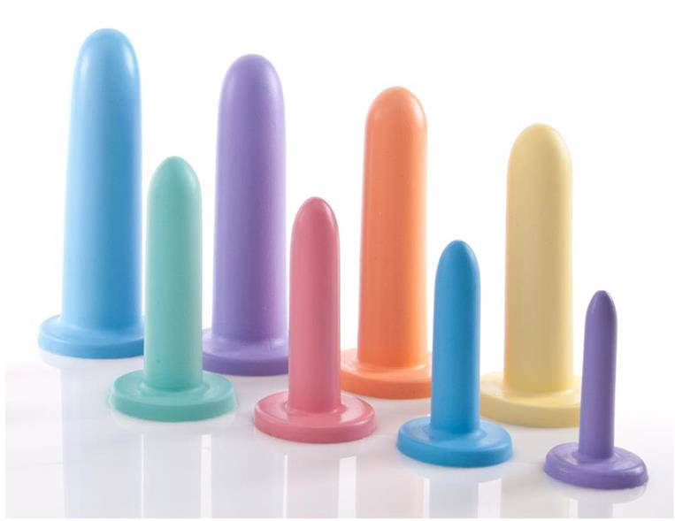
Useful patient resources
Websites:
www.bssvd.org
www.vulvalpainsociety.org
www.omgyes.com
www.vaginismus.org
2. Books
Wonder down under
Anatomy of arousal
Heal pelvic pain
3. Apps
Headspace
Finding peace in a frantic world
Calms
4. Dilators/wands/sex toys – Sh!, Love honey, Soul source
Notes:
www.omgyes.com
www.vaginismus.com

Slide 18

Other useful pelvic health physiotherapy resources
Other useful pelvic health physiotherapy resources:
POGP leaflets - https://pogp.csp.org.uk/publications
Including:
Pregnancy related pelvic girdle pain
Exercise and advice after pregnancy
Pelvic floor muscle exercises
Promoting continence with physiotherapy
Fit for future
Fit for birth
Fit for pregnancy
Fit following surgery

Slide 19
References
WHO 2006a
NATSAL 3 (National Survey of Sexual Attitudes and Lifestyles UK) 2013
Bornstein, Jacob, Goldstein, Andrew, Stockdale, Colleen K. et al (2016). Consensus Terminology of Persistent Vulvar Pain and Vulvodynia. Obstetrics & Gynecology: Volume 127 - Issue 4 - p 745–751.
Conforti, Celine. (2017). Genito-Pelvic Pain/Penetration Disorder (GPPPD): An Overview of Current Terminology, Etiology, and Treatment. University of Ottawa Journal of Medicine. 7. 48. 10.18192.
Nikki M W Lee, Adam D Jakes, Jillian Lloyd, Leila C G Frodsham. (2018) Dyspareunia. BMJ 2018; 361
Bergeron S, Brown C, Lord MJ, Oala M, Binik YM, Khalifé S. (2002) Physical therapy for vulvar vestibulitis syndrome: a retrospective study. J Sex Marital Ther. 2002 May-Jun;28(3):183-92.
Foster DC, Kotok MB, Huang L, et al. Oral desipramine and topical lidocaine for vulvodynia: a randomized controlled trial. Obstet Gynecol. 2010;116(3):583-93.
Micheletti L, Radici G, Lynch PJ (2015) Is the 2003 ISSVD terminology and classification of vulvodynia up-to-date? A neurobiological perspective. J Obstet Gynaecol. 2015;35(8):788-92.

