Slide 1

Frailty
Claire Solomon
Consultant Geriatrician
Frailty Lead Charing Cross Hospital
Imperial College Healthcare NHS Trust

Slide 2
Objectives
To understand what is meant by Frailty
To understand the importance of diagnosing frailty
To understand the different ways we identify frailty
To understand successful (and the ineffective) interventions for frailty
The Frailty Service at Imperial
Case studies

Slide 3
What is frailty?
Inflammation, immune system failure and dysregulation of neuroendocrine pathways leading to skeletal muscle decline
There is no gold standard for diagnosis
It IS however a distinct entity from ‘old age’ or ‘multi-morbidity’ or ‘cognitive impairment’
Some older patients remain fit, well and active while others have gradual, unrelenting functional decline
4 to 16 % in men and women aged 65 and older (USA)

Slide 4
What is frailty
A clinical state of vulnerability with inherent risks for adverse clinical outcomes
Hallmark geriatric syndrome
Poor functional reserve - small insults result in large, steep, sudden declines in function and/or cognition

Slide 5
Why do we need to identify frailty?
Frailty is central to the activity of every healthcare provider
Frailty increases the risk of acute unscheduled admission
Frailty predisposes patients to poorer outcomes (falls, procedural complications, institutionalisation, disability, death)
Frailty is a pre-terminal diagnosis
1/3 of patients ‘not managing at home’ will be dead within 12 months

Slide 6
Frailty screening
Utilised to identify older adults at high risk of adverse outcomes in a variety of clinical settings
Important to target the correct patients for intervention – not those ‘too well’ or ‘too sick’
Their direct prognostic ability or clinical role is limited and challenging
As an exercise in Frailty recognition and improving care, are effective.

Slide 7
Identifying Frailty
Much research exists now looking at frailty as a clinical and physiological entity
Different frailty scores: no gold standard
2 categories –
The Frailty Phenotype (FRAIL, Rockwood)
The accumulation-of-deficits model – the more medical conditions and impairments a person has, the more frail (eFI, Edmonton)
Only as good as the team using them
Many now in routine clinical use

Slide 8
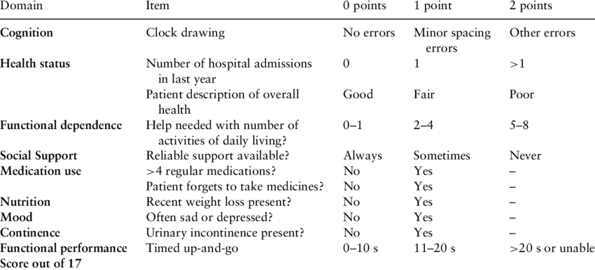
The Edmonton Frailty Scale

Slide 9
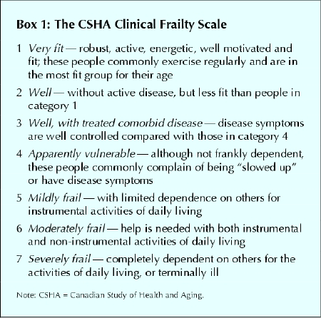

Slide 10
FRAIL screening tool
●Fatigue ("Are you fatigued?")
●Resistance ("Can you (not) climb one flight of stairs?")
●Ambulation ("Can you (not) walk one block?")
●Illnesses (greater than five)
●Loss of weight (greater than 5 percent)
"Yes" to three or more questions indicates frailty. "Yes" to one or two questions indicates pre-frailty

Slide 11
eFI
Uses data from the GP electronic health record to identify and grade frailty
Data from around one million UK patients
Identifies older people who are fit or mildly, moderately or severely frail
It accurately predicts risk of nursing home admission, hospital admission, length of hospital stay and mortality
Uses routinely available data (36 domains), without the need for an additional clinical assessment.
Implemented into the SystmOne GP electronic health record and the two other main UK GP electronic health records (EMISWeb and Vision) is at an advanced stage.
Community programmes case-finding using eFI include
  developing a tiered community frailty service for older people
  identify patients for pharmacist-led medication reviews
  identifying patients for proactive falls prevention treatment.

Slide 12
Imperial Daily Frailty Report: all over 70s scored 3 or above, last 72 hours
MRN | Name | Birth Date | Sex | Encounter Identifier Millennium | Consultant | Admit Date & Time | Current / Last Facility | Current / Last Building | Current / Last Ward | Current / Last Room | Current / Last Bed | First Frailty Scale Category
 |  |  | Male |  |  | 11/09/2018 15:04 | CXH | CX Twr 10 S | CX 10S | Bay D | Bed 01 | 5
 |  |  | Female |  |  | 11/09/2018 06:30 | CXH | CX Twr 10 S | CX 10S | Side Room B | SR B | 4
 |  |  | Female |  |  | 08/09/2018 14:43 | CXH | CX Twr 11 N | CX 11N | Large Bay | Bed 10 | 7
 |  |  | Male |  |  | 10/09/2018 05:50 | CXH | CX Twr 11 S | CX 11S Neuro | Bay E | Bed 04 | 6
 |  |  | Female |  |  | 07/09/2018 02:30 | CXH | CX Twr 04 S | CX 4S | Bay A | Bed 02 | 5
 |  |  | Male |  |  | 11/09/2018 09:17 | CXH | CX Twr 06 N | CX 6N | Bay A | Bed 03 | 4
 |  |  | Female |  |  | 09/09/2018 19:14 | CXH | CX Twr 06 N | CX 6N | Bay E | Bed 02 | 4
 |  |  | Female |  |  | 08/09/2018 19:41 | CXH | CX Twr 06 N | CX 6N | Bay E | Bed 04 | 6
 |  |  | Female |  |  | 07/09/2018 13:51 | CXH | CX Twr 06 N | CX 6N | Bay K | Bed 01 | 5
 |  |  | Male |  |  | 10/09/2018 18:14 | CXH | CX Twr 06 N | CX 6N | Side Room C | SR C | 4
 |  |  | Female |  |  | 07/09/2018 14:11 | CXH | CX Twr 07 N | CX 7N | Bay A | Bed 02 | 3
 |  |  | Female |  |  | 09/09/2018 10:36 | CXH | CX Twr 07 W | CX 7W Rav | Bay F | Bed 04 | 6
 |  |  | Male |  |  | 07/09/2018 08:55 | CXH | CX Twr 08 S | CX 8S | Bay F | Bed 03 | 5
 |  |  | Female |  |  | 10/09/2018 18:02 | CXH | CX Twr 08 W | CX 8W MFE | Bay A | Bed 03 | 6
 |  |  | Female |  |  | 08/09/2018 12:30 | CXH | CX Twr 08 W | CX 8W MFE | Bay F | Bed 01 | 7

Slide 13
The common frailty syndrome presentations are:
delirium
falls
acute or sub acute decline in mobility
not managing at home
recurrent attendances/frequent contact with services
weight loss
not eating and drinking
incontinence
pressure ulcers
sleep disorders + sensory deficits
fatigue
dizziness

Slide 14
Frailty interventions: what works?
Specialist organised multidisciplinary geriatric diagnostic and treatment process as represented by a CGA (comprehensive geriatric assessment) is the gold standard of care (Cochrane 2011, 2017)
CGA domains include:
Functional capacity
Falls risk
Cognition
Mood
Polypharmacy
Social support
Financial concerns
Goals of care
Advance care preferences

Slide 15
Efficacy of CGA
Meta-analyses have consistently found CGA improves detection and documentation of geriatric problems
Whether CGA improves outcomes depends on CGA models and their settings
Home geriatric assessment and acute geriatric care units have been shown to be consistently beneficial for several health outcomes. Co-management programmes eg orthogeriatrics has increasing evidence
The data is conflicting for post-hospital discharge, outpatient geriatric consultation, and inpatient geriatric consultation services.

Slide 16
The best evidence is for:
OT interventions
Exercise
Nutrition
Medication reviews
Advanced care plans/goal setting incl. palliative care involvement

Slide 17
There is no evidence for……
Testosterone supplementation
Growth hormone supplementation
DHEA-S supplementation
Anti-inflammatory interventions

Slide 18
Frailty Services at Charing Cross
ED + CDU liaison
Monday – Friday, 9-5
OPRAC (Older Persons Rapid Access Clinic)
Patients needing Comprehensive Geriatric Assessment, therapy and diagnostics within approx. 1 week/at risk of admission – within 24 hrs if urgent – referrals via e-RS
Frailty Unit
Monday -Friday
Short-stay admissions (24-48hrs) CGA plus – other assessments/defined treatments/diagnostics/increases or new POC – no monitored beds
Email advice
ICHC-tr.adviceelderlymedicine-imperial@nhs.net
Telephone advice line
Monday – Friday, 9-5: CX 02033115162, SMH 07789 618954

Slide 19
OPAL (older persons assessment and liaison) Team
Frailty team working on the AMU
MFE wards
48 beds across 2 wards
Rehabilitation ward
15 beds
Clinics
OPRAC
Falls
General
The Virtual Ward
CIS plus Imperial consultant geriatric input
‘hospital-at-home’
Liaison with OPRAC
Referrals from GPs or hospital on DC

Slide 20
Other trust frailty services
SMH | HH
Orthogeriatrics | Cardiology liaison
Vascular liaison | Renal liaison
Trauma liaison | MFE beds
AMU-based frailty service/OPAL | Memory clinic
MFE beds | General MFE clinic
Falls clinic
General MFE clinic

Slide 21
OPRAC case study: 1
Mr P, 75, referred by GP
Rapidly deteriorating mobility and cognitive function
Came to OPRAC accompanied by wife
Assessment:
CGA incl. therapy ax and medication RV
dementia bloods
CT head
ECG
urinalysis
MOCA
Diagnosis:
Likely advanced vascular dementia, possible normal pressure hydrocephalus
Severe visual-spatial awareness deficits causing decreased mobility, in particular at doorways, on tiles, on darker coloured rugs.
Interventions:
Neurology review in OPRAC plus f/up arranged
OP MRI brain to exclude NPH
Carer education on dementia related gait disturbance, visual aids etc.
Direct discussion with St Vincent’s to ensure prompt review in memory clinic
Commencement of a new POC

Slide 22
OPRAC case study: 2
88 year old man
GP referral with worsening DIB despite treatment for chest infection and a history of falls
Assessment:
CGA
CXR
bloods incl. d-dimer and BNP
sats. on mobilising
ECG
CTPA
Diagnosis
Acute exacerbation of heart failure
Interventions:
IV diuretics – patient kept over night on Frailty Unit
up – titration heart failure medication
Referred to community HF team
walking stick provided, patient declined referral to falls clinic
D/Cd next morning - GP asked to continue monitoring U&Es and weight

Slide 23
OPRAC case study: 3
84 year old lady
GP referral
Advanced dementia and pressure ulcer over the hip – worsening pain + discharge from pressure ulcer
Pressure relieving mattress pre-arranged for OPRAC
Assessment:
CGA
CT pelvis with contrast
Review by infectious diseases team with wound swab
Diagnosis:
Clean pressure ulcer without underlying osteomyelitis
Treatment:
No need for antibiotics
OT provided rota stand to facilitate transfers,
Community OT referral made
Up-titration of analgesia
Advance care planning discussions with family

