Slide 1
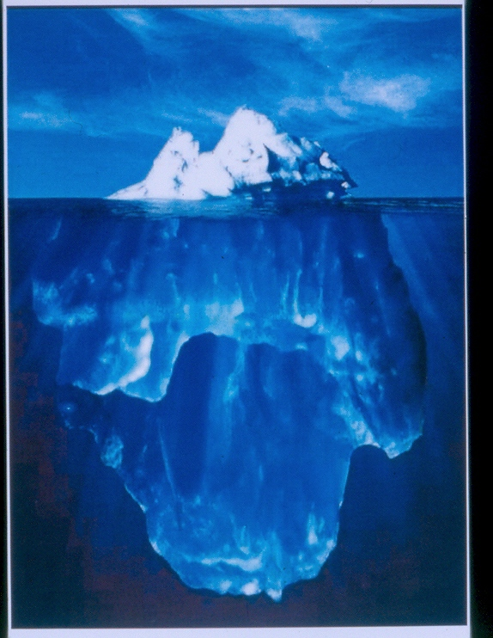
GP Elderly Medicine Study Afternoon
20 September 2018
Dr David James
Consultant Geriatrician
St Mary’s Hospital
Dementia in an Ageing Population
Dr David James
Consultant Geriatrician
Trust Clinical Lead for Dementia

Slide 2
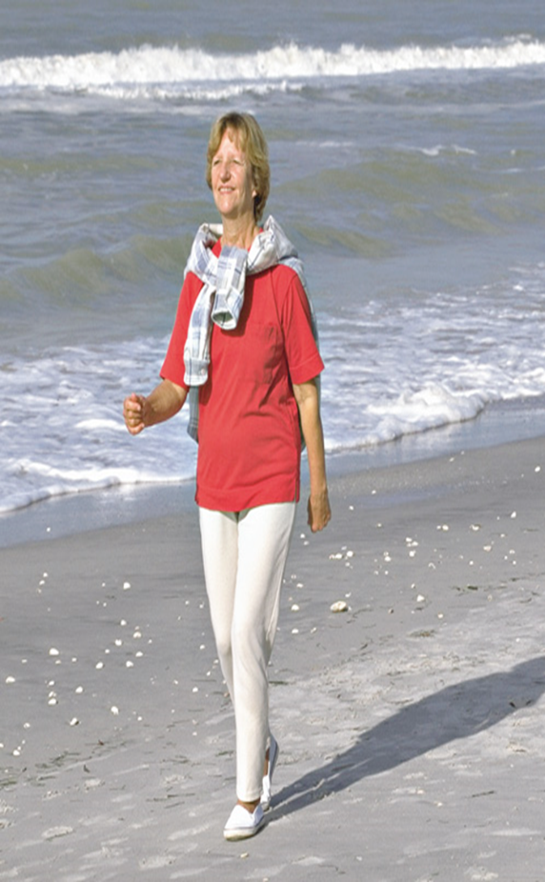
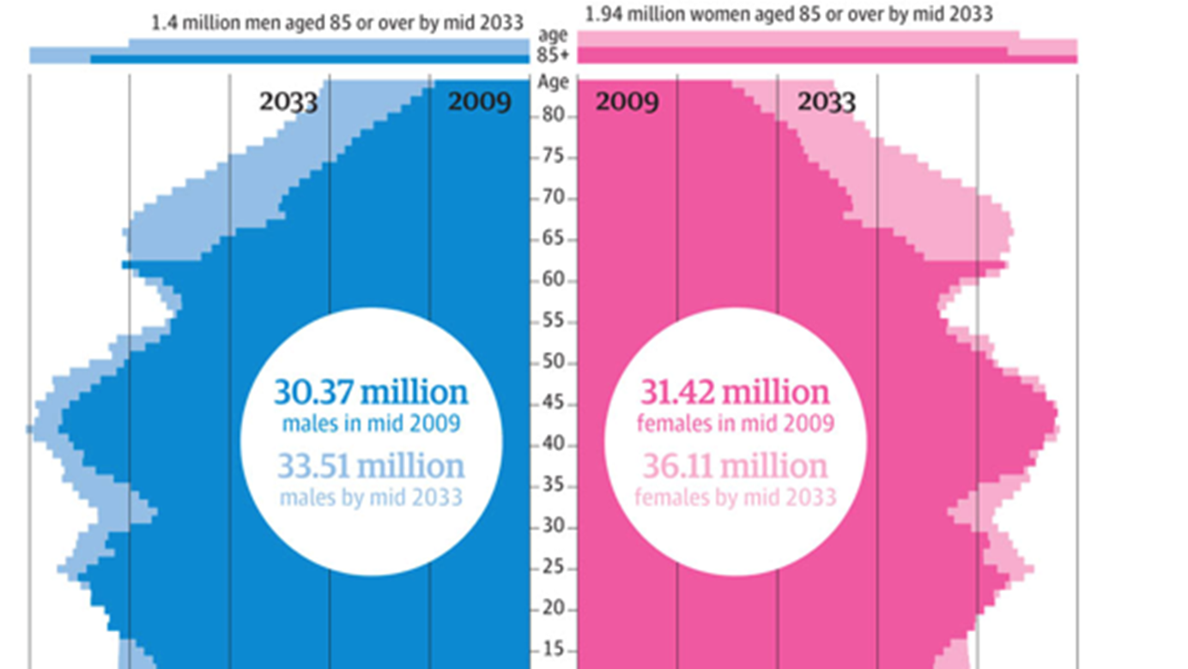
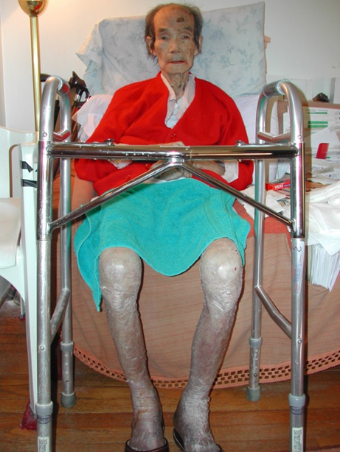
The challenge

Slide 3
Snapshot of Lewis Loyd Ward 11/09/18
AGE | 0 - 1 CD | 2 CD | 3+ CD | Cognitive imp/dementia | Mobility ↓
76 |  |  | ✓ | ✓ | -
82 |  |  | ✓ | ✓ | ✓
82 |  |  | ✓ | ✓ | ✓
82 |  |  | ✓ | ✓ | ✓
82 |  |  | ✓ | ✓ | ✓
86 |  |  | ✓ | ? | ✓
89 | ✓ |  |  | ✓ | -
90 |  |  | ✓ | ? | ✓
91 | ✓ |  |  | - | -
91 |  |  | ✓ | ✓ | ✓
94 | ✓ |  |  | ? | ✓
95 |  |  | ✓ | ✓ | -
96 |  |  | ✓ | ✓ | ✓
96 |  |  | ✓ | ✓ | Post hypo
97 |  |  | ✓ | ✓ | ✓

Slide 4
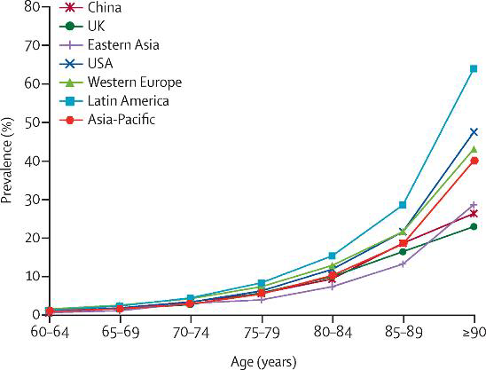
Dementia worldwide
Prevalence by age (UK)
1% of 65 - 69
4% of 70 - 74
8% of 75 - 79
16% of 80 - 84

Slide 5
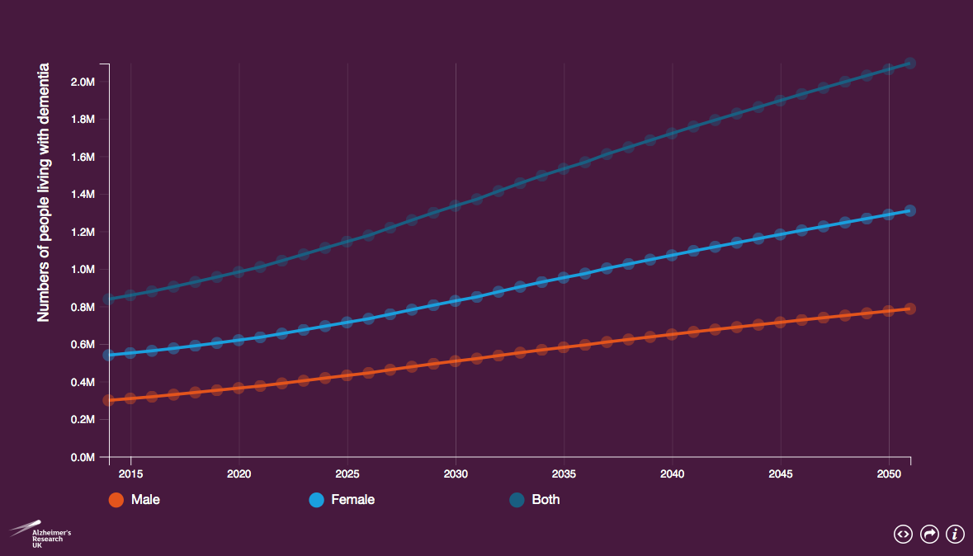
Projections of dementia prevalence in UK
Source: Prince, M et al (2014) Dementia UK: Update Second Edition report produced by King’s College London and the London School of Economics for the Alzheimer’s Society

Slide 6


Learning objectives
The clinical features of dementia in advanced age
The different diagnostic screens for dementia
Dementia as one of a number of chronic conditions
Which patients to refer to which services

Slide 7
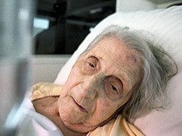
Case study
Mrs SS DOB 24/10/1924

Slide 8
Emergency admission
Admitted (after 24 hours on CDU) – presented to ED with:
Pain and swelling R wrist (No history from patient - ? Recent fall/trauma)
Recent admission under Ortho with L elbow avulsion fracture and haemarthrosis and “acute confusion”

Slide 9
Past medical history
Type 2 DM
Hypertension
CABG 2008
CKD stage 4
OA
Pseudogout
Recurrent falls due to postural hypotension
R total hip replacement (8 years ago)

Slide 10
Medications
Aspirin 75 od
Enalapril 10 mg od
Atorvastatin 40 od
Gliclazide 80 od
Metformin 500 bd
Omeprazole 20 od
Ferrous fumarate 210 bd
Adcal D3 forte 1 tab bd
Sodium docusate 200 bd

Slide 11
Social history
Widow last 37 years
No close family/friends
In sheltered accommodation
Used to go to a day centre – recently “not interested”
Carers increased to QDS since stopped going to day centre
Concern about worsening mobility and weight loss

Slide 12
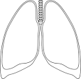
Examination
T 36.4 HR 72 Reg BP 100/50 RR 18 Sats 96% RA BM 7.4 (At 07.25 BM 3.5) AMTS 5/10
HS normal JVP ↔
Abdo: soft, non tender
R wrist: visibly swollen, minimal erythema, tender to palp, all movements painful +++
Bruising both arms
BS normal R+L

Slide 13
Investigations
Hb 96 MCV 79 WCC 8.3 Plat 281
Na 137 K 5.3 Urea 9.9 Creat 111 Ca 2.48
ALT 25 ALP 68 Albumin 24 Bilirubin 6
Urate 331 CRP 14
Urine dip: negative
CXR: Cardiomegaly only
ECG: SR 84 LAD

Slide 14
Problem list
Acute monoarthritis (?septic arthritis, crystal arthropathy)
Delirium (“AMTS off baseline”)
- ?Infection/inflammation wrist joint
- Hypoglycaemia
- Fall and ?head injury

Slide 15
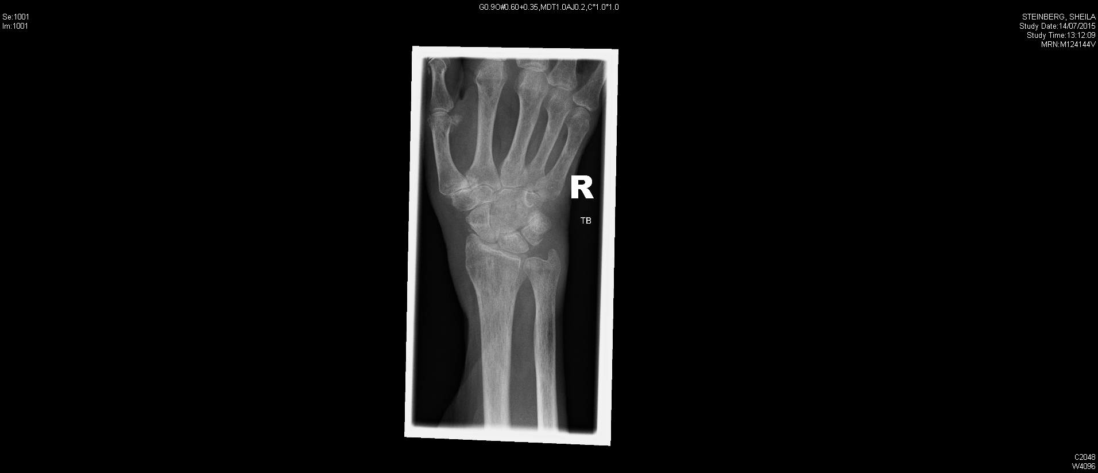

Slide 16
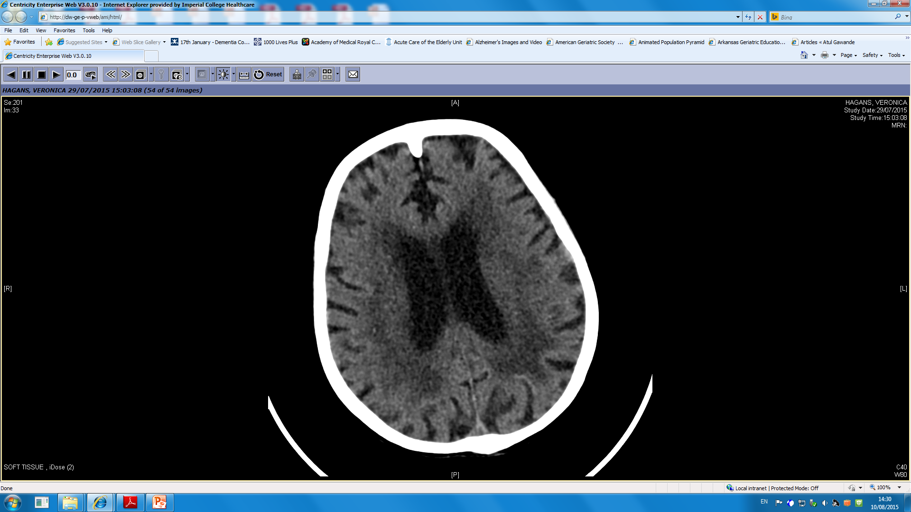

Slide 17
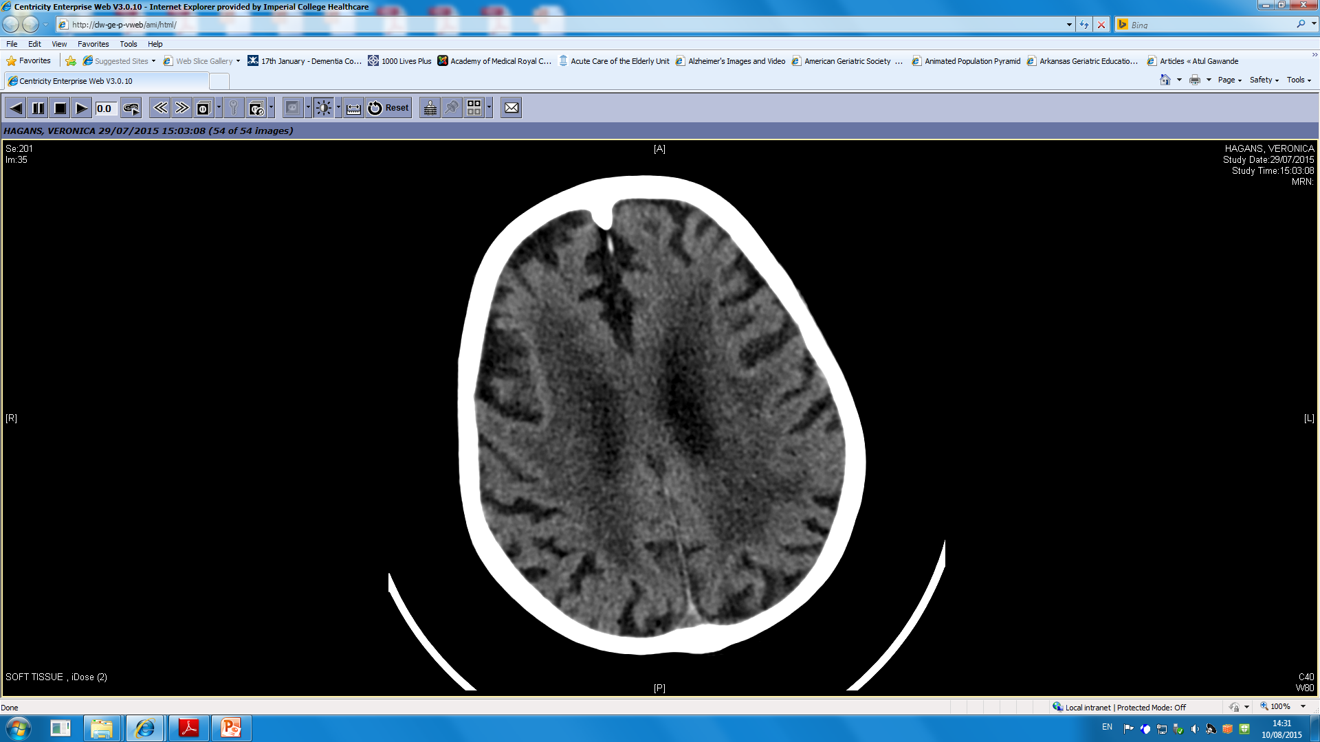

Slide 18
Management plan
Aspiration R wrist under U/S
Treat for ?septic arthritis (Co-amoxiclav)
Intravenous fluids
Analgesia + colchicine if gout confirmed

Slide 19
Progress on acute admissions ward
Nursing entries
Patient remains stable
Remains incontinent
Refusing physiotherapy assessment
Not eating/drinking well. Needs encouragement +++
Refused lunch – had only biscuits
Drinks offered regularly – often refuses
Not taking medications
Medically fit – can go home once OT/PT happy
To be seen by social worker today – for increased POC

Slide 20
Mrs SS 94 years old
Is the patient delirious?
What is going on?
Is she MFFD?
What next?

Slide 21
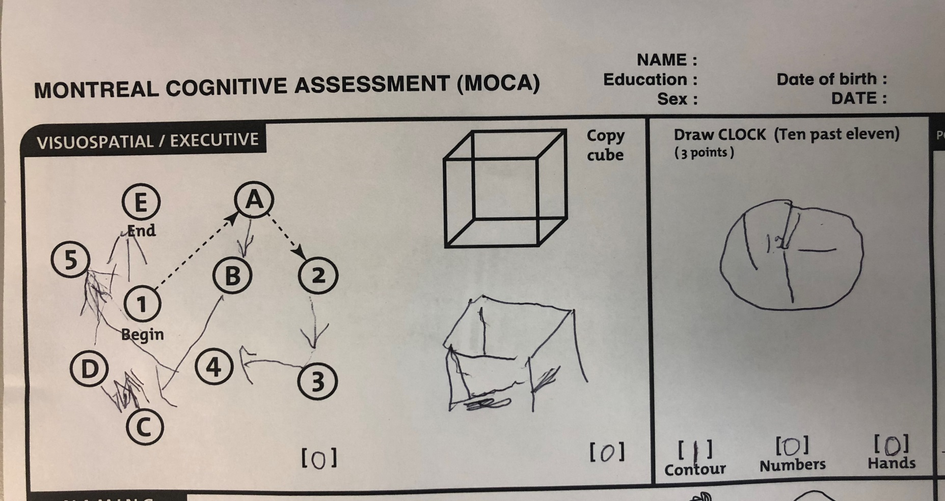
MOCA 17/30

Slide 22
Mrs SS 94 years old
What is going on here?

Slide 23
Mrs SS - Past medical history
Type 2 DM
Hypertension
CABG 2008
CKD stage 4
OA
Pseudogout
Recurrent falls due to postural hypotension
R total hip replacement 8 years ago

Slide 24
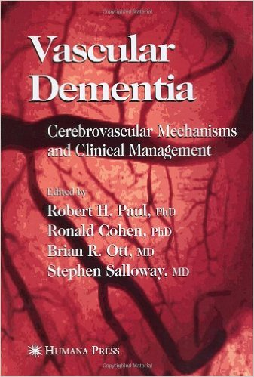

Slide 25

Dementia in Advanced Age
AD
VaD
Both vascular and degenerative mechanisms often contribute to dementia development in older adults. Viswanathan, et al., Neurology 2009

Slide 26
VaD
Vascular Risk Factors
Hypertension Diabetes Genetics Hypercholesterolemia Heart Disease
Damage to Cerebral Vasculature
Multiple Distinct Pathologies
Large vessel infarcts
Small vessel infarcts
Hemorrhage
Hypoperfusion
Multiple Lacunae
Binswanger’s Disease
CADASIL
Chronic SDH
SAH
ICH
Global (e.g., cardiac arrest)
Hypotension (major surgery)
Strategic Single Infarcts
Multi-infarct Dementia
Final Common
Pathway
Damage to critical cortical and subcortical structures
Damage/interruption of subcortical circuits and projections
VaD
Erkinjuntti T. CNS Drugs, 1999.
Notes:
Key Points
VaD is a heterogenous disorder originating from cardiovascular risk factors, which contribute to ischemic damage of varying degrees within the cerebrovasculature. From this point, there can be a large divergence in pathology, ranging from large and small vessel infarcts to hemorrhage to hypoperfusion (stemming from an MI or hypotension).
All damage, regardless of its distinct cause and pathology, ultimately leads to the final common pathway of decreasing cholinergic transmission and the presentation of symptoms recognized as VaD.
Reference
Erkinjuntti T. Cerebrovascular dementia: pathophysiology, diagnosis and treatment. CNS Drugs 1999;12:35-48.

Slide 27
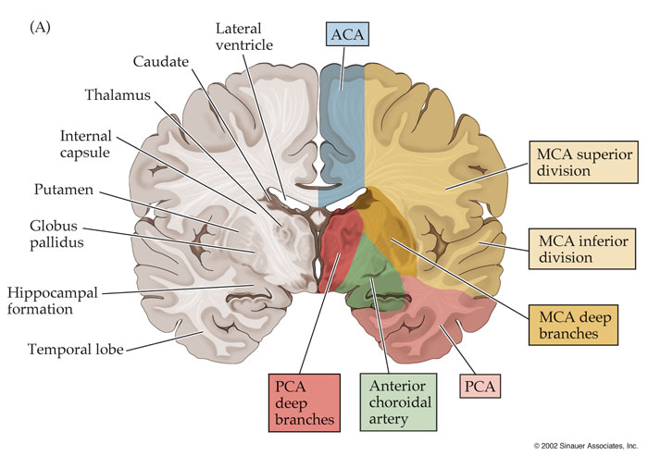
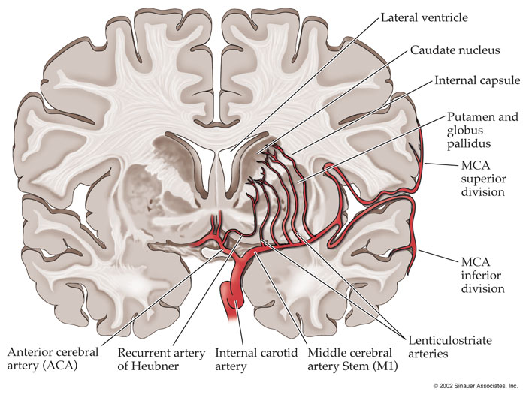
Vascular supply of subcortical structures

Slide 29
“The presence of vascular dementia is largely unrecognized and untreated in the elderly. The typical history is that of an elderly parent or grandparent who fails to regain the previous level of function and independence after a stroke or illness. More often, in the absence of the heralding stroke symptoms, the family notices that the patient has become depressed and apathetic, exhibits personality changes, experiences social inhibition, and has slowing mental capacity and sluggish motor activities with the inability to solve simple daily problems. Walking becomes deliberate, insecure, with a shuffling character and short steps; patients become unsteady on their feet and may have frequent falls. Often, the patient also suffers from urinary urgency, stress incontinence, and nocturia. Patients are no longer able to perform simple ADLs, such as using the bathroom, showering, getting dressed, cooking, shopping, participating in rehabilitation activities and exercise routines, or performing more complex tasks, such as using the telephone or balancing a chequebook. Frequently, these changes occur after a surgical procedure, such as abdominal surgery, knee or hip replacement, or coronary artery bypass graft (CABG)”.
Notes:
The cognitive profile of subcortical VaD:
Executive dysfunction
- slowed information processing
- impaired initiation, planning, sequencing, abstracting
Episodic memory impairment typically milder than AD with impaired recall but better recognition which benefits from cueing.
Neuropsychiatric signs – depression, inertia, emotional lability
Neurological signs although fewer than in cortical VaD
Gait disorder – “frontal” gait pattern → broad-based and small step.
Urinary incontinence
Extrapyramidal signs
Although there is overlap, mild subcortical VaD can be differentiated from AD on the basis of greater impairment in tests of semantic memory, executive function and visuospatial/perceptual skills. Use of the MMSE is generally insensitive for the detection of subcortical VaD.

Slide 30
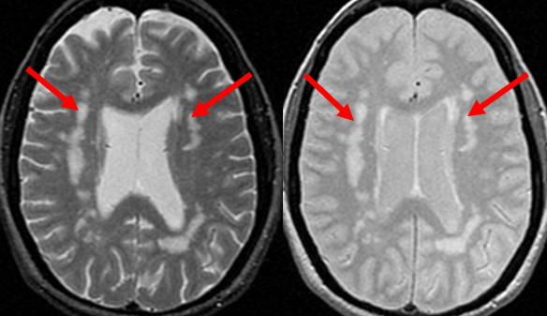
Subcortical dementias
Clinical features
Associated with movement disorders, gait apraxia, psychomotor retardation, apathy, akinetic mutism
Alert, but slowly responsive and inactive
Not fluent in language, but comprehends
Often dysarthric - difficulty forming complex sentences
Difficulty with executive function

Slide 31
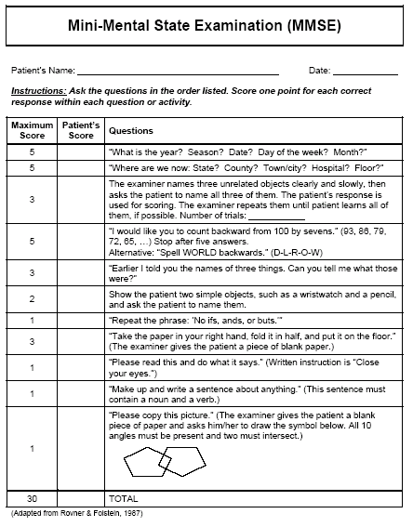
Which cognitive screen to use?
AMTS
MMSE
MoCA
ACE-R

Slide 32
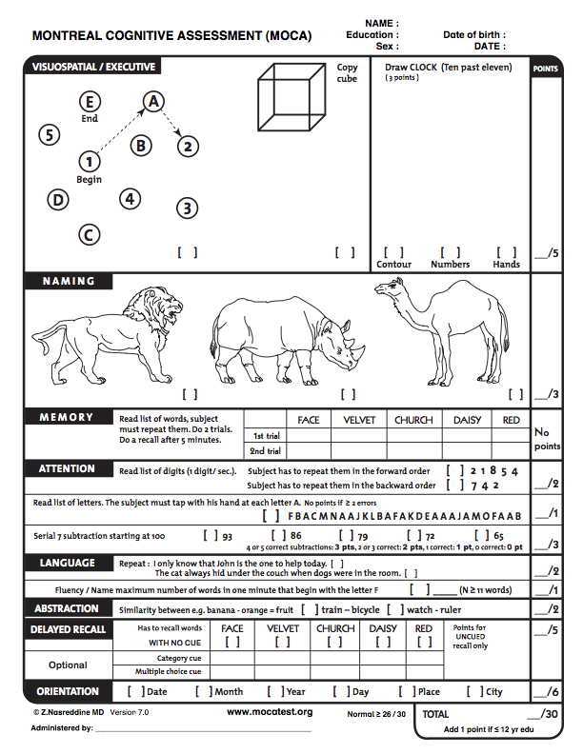
Montreal Cognitive
Assessment (MoCA)

Slide 33
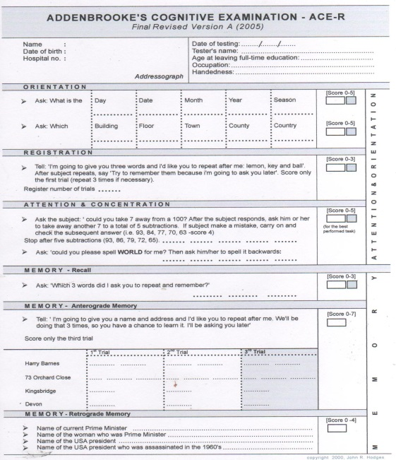
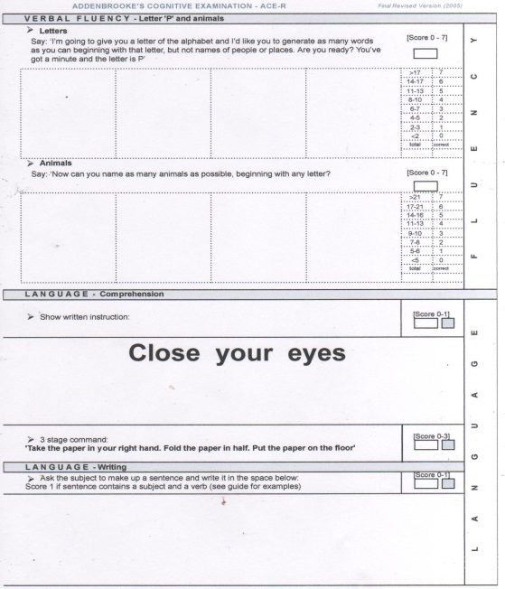
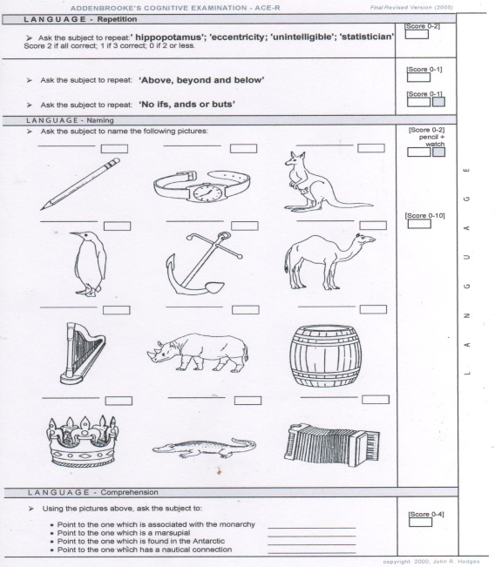
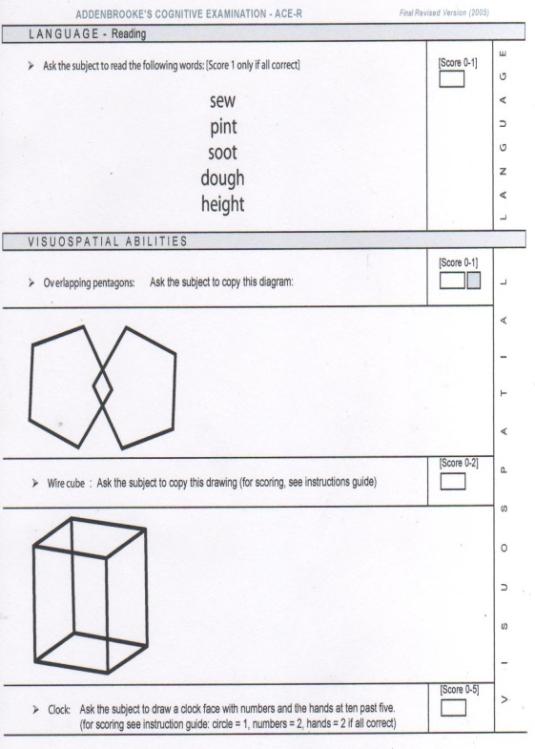
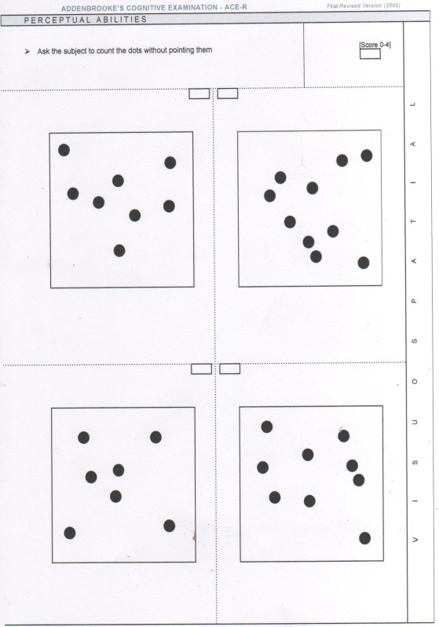
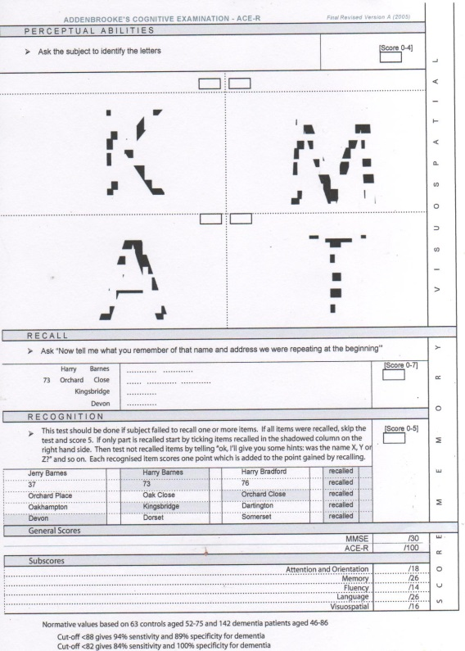
Addenbrooke’s Cognitive Examination ACE-R

Slide 34
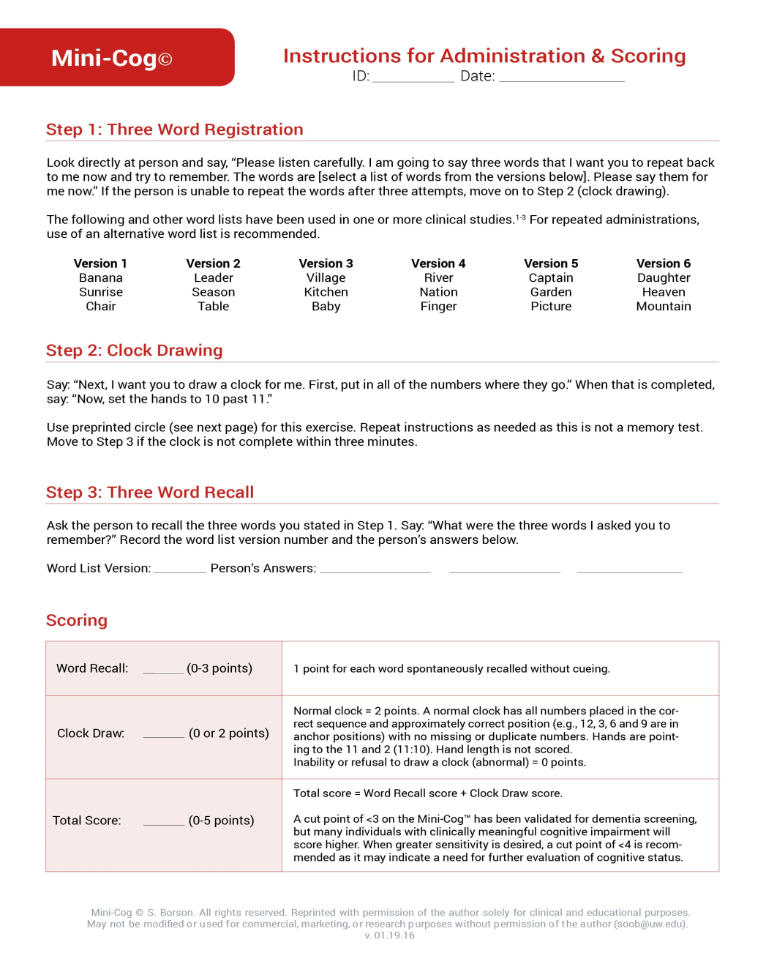

Slide 35
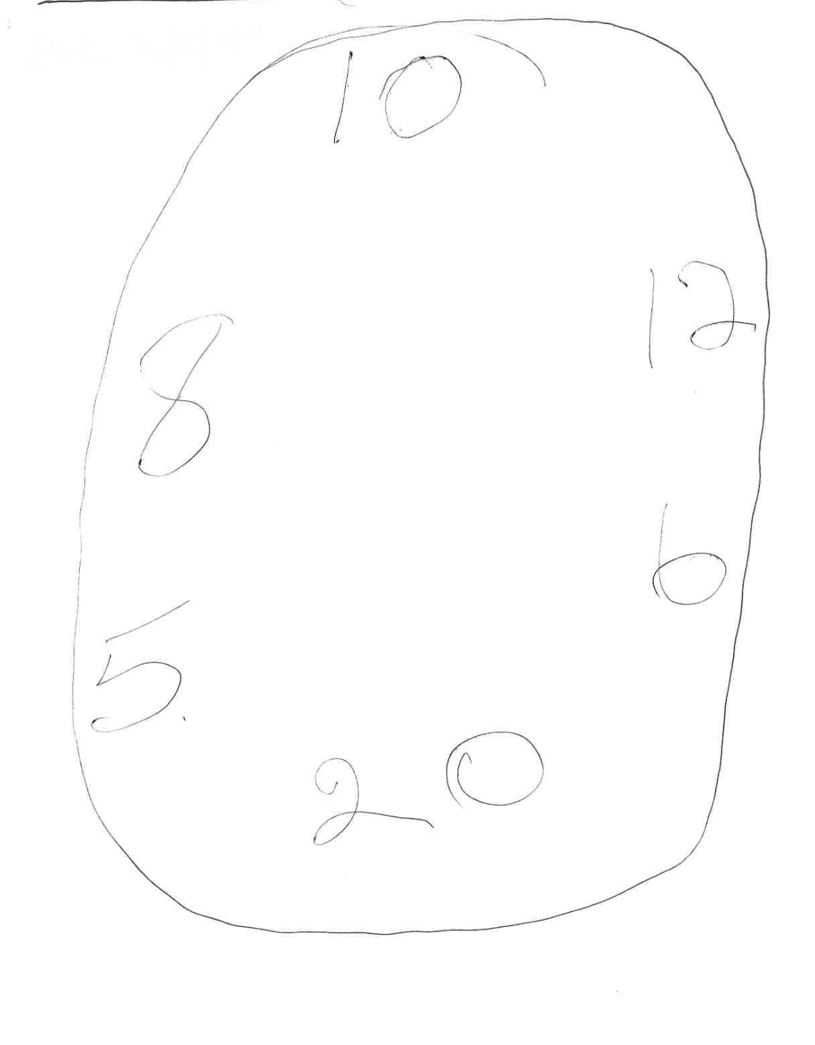
Mini-Cog
Three item recall
Apple ✓
Book ✓
Table ✓

Slide 36
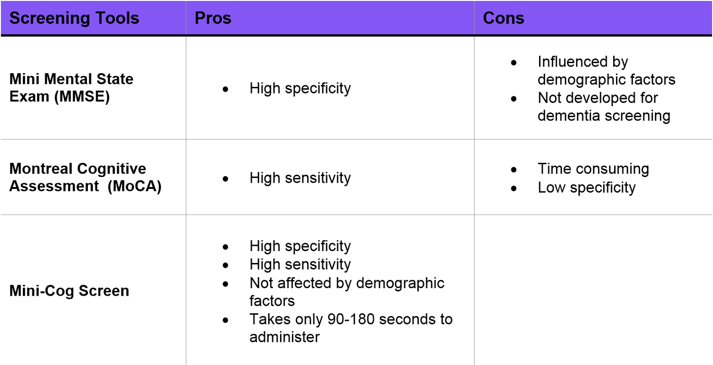
Which cognitive screen?

Slide 37
Dementia as one of a number of chronic conditions
Type 2 DM
Hypertension
CABG 2005
CKD stage 4
OA
Pseudogout
Recurrent falls due to postural hypotension
R total hip replacement (8 years ago)

Slide 38
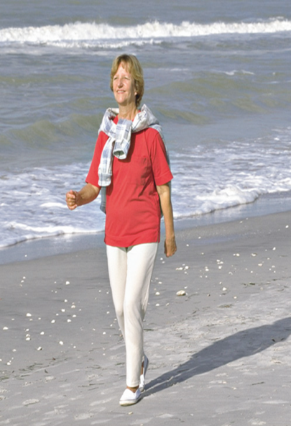

Dementia and frailty (= co-morbidities)
Fit 85 y.o. who walks and swims
85 y.o. with poor mobility and on multiple medications +/- dementia
Strong/repeated precipitant needed
Minimal precipitant needed
Notes:
38
A state of increased vulnerability to stressors events
Poor physiological reserve – “homeostenosis” where a small insult → disproportionate change in health state eg from independent to dependent, mobile to immobile, lucid to delirious
However, as we heard this morning, delirium is often the result of a complex interaction between susceptibility factors of the host, and precipitating external factors

Slide 39
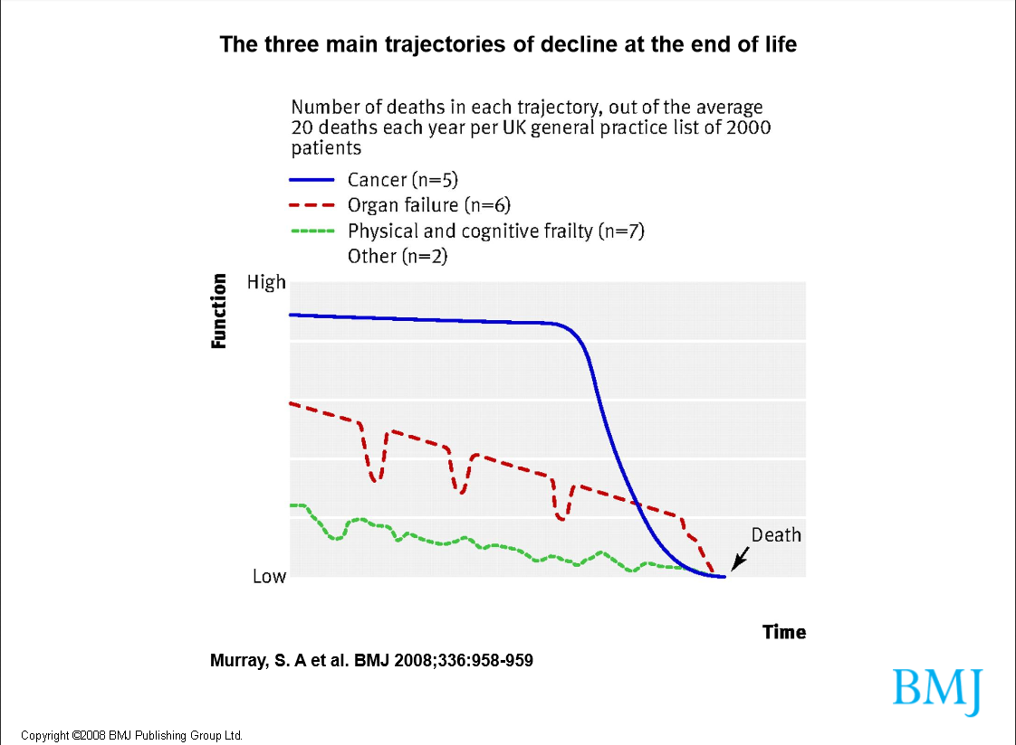

Slide 40
“Design for the young and you exclude the old; design for the old and you include the young”
Professor Bernard Isaacs
“If we design services for people with one thing wrong but people with many things wrong turn up, the fault lies not with the users but with the service. Yet all too often these patients are labelled as ‘inappropriate’ and presented as a problem”
Professor Kenneth Rockwood

Slide 41
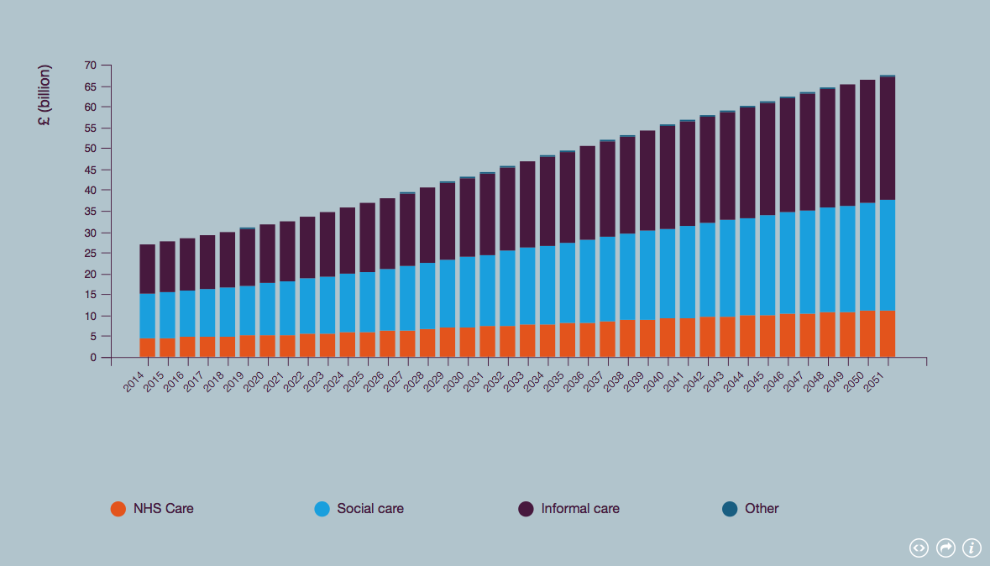
Total annual cost as the sum of the different sectors
Prince, M et al (2014) Dementia UK: Update Second Edition report produced by King’s College London and the London School of Economics for the Alzheimer’s Society

Slide 42
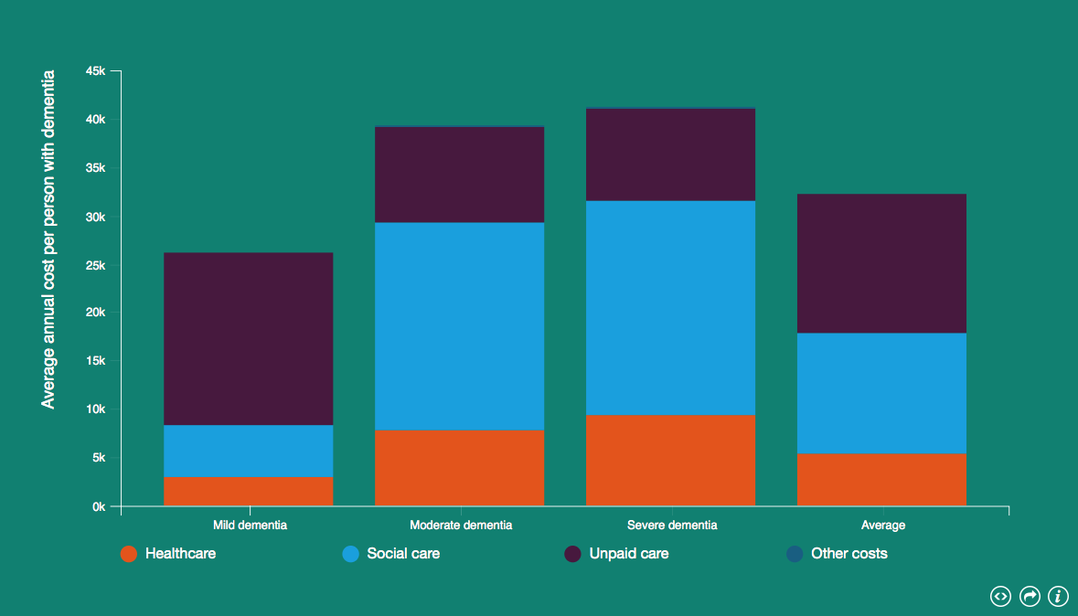
Average cost of dementia in UK
Prince, M et al (2014) Dementia UK: Update Second Edition report produced by King’s College London and the London School of Economics for the Alzheimer’s Society

Slide 43
Discussion
VaD is a common, often overlooked, cause of dementia
- Think vascular risk factors; appropriate cognitive screens
Investment in social support for an increasingly dependent population
Referral pathways for the frail patient with dementia
- Rethink memory-based services

