Slide 1
Cardiology Liaison in the Elderly
Shuli Levy, Geriatrician
Cardiology department, Hammersmith hospital

Slide 2

Objectives
Understand the demographics of cardiac disease in older people
Understand the main treatment pathways in older inpatients with cardiac disease, with a specific focus on heart failure
Consider polypharmacy and rationing in cardiac disease and older people
Understand the role of the Geriatrician and the MDT in treating this population

Slide 3
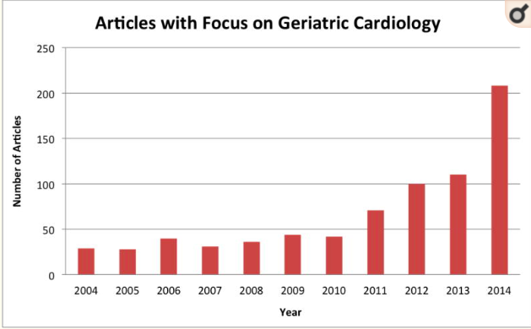
Trends in elderly cardiology

Slide 4
Heart failure
5% of all emergency admission: Leading cause of admission in >65 yr olds
2% of entire NHS budget: £3,796 average cost per admission
This decade: 12% increase in the total number of new cases of HF: similar to the total number of new cases of breast, prostate, lung, and bowel cancer combined.
Heart failure accounts for a total of 1 million inpatient bed days – 2% of all NHS inpatient bed-days
Hospital admissions for heart failure are projected to rise by 50% over the next 25 years
Incidence of new heart failure is going down in every age group except >85y
Conrad et al Lancet 2018; 391: 572–80

Slide 5
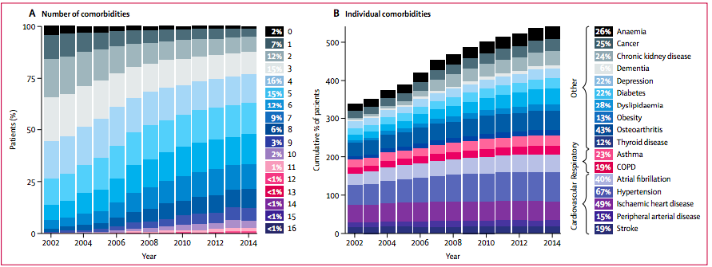
High burden of comorbidities in heart failure – mean = 5.4 in 2014

Slide 6
Cardiovascular comorbidities
Rich, M. ACC, 2016

Slide 7
The liaison service
LAS
Home
Imperial ED
Heart Assessment centre (HAC)
C8
15 beds
Daily consultant MfE WR
2xCTs, 1xACNP, 1x pharmacist Daily cardiologist reviews
Repatriate
Other Trusts
CCU and A7
JHW / A7 / Renal / other
Placement / hospice
Clinics and electives
RIP
Renal MDM
Haem MDM
CICU
Heart failure
OPD

Slide 8
Liaison service – typical patients
Older / frailer / comorbid people
STEMI/NSTEMI/UA +/- intervention
Heart failure
Post device insertion
Pre/post TAVI
AF
Infection – endocarditis, devices, leads
Type 2 MI
Rehab + therapy + MDMs
Cognitive screening
Care planning and education
Anaemia
Diabetes
Polypharmacy and secondary prevention (dedicated cardiac pharmacist)
Heart failure medication titration + MDM

Slide 9
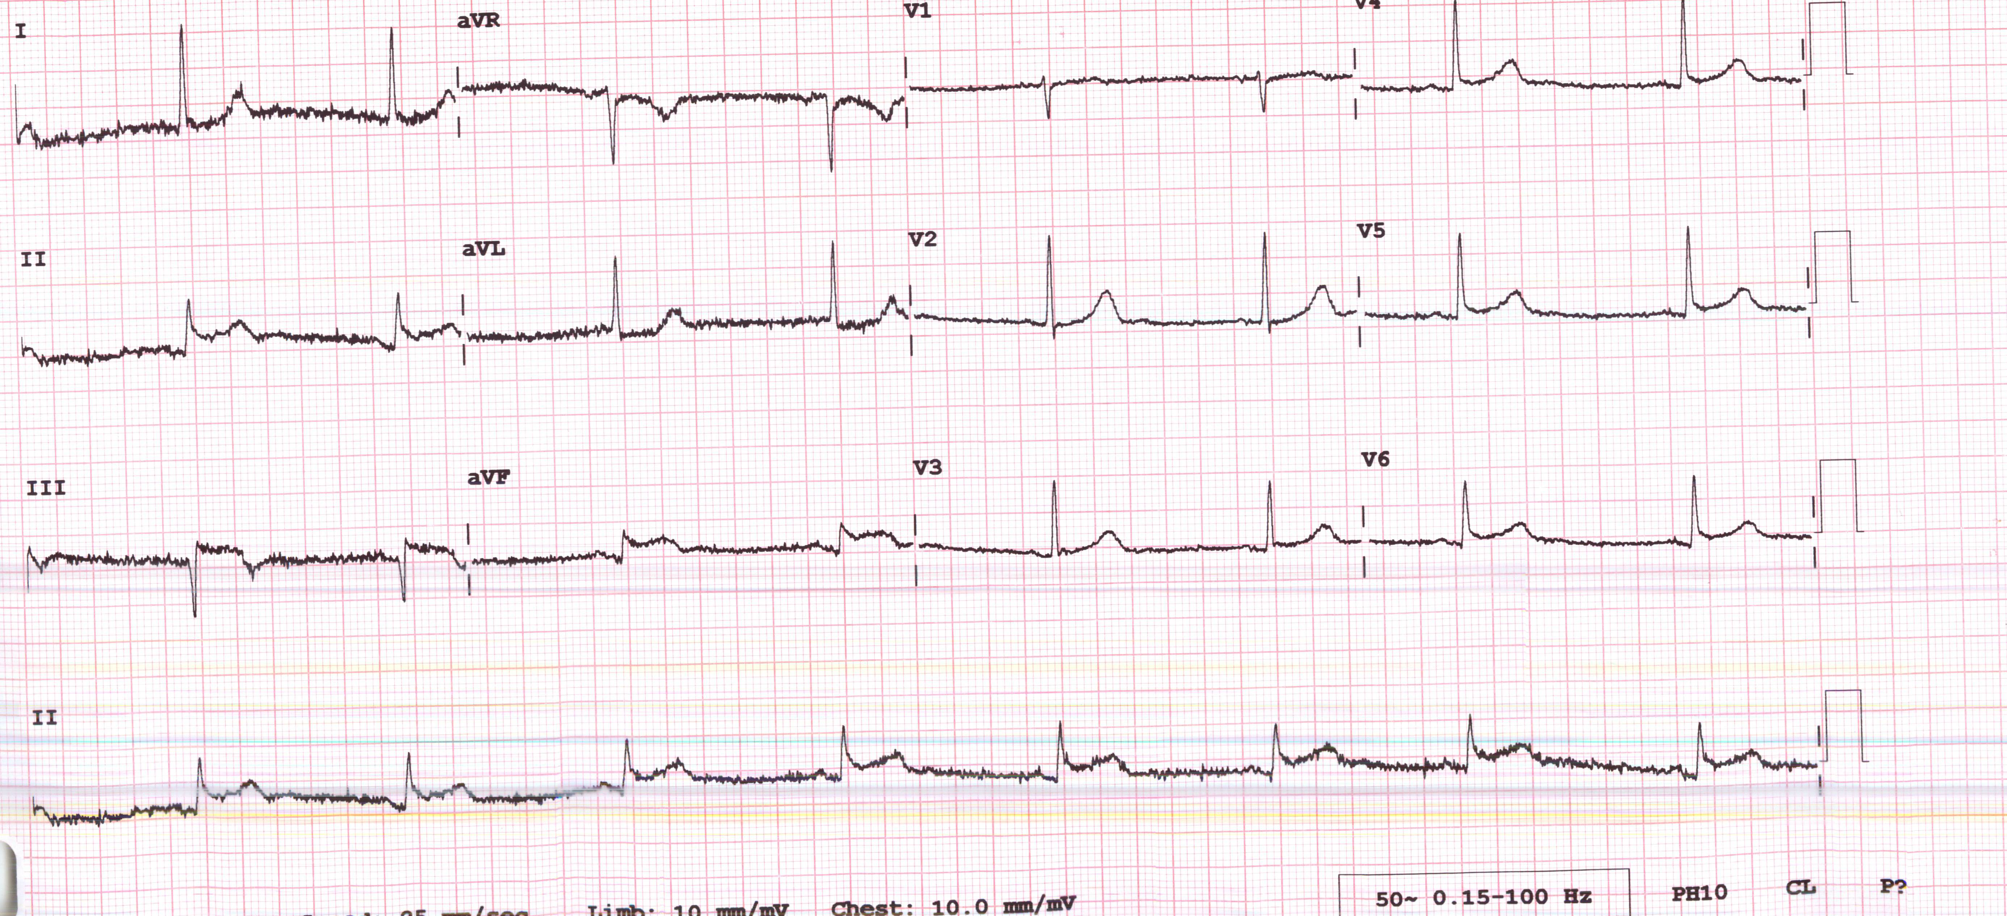
Inpatient scenarios – STEMIs in the elderly
76y F: fall, presyncope, chest pain previous day
Troponin 100,000 but pain free → conservatively initially
Further chest pain - PCI
    Critical disease RCA – stented
        Disease in LAD, Cx – too agitated to tolerate further intervention and develops AF peri-procedure, so for staged intervention

Slide 10
Inpatient scenarios – STEMIs in the elderly
Develops AKI, agitation and acute hepatic injury (presumed ischaemic)
Background of severe, deforming Rheumatoid Arthritis and has become immobile whilst an IP
Also previous breast cancer and endometrial cancer
Transferred to C8
  Mobility and transfers
  Equipment, POC
  Analgesia - previously on NSAIDS
  Constipation
  Abdo US - fatty liver, unilateral pleural effusion - examine for breast mass
  Titration of secondary prevention and pharmacy counselling
  confusion screen
  AKI settles
  Cardiac rehab review
  Antiplatelet / anticoag plan individualised by cardiologists
  Follow up – cardiology post STEMI, me for LFTs and pleural effusion

Slide 11
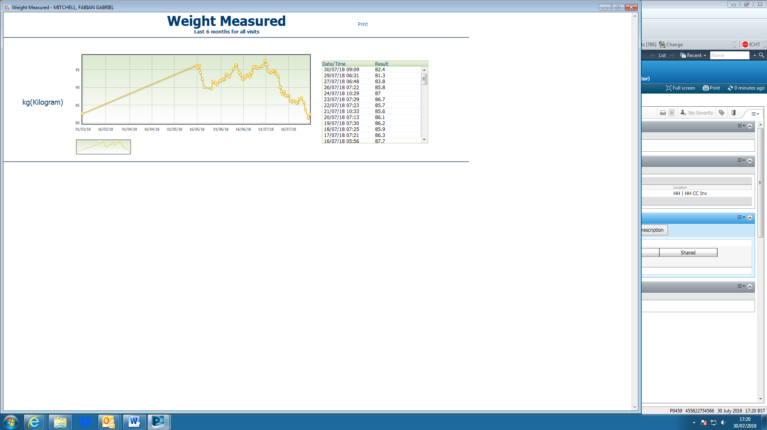
Inpatient scenarios – heart failure in the elderly
Admit
1st wean
2nd wean
HH
Severe LV impairment (EF 24%)
Severe RV impairment (EF 34%)
Likely alcoholic aetiology
Diuretics – same team every day
Sleeplessness – better breathing, neuropathic agent
Constipation
IV iron
CRT-P (after long discussions about D)

Slide 12
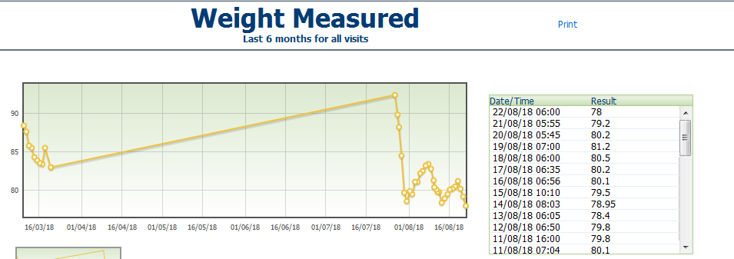
Inpatient scenarios – heart failure in the elderly

Slide 13
Inpatient scenarios – non cardiac presentations
Collapse with troponin rise→ echo → critical AoS → HH
Severe non critical AoS, not for intervention
Aspiration pneumonia 2ry PD, unsafe swallow
C8
NG fed with no potential for swallow recovery → RIG → acute abdomen ? Perforation → settles
New bullous eruption – bullous pemphigoid
6 weeks of steroids and wound healing
PEG inserted and discharged

Slide 14
Outpatient scenarios 89yF
Admission late 2016
  Fast AF and troponin rise
  CAP – wheeze prominent and inhalers started
  Hb drop – antral gastritis on OGD
PMHx: IHD – MI 2015, HTN, AF –warfarin, AoS on 2015 echo
Follow up clinic review Jan 2017 - still very SOB – why?
    Poorly controlled AF: rate 100-120 in clinic
    Inhaler technique
    ? AoS :Old echo shows mod/severe AoS
    ? anaemia
Bloods, repeat echo, prescribed a spacer with increased dose inhaler, start digoxin for fast rate, small dose nitrate in case its angina (high resting BP)

Slide 15
Outpatient scenarios
Clinic 28.2.17
Much better with spacer (lungs clear) and digoxin (HR 77)
Echo: severe AoS
TAVI team: not critical and not for TAVI
Breathing at its best for months
Noted to be hypercalcaemic – bloods sent
Clinic 19.07.17
Cough – long standing but previously responded to seretide
Now has haemoptysis
Has had abx from GP
CT thorax and discharge next time
  CT thorax: LLL malignancy confirmed histologically
  Elected for palliative care
Clinic 24.10.17
Rapidly worsening – discharge for community care

Slide 16
Outpatient scenarios – 85yM
Acute medical admission (SMH) August ‘17
  Chest pain, SOB
  Negative CTPA – consolidation – Rx CAP
  Runs of A flutter: bisoprolol and apixaban
Clinic 11.10.17
  Still SOB
  AF 48 – for 24 h tape
Clinic 22.11.17
  Still SOB
  Tape

Slide 17
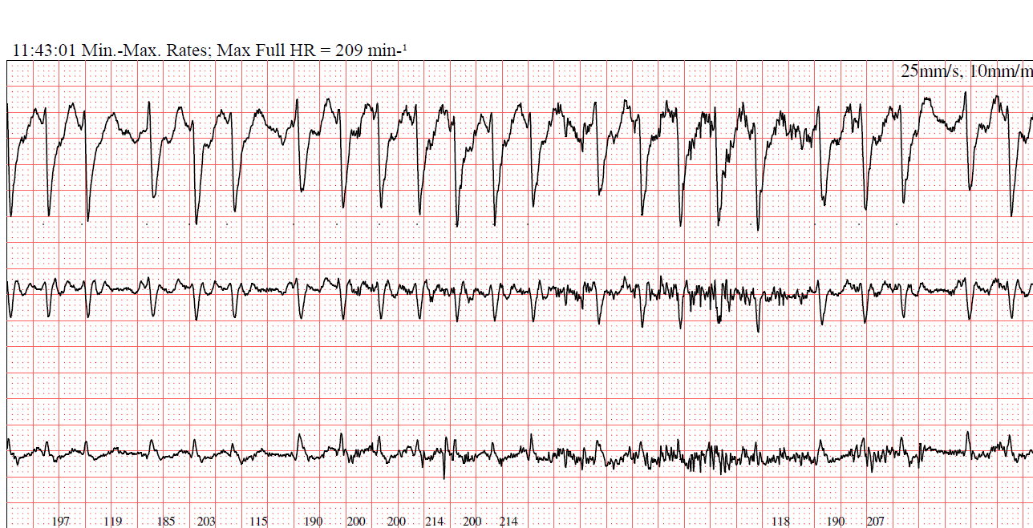
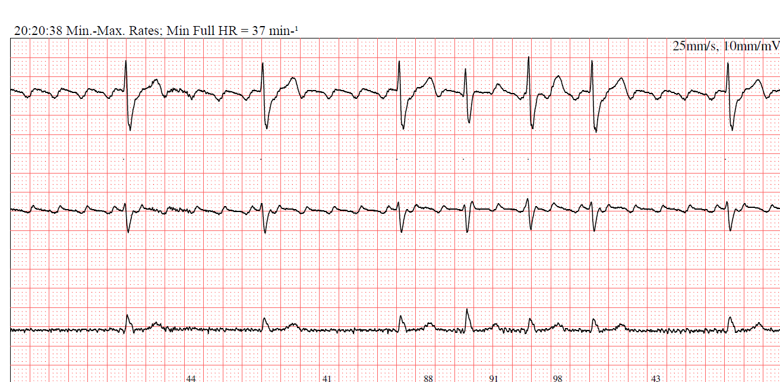
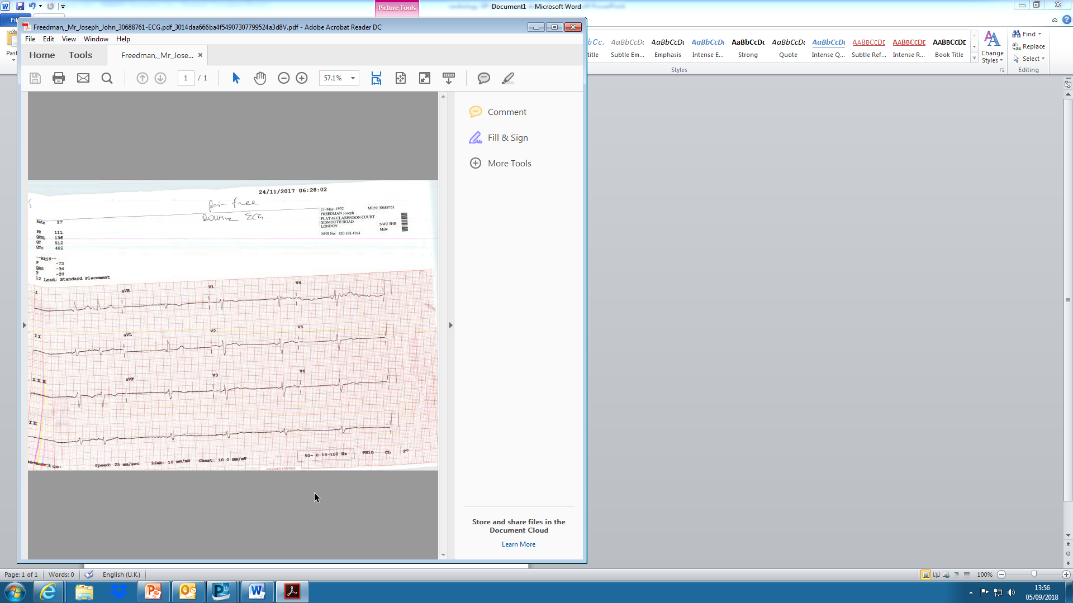
Outpatient scenarios
Flutter with variable V response
Admitted directly for DCCV
1x 150J shock
Back to SR
PPM insertion without complication

Slide 18
Clinics - HH
Unexplained symptoms – breathlessness, palpitations, chest pain, leg swelling, dizziness
Follow up from admission with outstanding medical issues
Heart failure
  Yes / no
  Medication management
  MDM discussion
Cardiac disease and …
  Anaemia
  Frailty
  Cognitive impairment
  Renal impairment
Work closely with cardiologists – admit / advice / refer

Slide 19
Clinics – community heart failure
Based at Westminster Cardiac centre (maida vale)
With trust HF lead and HFNs
Receive referrals from the HF team – diastolic failure, frailty, comorbidities, polypharmacy
Cases discussed at HF MDM
Novel service

Slide 20
Tips
Only about 10% of COPD patients worsen with b blockers
10-20% deterioration in renal function is acceptable on starting an ACEi
B blockers and ACEi can be dosed BD to achieve higher doses (preferred in heart failure)
No evidence for any drugs in diastolic failure, it’s all about symptoms
Good evidence for treating iron deficiency in systolic heart failure – even if not anaemic
BNP useful for diagnosing heart failure in the presence of equivocal symptoms or preserved LV on echo
Ramipril is the first choice ACE in heart failure – titrate to 5mg BD
Failure on maximum ACE may indicate Entresto (HF specialists only)

Slide 21
Tips
AF
  anticoagulate!
  DOAC if NVAF
  Bisoprolol is preferred drug if required for rate
  Digoxin
Statins
  Not for primary prevention in over 80s
  Yes for secondary prevention
Clopidogrel and PPIs
  Some evidence that omeprazole (and esomeprazole), through CYP inhibition, reduces activity of clopidogrel
  Not evidenced in pantoprazole or lansoprazole, though presumed to be a class effect
  FDA and MHRA discourage omeprazole with clopidogrel
  In clinical practice we switch to lansoprazole
Clopidogrel vs Ticagrelor
  Evidence in favourable outcomes in STEMIs on ticagrelor, rather than clopidogrel
  However, tendency towards a worse GI bleeding profile in elderly
  Used very cautiously especially in frail patients or those with previous bleeding

Slide 22
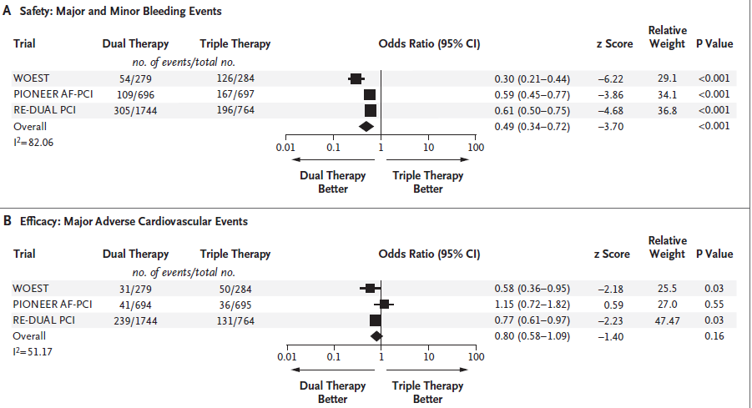
Drug choices
Triple therapy
AF with PCI is a common clinical scenario
Landscape rapidly changing
Currently
  Low bleeding risk: 6 months triple then O + C
  High bleeding risk: 4 weeks triple then O + C
  Give low dose O = 2.5mg BD apix or 15mg riva
  Clopi rather than ticagrelor
  Pioneer AF regime of low dose rivaroxaban is out of fashion – not powered to detect stroke risk
LAA closure is coming back to Imperial
Piccini, NEJM 2017

Slide 23
Tips
Diastolic heart failure / HeFPEF
Heart failure syndrome with preserved LV (>50%) and normal valves and evidence of diastolic dysfunction
Treated symptomatically
Probably around 50% of heart failure in elderly
Commoner in females
Usually comorbid: HTN, high BMI, DM, AF, CKD
Likely multifactorial (which is why drugs don’t work)

Slide 24
Summary
Older and frailer people have increasing requirements and access to cardiac interventions
Also have increasing complications that arise
On-site and clinic MfE team to support

