Slide 1

Frailty in the Emergency Department
Dr Ruth Brown
Emergency Medicine Consultant
Emergency Department

Slide 2
Learning outcomes
To describe what frailty means in the Emergency Department
To outline the approach and resources
To discuss the optimal collaborative working
Clinical Standards Guidance:
https://www.rcem.ac.uk/RCEM/Quality-Policy/Clinical_Standards_Guidance/RCEM_Guidance.aspx?WebsiteKey=b3d6bb2a-abba-44ed-b758-467776a958cd&hkey=862bd964-0363-4f7f-bdab-89e4a68c9de4&RCEM_Guidance=5#RCEM_Guidance

Slide 3


Slide 4


Slide 5


Slide 7



Slide 8
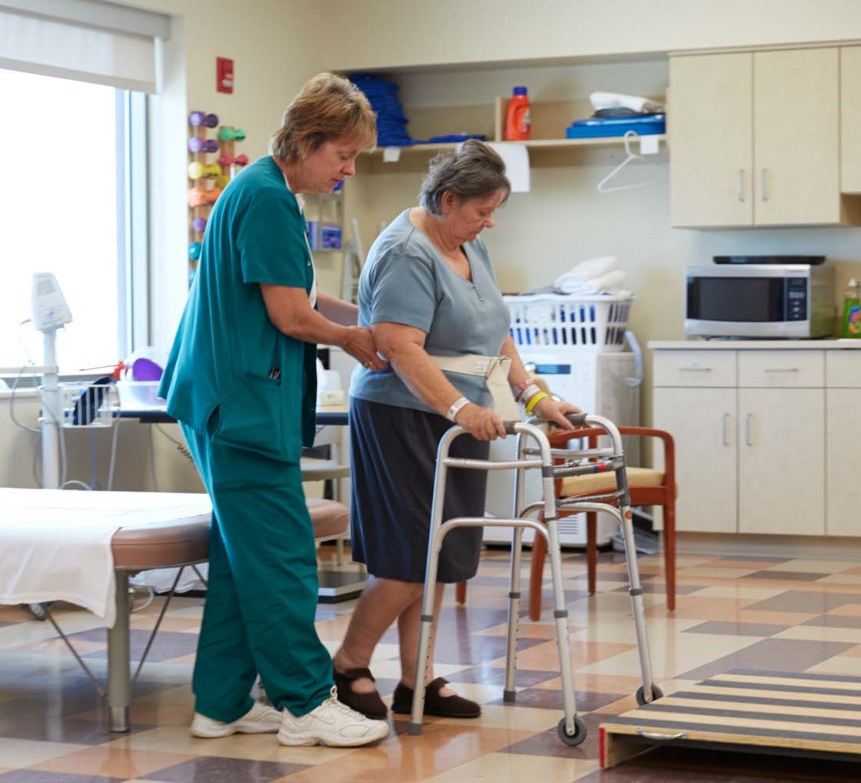

Slide 9
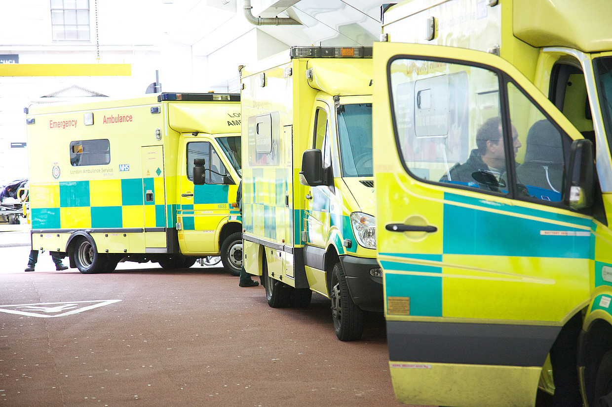

Slide 10
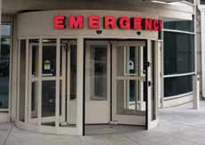

Slide 11
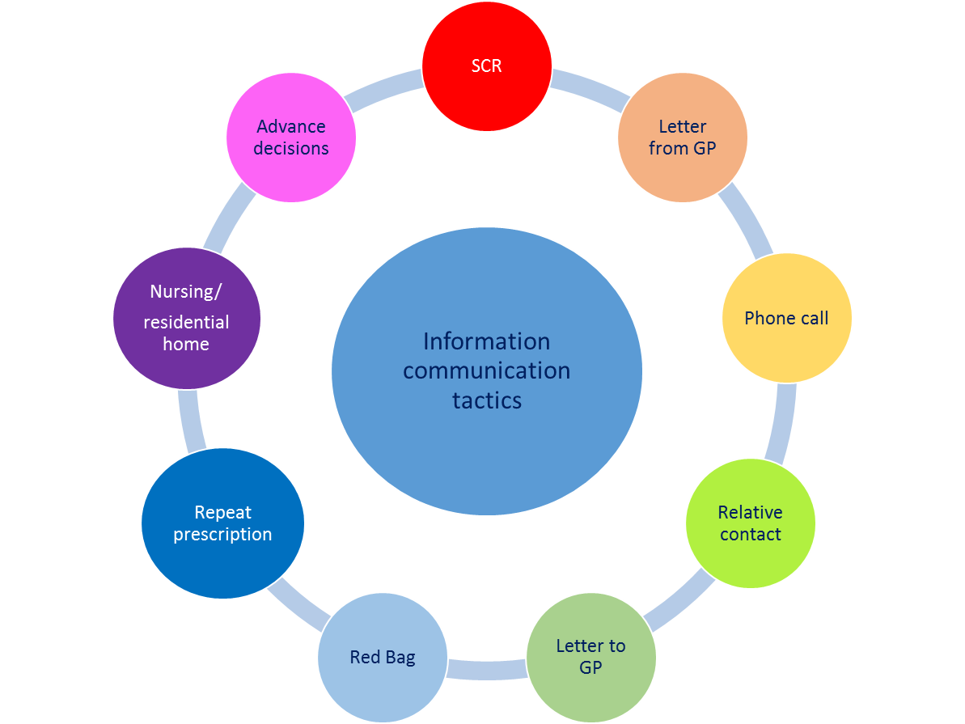

Slide 12


Slide 13

https://www.rcem.ac.uk

