Slide 1
Minor Injuries Overview
Julia Gamston
Consultant Nurse in Emergency and Urgent Care

Slide 2
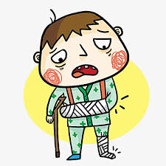
Learning Outcomes
An head to toe brief overview of minor injuries
Management in GP practice
When to send to ED/UCC
When to refer to specialism

Slide 3
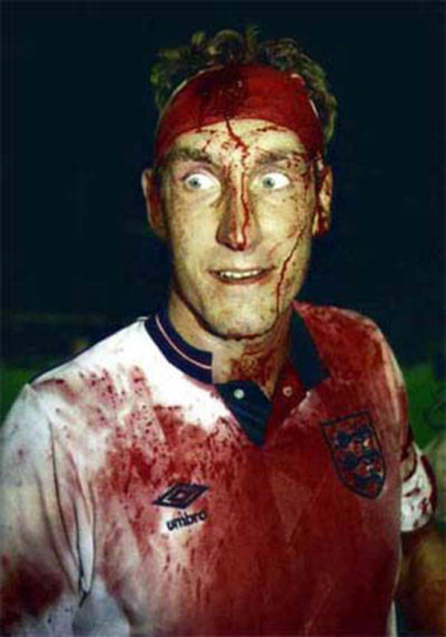
Head/facial injuries

Slide 4
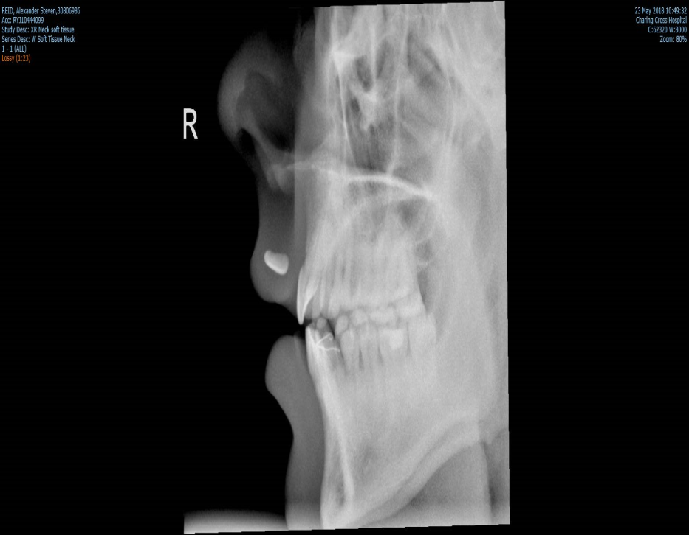
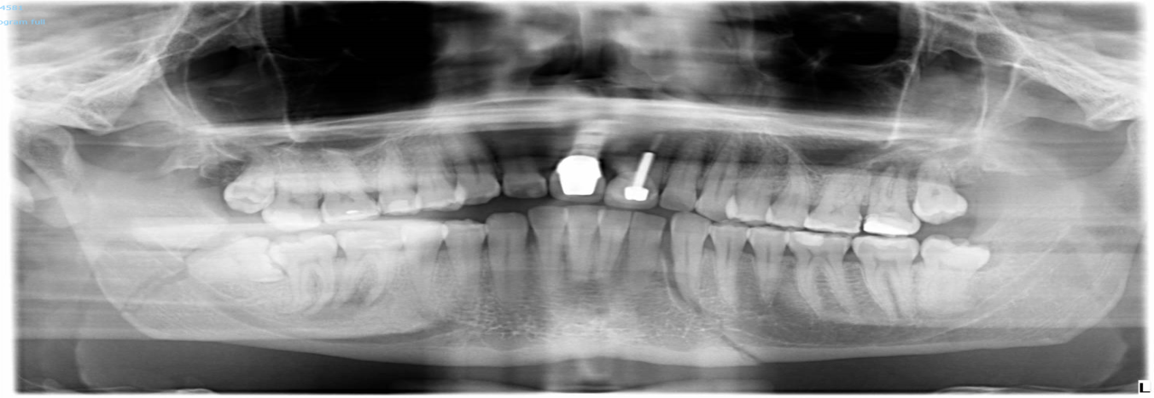
When to refer
? Fall ? Collapse
Significant MOI
LOC, period of amnesia ,vomiting
Neck pain
Wound management ?FB
Facial bony tenderness
Septal haematoma ?draining
Past Medical history, drug history

Slide 5
Management in GP Practice
Head injury instructions- verbal and written Paediatric and Adult
Red flags
Accompanied home/support at home
Nose injury review ?ENT referral

Slide 6



Structure for examination for limb injuries

Slide 7
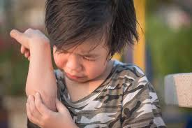
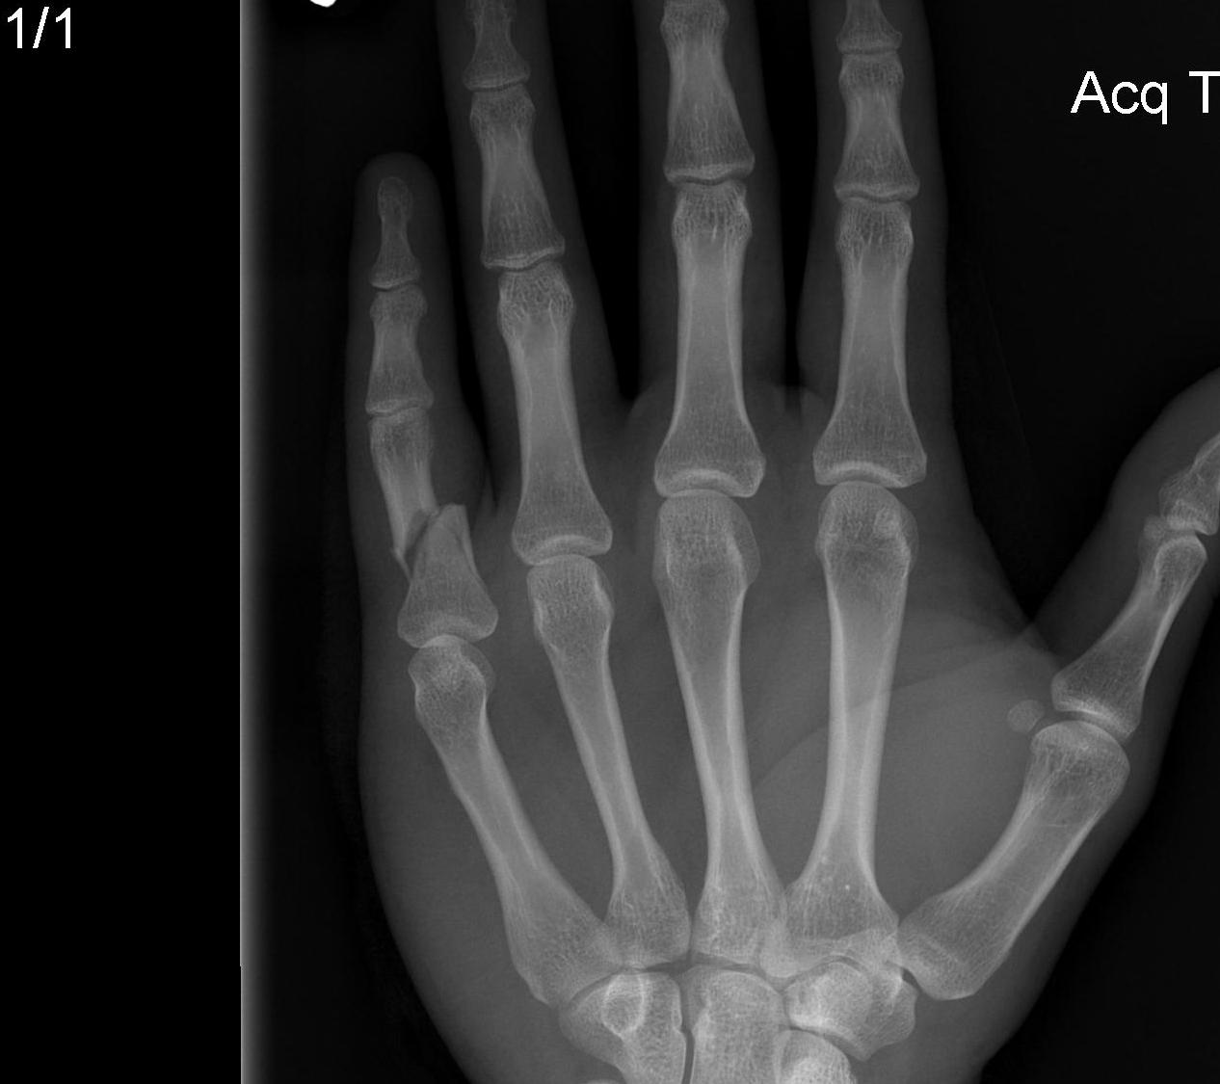
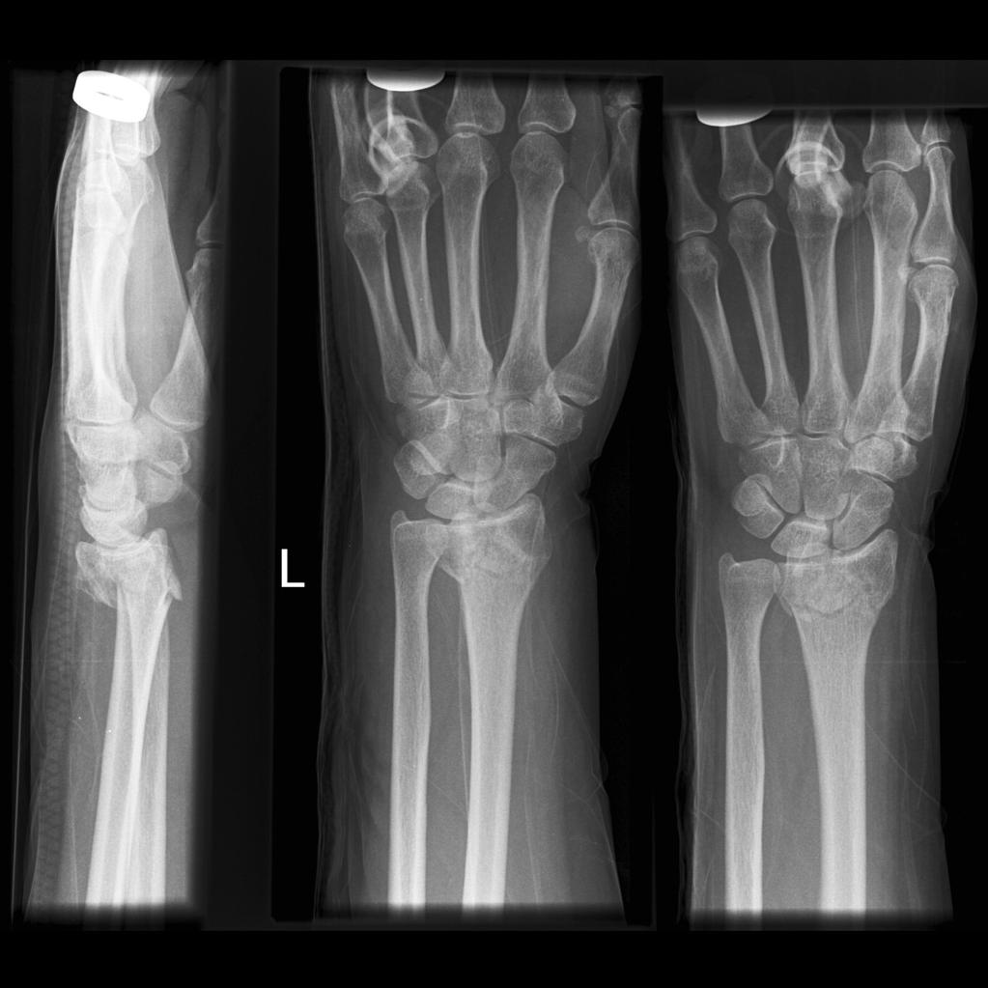
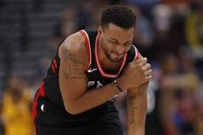
Upper limb

Slide 8
When to refer
Bony tenderness
Deformity ?dislocation
Wound ? FB
Complex Wound ? Tendon/nerve injury (ED/UCC with plastics) ?Contaminated

Slide 9
Management in GP Practice
Rest, Ice, compression, elevation RICE
Bandage, tubigrip, sling
Analgesia (?NSAIDS)
Gentle mobilisation
Wound care
? photo

Slide 10
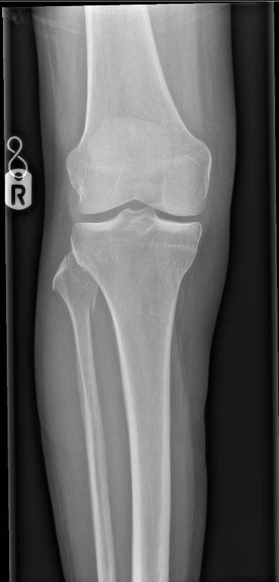
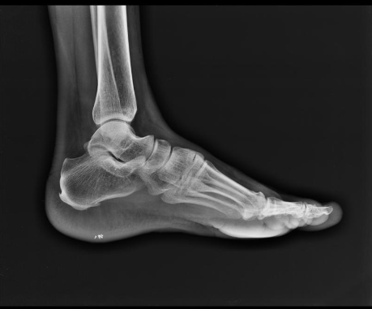
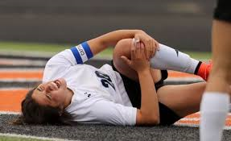
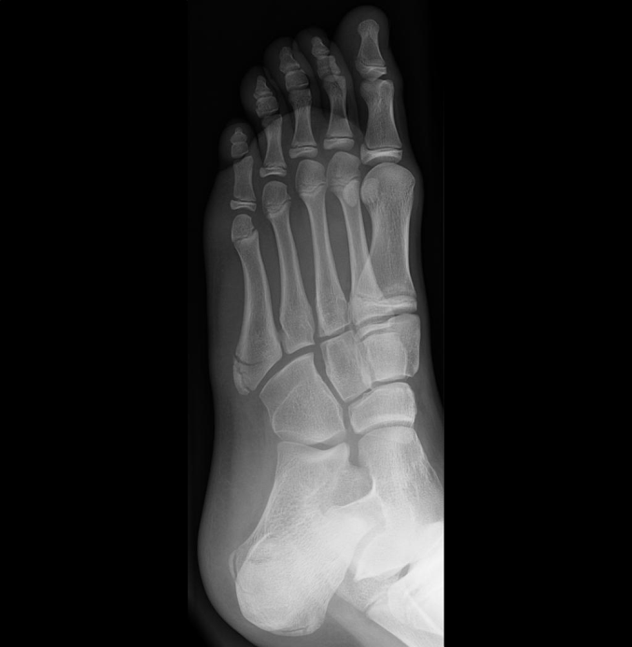
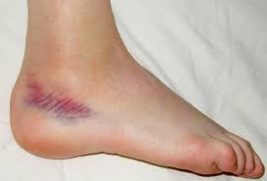
Lower limb

Slide 11
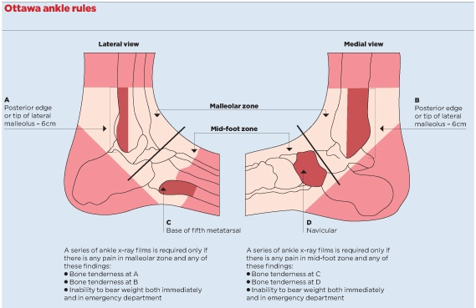
Ottawa ankle rules

Slide 12
When to refer
Ottawa Rules for knee and ankle for x-ray
Weightbearing (paed/older adult)
Wound +/- FB higher incidence of infection

Slide 13
Management in GP Practice
Analgesia
RICE
Gentle mobilisation
Physio

Slide 14
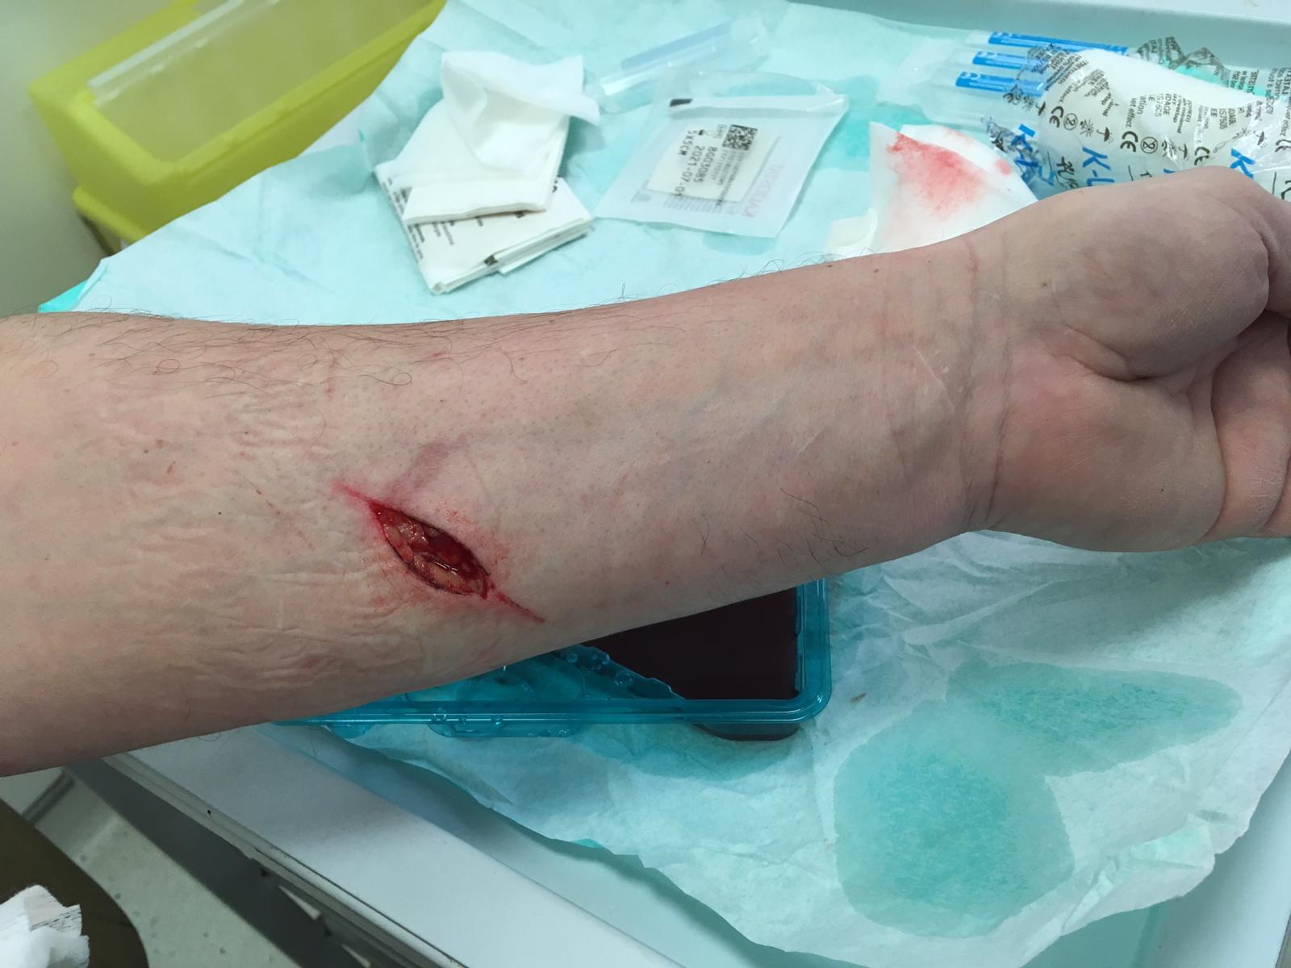
Wounds/Burns

Slide 15
When to refer
Full thickness burns or unable to assess
Inhalation, electrical, chemical burns
Facial, hands, genitals, feet, joints, scalp, ears or circumferential burns
Safe guarding concerns
Gaping bleeding wounds requiring closure
Possible FB ? Contaminated
Complex wounds, tendon/nerve involvement

Slide 16
Management in GP Practice
Analgesia
Immunisation
Wound review
Wound care advice
Photograph

Slide 17
References and resources
1. Bachmann LM, Kolb E, Koller MT et-al. Accuracy of Ottawa ankle rules to exclude fractures of the ankle and mid-foot: systematic review. BMJ. 2003;326 (7386): 417. doi:10.1136/bmj.326.7386.417
2. Atkinson P, Boyle A, Chisholm E. X-ray requesting patterns before and after introduction of the Ottawa Knee Rules in a UK emergency department. Eur J Emerg Med. 2004;11 (4): 204-7.
NICE head injury guidelines National Institute for Health and Care Excellence. Head injury: triage, assessment, investigation and early management of head injury in infants, children and adults. (Clinical guideline 176.) 2014. www.nice.org.uk/ CG176.

