Slide 1
Sepsis
George Bailey
Emergency Department, St Mary’s Hospital

Slide 2
Plan / Objectives
To define sepsis and determine severity & high risk features
To recognise sepsis and the value of scoring systems
To review the management of sepsis and current evidence
Our approach at Imperial College Healthcare NHS Trust, technology and artificial intelligence (AI)

Slide 3
Case Example

Slide 4
Sepsis
Life threatening organ dysfunction caused by a dysregulated host response to infection
(Organ dysfunction based on change in SOFA score)
Septic shock
Sepsis + persisting hypotension requiring vasopressors to maintain MAP > 65mmHg + lactate >2 despite adequate volume resuscitation
Notes:
Septic shcok 40% mortality

Slide 5
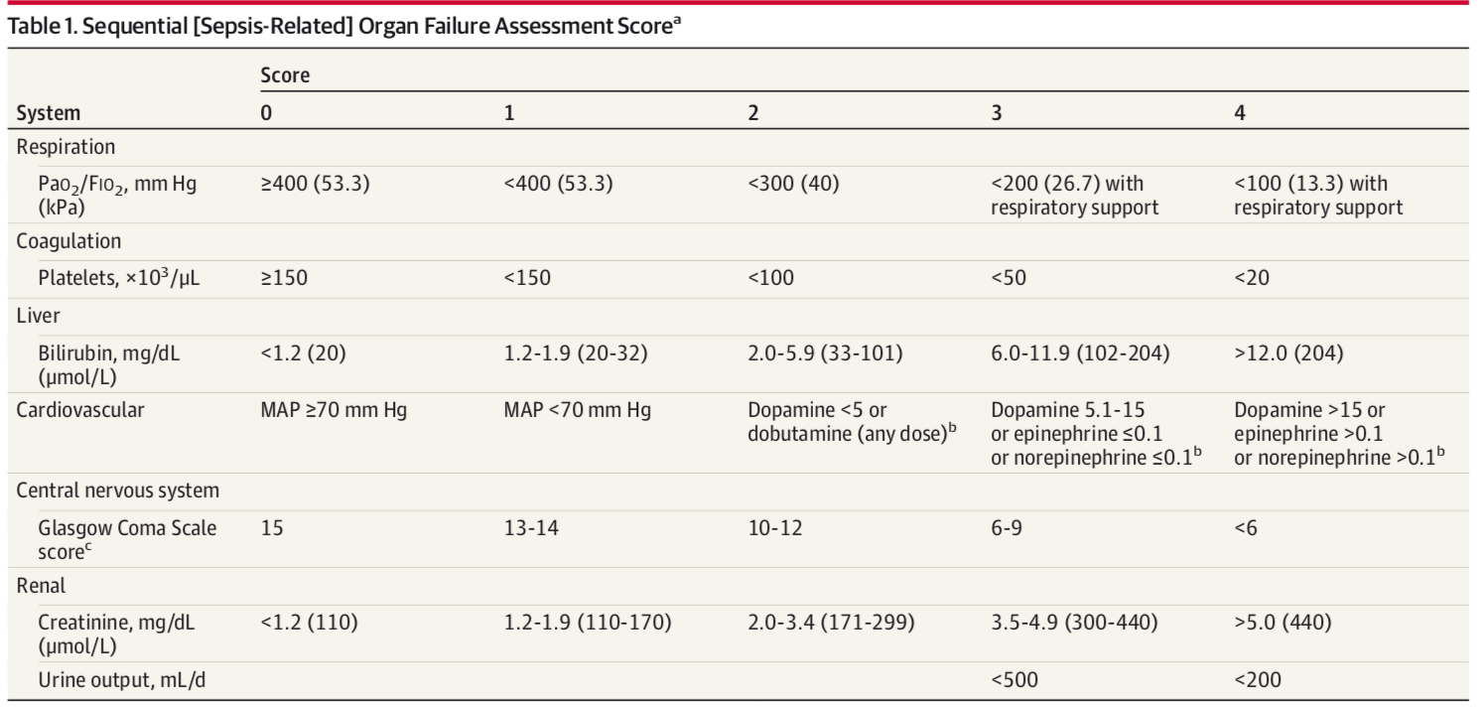
Notes:
SOFA score- but need lab values – not useful for primary care, also too late for ED early recognition?

Slide 6
qSOFA
Resp rate ≥22
Altered mental status
Systolic BP ≤100
Notes:
qSOFA- any criteria should prompt consideration of infection / sepsis

Slide 8
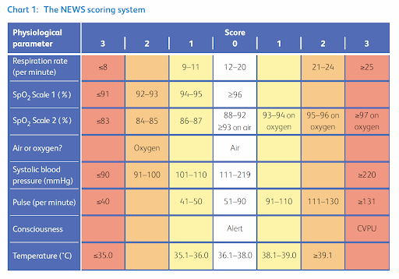
Notes:
NEWS2

Slide 9
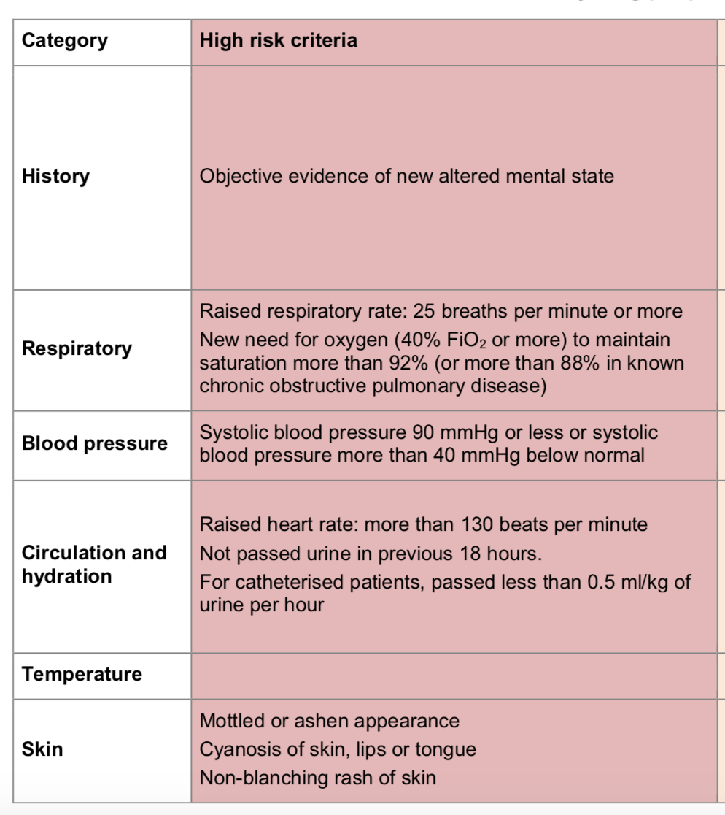
Notes:
NICE high risk criteria (Red flag criteria)

Slide 10
Notes:
Ambulance pre-alert patients
To get earlier abx

Slide 11
Notes:
Netherlands multicentre study- no mortality benefit to pre-hospital abx regardless of severity

Slide 12
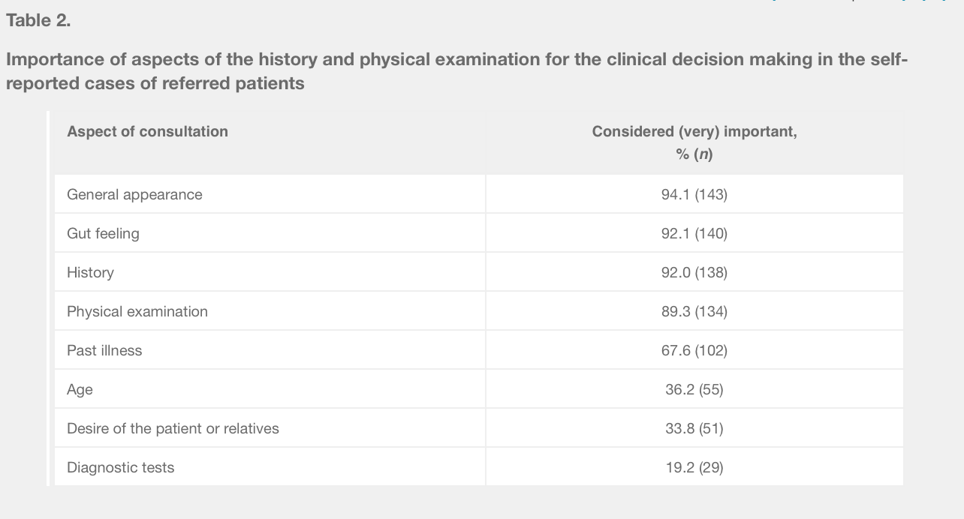
Notes:
Dutch study on GP decision making on referral to hospital
Lack of reliable diagnostic point of care tests is interesting and likely to change

Slide 13
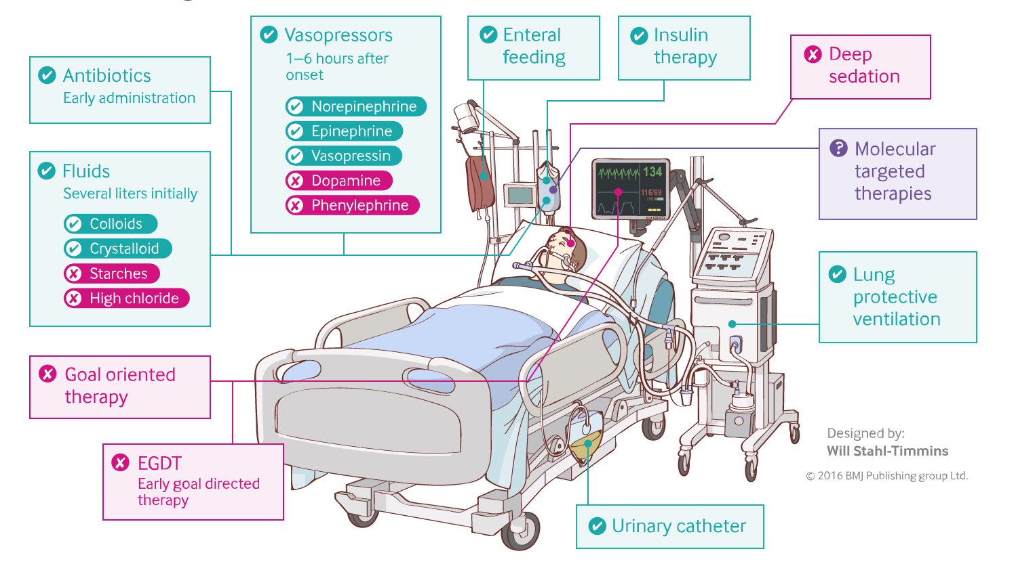

Slide 14
Notes:
Issues with sepsis 6 to discuss

Slide 15
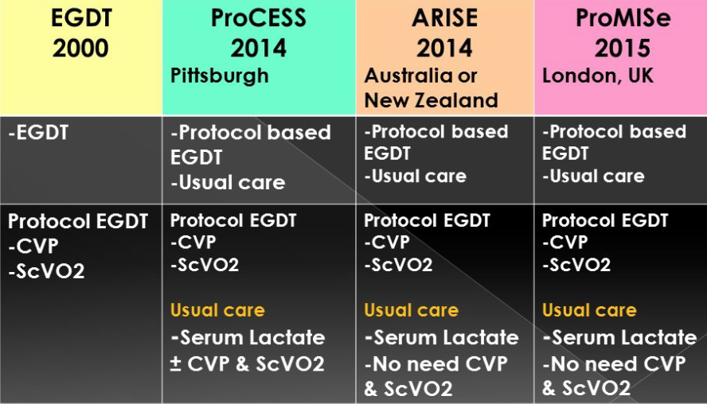
Early Goal Directed Therapy?

Slide 17
Early vasopressors?
Restrictive fluids?
Corticosteroids, vitamin C, thiamine?
Notes:
Marik paper 2017

Slide 18
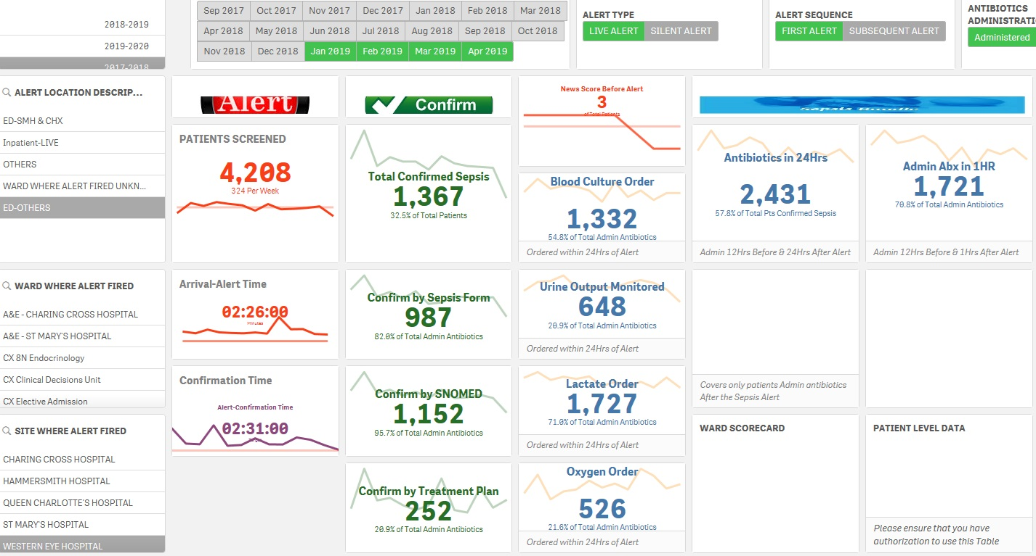
Notes:
Imperial sepsis dashboard

Slide 19
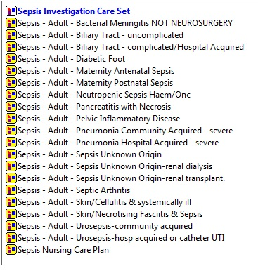

Slide 20
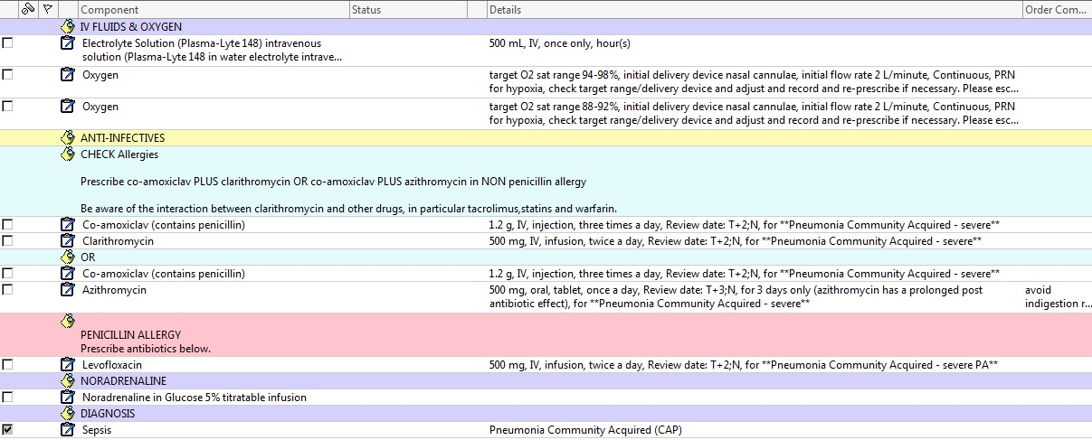

Slide 22
Notes:
AI / data driven treatments including inotrope dosing

Slide 23
Summary
Definition
Criteria & scoring systems
Recognition
Treatments & controversies
Technology & AI

