Slide 1
Paediatric Sepsis Screening in the Emergency Department
Dr Neil Thompson
Paediatric Emergency Department

Slide 2

Learning Objectives
The challenges to screening for sepsis in children
NICE guidance and other tools
The approach from Imperial College Healthcare NHS Trust’s Paediatric Emergency Department to sepsis screening in children

Slide 3
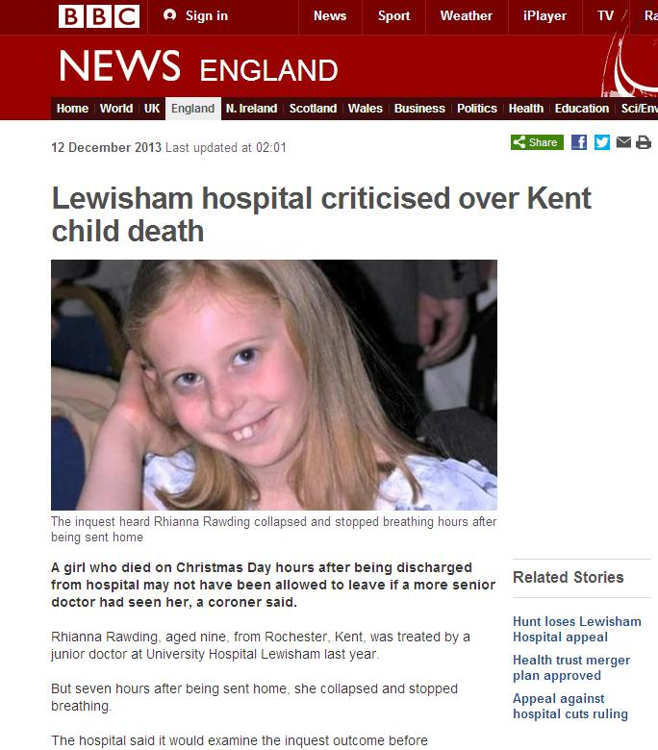
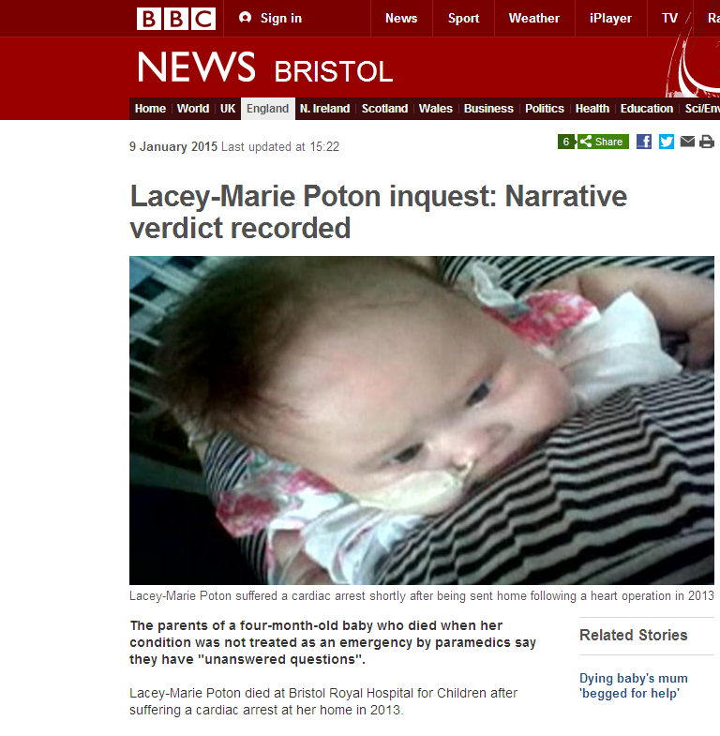
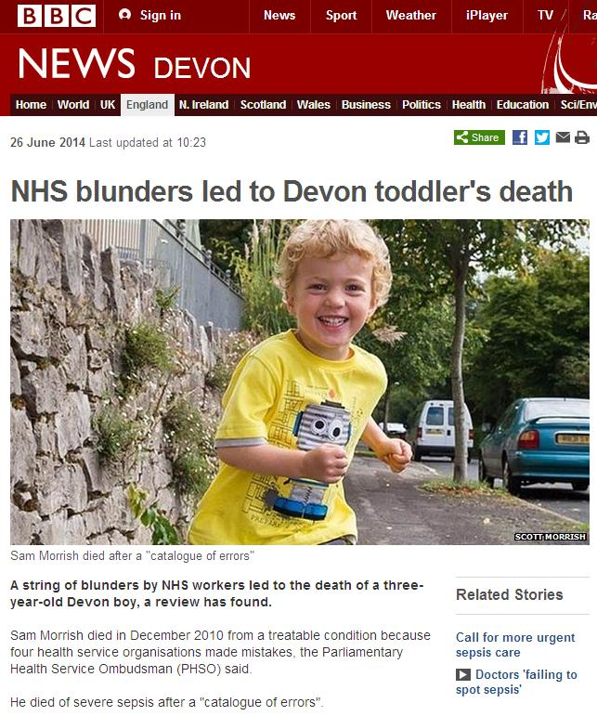
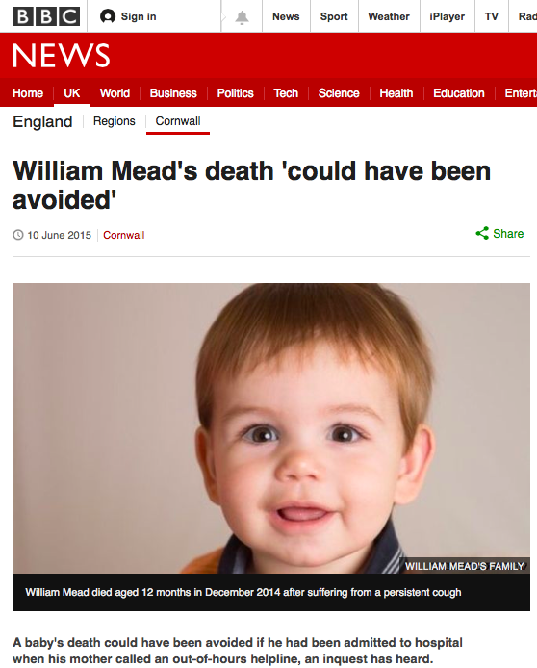
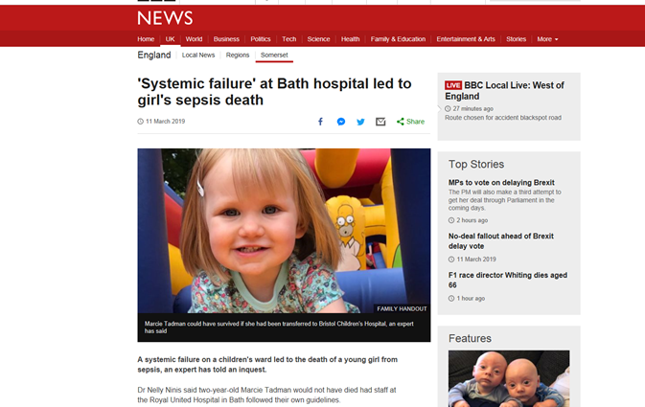
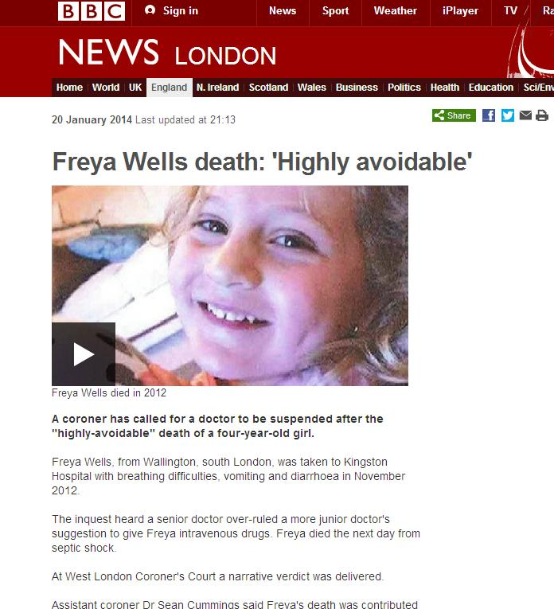
Why are we talking about sepsis?

Slide 4

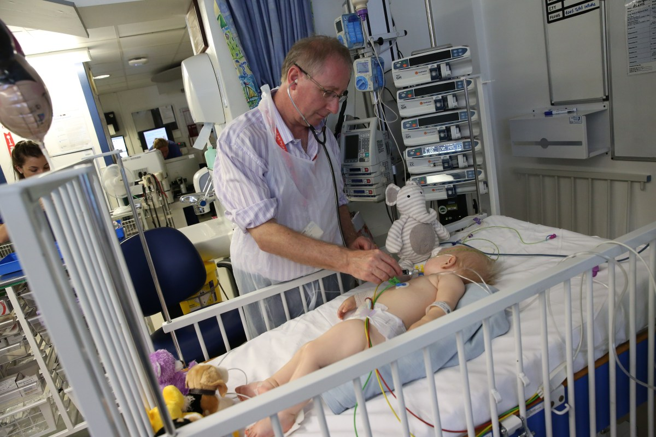

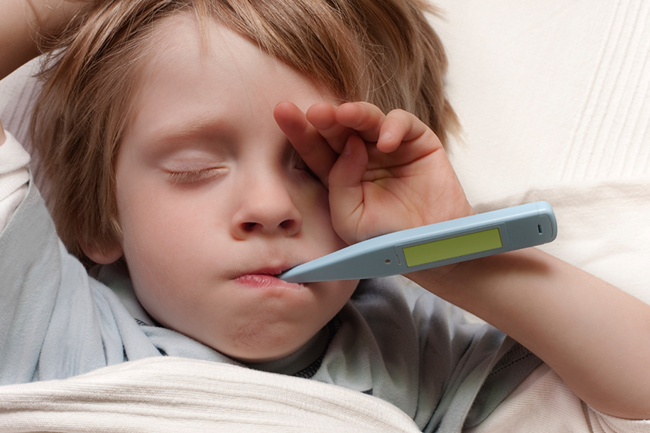
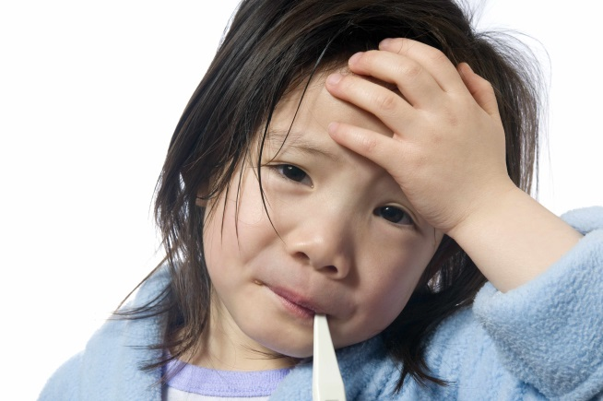

Slide 5
Problems
No useful definition of sepsis in paediatrics

Slide 6
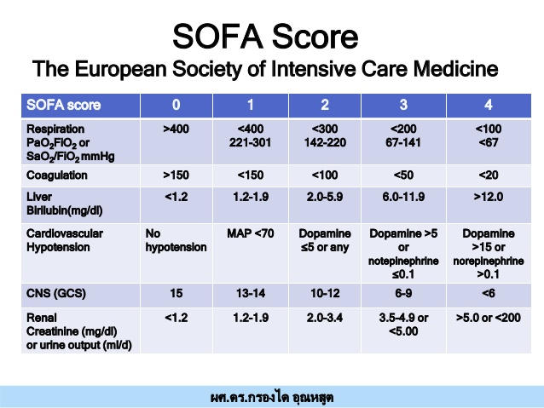

Slide 7
Problems
No useful definition of sepsis in paediatrics
Febrile illnesses are common

Slide 8
3,842,708 attendances to Emergency Services Under 14s 2014-2015.
20-30% of ED attendances are due to fever
4 – 6 episodes in first 2 years
Majority are viral

Slide 9
Problems
No useful definition of sepsis in paediatrics
Febrile illnesses are common
Sepsis isn’t that common in children

Slide 10
38 - 44,000 lives
annually in the U.K
costs the NHS an estimated
£2.5 billion.

Slide 11
Hartman ME, Linde-Zwirble WT, Angus DC, et al. Trends in the epidemiology of pediatric severe sepsis. Pediatr Crit Care Med 2013;14:686-93.
Retrospective review of data in 7 states in the US
0.89 cases per 1000 paediatric population
9.7 per 1000 - newborns
2.25 per 1000 - <1yr
0.23 per 1000 – 1-19yrs

Slide 12
Van de Voorde, Emerson et al Paediatric community-acquired septic shock: results from the REPEM network study.
Eur J Pediatr. 2013 May;172(5):667-74
270, 461 ED attendances
176 with severe sepsis (0.07% - 7 in 10,000)
8 deaths

Slide 13
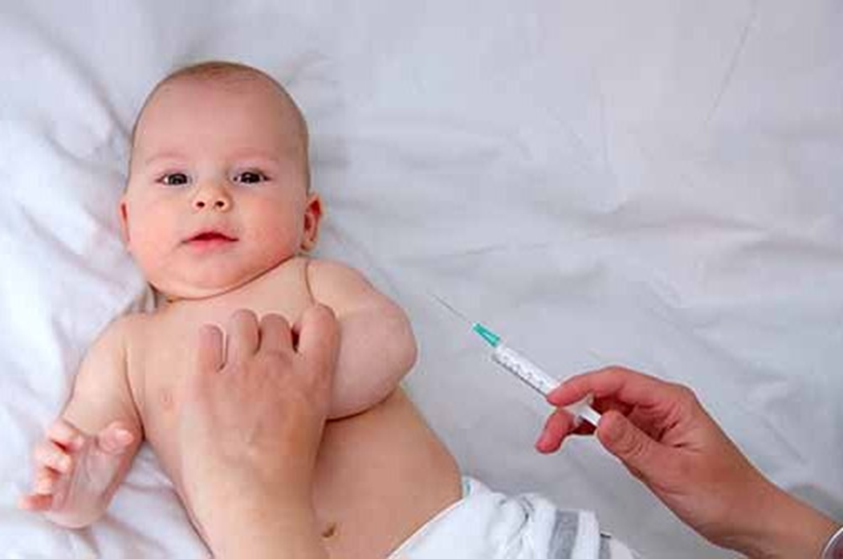

Slide 14
Sepsis in children
1000 children
admitted annually to PICU in UK with sepsis
Risk factors:
  Extreme prematurity
  pre-existing co-morbidities
  immunocompromise
20% mortality

Slide 15
Problems
No useful definition of sepsis in paediatrics
Febrile illnesses are common
Sepsis isn’t that common in children
There’s no magic test

Slide 16
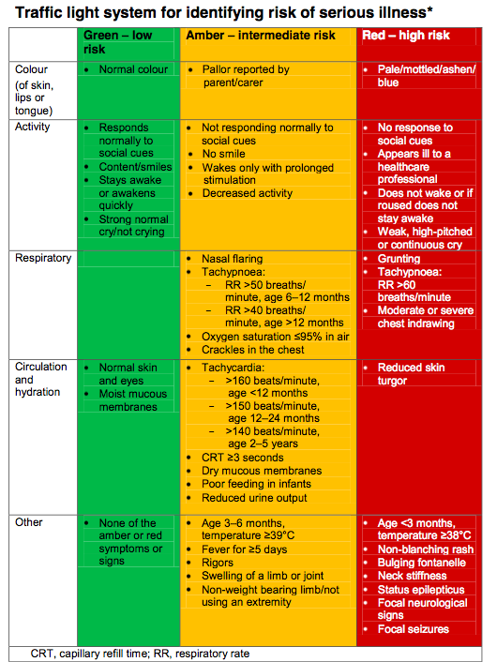
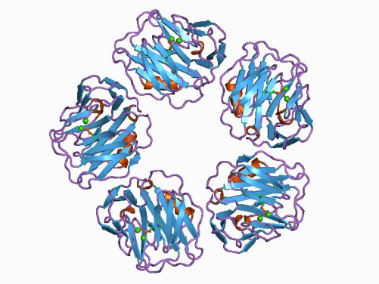
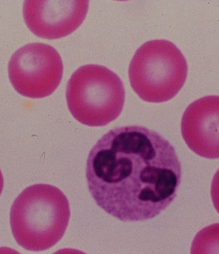
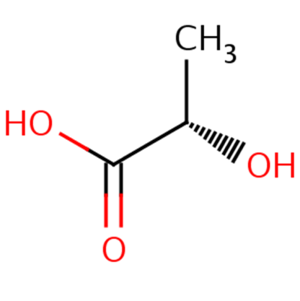
Notes:
Procalcitonin – not as useful
RSV can raise it

Slide 17
Problems
No useful definition of sepsis in paediatrics
Febrile illnesses are common
Sepsis isn’t that common in children
There’s no magic test
Children can change

Slide 18
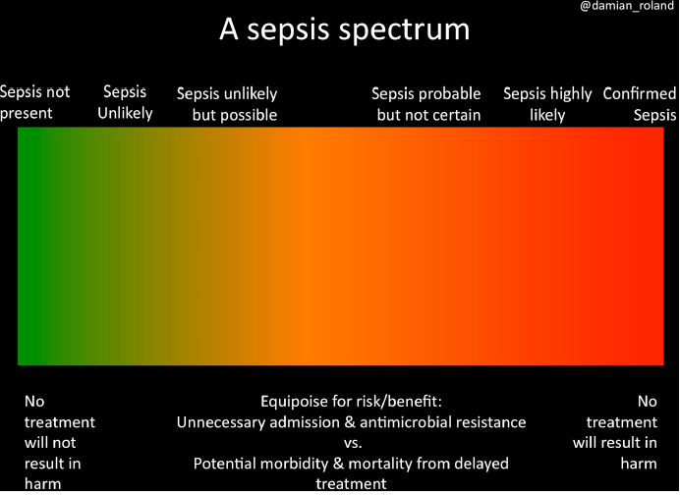
title
text
Roland D, Snelson E ‘So why didn’t you think this baby was ill?’ Decision-making in acute paediatrics
Archives of Disease in Childhood - Education and Practice 2019;104:43-48.

Slide 19
Problems
No useful definition of sepsis in paediatrics
Febrile illnesses are common
Sepsis isn’t that common in children
There’s no magic test
Children can change
Problems with systems

Slide 20
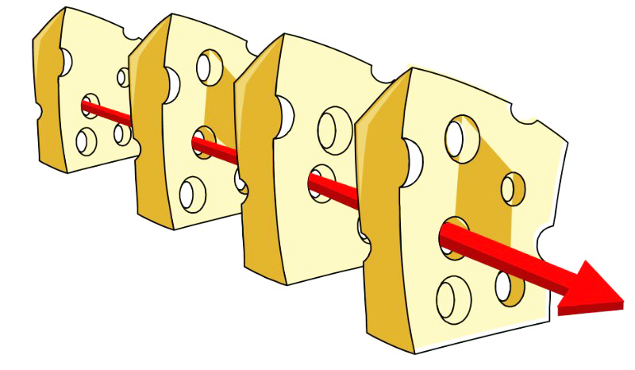

Slide 21
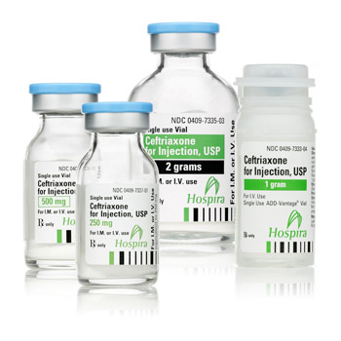
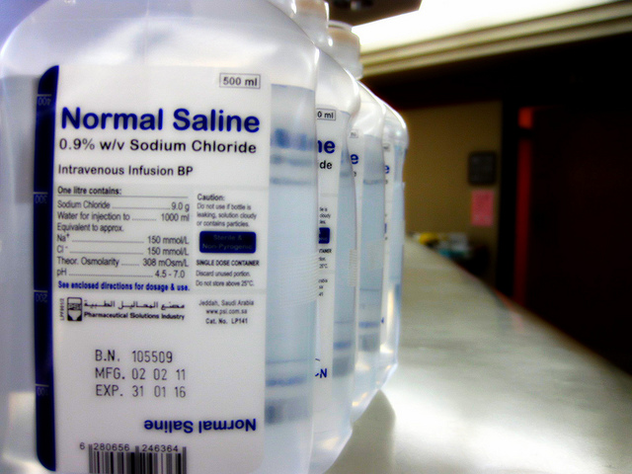

How do we treat it?
text

Slide 22
Cruz, Perry, William et al Implementation of Goal-Directed Therapy for Children With Suspected Sepsis in the Emergency Department
Pediatrics 2011; 127 (3) e758 -e766
Large PED (85,000/yr)
Implemented protocol for recognition and management of sepsis

Slide 23
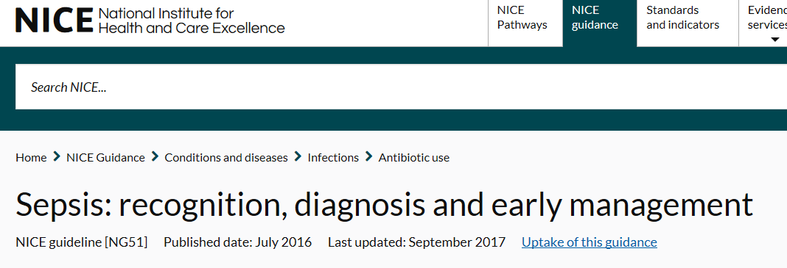
text

Slide 24
NICE guidance
15 studies included – all low quality
There is a trend in the evidence that if any of the following is a cause for concern:
  elevated temperature, heart rate or respiratory rate;
  hypothermia;
  hypotension;
  altered mental state;
  low oxygen saturation;
  low urine output.

Slide 25
NICE guidance
The GDG concurred that none of the signs and symptoms alone is sufficient to make a diagnosis of sepsis, or to predict patient outcome. While the available evidence was of very low quality the GDG also recognised that sepsis can be overwhelming and of rapid onset with few early clinical signs.

Slide 26
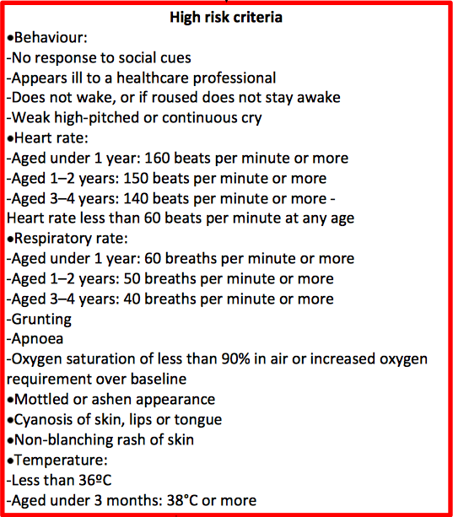
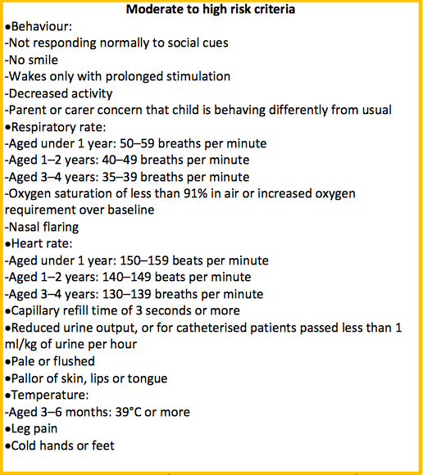

Slide 27
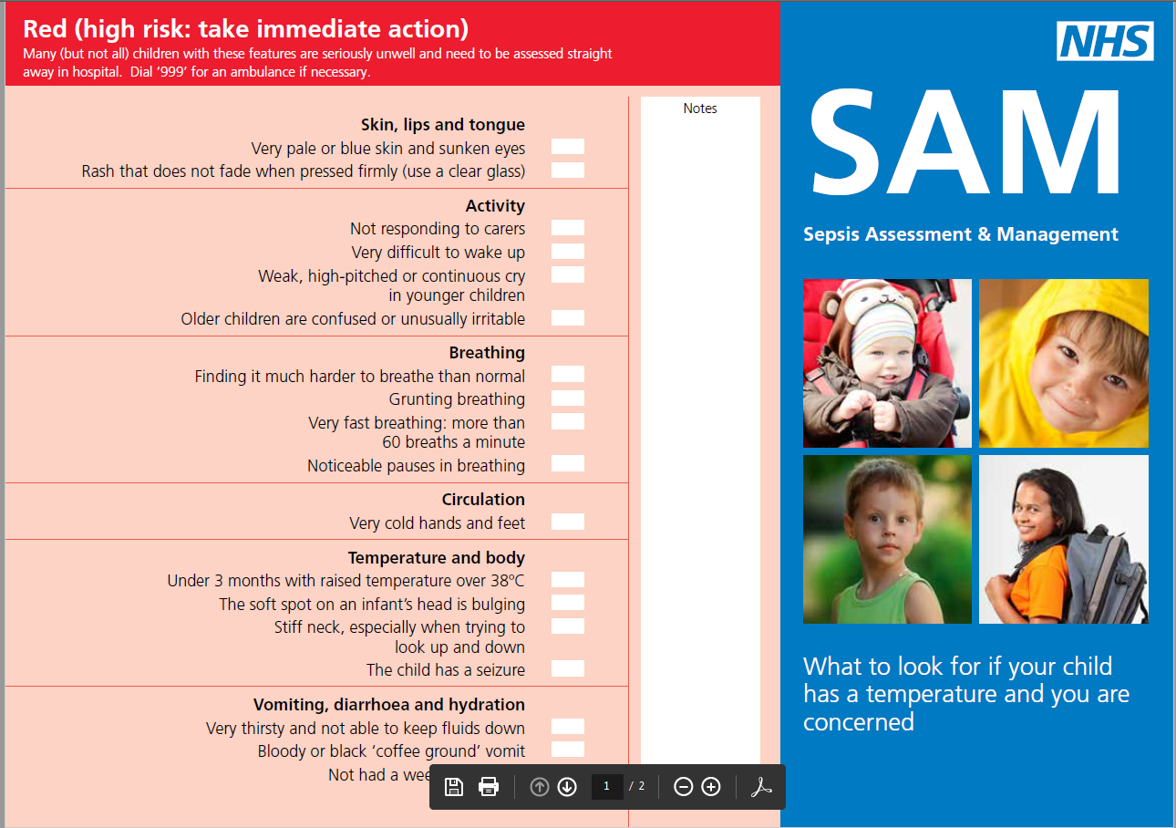

Slide 28
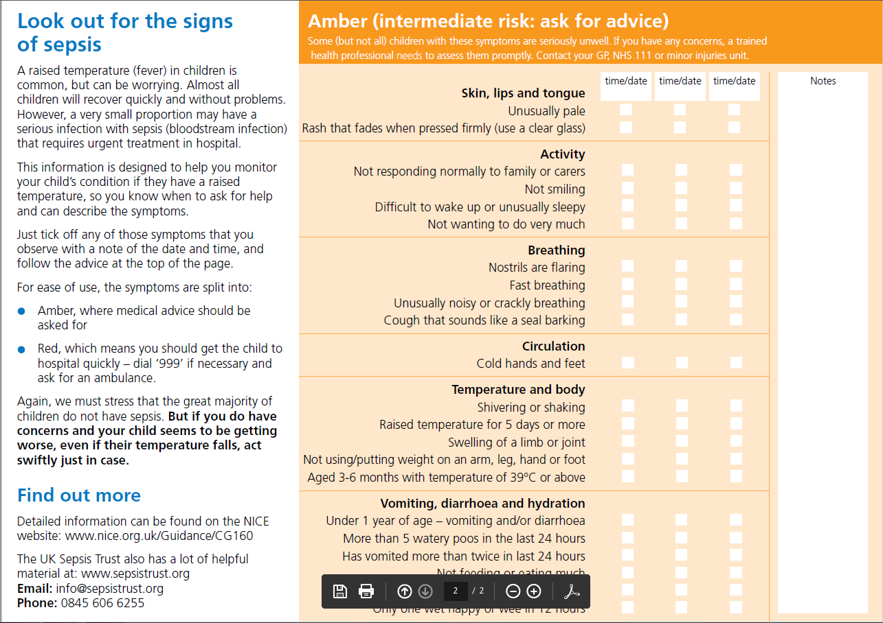

Slide 29
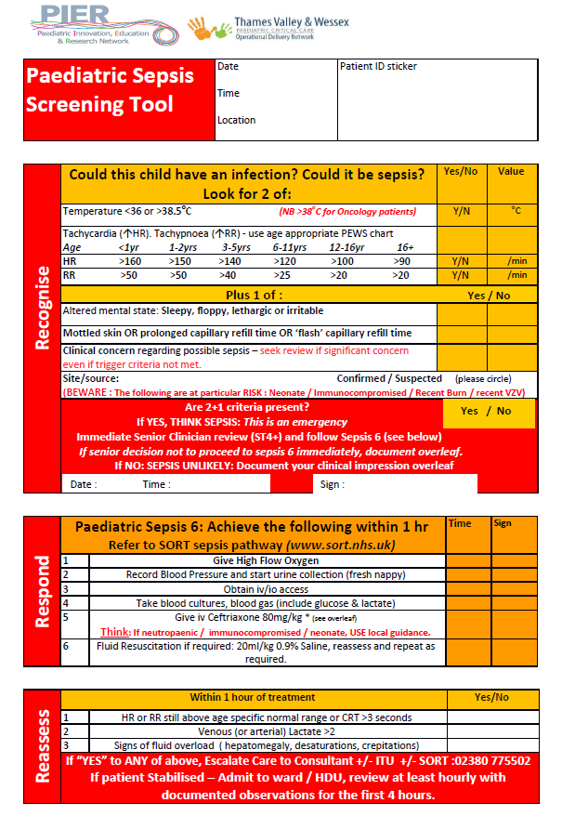

Slide 30
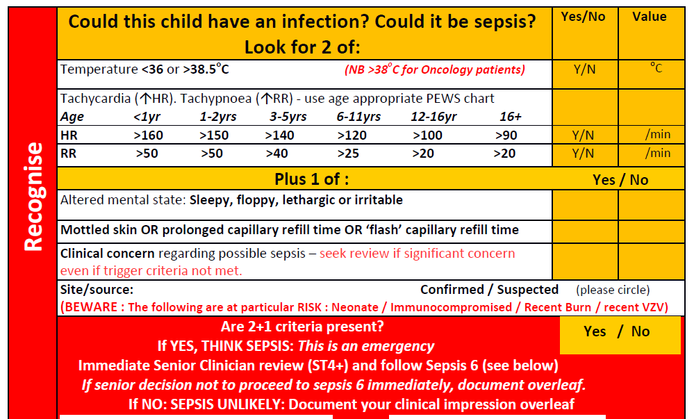

Slide 31
Initial scope using NICE guidance
Between 1st – 14th June 2018
  892 patients were triaged.
  388 presented with illnesses

Slide 32
Quality Improvement Methodology
Starting with work done at the Royal Free Hospital
Redesigned flowchart
PDSA cycles with multidisciplinary input
Data collected on all those who triggered red or amber

Slide 33
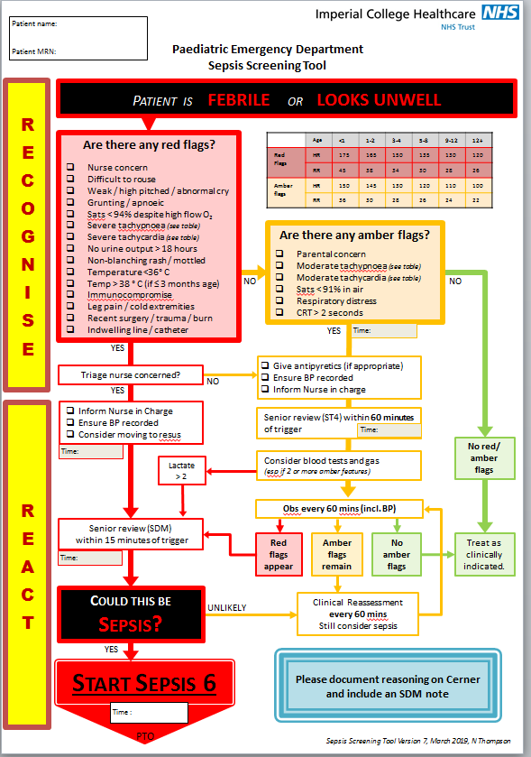

Slide 34
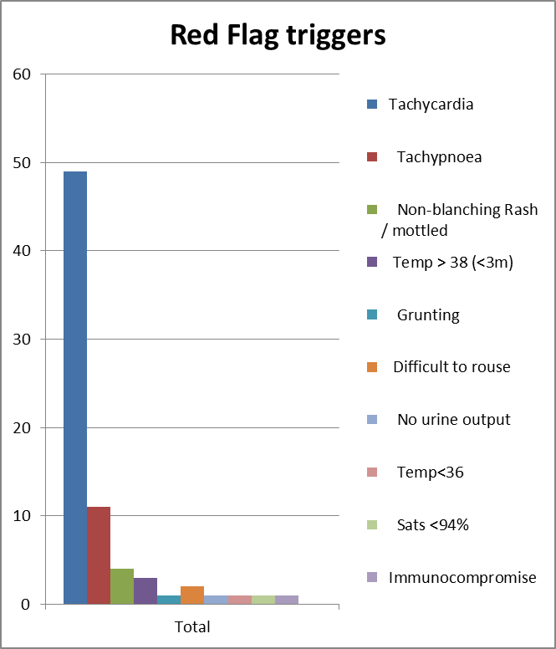
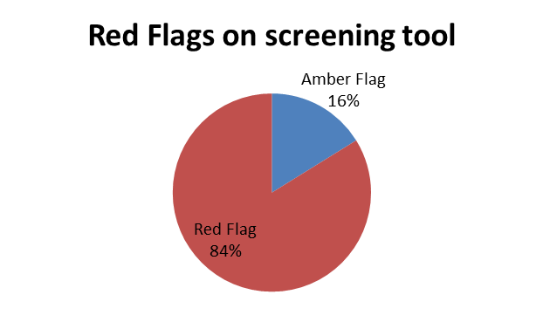

Slide 35
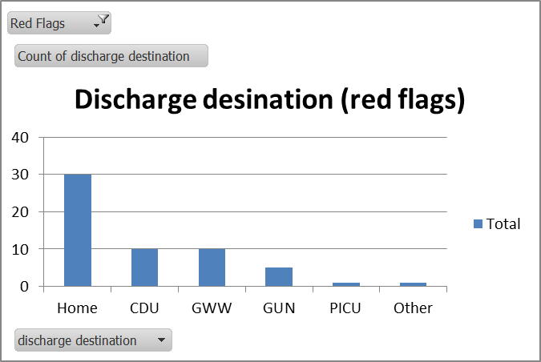

Slide 36
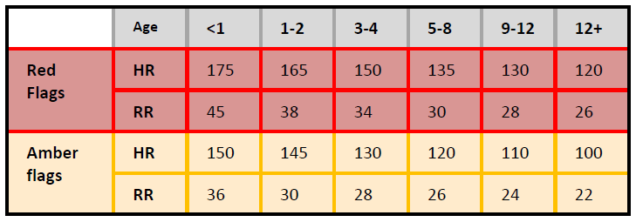
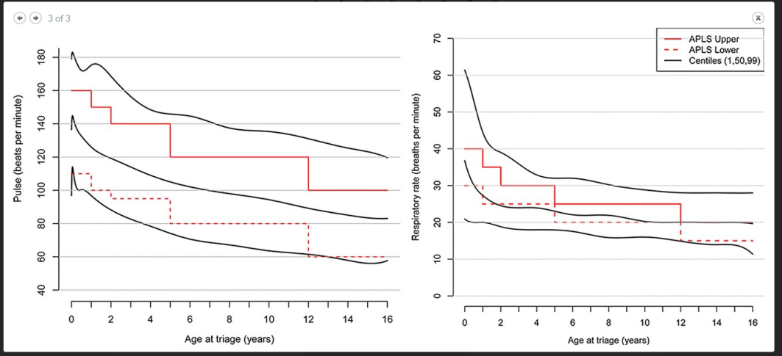
Changes in physiological limits

Slide 37
Lessons learned
It’s still difficult!
Using a paper form in a computerised process
It distorts the flow of the department
Need to have buy-in of all staff

Slide 38
Going forward
How to link to PEWS and electronic systems
How to measure success
How to link to other areas – wards / theatres / primary care?
Research ongoing
    Delphi process
    Biomarkers
    Outcome measures

Slide 39

title
text

Slide 40
Summary
Paediatric sepsis is rare but devastating
Paediatric sepsis is difficult to spot
Tools for screening are imperfect
There is much progress to be made

