Slide 1
GP and Trust forum
29 January 2025
Notes:
-

Slide 2
Agenda
Welcome
Outpatient improvement and transformation programme
Reactive issues, themes and resolutions
System interface updates

Slide 3
Outpatient improvement and transformation programme update
Dr Amrish Mehta and Dr Benjamin Ellis
Notes:
-

Slide 4
Overview – aims and scope
Phase 1:
Redesigning and standardising end-to-end administrative processes, to better meet individual patient and clinician needs and to make best use of digital technologies.
Improving existing models of care, to avoid unnecessary appointments and interactions and to maximise the value of appointments that are booked.
  Phase 2:
A more comprehensive redesign of clinical pathways, from diagnosis to treatment to ongoing support, grounded in partnership working and shared decision-making.
Organising and joining-up care around patients’ needs, using all resources as wisely as possible, to offer an even more tailored and responsive service to our diverse communities, and to help improve health as well as healthcare.

Slide 5
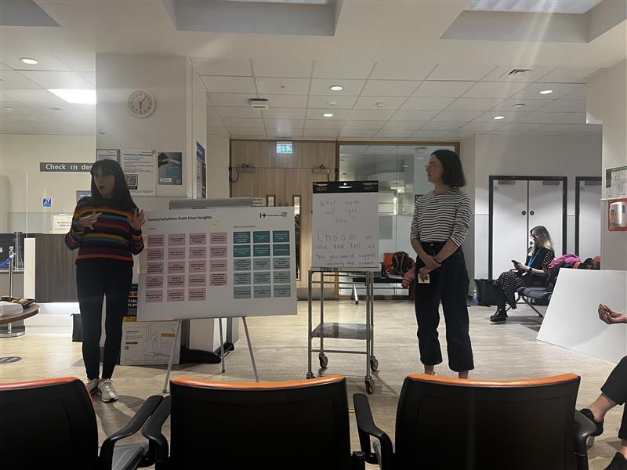
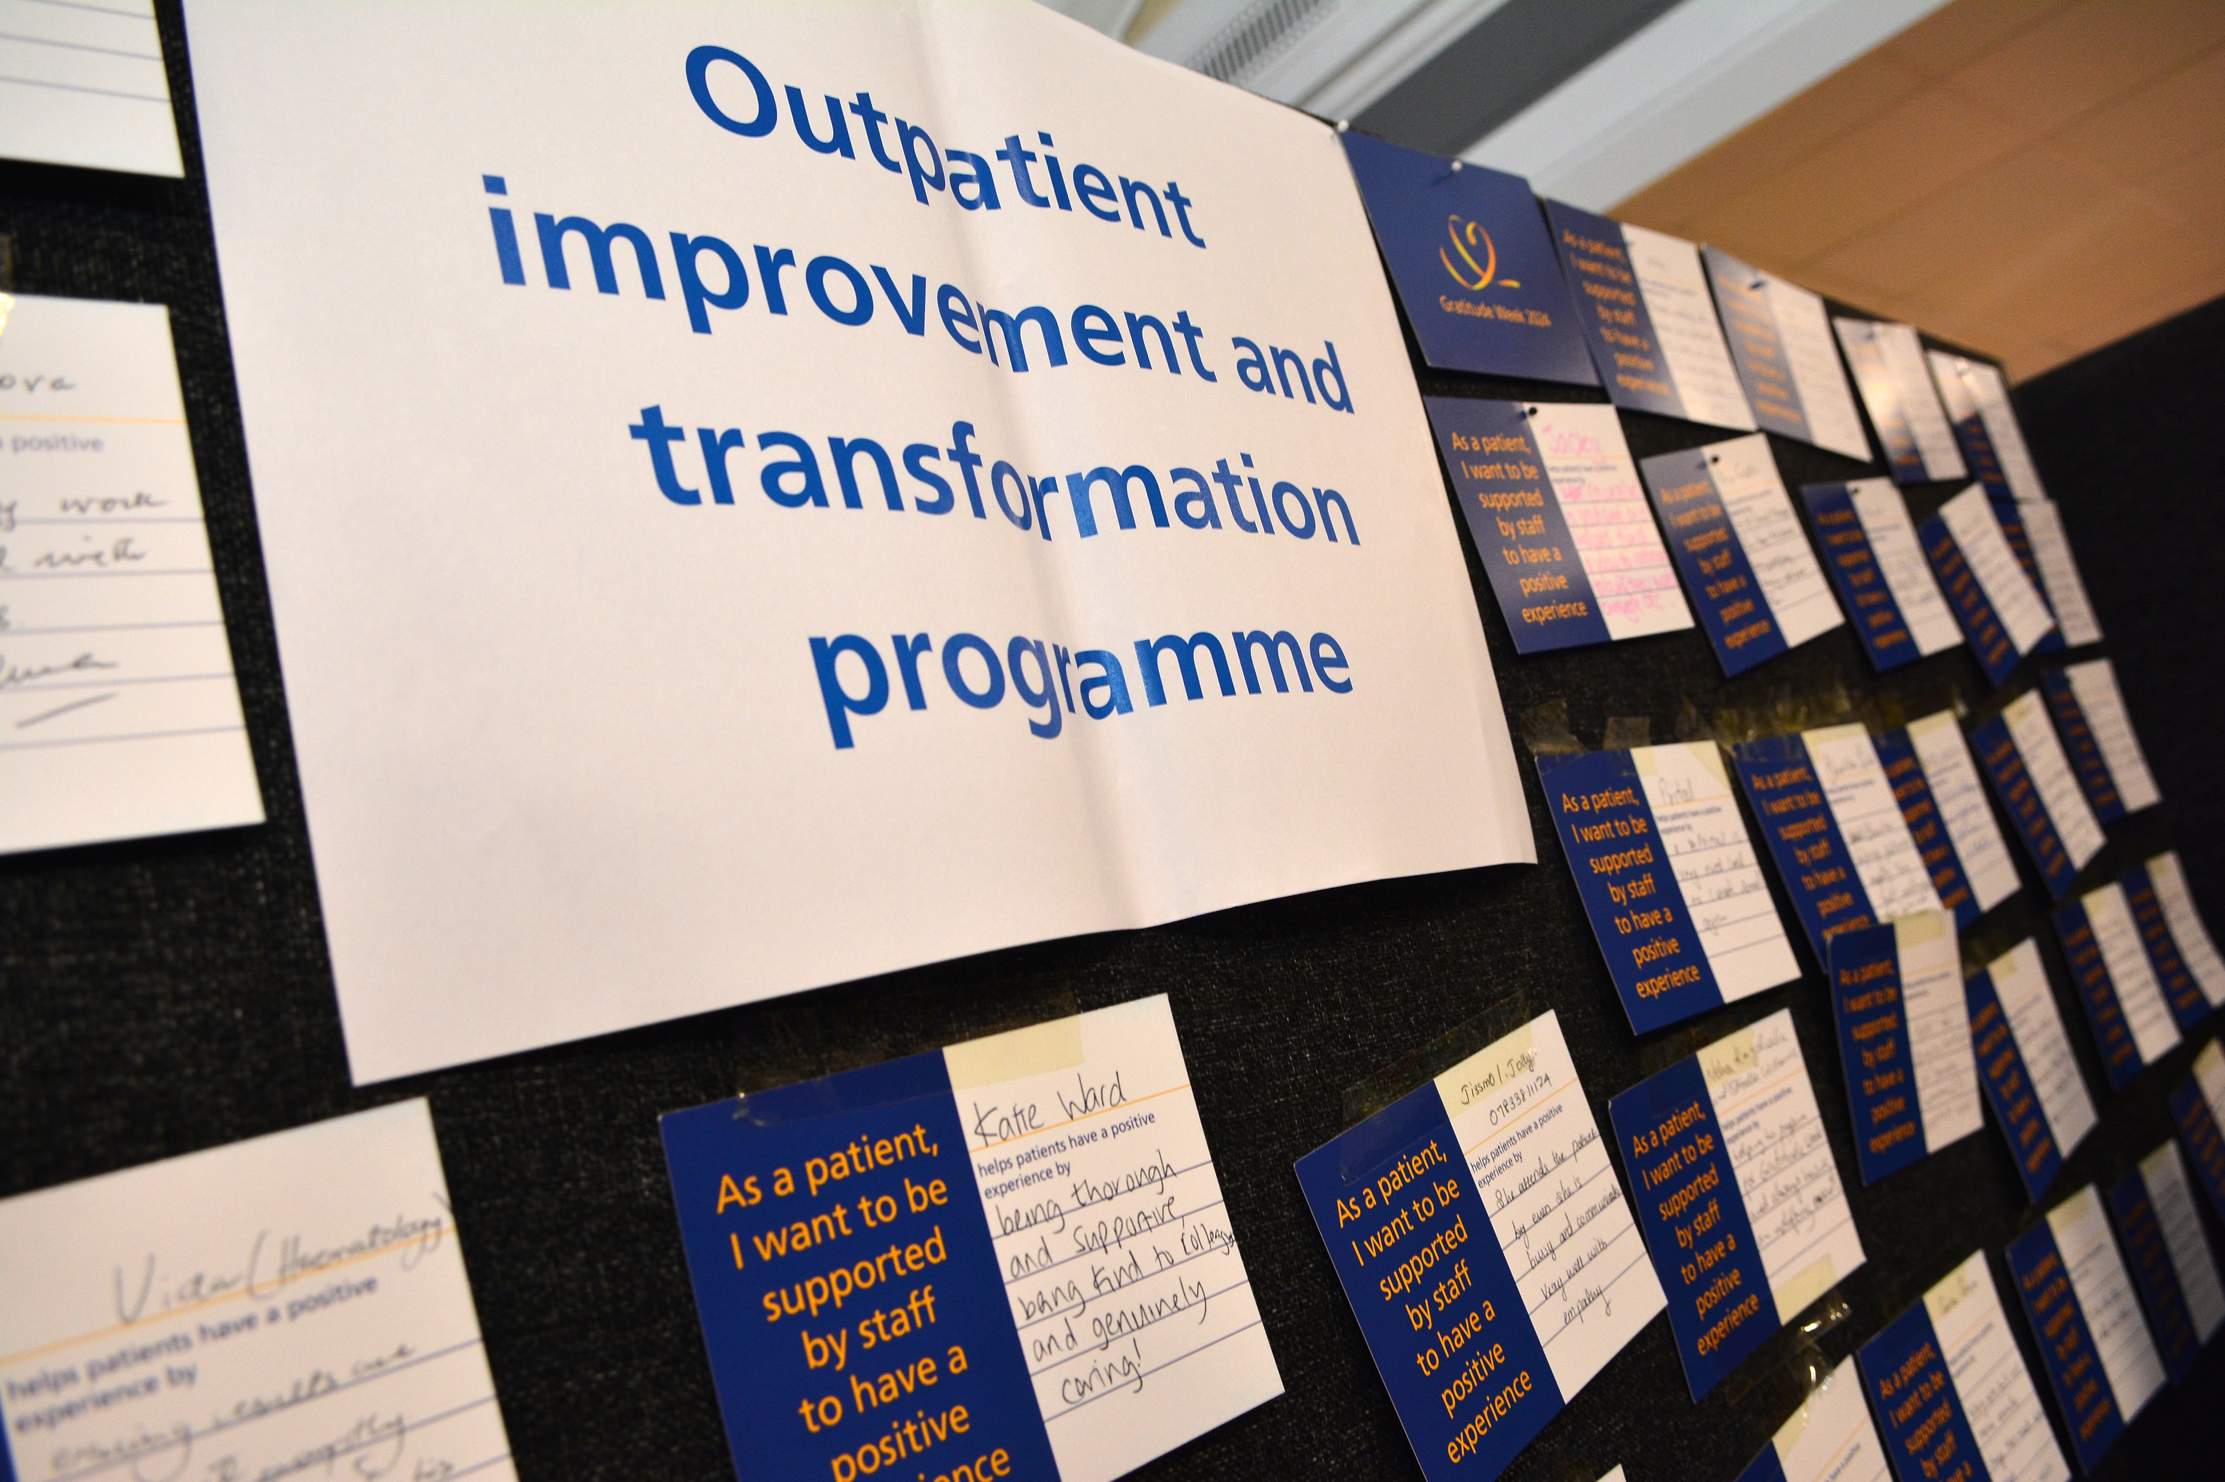
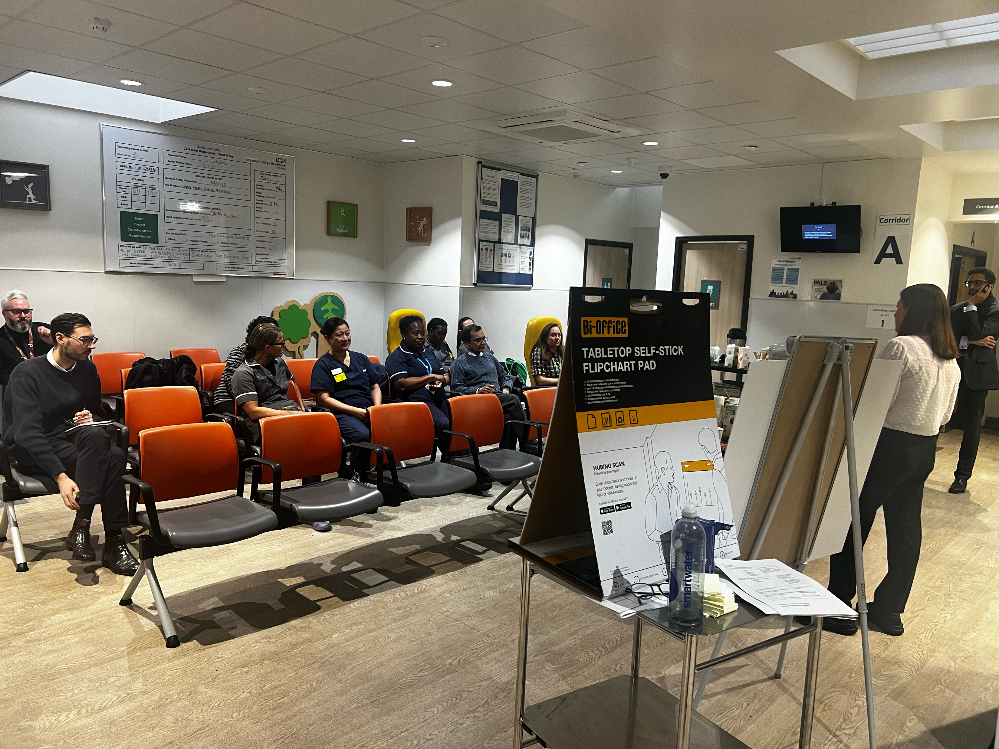
Overview – approach
The whole programme is grounded in extensive analysis of existing user insights and additional research with patients, local communities and staff.
The Helix Centre is supporting us on user-focused designed.
Patients, staff and GP colleagues are involved in various planning and development workshops, testing and governance groups.
We are committed to doing more to involve all our different ‘users’ and partners.

Slide 6
‘Live’ initiatives
1 My choice booking pilot
2 Digital direct booking pilot
3 More accessible communications
4 Improving outpatient correspondence
5 Improving wayfinding
6 Improving models of care

Slide 7
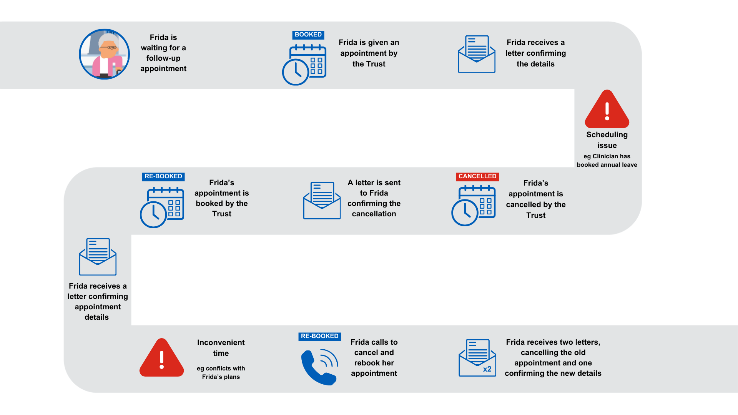
1
My choice booking –
what we do now
Case study of how we book non-urgent follow-up appointments currently

Slide 8

1
My choice booking –
why do we need it
"I want an appointment booked at a time and date that suits me [using my preferred method for arranging]."
Our new approach addresses a range of needs and preferences:
Offers patients a choice of appointment slots - to help make sure the slot works for them from the start – to reduce cancellations/re-bookings and no-shows.
Offers available slots only six-weeks ahead of the date – when everyone is clearer about what they are doing – to reduce cancellations by us as well as the patient.
Builds in regular (every 12-weeks) validation of whether the appointment is (still) needed by the patient and the clinician – to prevent unnecessary appointments and reduce no-shows
Systematic communications with the patient to ensure they know what is happening and what to expect.
More focus on identifying and supporting patient who are not engaging or are unable to engage in the standard way.
The pilot is running from January to April
non-urgent follow-up appointments only
Clinics involved include menopause, fibroid, benign gynaecology, vascular and colorectal surgery, IBD, med HPB, one rheumatology clinic

Slide 9
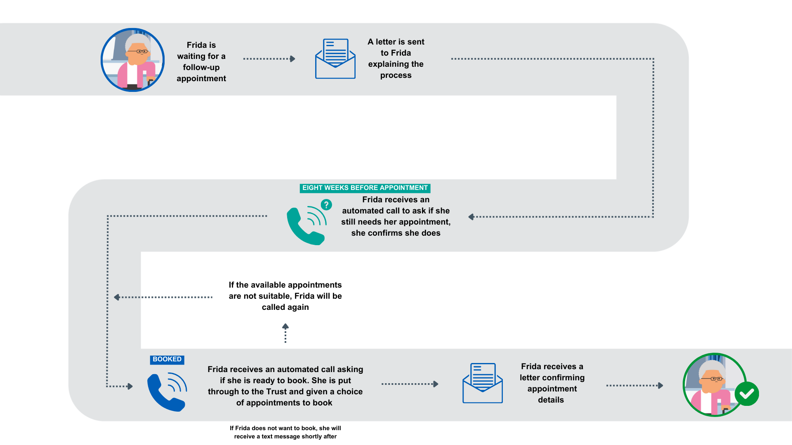
1
My choice booking –
what we are piloting

Slide 10
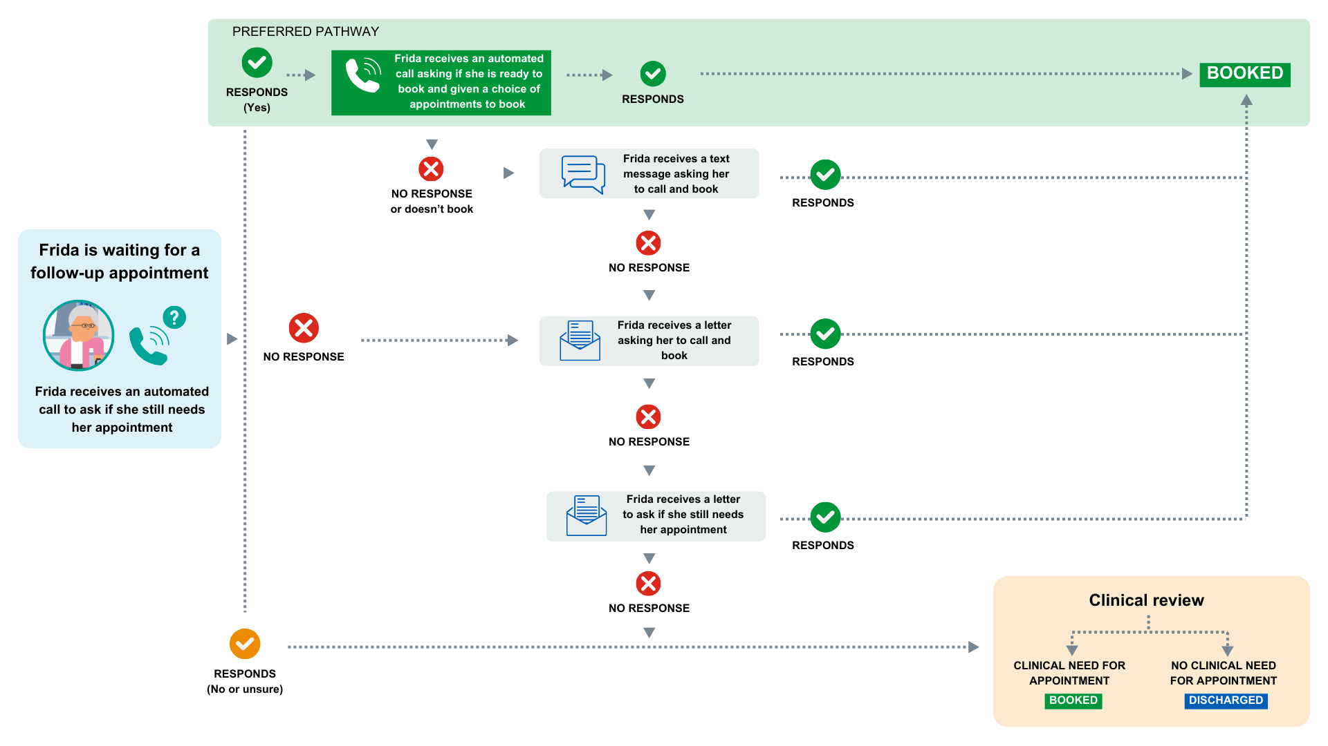
1
My choice booking –
what we are piloting

Slide 11

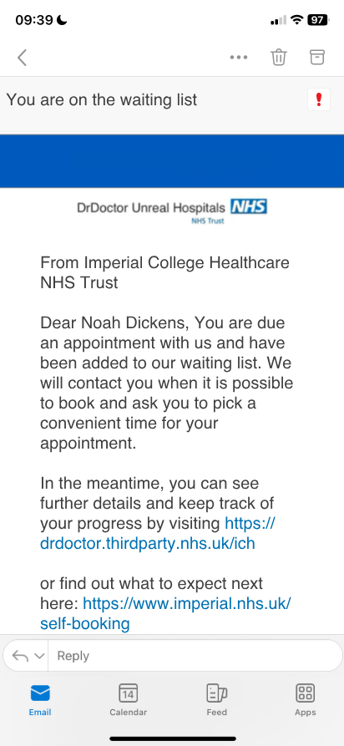
2
Digital direct booking
"I want an appointment booked at a time and date that suits me using my preferred method for arranging."
We will extend the ‘my choice’ pilot for non-urgent follow up appointments in the spring:
Self-serve option, available through patients’ phones or computers
Choice to book, reschedule or cancel appointments
Frees up capacity for patients who require more support to engage – to help improve equity.
Major focus on ensuring our data is accurate
Connecting with the NHS app

Slide 12

3
More accessible
communications
”I want to be able to understand communications from the hospital myself, especially to know how and when to come to my appointment.”
1
Gathering insights, to learn and improve
We have begun a project to understand the current challenges and potential solutions of making appointment management accessible and inclusive, with a focus on patients with specific accessibility and inclusion needs.
We will map the current process – and gaps - for collecting, recording and implementing patients’ information or communication needs.
And we will determine, in detail, what good looks like for collecting, recording and implementing patients’ information or communication needs.
2
Engaging community and GP services
We are engaging community providers and GPs to understand how we might share approaches and potentially data.
3
Changing and evaluating how we contact people in the new booking process
As part of the ‘my choice’ pilot, we are trialling automated voice calls to understand how they might help or hinder people with specific accessibility needs.
4
Improve interpreting and translation
This project is linked to our existing interpreting service transformation project.

Slide 13
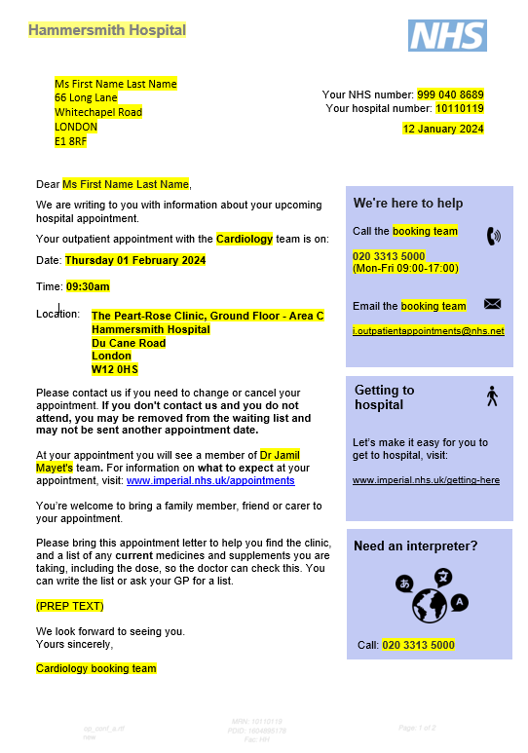

4
Improving outpatient correspondence
1
Better location information in appointment letters
We’re working to align letters with our new wayfinding approach, including directions.
1
Redesigning the first appointment
letter and leaflet
We've worked with the
cardiology service and
patients to redesign the
first appointment letter
and leaflet, including
versions for:
telephone
appointments
video
appointments
clinic
appointments
2
3
Helping patients update their contact details so we can stay in touch
We are raising awareness of how patients can best update their email address and telephone number on the NHS spine. We are advising that they use the NHS app, or communicate the changes to their GP, particularly if they need to update their postal address. We are also exploring how we might best update the spine ourselves without causing additional issues such as incorrect updates.
4
Clinical outcome letters
We are working across the North West London Acute Provider Collaborative to improve clinical outcome letter templates, for patients and GPs.
“As a GP, ​I need to remain informed about my patient by the hospital. ​
So that I can fulfil the role patients expect of me as a point of contact.”

Slide 14
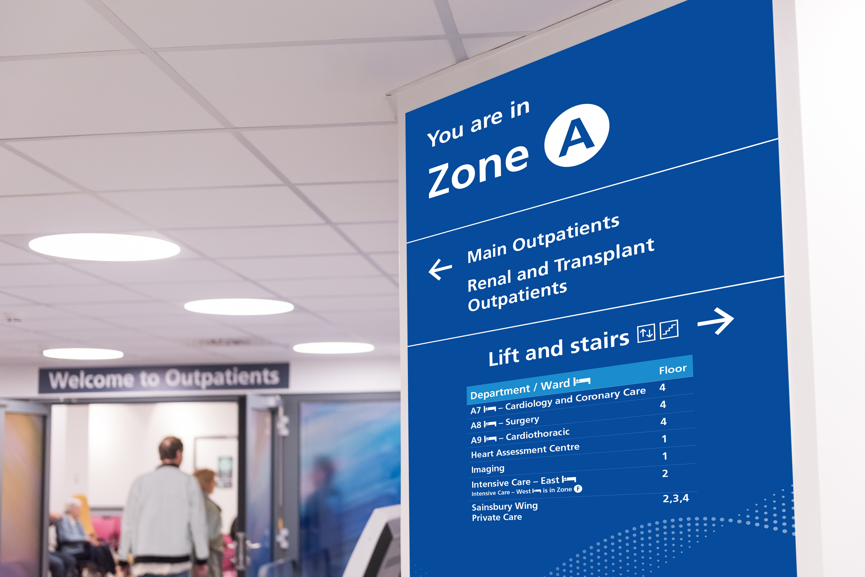
5
Wayfinding
improvements
”I want to be able to understand communications from the hospital myself, especially to know how and when to come to my appointment.”
We have nearly completed the roll-out of a new signage approach across our complex estate:
developed with patients and local residents, including a special focus on accessibility and inclusion needs
we will continue to make improvements including zoning outpatient areas to make it easier to navigate.

Slide 15



6
Improving models
of care
Getting from GP to specialist
Getting to diagnosis
and shared decision making
Treatment
Supporting people
to live well
1
Patient initiated follow-up
2
Aligning with ‘Reforming elective care for patients’ plans
3
Trust and North West London Acute Provider Collaborative initiatives
4
Engagement events with our staff, with some partner input – what are we already doing, what would improve clinical care, patient experience and ensure value in every interaction.

Slide 16
Discussion
Questions, comments on our overall approach
Question, comments on live initiatives and links to your issues
How can best involve more primary care colleagues?

Slide 17
GP liaison service update
Joselyn King
Notes:
-

Slide 18
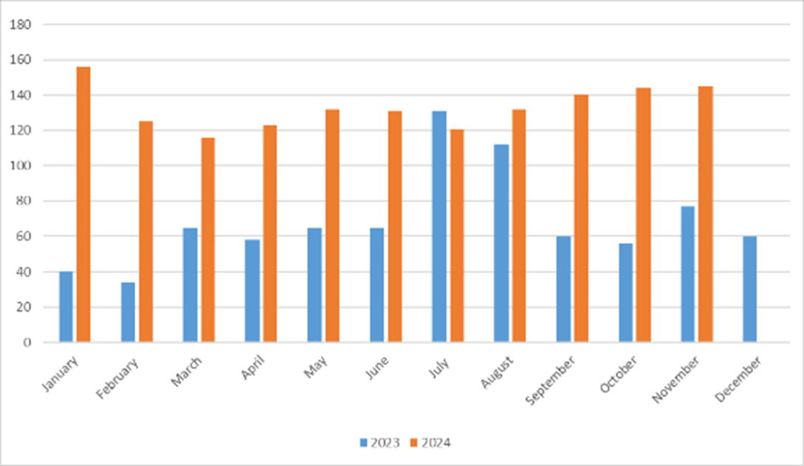
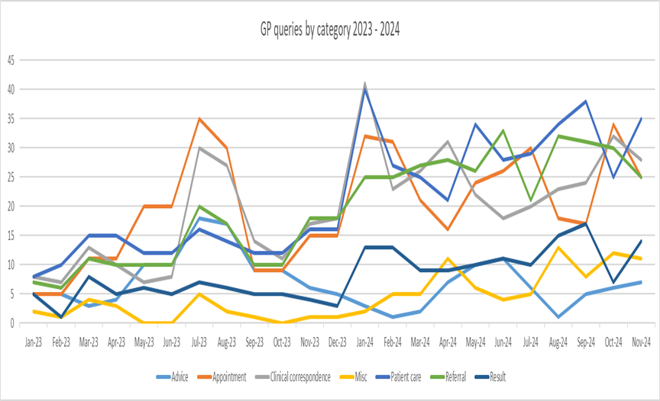
Reactive issues,
themes and resolutions
GP liaison service contacts
December 2024
121 GP practice contacts
Increasing trend in all categories aside from appointment queries but including referral, clinical correspondence and patient care queries
Top three topics this month are clinical correspondence, patient care and referrals
Key issues and queries for resolution
ECG appointments at CDCs
Endoscopy referrals
Accurx issues
Audiology access
Other actions
Expanding invitations and engagement for GP forum
Moving to monthly GP bulletins
Facilitating strategic and key project updates

Slide 19
Update on system interface programme
Martina Dinneen
Notes:
-

Slide 20
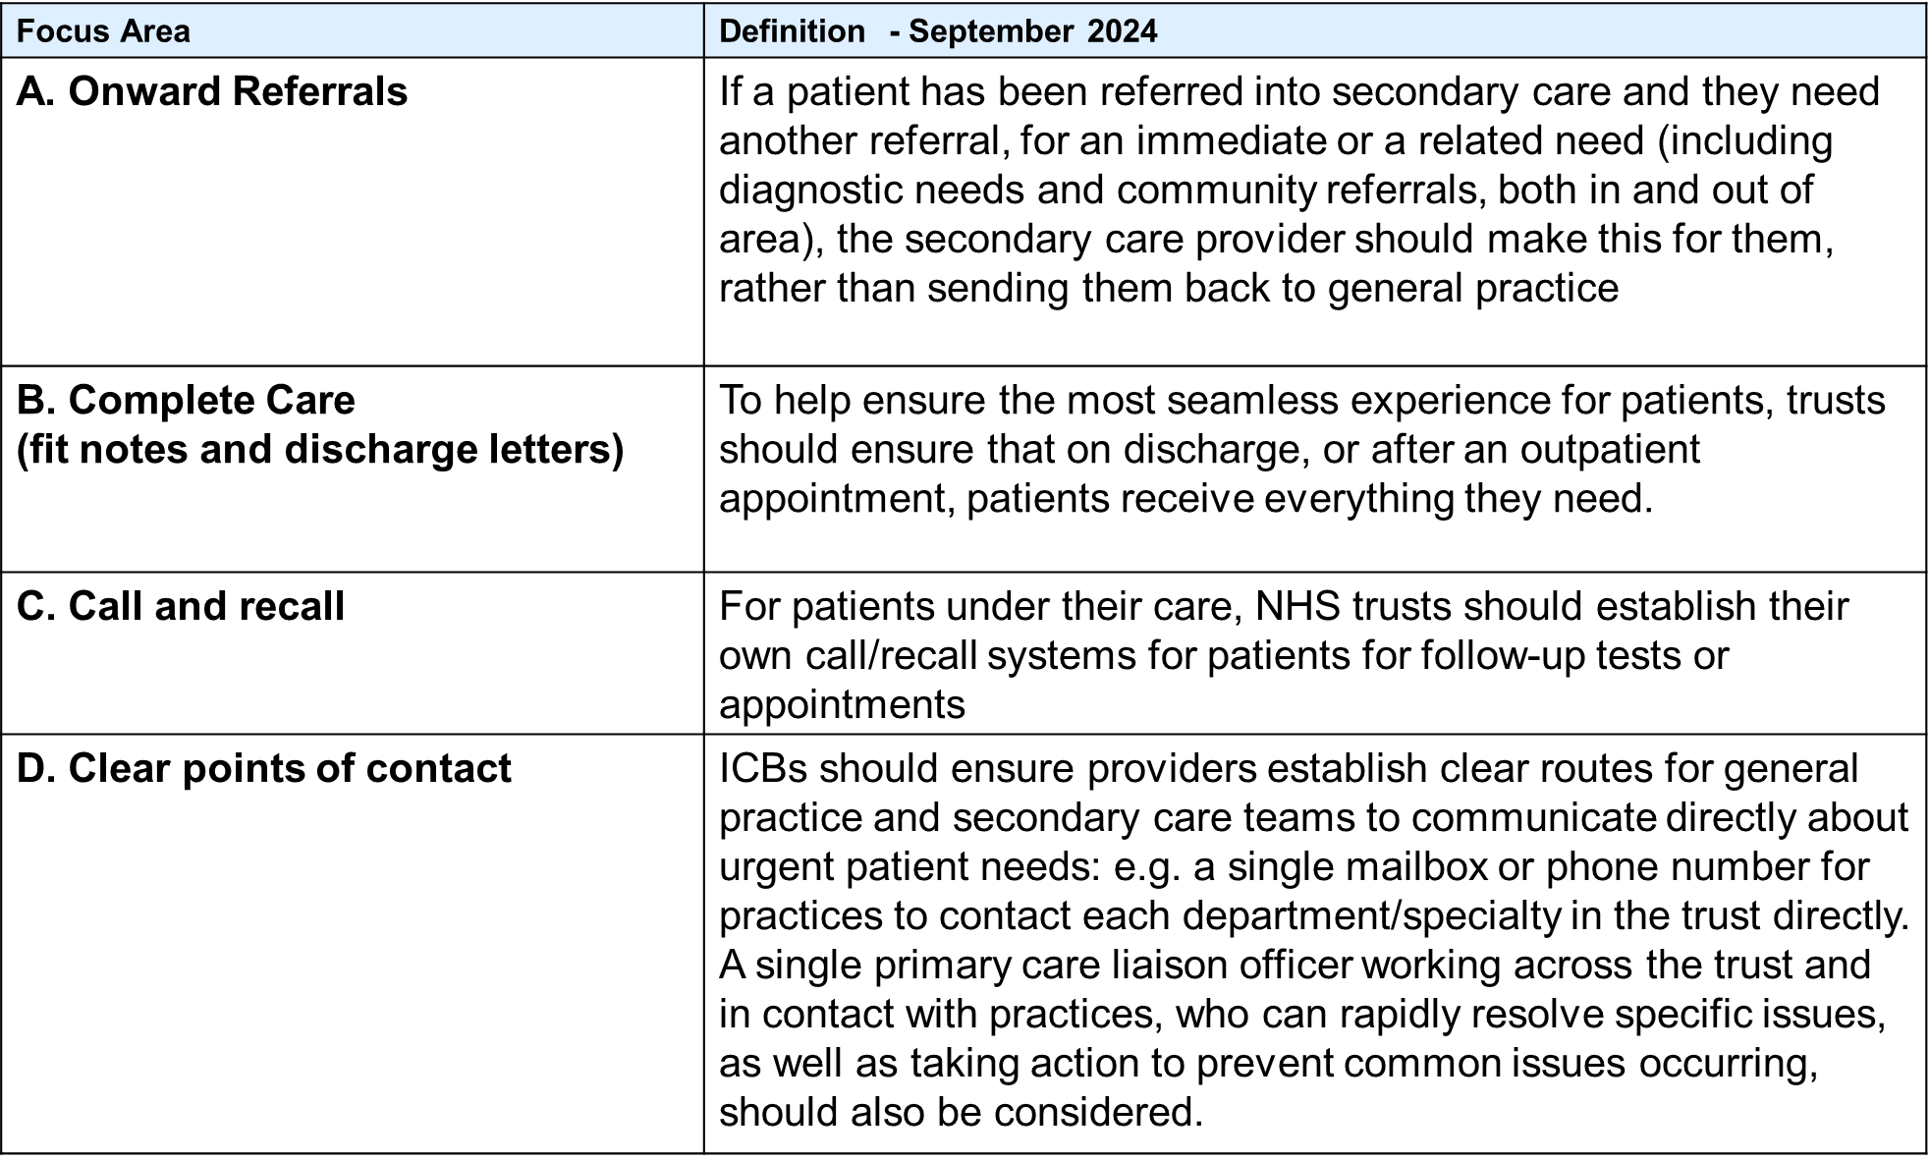
System interface
focus areas

Slide 21
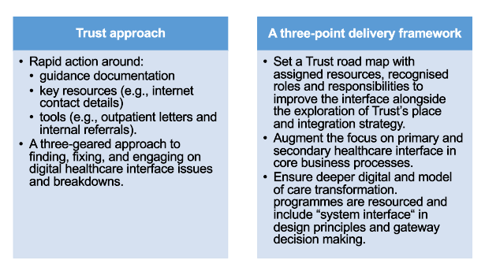
Discuss points

Slide 22
Update on actions
No | Action | Update
1 | Collate all activity across ICHT primary and secondary interface. PODs by specialty, GP practice, PCN, borough by hospital in ICHT Digital traffic – apps, eRS & REGO | Data set compiled. Introducing data to clinical, operational, site and transformational teams: to support relationship building to identify and connect with primary care stakeholders to raise awareness of scale and size of ICHT the system interface.
2 | Proactively invite feedback from GP practices to identify themes and take immediate actions. | Now established as standing agenda item for the forum. Led by Joselyn King – Trust Head of GP Partnerships
3 | Strengthening authority and engagement at the GP and hospital forum. | NWL System – Formal reporting to NWL System Interface Group established. ICHT – monthly executive lead strategic support group in design. Place – reviewing and strengthening contact with GPs through forum, digital and human communication channels.
4 | Provide more direct contact points for specialty, directorate and divisional leads ahead of the outpatient booking line, GP liaison and the eRS email account. | In progress – compiled with 75% validated.
5 | Identify intersections and dependencies of system interface deliverables with ICHT programmes and NWL APC programmes. | Scoping complete. System interface deliverables embedding in ICHT Outpatient Improvement Programme and NWL APC Digital Transformation Programme.
6 | Collate ICHT – core processes of care delivery plan for ICHT executive and ICHT GP/Hospital forum approval. | Completed – summarised in next slide.

Slide 23
System interface
deliverables roadmap
Deliverables | Scheme name | Delegation | Impact on GP/Hospital interface | Delivery date
Onward Referrals | Internal Referrals | EPR Enhancement – Transformation & Projects | Standardise a digital process informed by users which enables tracking and visibility to hospitals, GPs and patients - 7 workflows. | Q4 25/26
 | Interim Guidance based on best process currently available | Unassigned | Channel users to best available process available and establish responsible officers and monitoring. | Feb 2025
Complete Care | Discharge Workflow (mPAGE 1&2) | EPR Enhancement – Transformation & Projects | Improved content, completeness and out bounding of the discharge letter | Q4 25/26
 | Outpatient Electronic Prescribing | EPR Enhancement – Transformation & Projects | TBC | Q4 25/26
 | eMED3 | EPR Enhancement – Transformation & Projects | Enable electronic FIT notes | Q4 25/26
 | Electronic Prescribing Service | Digital Transformation & service led improvement(WCCS) | Enable electronic community prescribing | Q4 25/26
 | CERNER Outpatient Letter Optimisation | EPR Enhancement – Transformation & Projects | Improved content, completeness and out bounding of the outpatient letter | Q 24/25
 | Model of Care 2 | Outpatient Improvement and Transformation Programme | Establish end to end pathway care for outpatient/ambulatory care | Dependent on business case development
 | CERNER Procedure Documentation Standard | Unassigned | Channel users to best available process available and establish responsible officers and monitoring. | 31-Jan-25 (slight delay)

Slide 24
System interface
deliverables roadmap
Deliverables | Scheme name | Delegation | Impact on GP/Hospital interface | Delivery date
Call and recall | Model of Care 2 | Outpatient Improvement and Transformation Programme | Establish end to end pathway care for outpatient/ambulatory care. | Dependent on business case development
 | Interim Guidance based on best process currently available | Unassigned | Channel users to best available process available and establish responsible officers and monitoring. | 28-Feb-25
Clear points of contact | eRS healthcare team completion | Service Led Improvement (WCCS) | Ensure responsible clinical lead/s are specified on eRS. | 31-Jan-25
 | Internet and URL access – specialty & department contact details | Service Led Improvement (Comms & Engagement) | Provide mechanism to contact specialty/department and/or consultant that is easy to navigate when required. | 31-Mar-25
 | Excel – specialty, directorate and divisional leadership contact details | Service Led Improvement (Comms & Engagement) | Provide mechanism to contact specialty/department and/or consultant that is easy to navigate when required. | 31-Dec-25
 | CERNER Procedure Documentation Standard | Unassigned | Channel users to best available process available and establish responsible officers and monitoring. | 31-Jan-25 (slight delay)

Slide 25
Three groups of
tasks/deliverables
ICHT leadership support and prioritisation to provide:
guidance documentation
key resources (e.g., internet contact details)
tools (e.g., outpatient letters and internal referrals)
Executive discussion summary 20 December 2024: Clear ‘quick win’ opportunities around outpatient correspondence, fit notes and onwards referrals are a behavioural ask of clinical colleagues and we can address speedily (e.g. send out a letter to all consultants from MDO, DDs and Tim to set out what we’re asking for. Potential to audit to see compliance).

Slide 26

Managing the ICHT
digital ecosystem
Finding, fixing and engaging on digital healthcare interface issues and breakdowns
Gear 1: Identifying and resolving bugs and defects
proactive detection and swift resolution.
Gear 2: Optimisation of digital skills and application
educating to improve experience & embedding in operations.
Gear 3: Learning from breakdowns in ICHT digital ecosystem
analyzing system performance, identifying root causes, implementing corrective actions, documenting lessons learned and best practice, creating frictionless user feedback and potential creation of user communities/networks.

Slide 27
Augment the primary and secondary interface in core business processes
The aim is to improve patient experience and outcomes, enhance system efficiency, and create a more integrated healthcare ecosystem.
The application of consistent principles:
Stakeholder engagement
Integrated care delivery
Data-Driven decision making
Joint workforce development
Joint technology and innovation
How do we enable the collaboration and connections that mean teams can play to their specialist strengths but operate as part of the bigger collective?
Day to day:
Responsive problem-solving service for GPs and monitoring for action.
Feedback mechanisms – structured feedback processes on themes.
Clear communication channels
Regular collaborative meetings
Mutual education and training
Build Trust = Truth + Consistency + Time
In programmes, projects and changes:
Harmonise/agree design principles across programmes
Include involvement and engagement plans
Include senior interface/place stakeholders in gateway reviews

Slide 28

Thank you
Outcome based accountability in the face of a large, complex and ever-changing archipelago!

