Slide 1
Welcome to our
AGM 2017

Slide 2
Please take a seat,
the AGM is about to begin

Slide 3
Welcome
Chairman,
Sir Richard Sykes

Slide 4
2016/17 review and
a look ahead
Chief executive,
Ian Dalton CBE

Slide 5
Our three pillars
Clinical services
Research
Education

Slide 6
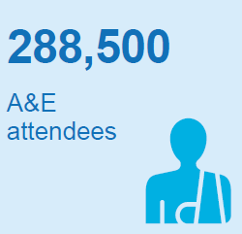
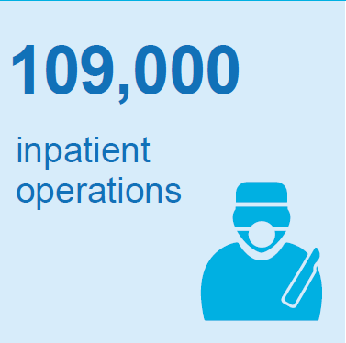
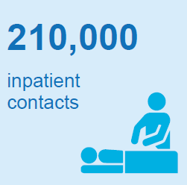
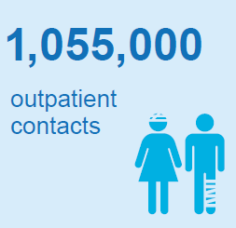
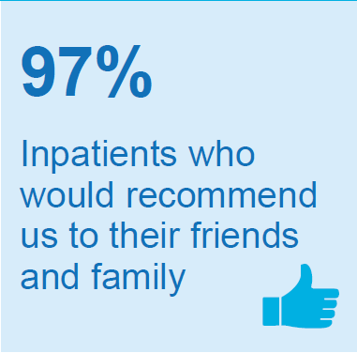
2016/17 in numbers

Slide 7
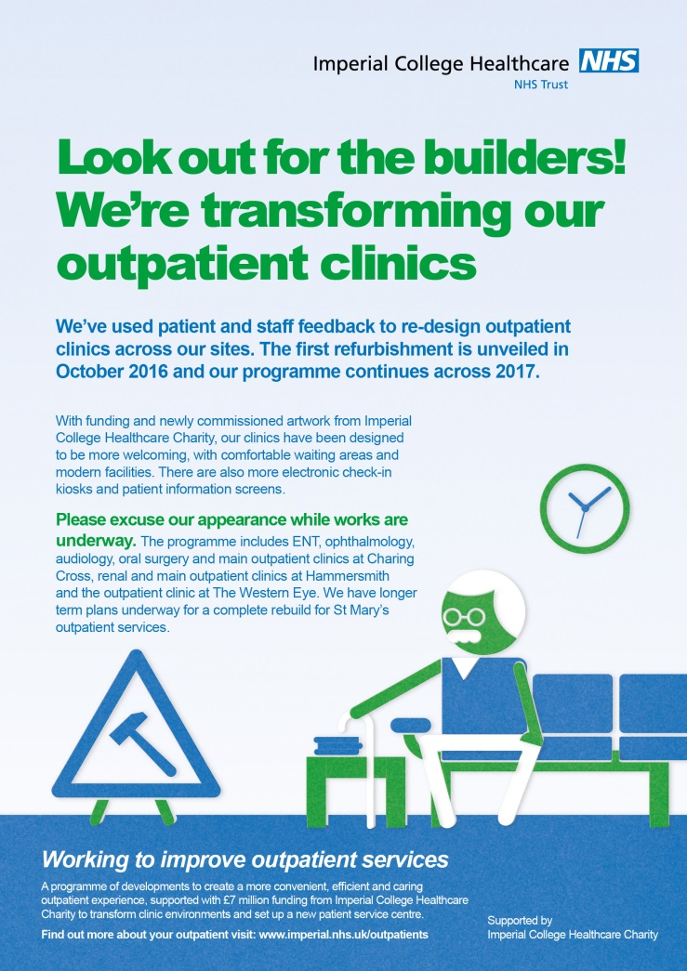
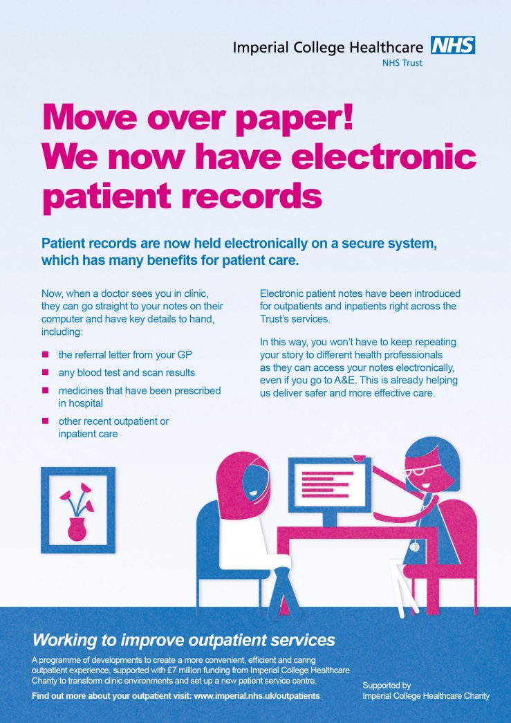

Improvements in outpatient services

Slide 8
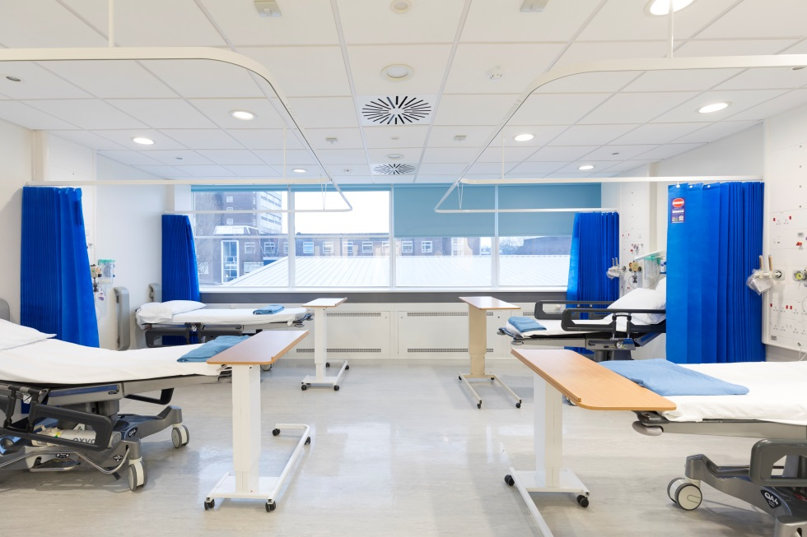
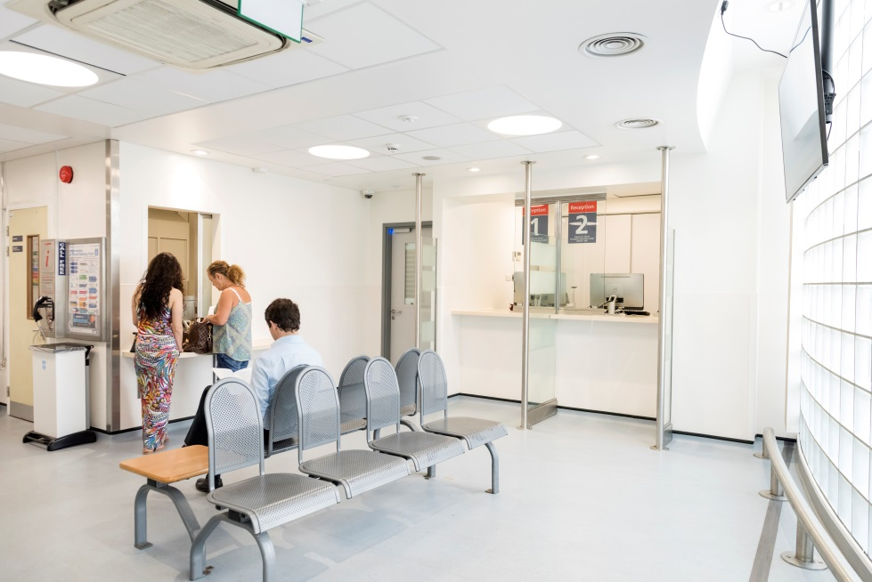

Building improvements worth £18m
Riverside theatres
Charing Cross Hospital
Accident and emergency
St Mary’s Hospital

Slide 9
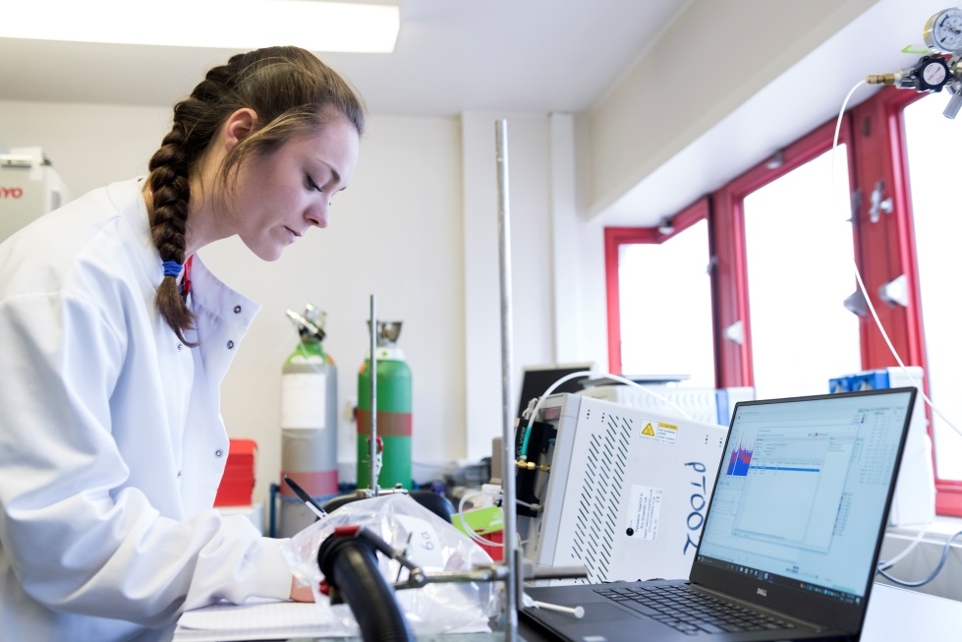
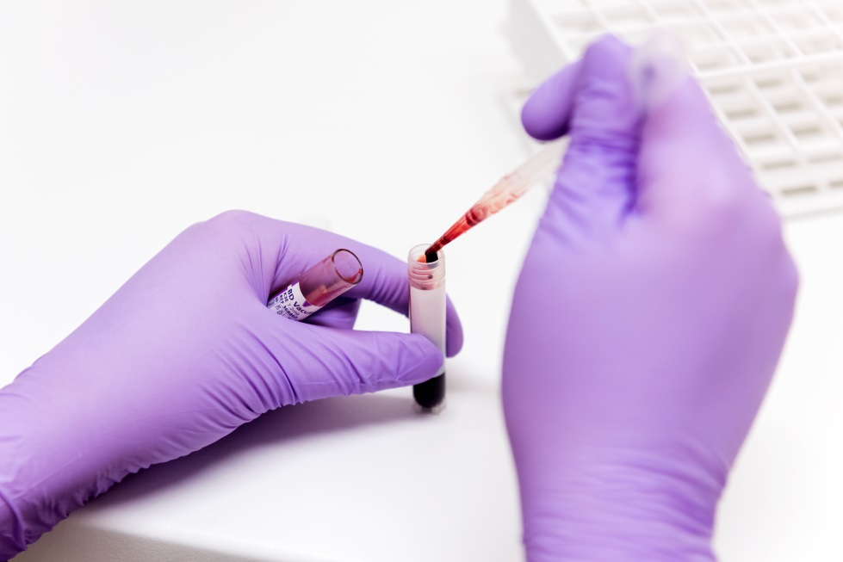
£90m funding for biomedical research centre

Slide 10
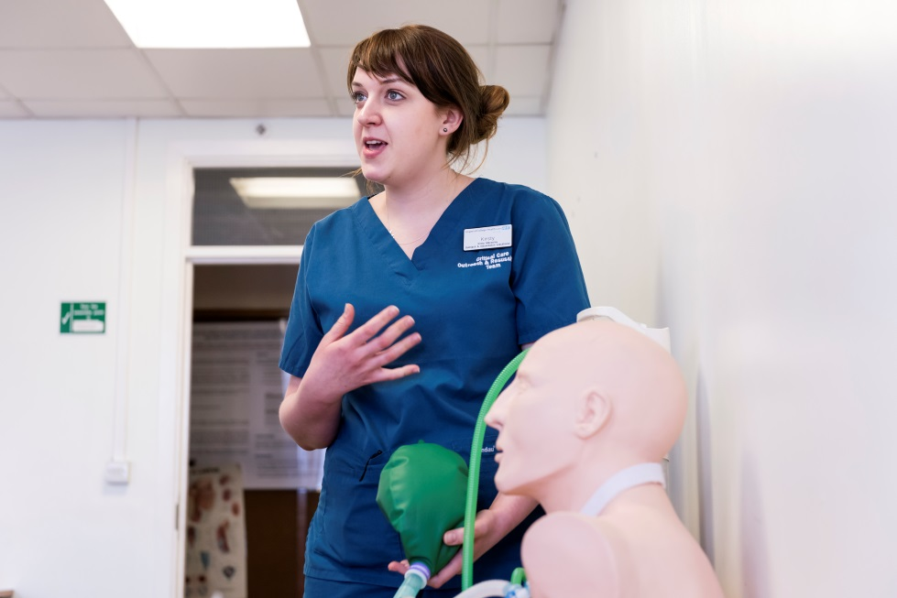
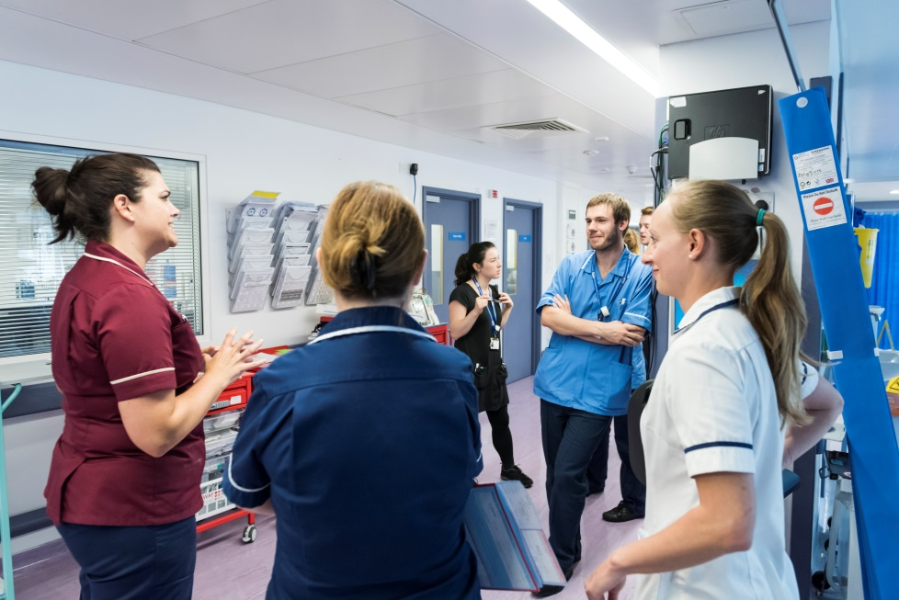
Educating doctors, nurses and a wide range of other health professionals

Slide 11
Four hour accident & emergency access
4 hour standard
England performance
Trust performance

Slide 12
18 week referral to treatment (RTT)
92% RTT standard
England performance
Trust performance

Slide 13
Cancer 62 day waits
Trust performance
62 day wait standard
England performance

Slide 14


Responding to growing and changing needs

Slide 15
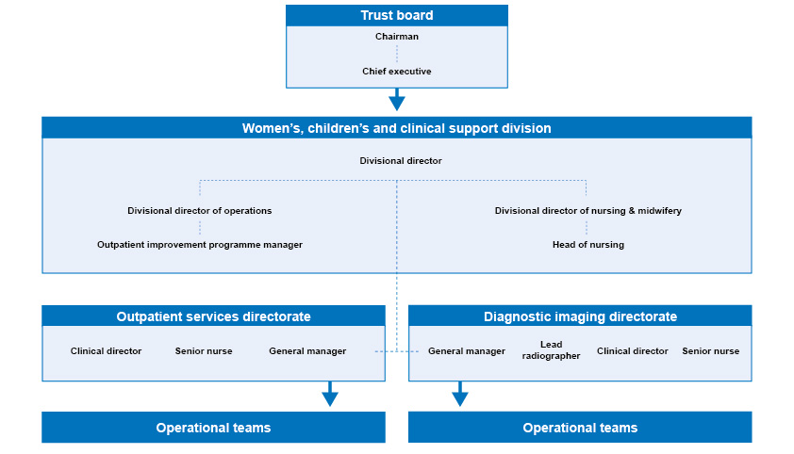
Ensuring we have enough people with the right skills in the right roles
Streamlining our structure: an example of four layers from ward to board

Slide 16
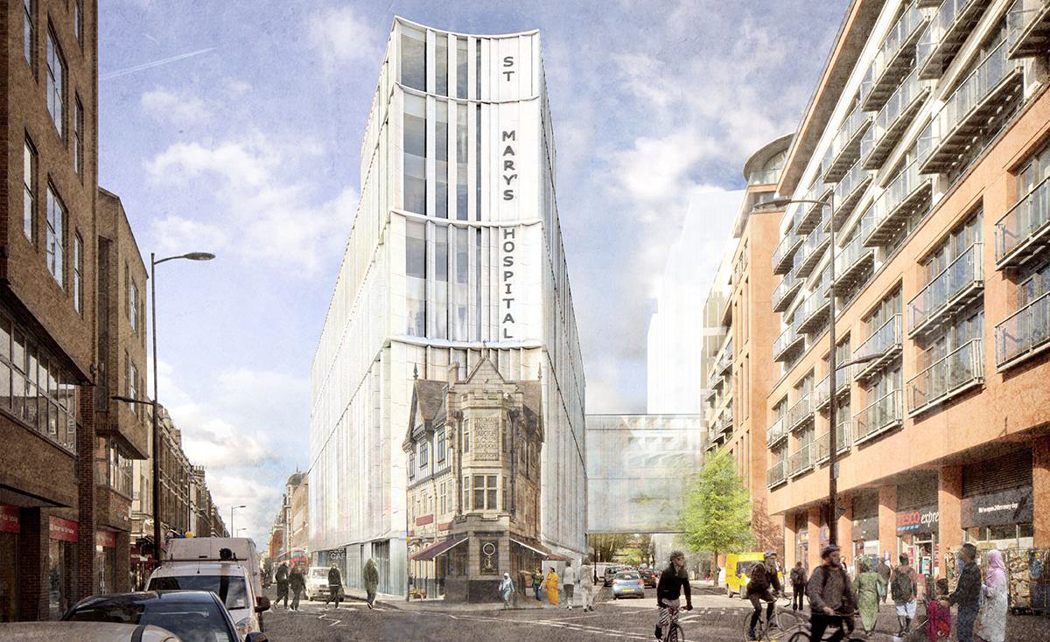
Securing investment for the buildings and facilities we need
St Mary’s redevelopment phase 1 – artist’s impression

Slide 17
My commitment to you
We will always be open and transparent about the challenges and opportunities
we face
We will ensure patients and the public are able to actively shape and contribute to every aspect of our work

Slide 18


Slide 19
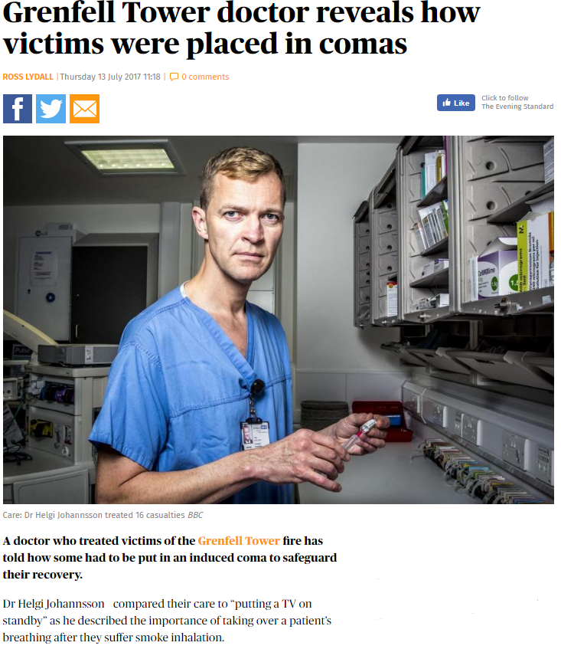
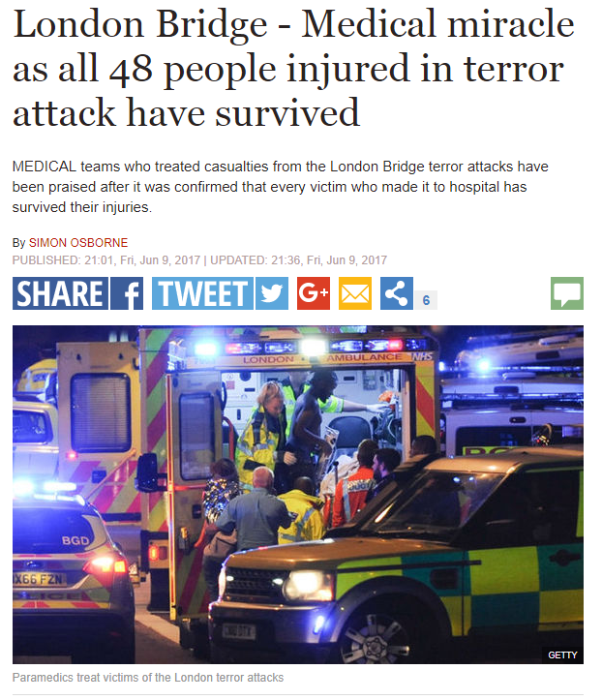
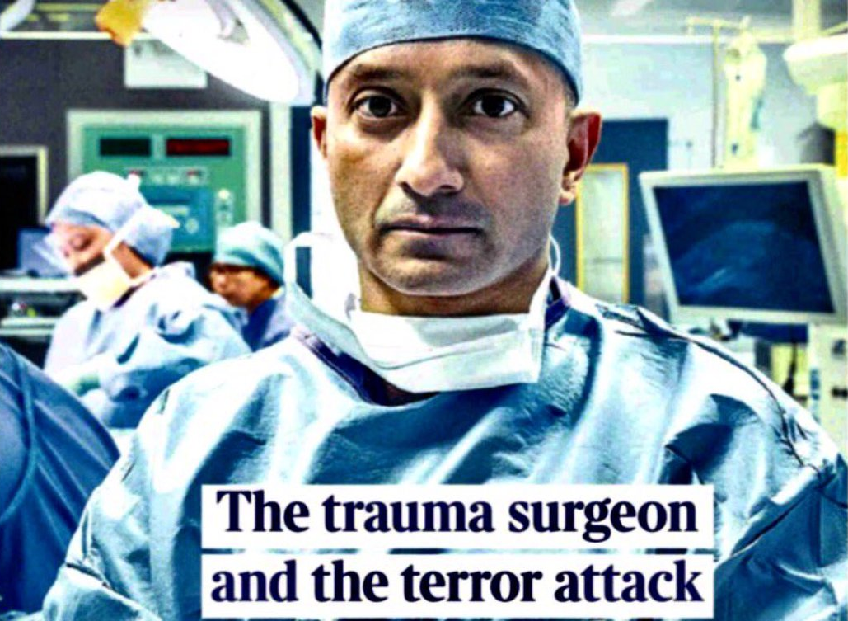
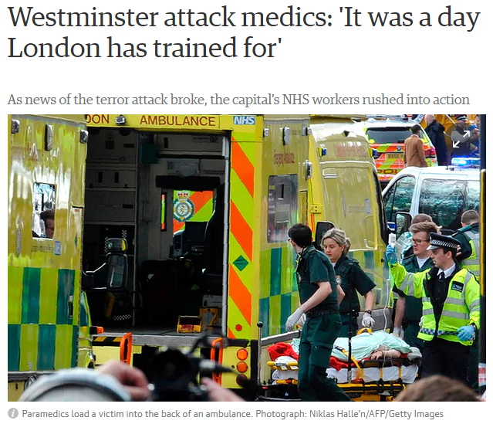
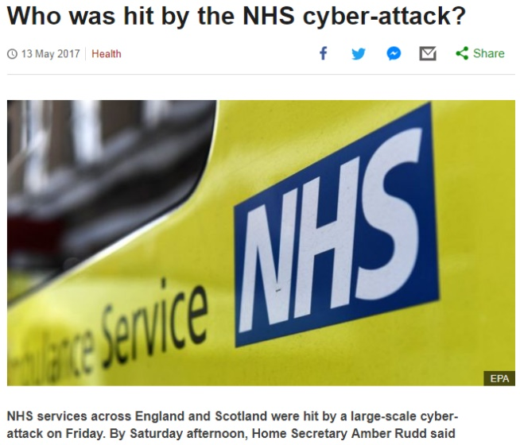
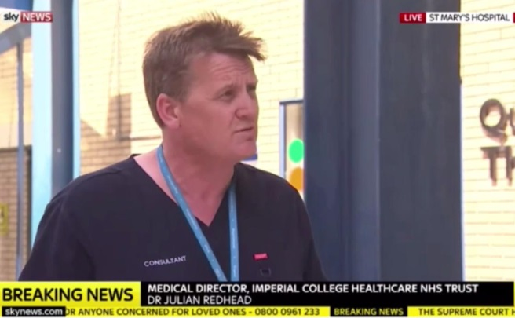

Slide 20
Financial accounts 2016/17
Chief financial officer,
Richard Alexander

Slide 21
Agenda
2016/17
headlines
context
financial snapshot
investment and savings
2017/18
looking ahead

Slide 22
2016/17 headlines
Year end
deficit
(£15.3m)
Capital
expenditure
£47.6m
Savings programme
£53.8m
Cash balance
£21.0m

Slide 23
2016/17 in context
 | 2014-15 | 2015-16 | 2016-17
 | £'m | £'m | £'m
Revenue from patient care activities | 795.7 | 832.2 | 880.1
Other operating revenue | 204.9 | 187.7 | 191.0
Sustainability and Transformation Funding (STF) | - | - | 25.5
Total revenue | 1,000.6 | 1,019.9 | 1,096.6
Employee benefits | (553.4) | (582.7) | (600.0)
Other operating costs* | (418.0) | (470.9) | (491.5)
Operating surplus | 29.3 | (33.7) | 5.1
Net financing costs | (0.4) | (0.6) | (1.1)
Public dividend capital payable | (14.4) | (11.5) | (12.2)
Donated asset adjustment | 0.9 | (2.2) | (7.2)
Surplus/(deficit) for the financial year | 15.4 | (47.9) | (15.3)
* Adjusted for fixed asset revaluation

Slide 24
2016/17 financial snapshot
Where do £s come from?
Where do £s go?

Slide 25
2016/17 investing in staff (£m)
─ Total fixed workforce
Consultants
Other medical
Nursing
Healthcare assistants
Scientific and technical
Administration and estates
Senior managers
─ Total flexible workforce

Slide 26
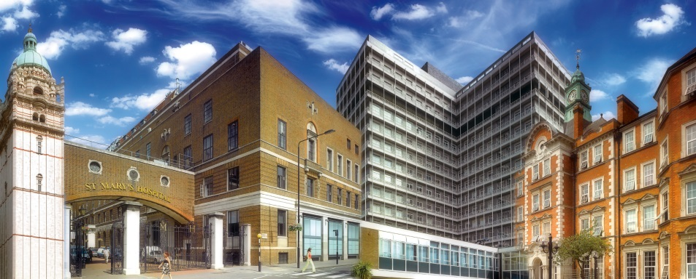
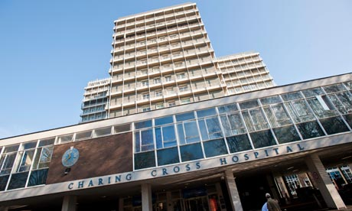
2016/17 investing in estates
and equipment
All sites | £33.3m
Backlog maintenance schemes | £11.4m
Medical equipment | £6.1m
ICT infrastructure | £6.1m
Building maintenance | £5.3m
Outpatient re-development | £1.9m
Energy efficiency (Salix) | £1.0m
Other | £1.7m
Charing Cross Hospital | £5.3m
Theatres | £1.9m
Patient service centre | £1.7m
Bacteriology laboratory automation | £1.7m

Slide 27
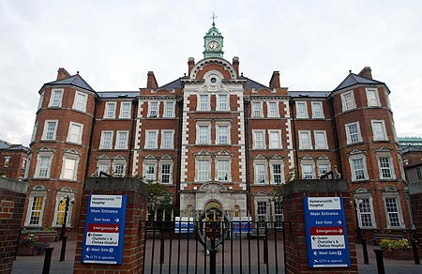
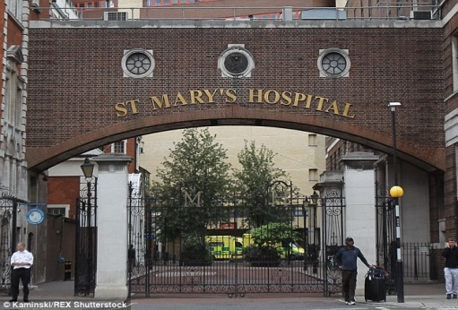
2016/17 investing in estates and equipment
Hammersmith Hospital Queen Charlotte’s & Chelsea Hospital | £2.5m
2 x SPECT enabling works | £1.3m
Power infrastructure | £1.2m
St Mary's Hospital The Western Eye Hospital | £6.5m
Site redevelopment | £3.4m
A&E reconfiguration | £2.3m
PICU | £0.7m

Slide 28
2016/17 saving summary
As part of delivering sustainable services for our patients and an improved financial position for the tax payer, the Trust worked hard to deliver a challenging £53.8m of savings in 2016/17
 | Clinical divisions £m | Corporate £m | Total £m
Trust CIP 2016/17 | 43.3 | 10.5 | 53.8
Income
Acute income | 25 | 0 | 25
Community income | 2.8 | 0 | 2.8
Other income | 3.6 | 1.4 | 5
Income total | 31.4 | 1.4 | 32.8
Pay
Bank and agency | 3.2 | 1.5 | 4.7
Non clinical/admin | 1.2 | 3.2 | 4.4
Clinical related pay savings | 2.8 | 0 | 2.8
Pay total | 7.2 | 4.7 | 11.9
Non-Pay
Commercial contracts/procurement | 2.3 | 1.4 | 3.7
Consultancy | 0 | 1.6 | 1.6
Medicines management/drugs | 1.1 | 0 | 1.1
Consumables and waste reduction | 0.9 | 0.2 | 1.1
Other non-pay cost reduction | 0.4 | 1.2 | 1.6
Non-pay total | 4.7 | 4.4 | 9.1

Slide 29
2017/18 looking ahead
 | 2016/17 actual | 2017/18 plan | Change
 | £m | £m | £m
Income | 1,071.1 | 1,101.7 | ↑30.5
STF | 25.5 | 20.7 | ↓4.8
Expenditure | (1,111.9) | (1,126.8) | ↓14.9
Surplus/(deficit) | (15.3) | (4.5) | ↑10.8
Savings | 53.8 | 54.4 | ↑0.6
Capital | 47.6 | 49.5 | ↑1.9
Year-end cash | 21.0 | 26.3 | ↑5.4

Slide 30
2017/18 looking ahead
Plan
Actual
Underlying position

Slide 31
2017/18 looking ahead
Challenging financial position in 2017/18 and into the future
We are implementing our financial improvement programme 2, agreed with NHS Improvement and supported by PricewaterhouseCoopers
Addressing the underlying financial challenge is the key to success and we have to expect change
We are continuing to invest in maintaining and improving our estate and equipment, improvements to outpatients and paediatric intensive care, and preparing for redevelopment

Slide 32
Questions and answers
Chairman, Sir Richard Sykes
Chief executive, Ian Dalton, CBE
Chief financial officer, Richard Alexander
Director of nursing, Professor Janice Sigsworth
Medical director, Dr Julian Redhead
Also here to take any questions are our divisional directors:
Professor Tim Orchard - medicine and integrated care
Dr Katie Urch - surgery, cancer and cardiovascular
Professor TG Teoh - women’s, children’s and clinical support

Slide 33
The power of patient information – to create better health and care
Consultant anaesthetist
Chief clinical information officer,
Dr Sanjay Gautama

Slide 34
To share or not to share
Patient records available to health and care professionals and patients
Patient data collected
Better health, for life
Data anonymised and used together with thousands of other records for research

Slide 35
Transforming healthcare
Population Health
Integrated Care
Patient Engagement
Digital Records
Data Sharing
Data management and complex analysis, registries and scorecards, predictive care management
Management of complex pathways including virtual MDTs, shared care plans, messaging, tasking, requesting
Patients access their own record and contribute to content
Information shared between organisations and available for authorised users
to view
No longer reliant on paper, information is now digital preferably in structured format

Slide 36

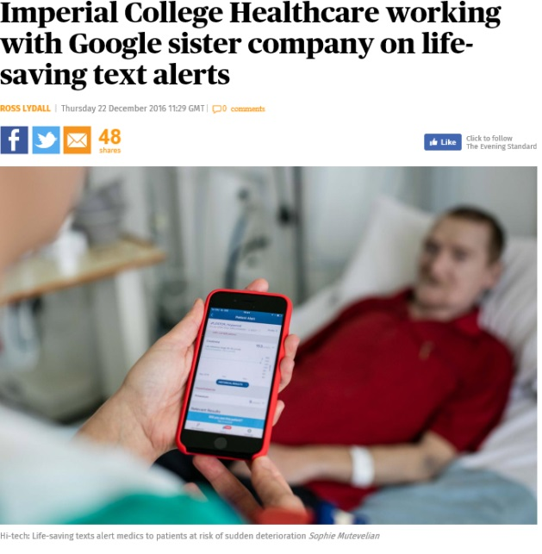
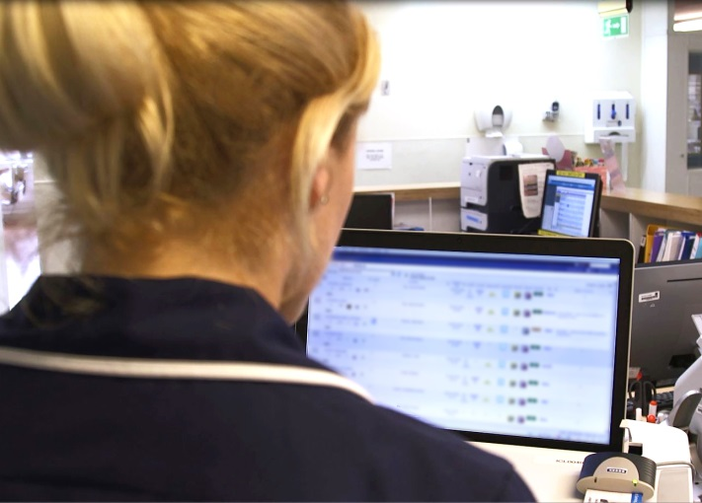


Using patient data for direct care

Slide 37

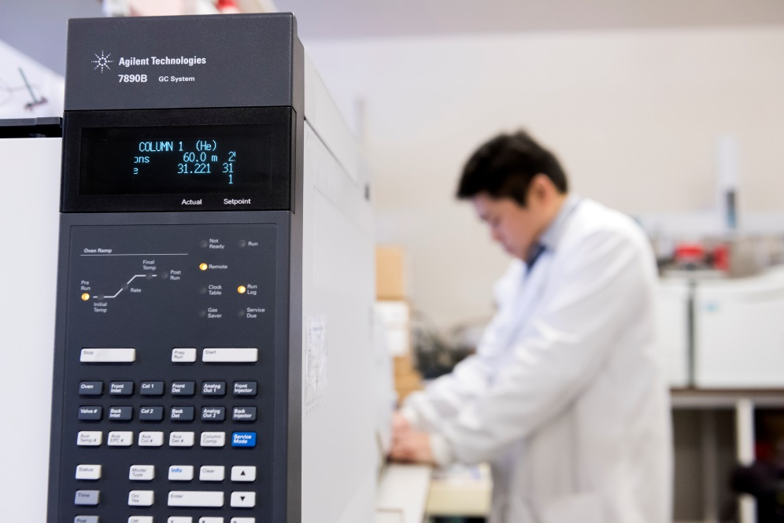
Using patient data for research
Genomic medicine
Health informatics collaboration

Slide 38
Putting patients at the centre
Where we have been
Where we want to be
GPs
GPs
Acute hospitals
Mental health hospitals
Individual
Community care
Individual
Acute hospitals
Community care
Social care
Mental health hospitals
Social care

Slide 39
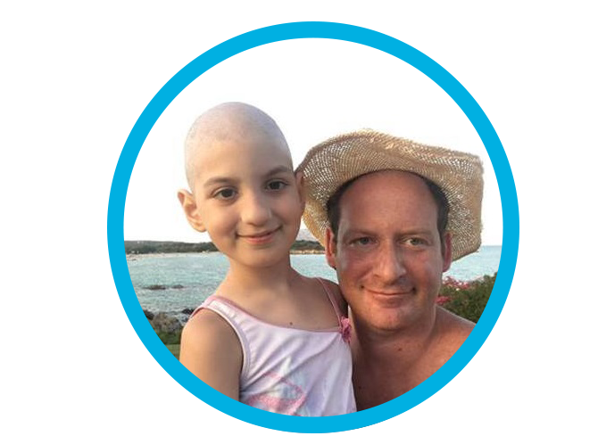
The Care Information Exchange
Parker Moss

Slide 40
Better health, for life
Consultant paediatrician Associate medical director (quality improvement),
Dr Bob Klaber

Slide 41
Questions and answers
Consultant anaesthetist and chief clinical information officer,
Dr Sanjay Gautama
Parker Moss
Consultant paediatrician and associate medical director
(quality improvement), Dr Bob Klaber

Slide 42
Thank you
Chairman,
Sir Richard Sykes

