Slide 1
Notes:
Slide at the start and end of slide deck

Slide 2
What is the Flow Coaching Academy?
Flow Coaching Academy Imperial
Flow Coaching Academy Imperial is part of Sheffield Teaching Hospitals’ flow coaching academy programme supported by The Health Foundation.
The Flow Coaching Academy aims to help improve flow and reduced unwarranted variation across a defined care pathway

Slide 3
FCA Aims – Improving patient care
Improving patient flow
Many of the challenges faced by healthcare providers relate to ‘bottlenecks’ in the system where we are unable to progress patient care smoothly and efficiently
This results in operational and financial pressures and negatively impacts the quality and experience of care delivered
Reducing unwarranted variation
Some variation is expected, often linked to severity of illness or patient-preference, but some is ‘unwarranted’
This type of variation offers opportunities for improvement through designing a more reliable and high performing system
Notes:
Slide at the start and end of slide deck

Slide 4
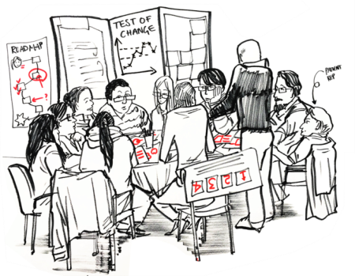
How does a FCA work?
‘Coaching pairs’
Staff pairs are identified to lead on the improvement of a defined clinical pathway, one clinical and one non-clinical.
‘Big rooms’
The pairs put their learning into practice by coaching a weekly ‘big room’ – a face-to-face session bringing together a range of staff and patients involved in the pathway to discuss, plan and review improvements.
LUTS Coaching pair
Tamer El-Husseiny
Viren Jeram
LUTS Big Room
12-1pm, Wednesdays
Meeting Room,
15th Floor, CXH

Slide 5
Where does the work focus?
Notes:
So in terms of FLOW where do pathways sit in the organisation of care?
Clinical microsystems are the small units where care is delivered to patients e.g. wards, outpatients, theatres, imaging. There are also supporting microsystems as important to patient care and experience- pharmacy, estates, hotel services, catering
Multiple microsystems where patients move through departments and wards etc. form meso systems which in turn collectively form macrosystems such as hospitals
In FLOW the microsystems that form mesosystems are likely to transcend organisational boundaries and dependant on context and where patients experience care
Care can only be as good as the sum of all the small units (microsystems) that’s why we believe it is important to work on improving the wider system and how patients move through and experience care within these systems

Slide 6
LUTS pathway – mesosystem map
Diagnostics
GP
Surgery
Outpatients
Home
This work will be most effective if we consider the point of presentation with LUTS wherever that is in the wider health system rather than just considering from the point of referral into Imperial.

Slide 7
What we’re doing
Improving how we work together as a multi disciplinary team to solve problems
Clarifying our referral criteria
Standardising our internal processes and making the way we work more consistent
Piloting a one stop LUTS clinic starting on Saturday

Slide 8
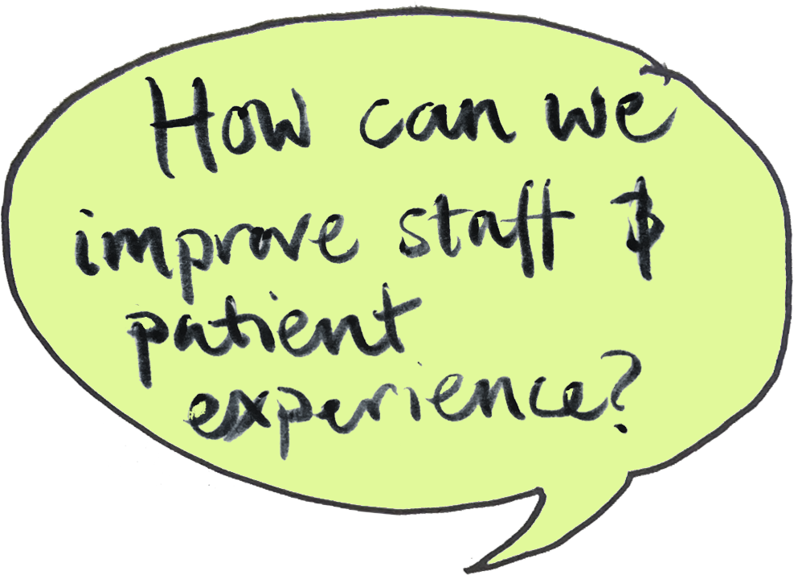
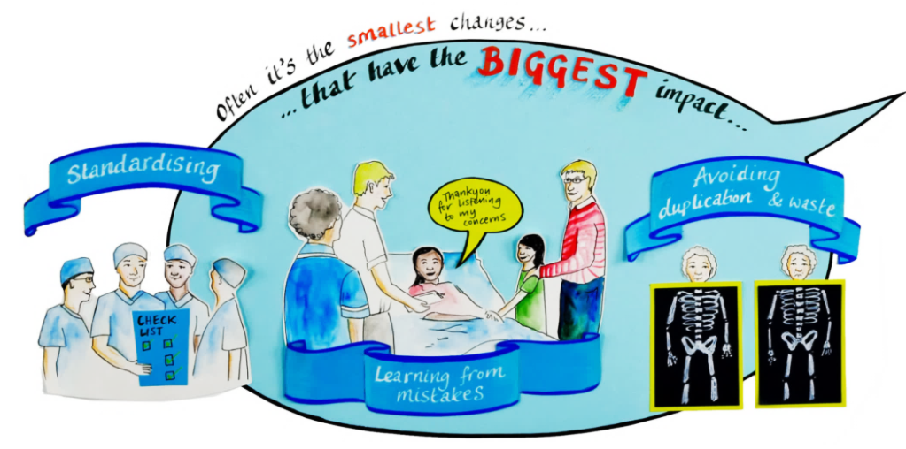
Help improve the LUTS pathway for your patients!
Drop in Wednesdays
12.00 – 13.00
Meeting room, 15th floor west, Charing Cross Hospital
Get in touch
Tamer.El-Husseiny@nhs.net
Viren.Jeram@nhs.net

Slide 9
How to get involved
Help to design the best pathway for LUTS patients in NWL
Give us feedback on our referral criteria
Help us to understand how to support you in treating LUTS patients
Support to spread what you’re learning with your colleagues
Come to the Big Room!

Slide 10
Help improve the LUTS pathway for your patients!
Drop in Wednesdays
12.00 – 13.00
Meeting room, 15th floor west, Charing Cross Hospital
Get in touch
Tamer.El-Husseiny@nhs.net
Viren.Jeram@nhs.net

