Slide 1
Antenatal Big Room
Quality improvement in action
Sabrina Das
Consultant Obstetrician and Gynaecologist
Lead for Antenatal Services

Slide 2
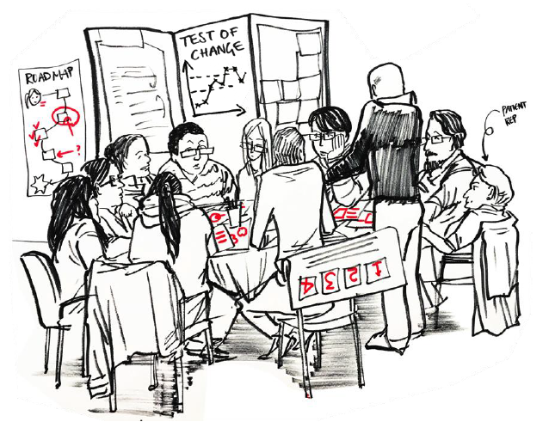
“I tried to make an appointment to see the GP so I could be referred for Antenatal Care. The receptionist told me ‘you don’t need to do that anymore, you just go online and refer yourself’. The way she said it, she made me feel really stupid that I didn’t know this.”
Women with complex health or social needs can’t always communicate these in a self referral
Women get turned away at GP practices when seeking Antenatal referral
Late booking = missed screening
Some vulnerable women find it harder to access early Antenatal care
Problems with vetting referrals when we don’t always have the right information

Slide 3
WHAT OPPORTUNITIES DO YOU SEE FOR MAKING PROGRESS ON THIS CHALLENGE?
Silent reflection on your own
1 minute
Generate ideas in pairs, building on ideas from your self-reflection
2 minutes
Get into a foursome – share and develop ideas (notice similarities and differences)
4 minutes
What is one idea that stood out in your conversation?
5 minutes

Slide 4
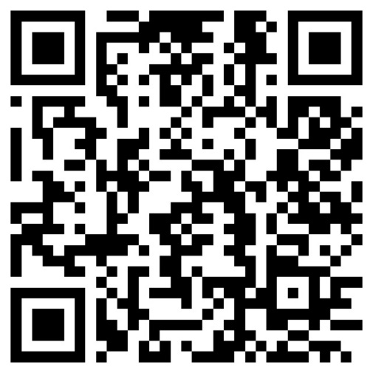
Come along anytime – Every Thursday 1-2pm, Duke of Sussex Boardroom, 2nd Floor, Queen Charlottes Hospital
Direct women to our Maternity Voice Partnership
Check out our new web based self-referral form
Sabrina.das@nhs.net

