Slide 1
Osteoporosis
Dr Colin Tench
Consultant Rheumatologist
Imperial College Healthcare

Slide 2
Objectives
What is it?
How common is it?
NICE guidance
Who to assess?
How to assess?
Who to treat?
How to treat?

Slide 3
Osteoporosis
Low bone mass and structural deterioration of bone tissue, with a consequent increase in bone fragility and susceptibility to fracture
Asymptomatic
Remains undiagnosed until a fragility fracture occurs

Slide 4
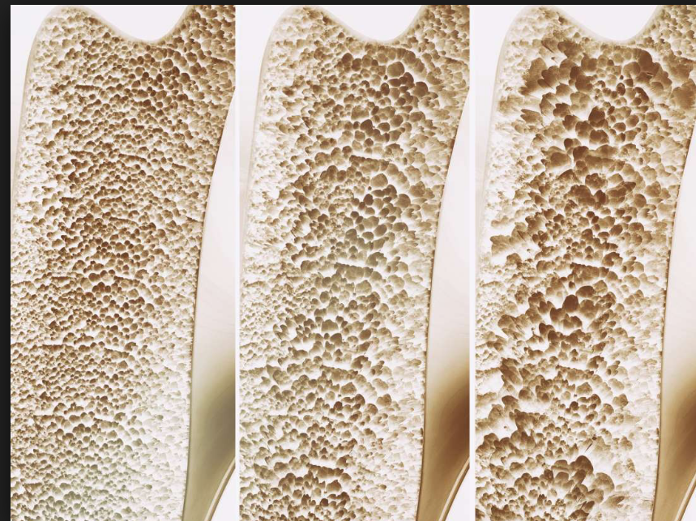

Slide 5
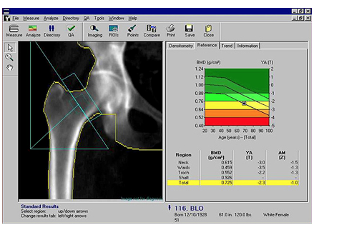
WHO
BMD >2.5 standard deviations below the mean peak mass DXA applied to the femoral neck and reported as a T-score

Slide 6
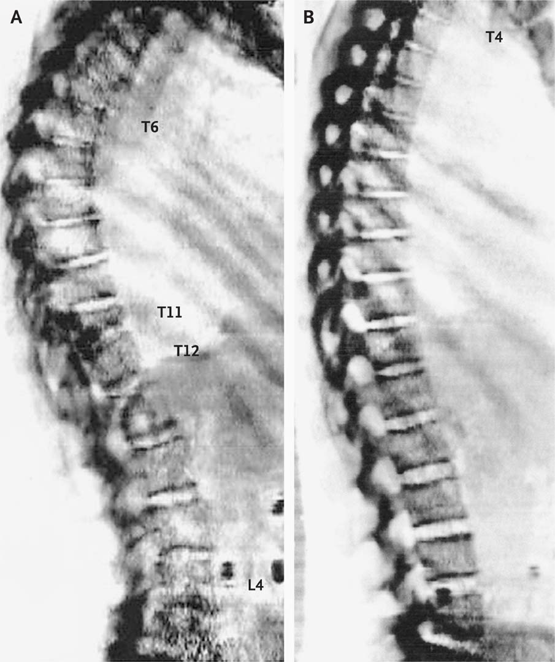
Dual-Energy X-Ray Absorptiometry (DXA) Scan of the Thoracic and Lumbar Spine
Notes:
Figure 2 Dual-Energy X-Ray Absorptiometry (DXA) Scan of the Thoracic and Lumbar Spine. Vertebral deformation at the thoracic and lumbar spine was assessed in the patient described in the vignette, with the use of the vertebral-fracture assessment on the same DXA scanner as that used for the measurement of bone mineral density in Figure 1. Panel A shows thoracic kyphosis due to a 75% loss of height of T11. For comparison, Panel B shows a normal vertebral-fracture assessment in a 58-year-old woman without osteoporosis.

Slide 7
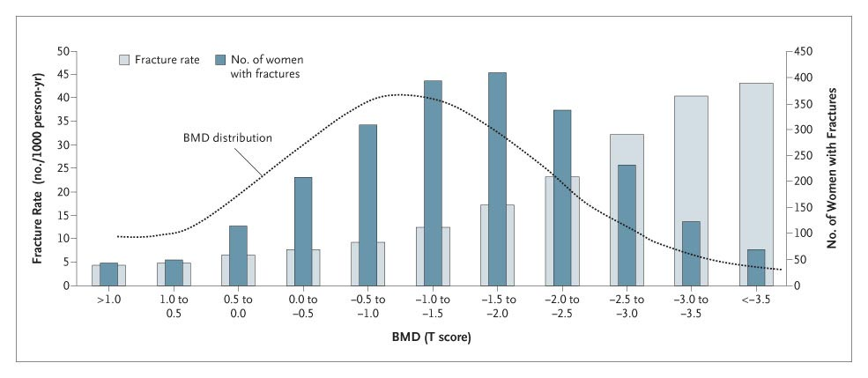
Fracture Rate and the Number of Women with Fractures According to Peripheral Bone Mineral Most osteoporotic fractures occur in women who do not have osteoporosis
Density (BMD)
Khosla S and Melton L. N Engl J Med 2007;356:2293-2300
Notes:
Figure 1. Fracture Rate and the Number of Women with Fractures According to Peripheral Bone Mineral Density (BMD). Data are from Siris et al.10

Slide 8
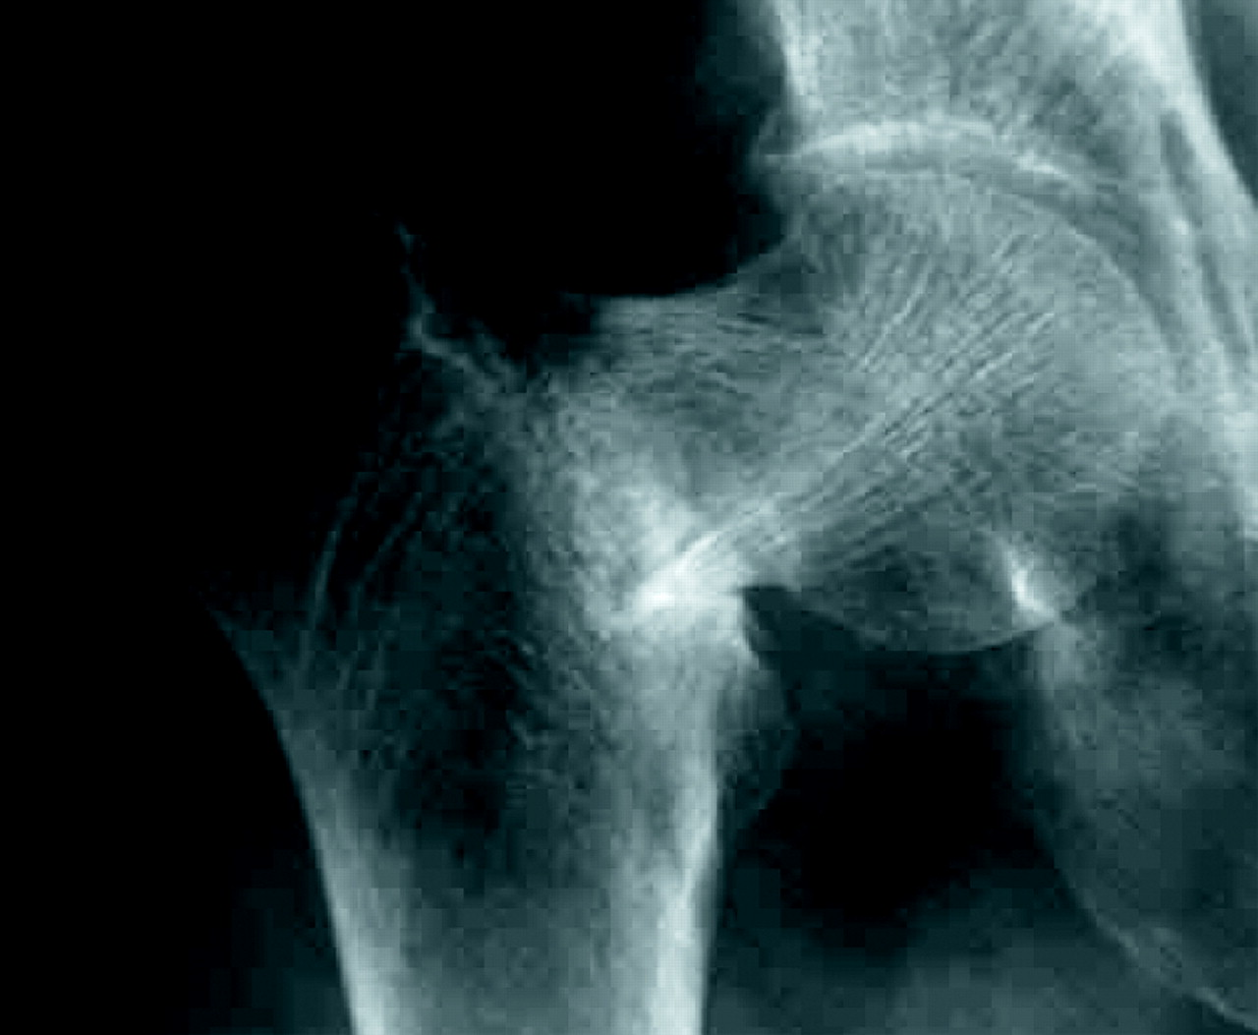
Fragility fractures
Occur as a consequence of increased bone fragility caused by osteoporosis
Wrist, spine, and hip.
Fall from standing height
Vertebral fractures may occur spontaneously

Slide 9
Facts and figures
Most common cause of fracture in older adults
9 million fractures world wide
Post menopausal white women have 40% life time risk of at least one osteoporotic fracture
Annually around 180,000 fractures occur as a result of osteoporosis
50% of people with an osteoporotic fragility fracture of the hip can no longer live independently .
Women are at greater risk
2% at 50 years of age, almost 50% at 80 years of age
In England and Wales, more than 2 million women have osteoporosis

Slide 10
Risk factors for osteoporosis
Female gender.
Increasing age.
Menopause.
Oral corticosteroids
Smoking.
Alcohol
Previous fragility fracture
Rheumatological conditions, such as rheumatoid arthritis and other inflammatory arthropathies.
Parental history of hip fracture
Body mass index of less than 18.5 kg/m².

Slide 11
Who to assess?
All women >65 years all men >75 years
Younger patients
fragility fracture.
oral corticosteroids.
History of falls.
BMI<18.5 kg/m²
Smoker.
Alcohol >14 U/week.
A secondary cause of osteoporosis

Slide 12
How to assess?
A 10-year fragility fracture risk score should be calculated before requesting a DXA scan to measure bone mineral density (BMD), or starting a bisphosphonate, except in people:
Over 50 years of age with a history of fragility fractures
Under 40 years of age who have a major risk factor for fragility fracture
With vertebral or hip fractures — starting treatment without undertaking DXA should be considered if this is inappropriate or impractical.

Slide 13
Fragility fracture risk
QFracture® or FRAX® online assessment calculators.
People at high risk -DXA scan to confirm osteoporosis.
People at intermediate risk plus other risk factors -DXA scan.
People at low risk should not be offered treatment or a DXA scan, but given lifestyle advice.

Slide 15
Case 1
63 year old lady
Fit and well
Concerned because her mother fell over and fractured her hip

Slide 20
Case example 1
A 67-year-old woman was referred by her GP for treatment of osteoporosis and progressive bone loss.
One year before the visit, the patient had discontinued hormone-replacement therapy.
Low back pain and x-ray showed wedge fracture L1
A dual-energy x-ray absorptiometry (DXA) scan showed bone mineral density T scores of −3.1 at the lumbar spine and −2.8 at the femoral neck, which are consistent with a diagnosis of osteoporosis.
Results of blood and urine tests ruled out the common secondary causes of osteoporosis.
To prevent additional vertebral fractures, oral bisphosphonate therapy was recommended.

Slide 24
Limitations
Large disparity between femoral neck and lumbar spine T score
No extra weighting
Multiple fragility fractures
High dose prednisolone use
Heavy OH consumption
Only used in untreated patients

Slide 25
Assess for vitamin D deficiency and inadequate calcium intake.
>65 years
not exposed to much sunlight
A calcium intake of at least 1000 mg/day
Identify any risk factors for falls
Exclude non-osteoporotic causes of fragility fracture
Metastatic bone disease
Multiple myeloma
Paget's disease

Slide 26
Lifestyle information?
Regular exercise
Walking, especially outdoors (vitamin D production)
Strength training (such as weight training) of different muscle groups (for example hip, wrist, and spine).
A combination of exercise types, for example balance, flexibility, stretching, endurance, and progressive strengthening exercises.
Eat a balanced diet as this may improve bone health.
Stop smoking
Drink alcohol within recommended limits
Education and information

Slide 27
Treatment options- first line
Oral bisphosphonate treatment
T-score of -2.5 or less
HRT if premature menopause
Risk factors for falls should be managed if present.
Follow up should be arranged to assess and manage the:
Adverse effects of bone-sparing treatment.
Adherence to treatment.
Need for continuing treatment with bisphosphonates after 3–5 years.

Slide 28
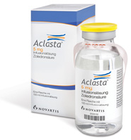
Zoledronic acid and osteoporosis
Side effects with oral bisphosphonates
Malignant hypercalcaemia
Paget’s
Most potent
5mg iv once a year

Slide 29
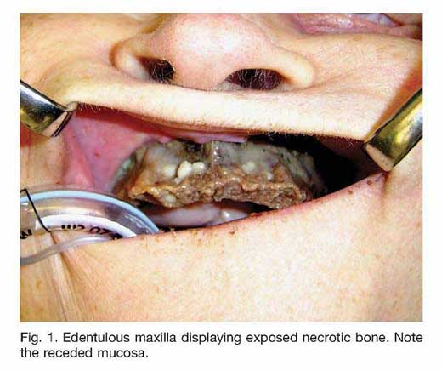

Slide 30
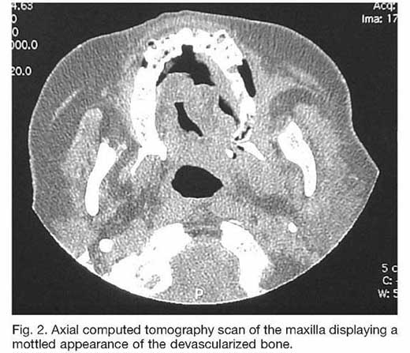
Osteonecrosis of the jaw
95% cases with zoledronic acid or pamidronate
1.3% up to 7%
Dental disease
Dental surgery
Less than 50 cases in oral bisphosphonates

Slide 31
AVN

Slide 32
Atypical femoral shaft fracture

Slide 33
After 3–5 years
High risk of an osteoporotic fragility fracture, continue treatment for up to 10 years
Age over 75 years.
A previous hip or vertebral fracture.
In other people, arrange a dual-energy X-ray absorptiometry (DXA) scan and consider:
Continuing treatment if the T-score is less than -2.5. Reassess their fracture risk and bone mineral density (BMD) every 3–5 years.
Stopping treatment if the BMD T-score is greater than -2.5. Reassess their fracture risk and re-measure BMD after 2 years.

Slide 34
Osteoporotic fracture on treatment
Check adherence to treatment
Exclude secondary causes for osteoporosis
Treatment is recommended for at least 5 years to reduce the risk of further fractures.

Slide 35
For people whose fracture risk was intermediate the last time they were assessed, reassess after a minimum of 2 years.

Slide 36
Denosumab
Monoclonal antibody that reduces osteoclast activity, and so reduces bone breakdown
Subcutaneous injection 60 mg once every 6 months.
£366 for 1 year of treatment

Slide 37
Secondary prevention
2nd line
Post menopausal women
Osteoporosis

Slide 38
Primary prevention
Failed oral bisphosphonates and
 | Number of independent clinical risk factors for fracture
Age (years) | 0 | 1 | 2
65-69 | –^{[a]} | −4.5 | −4.0
70-74 | −4.5 | −4.0 | −3.5
75 or older | −4.0 | −4.0 | −3.0
^{[a]} Treatment with denosumab is not recommended.

Slide 39
Independent clinical risk factors
parental history of hip fracture
alcohol intake of 4 or more units per day
rheumatoid arthritis.

Slide 40
Teriparatide
human parathyroid hormone
anabolic agent
stimulates new formation of bone and increases resistance to fracture.
20 mcg s/c
18 months
yearly cost of £3544.15

Slide 41
Teriparatide
Secondary prevention
Unable to take or unsatisfactory to alendronate and risedronate and
>65 years or older and have a T-score of –4.0 SD or below, or a T-score of –3.5 SD or below plus more than two fractures, or
55–64 years and have a T-score of –4 SD or below plus more than two fractures.

Slide 42
Treatment with raloxifene
 | Number of independent clinical risk factors for fracture (section 1.5)
Age (years) | 0 | 1 | 2
50–54 | – ª | −3.5 | −3.5
55–59 | −4.0 | −3.5 | −3.5
60–64 | −4.0 | −3.5 | −3.5
65–69 | −4.0 | −3.5 | −3.0
70–74 | −3.0 | −3.0 | −2.5
75 or older | −3.0 | −2.5 | −2.5
ª Treatment with raloxifene is not recommended

Slide 43
Percutaneous vertebroplasty and kyphoplastyy
Opinion divided
Small studies
Short follow up
Some level pain relief 58-97%
Complications uncommon
Cement leaks (27%), further intervention in only 1%
Unnecessary, fracture will heal, further fractures higher up

Slide 44
NICE guidance
Options for treating osteoporotic vertebral compression fractures only in people:
severe ongoing pain after a recent, unhealed vertebral fracture despite optimal pain management and
pain has been confirmed to be at the level of the fracture by physical examination and imaging.

Slide 45
Emerging therapies
Sclerostin produced by osteocytes and inhibits bone formation
Romosozumab
monoclonal antibody
inhibits the protein sclerostin
increasing bone formation
decreasing bone breakdown
subcutaneous injection
It does not currently have a marketing authorisation in the UK for treating osteoporosis.

Slide 46
Objectives
What is it?
How common is it?
Who to assess?
How to assess?
Who to treat?
How to treat?

