Slide 1
Abnormal Liver Function Tests
Dr Heather Lewis
Consultant Hepatologist
Imperial College Healthcare NHS Trust

Slide 2
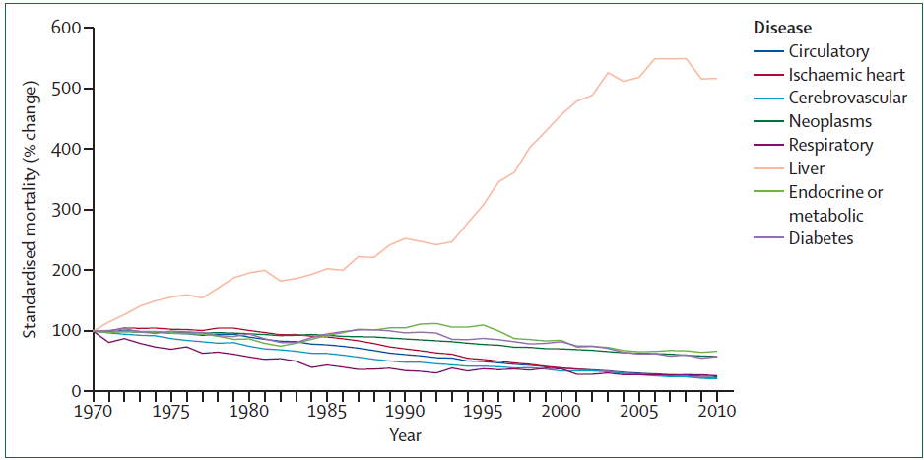
Mortality from liver disease in the UK
The Lancet 2014
Notes:
In Europe alcohol is responsible for 6.5% of all deaths, and 11.6% of DALYs
PHE estimates 23,839 alcohol related deaths in England in 2016
400% increase in the standardised mortality rate over the period 1970–2010.¹
For those patients younger than 65, the rise in standardised mortality rate for liver disease is >500%, such that it now constitutes the fifth biggest cause of premature mortality² with 64 000 years of working life lost every year.
2

Slide 3
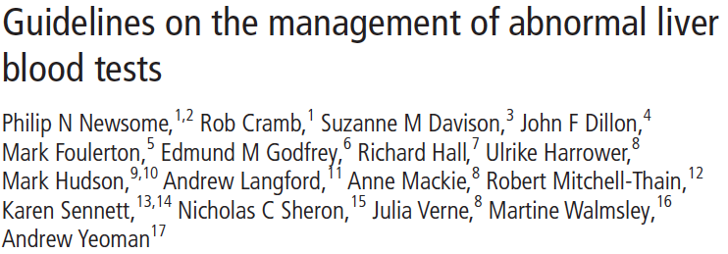
Notes:
Clinical services and standards committee of the bsg

Slide 4
Liver function tests vs liver blood tests
Bilirubin, albumin and INR are the only blood markers of liver function
ALT, AST, ALP and GGT are liver enzymes indicating level of ongoing liver injury
Platelets may indicate level of fibrosis
Liver disease is silent
Notes:
Studies from Birmingham and Scotland show that only about 4% of patients with an abnormal LFT will be diagnosed with significant liver disease within 5 years. They are not specific diagnostic tools nor specific exclusion tools

Slide 5
Abnormal LFTs
30% GP LFT requests have at least one value outside reference range
Only 3.9% of those with raised ALT or AST have significant liver disease
84% of adults still have an abnormal test when repeated 1 month later
BALLETS study
Prospective cohort study 2 years Birmingham and Lambeth, 11 GPs, common protocol
Notes:
The Abnormal Liver Function Investigations Evaluation (ALFIE) study from Tayside in
Scotland showed that over a 10-year period 25% of the community
population aged over 16 had liver blood tests, with about a
third having at least one abnormal value. Although an abnormal
aspartate aminotransferase (AST) or alanine aminotransferase
(ALT) level was predictive of liver disease (HR=4.2), the rate
of detection was remarkably low, with only 3.9% of those with
an abnormal value being diagnosed with significant liver disease

Slide 6
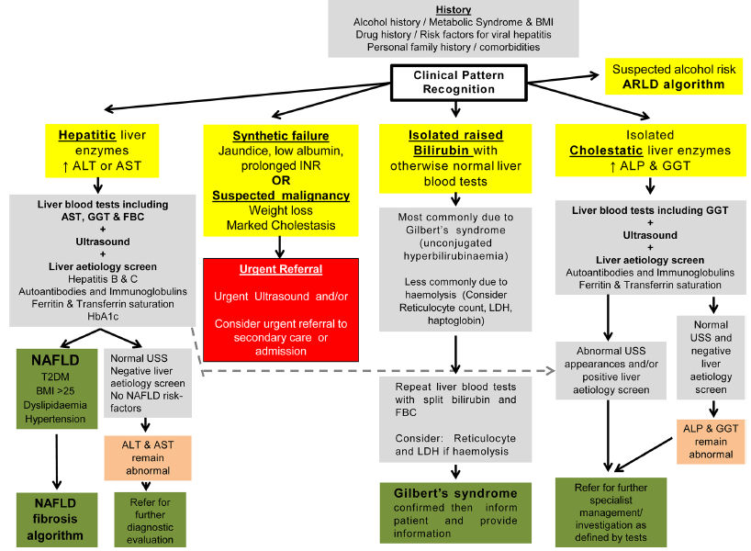

Slide 7
Abnormal LFTs
Dear Colleague,
Reason for referral:
Thank you for your review of this 44 year old lady who has persistently deranged liver function tests with an elevated ALT of 79 U/L and ALP of 175U/L on her most recent blood tests this month. She has undergone a liver screen last year which was negative and an abdominal ultrasound scan revealed no liver pathology (report copied into the end of this letter and available to view on the ICE system along with her liver screen blood tests). I have arranged an interval repeat blood test so you will have an up to date idea of the trend but would appreciate your specialist review.

Slide 8
Risk stratify the LFTs
Is there synthetic failure?
Bilirubin, Albumin, INR
Could there be malignancy?
Weight loss, severe jaundice
Anaemia (FBC)
Recommendation: check FBC, albumin, bilirubin, ALT, AST, ALP, GGT

Slide 12
Liver Ultrasound: key questions
Is there cirrhosis?
Irregular liver edge
Splenomegaly
Is there cancer?
Primary liver cancer
Hepatocellular carcinoma or cholangiocarcinoma
Secondary metastases
Is there biliary obstruction?
Extra hepatic duct dilatation?
Are there gallstones?
Intra hepatic duct dilation?
Notes:
Coarse echotexture is non-specific

Slide 13
Raised transaminases
If liver screen negative:
If ALT remain abnormal
Is this fatty liver
Drug and alcohol history
NAFLD if USD shows fatty change or other metabolic RF
If no fat and no metabolic RF refer to hepatology if ALT still abnormal after 3/12
If Fatty liver – fatty liver pathway
Notes:
While it is hard to justify the routine analysis of
both AST and ALT together on every liver blood test request,
a strategy not supported by the data from the BALLETS study,
subsequent testing of AST (or ALT depending which one is
undertaken first) to calculate the AST:ALT ratio is clearly
desirable. From a patient and cost perspective this is likely to
be more cost-effective if performed by ‘reflex’ on the same sera
following the detection of an abnormal ALT or GGT

Slide 15
Bilirubin
Check
Conjugated/unconjugated
LFT with GGT
FBC
Gilbert’s if normal FBC, normal LFT and [conjugated fraction <30% ] or the majority of the elevated bilirubin fraction is unconjugated Don’t refer
If bilirubin >85 umol/l or unconjugated bilirubin > 40 consider Crigler- najar
refer
Notes:
GP update guidelinees say <20 %
Bilirubin is predominantly the by-product of the breakdown
of the haem component of haemoglobin by the reticuloendothelial
system.24 It exists in two forms, unconjugated and
conjugated. Bilirubin is transported to the liver in its insoluble
unconjugated form, where it is converted into soluble conjugated
bilirubin in order to be excreted. Unconjugated hyperbilirubinaemia
is usually due to haemolysis or impaired conjugation
whereas conjugated hyperbilirubinaemia is typically due to
parenchymal liver disease or obstruction of the biliary system.
If the unconjugated bilirubin
is more markedly elevated (>40 μmol/L) then rarer causes
such as Crigler-Najjar syndrome46 should be considered and
genetic testing undertaken
Crigler-Najjar syndrome, also referred to as congenital nonhemolytic jaundice with glucuronosyltransferase deficiency, is a rare, autosomal recessive disorder of bilirubin metabolism. It has been divided into two distinct forms (types I and II) based upon the severity of the disease (table 1).
●Type I disease is associated with severe jaundice and neurologic impairment due to bilirubin encephalopathy that can result in permanent neurologic sequelae (kernicterus).
●Type II disease is associated with a lower serum bilirubin concentration and affected patients survive into adulthood without neurologic impairment.
Patients have a severe unconjugated hyperbilirubinaemia
The phenotype of Crigler-Najjar syndrome type I can be caused by a variety of alterations in the coding sequences of the bilirubin-uridine diphosphate glucuronosyltransferase (UGT1A1) gene which is responsible for the conjugation of bilirubin (figure 2) [4-6] (see "Bilirubin metabolism"). These mutations lead to the production of an abnormal protein, resulting in complete loss or very low levels of hepatic bilirubin-UGT (UGT1A1) activity

Slide 17
Alkaline Phosphatase
If ↑ check GGT ; if GGT normal consider:
Bone disease including Vit D deficiency, fractures, Paget’s, metastases
Physiological: bone growth, pregnancy
If GGT ↑ then likely liver origin; arrange
Ultrasound
Autoantibodies
Consider heart failure, drug causes
Refer hepatology if liver origin and if increasing / >150 / clinical concern
Refer to HPB medicine if suspect biliary disease eg dilated biliary tree, gall bladder pathology

Slide 18
Isolated GGT
Low specificity but good correlation with liver mortality
Causes: obesity, excess alcohol, drugs
Action:
Check BMI/ metabolic RF/ alcohol hx/
Ultrasound, AST, FIB 4 /NAFLD score
Refer as per alcohol or NALFD Guideline
Notes:
Addition of GGT to a
liver blood test panel increases the likelihood of an adult having
abnormal liver blood tests from around 15% to 30%35 and,
notably, a raised GGT is associated with increased liver as well
as all-cause (including cancer) mortality, with the greatest risk
being observed in those with the most significant elevations of
GGT

Slide 19
Statins and abnormal LFTs
3% of patients on statins will develop elevated ALT (not sig higher than placebo)
NAFLD patients undergoing statin Tx did not have higher ALT than those on placebo
In 326 patients with well compensated liver disease, and ALT elevations up to 5x ULN no difference in ALT elevation between placebo and statin Tx group
Notes:
In patients with well compensated liver disease start at low dose and monitor LFTs regularly
Patients with NAFLD should be prescribed statins

Slide 20
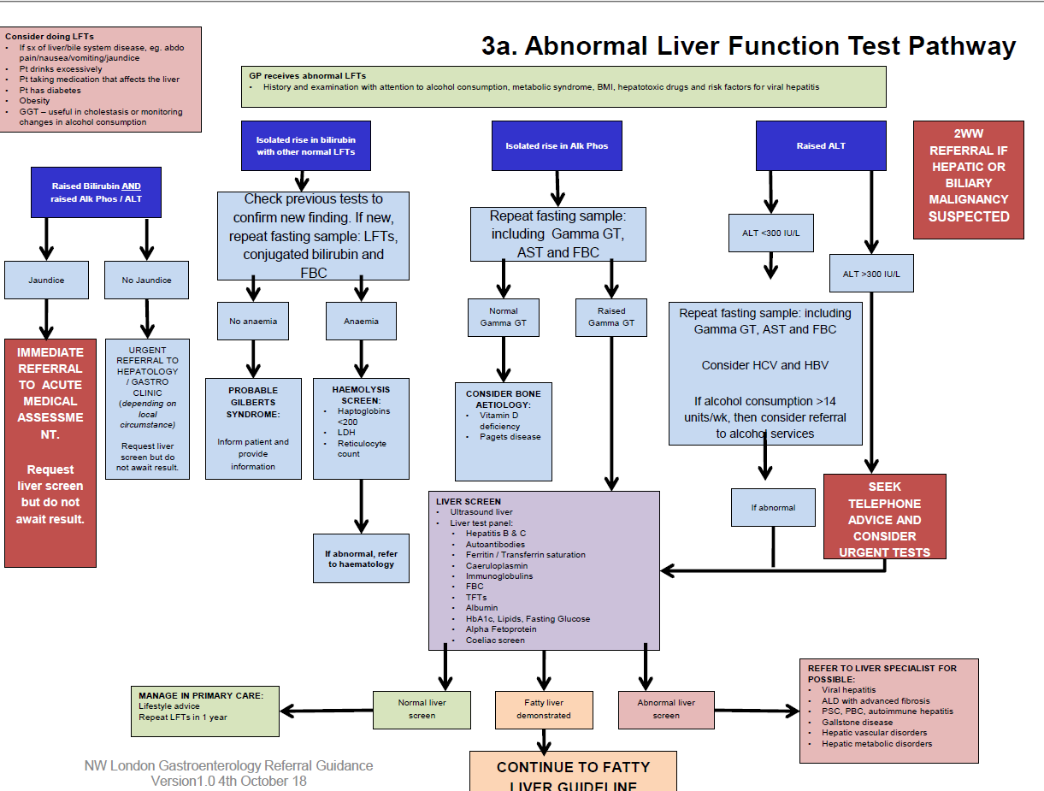

Slide 21
Questions?
heather.lewis4@nhs.net

